Slide 1
Generic Netlink中sk_buff的填充
邓国福

Slide 2
netlink这个协议在使用的sk_buff结构体中，所有的数据都会填充到数据空间中，头空间不变（netlink的头也会放到数据空间中）。

Slide 3
通过enlmsg_new新建一个sk_buff结构体，
/**
* genlmsg_new - Allocate a new generic netlink message
* @payload: size of the message payload
* @flags: the type of memory to allocate.
*/
static inline struct sk_buff *genlmsg_new(size_t payload, gfp_t flags)
生成的sk_buff包括了netlink头和generic netlink头的大小

Slide 4

通过enlmsg_new新建一个sk_buff结构体，
/**
* genlmsg_put - Add generic netlink header to netlink message，和用户自定义头
* @skb: socket buffer holding the message
* @portid: netlink portid the message is addressed to
* @seq: sequence number (usually the one of the sender)
* @family: generic netlink family
* @flags: netlink message flags
* @cmd: generic netlink command
* Returns pointer to user specific header
*/添加netlink头（已经填写内容）、 generic netlink head（已经填写内容），以及用户自定义头
void *genlmsg_put(struct sk_buff *skb, u32 portid, u32 seq,
const struct genl_family *family, int flags, u8 cmd)

Slide 5
通过__nla_put添加netlink attribute，
/**
* __nla_put - Add a netlink attribute to a socket buffer
* @skb: socket buffer to add attribute to
* @attrtype: attribute type
* @attrlen: length of attribute payload
* @data: head of attribute payload
*
* The caller is responsible to ensure that the skb provides enough
* tailroom for the attribute header and payload.
*/
void __nla_put(struct sk_buff *skb, int attrtype, int attrlen,
const void *data)

Slide 6
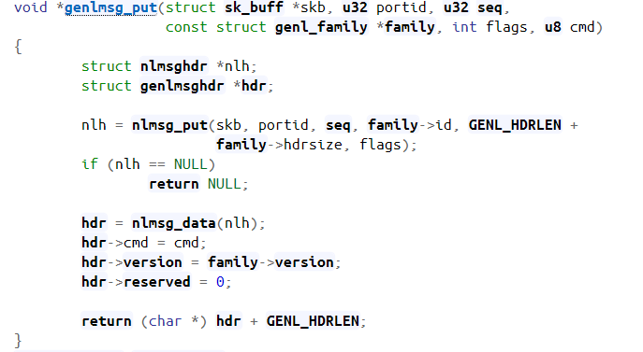
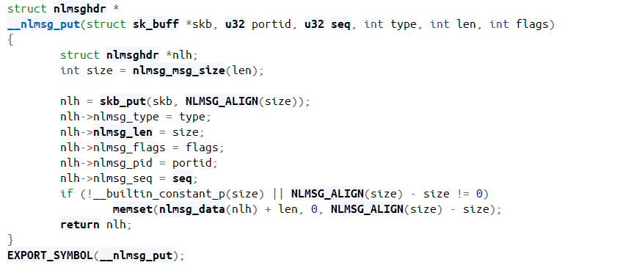

Slide 7
