Slide 1
Computer Systems:
A Programmer’s Perspective
程序设计与计算机系统
Lecture 2b
October 22, 2020
Wu junmin (jmwu@ustc.edu.cn)

Slide 2
Overview
Numeric Encodings
  Unsigned & Two’s complement
Programming Implications
  C promotion rules
Basic operations
  Addition, negation, multiplication
Programming Implications
  Consequences of overflow
  Using shifts to perform power-of-2 multiply/divide

Slide 3
C Puzzles
  Taken from old exams
  Assume machine with 32 bit word size, two’s complement integers
  For each of the following C expressions, either:
    Argue that is true for all argument values
    Give example where not true
x < 0 ⇒ ((x*2) < 0)
ux >= 0
x & 7 == 7 ⇒ (x<<30) < 0
ux > -1
x > y ⇒ -x < -y
x * x >= 0
x > 0 && y > 0 ⇒ x + y > 0
x >= 0 ⇒ -x <= 0
x <= 0 ⇒ -x >= 0
Initialization
int x = foo();
int y = bar();
unsigned ux = x;
unsigned uy = y;

Slide 4
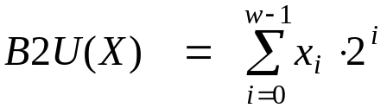
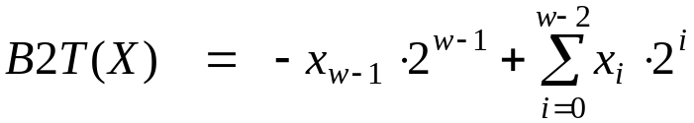
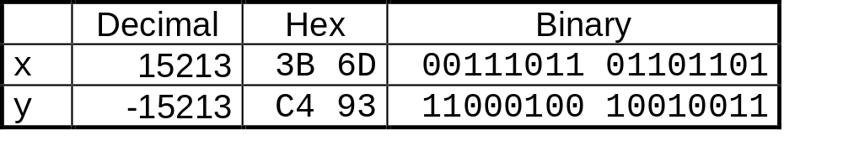
Encoding Integers
Unsigned
Two’s Complement
short int x = 15213;
short int y = -15213;
Sign
Bit
  C short 2 bytes long
Sign Bit
  For 2’s complement, most significant bit indicates sign
    0 for nonnegative
    1 for negative

Slide 5
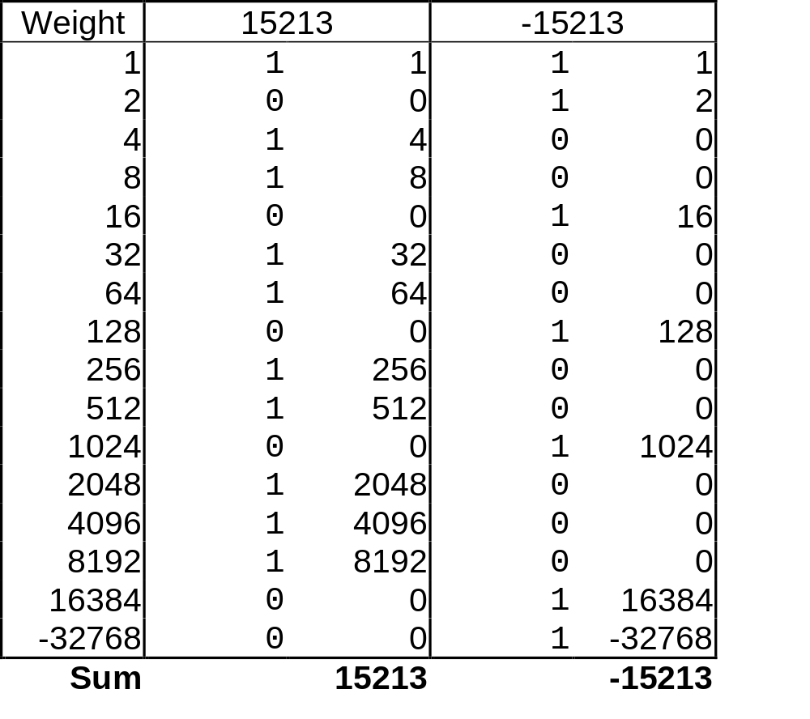
Encoding Example (Cont.)
x = 15213: 00111011 01101101
y = -15213: 11000100 10010011

Slide 6
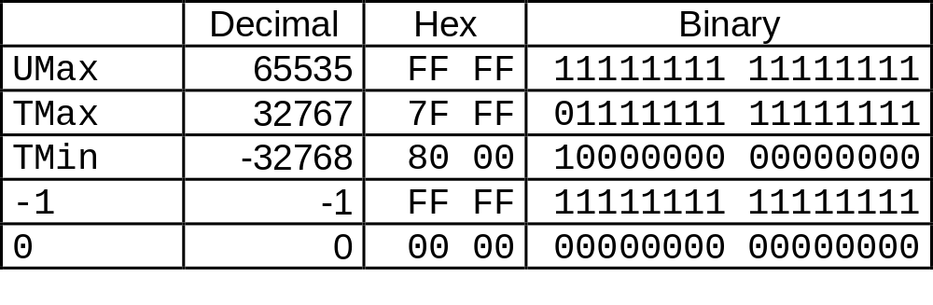
Numeric Ranges
Unsigned Values
  UMin = 0
    000…0
  UMax = 2^{w} – 1
    111…1
Two’s Complement Values
  TMin = –2^{w–1}
    100…0
  TMax = 2^{w–1} – 1
    011…1
Other Values
  Minus 1
    111…1
Values for W = 16

Slide 7
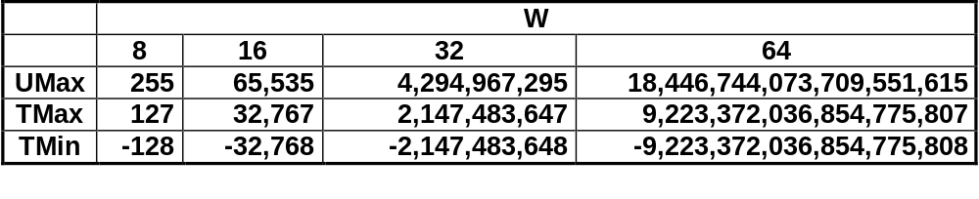
Values for Different Word Sizes
Observations
  |TMin | = TMax + 1
    Asymmetric range
  UMax = 2 * TMax + 1
C Programming
  #include <limits.h>
    K&R App. B11
  Declares constants, e.g.,
    ULONG_MAX
    LONG_MAX
    LONG_MIN
  Values platform-specific

Slide 8
Unsigned & Signed Numeric Values
X
B2U(X)
B2T(X)
Equivalence
  Same encodings for nonnegative values
Uniqueness
  Every bit pattern represents unique integer value
  Each representable integer has unique bit encoding
⇒ Can Invert Mappings
  U2B(x) = B2U⁻¹(x)
    Bit pattern for unsigned integer
  T2B(x) = B2T⁻¹(x)
    Bit pattern for two’s comp integer
0000
0
0
0001
1
1
0010
2
2
0011
3
3
0100
4
4
0101
5
5
0110
6
6
0111
7
7
1000
8
–8
1001
9
–7
1010
10
–6
1011
11
–5
1100
12
–4
1101
13
–3
1110
14
–2
1111
15
–1

Slide 9
Mapping Between Signed & Unsigned
Two’s Complement
Unsigned
T2U
x
T2B
B2U
ux
X
Maintain Same Bit Pattern
Unsigned
U2T
Two’s Complement
ux
U2B
B2T
x
X
Maintain Same Bit Pattern
Mappings between unsigned and two’s complement numbers:
keep bit representations and reinterpret

Slide 10
Mapping Signed ↔ Unsigned
Bits
0000
0001
0010
0011
0100
0101
0110
0111
1000
1001
1010
1011
1100
1101
1110
1111
Signed
0
1
2
3
4
5
6
7
-8
-7
-6
-5
-4
-3
-2
-1
Unsigned
0
1
2
3
4
5
6
7
8
9
10
11
12
13
14
15
T2U
U2T

Slide 11
Mapping Signed ↔ Unsigned
Bits
0000
0001
0010
0011
0100
0101
0110
0111
1000
1001
1010
1011
1100
1101
1110
1111
Signed
0
1
2
3
4
5
6
7
-8
-7
-6
-5
-4
-3
-2
-1
Unsigned
0
1
2
3
4
5
6
7
8
9
10
11
12
13
14
15
=
+/- 16

Slide 12
Casting Signed to Unsigned
C Allows Conversions from Signed to Unsigned
Resulting Value
  No change in bit representation
  Nonnegative values unchanged
    ux = 15213
  Negative values change into (large) positive values
    uy = 50323
short int x = 15213;
unsigned short int ux = (unsigned short) x;
short int y = -15213;
unsigned short int uy = (unsigned short) y;

Slide 13
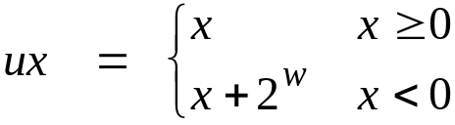
Relation between Signed & Unsigned
Two’s Complement
T2U
Unsigned
x
T2B
B2U
ux
X
Maintain Same Bit Pattern
w–1
0
ux
+
+
+
• • •
+
+
+
-
x
-
+
+
• • •
+
+
+
+2^{w–1} – –2^{w–1} = 2*2^{w–1} = 2^{w}

Slide 14
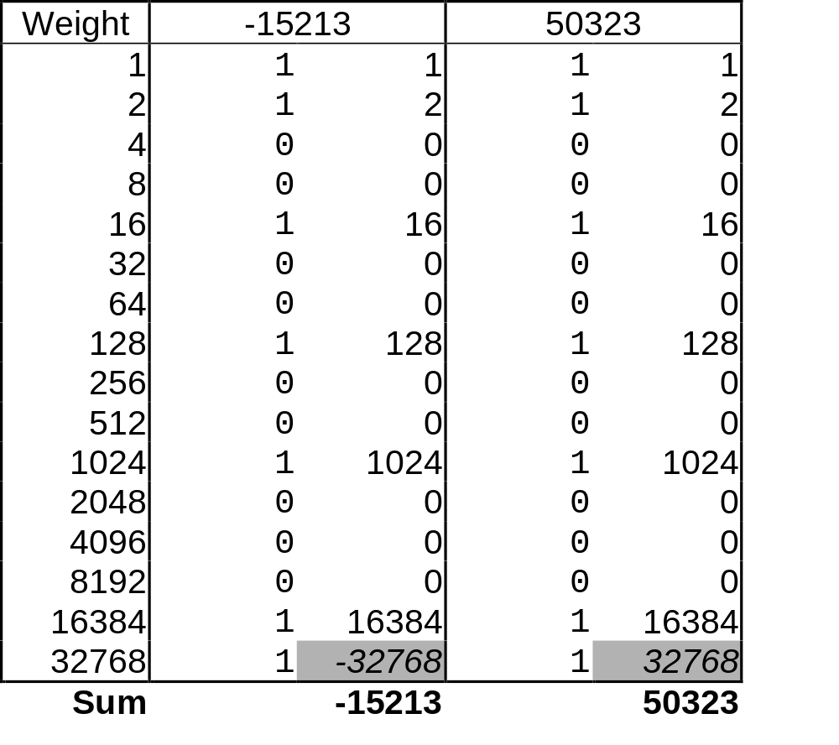
Relation Between Signed & Unsigned
  uy = y + 2 * 32768 = y + 65536

Slide 15
Signed vs. Unsigned in C
Constants
  By default are considered to be signed integers
  Unsigned if have “U” as suffix
    0U, 4294967259U
Casting
  Explicit casting between signed & unsigned same as U2T and T2U
    int tx, ty;
    unsigned ux, uy;
    tx = (int) ux;
    uy = (unsigned) ty;
  Implicit casting also occurs via assignments and procedure calls
    tx = ux;
    uy = ty;

Slide 16
Casting Surprises
Expression Evaluation
  If there is a mix of unsigned and signed in single expression,
  signed values implicitly cast to unsigned
  Including comparison operations <, >, ==, <=, >=
  Examples for W = 32: TMIN = -2,147,483,648 , TMAX = 2,147,483,647
Constant₁ Constant₂ Relation Evaluation
  0 0U
  -1 0
  -1 0U
  2147483647 -2147483647-1
  2147483647U -2147483647-1
  -1 -2
  (unsigned)-1 -2
  2147483647 2147483648U
  2147483647 (int) 2147483648U
  0 0U == unsigned
  -1 0 < signed
  -1 0U > unsigned
  2147483647 -2147483648 > signed
  2147483647U -2147483648 < unsigned
  -1 -2 > signed
  (unsigned) -1 -2 > unsigned
  2147483647 2147483648U < unsigned
  2147483647 (int) 2147483648U > signed

Slide 17
Explanation of Casting Surprises
2’s Comp. → Unsigned
  Ordering Inversion
  Negative → Big Positive
UMax
UMax – 1
TMax + 1
Unsigned
Range
TMax
TMax
2’s Comp.
Range
0
0
–1
–2
TMin

Slide 18
Code Security Example
/* Kernel memory region holding user-accessible data */
#define KSIZE 1024
char kbuf[KSIZE];
/* Copy at most maxlen bytes from kernel region to user buffer */
int copy_from_kernel(void *user_dest, int maxlen) {
/* Byte count len is minimum of buffer size and maxlen */
int len = KSIZE < maxlen ? KSIZE : maxlen;
memcpy(user_dest, kbuf, len);
return len;
}
Similar to code found in FreeBSD’s implementation of getpeername
There are legions of smart people trying to find vulnerabilities in programs

Slide 19
Typical Usage
/* Kernel memory region holding user-accessible data */
#define KSIZE 1024
char kbuf[KSIZE];
/* Copy at most maxlen bytes from kernel region to user buffer */
int copy_from_kernel(void *user_dest, int maxlen) {
/* Byte count len is minimum of buffer size and maxlen */
int len = KSIZE < maxlen ? KSIZE : maxlen;
memcpy(user_dest, kbuf, len);
return len;
}
#define MSIZE 528
void getstuff() {
char mybuf[MSIZE];
copy_from_kernel(mybuf, MSIZE);
printf(“%s\n”, mybuf);
}

Slide 20
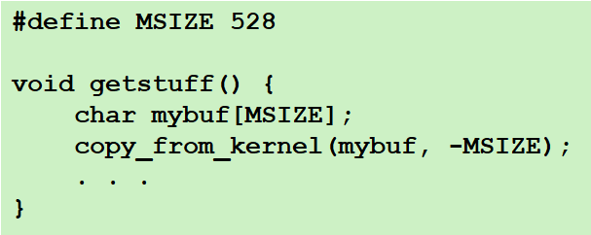
Malicious Usage
/* Declaration of library function memcpy */
void *memcpy(void *dest, void *src, size_t n);
/* Kernel memory region holding user-accessible data */
#define KSIZE 1024
char kbuf[KSIZE];
/* Copy at most maxlen bytes from kernel region to user buffer */
int copy_from_kernel(void *user_dest, int maxlen) {
/* Byte count len is minimum of buffer size and maxlen */
int len = KSIZE < maxlen ? KSIZE : maxlen;
memcpy(user_dest, kbuf, len);
return len;
}

Slide 21
Sign Extension
Task:
  Given w-bit signed integer x
  Convert it to w+k-bit integer with same value
Rule:
  Make k copies of sign bit:
  X ′ = x_{w–1} ,…, x_{w–1} , x_{w–1} , x_{w–2} ,…, x₀
k copies of MSB
w
X
• • •
• • •
X ′
• • •
• • •
k
w

Slide 22
Sign Extension Example
short int x = 15213;
int ix = (int) x;
short int y = -15213;
int iy = (int) y;
  Converting from smaller to larger integer data type
  C automatically performs sign extension
Decimal
Hex
Binary
x
15213
3B 6D
00111011 01101101
ix
15213
00 00 3B 6D
00000000 00000000 00111011 01101101
y
-15213
C4 93
11000100 10010011
iy
-15213
FF FF C4 93
11111111 11111111 11000100 10010011

Slide 23
Justification For Sign Extension
Prove Correctness by Induction on k
  Induction Step: extending by single bit maintains value
  Key observation: –2^{w–1} = –2^{w} +2^{w–1}
  Look at weight of upper bits:
    X –2^{w–1} x_{w–1}
    X ′ –2^{w} x_{w–1} + 2^{w–1} x_{w–1} = –2^{w–1} x_{w–1}
w
X
-
• • •
X ′
-
+
• • •
w+1

Slide 24
Negating with Complement & Increment
Claim: Following Holds for 2’s Complement
  ~x + 1 == -x
Complement
  Observation: ~x + x == 1111…11₂ == -1
Increment
  ~x + x + (-x + 1) == -1 + (-x + 1)
  ~x + 1 == -x
Warning: Be cautious treating int’s as integers
  OK here
x
1
0
0
1
1
1
0
1
+
~x
0
1
1
0
0
0
1
0
-1
1
1
1
1
1
1
1
1

Slide 25
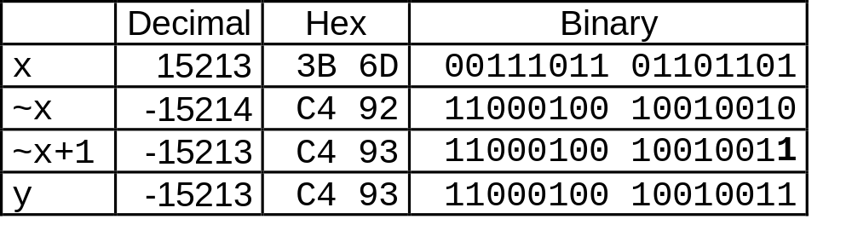
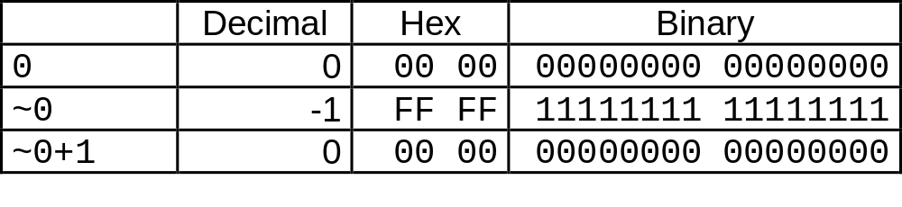
Comp. & Incr. Examples
x = 15213
0

Slide 26

Unsigned Addition
u
• • •
Operands: w bits
+
v
• • •
True Sum: w+1 bits
u + v
• • •
Discard Carry: w bits
UAdd_{w}(u , v)
• • •
Standard Addition Function
  Ignores carry output
Implements Modular Arithmetic
  s = UAdd_{w}(u , v) = u + v mod 2^{w}

Slide 27
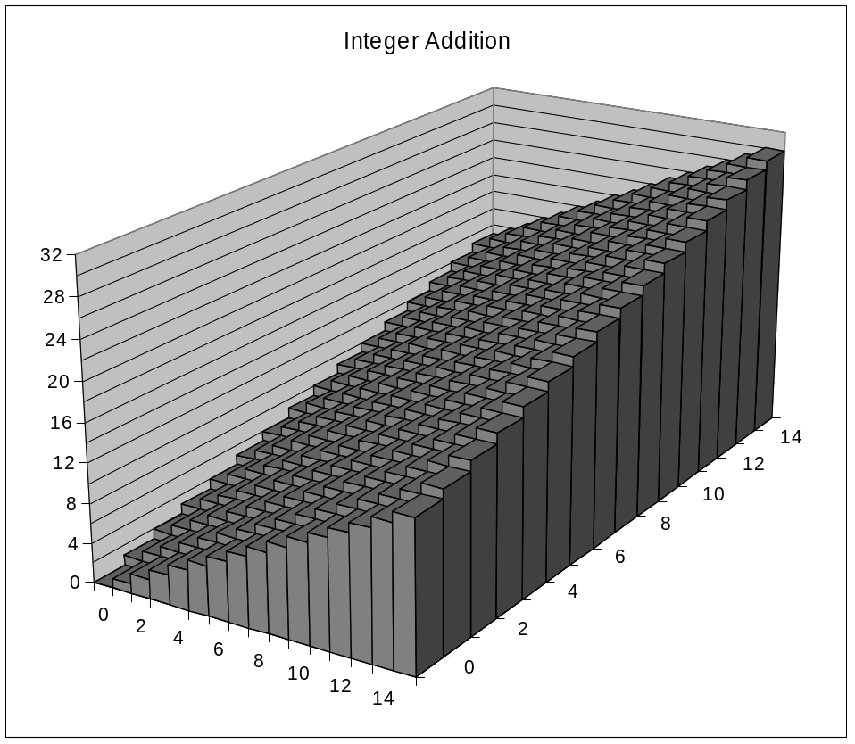
Visualizing Integer Addition
Integer Addition
  4-bit integers u, v
  Compute true sum Add₄(u , v)
  Values increase linearly with u and v
  Forms planar surface
Add₄(u , v)
v
u

Slide 28
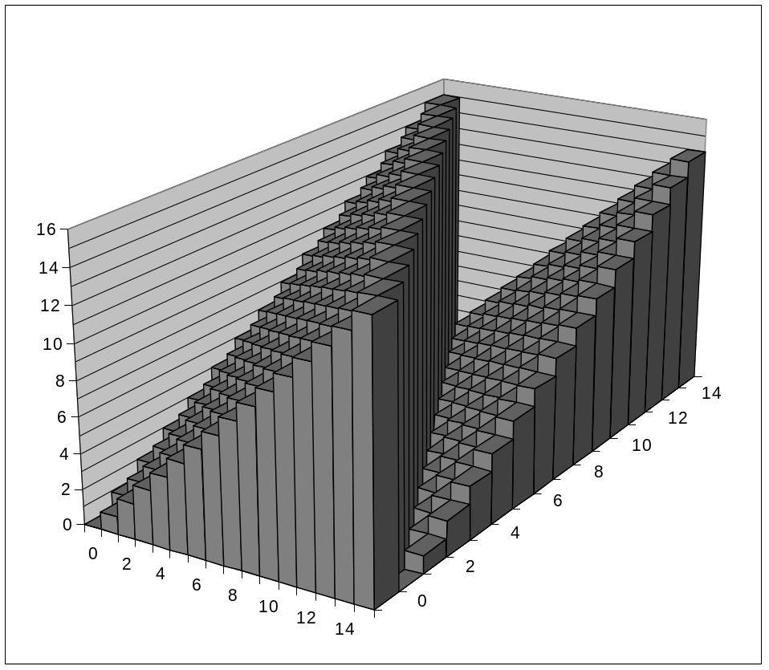
Visualizing Unsigned Addition
Wraps Around
  If true sum ≥ 2^{w}
  At most once
Overflow
UAdd₄(u , v)
True Sum
2^{w+1}
Overflow
2^{w}
v
0
Modular Sum
u

Slide 29
Mathematical Properties
Modular Addition Forms an Abelian Group
  Closed under addition
    0 ≤ UAdd_{w}(u , v) ≤ 2^{w} –1
  Commutative
    UAdd_{w}(u , v) = UAdd_{w}(v , u)
  Associative
    UAdd_{w}(t, UAdd_{w}(u , v)) = UAdd_{w}(UAdd_{w}(t, u ), v)
  0 is additive identity
    UAdd_{w}(u , 0) = u
  Every element has additive inverse
    Let UComp_{w} (u ) = 2^{w} – u
    UAdd_{w}(u , UComp_{w} (u )) = 0

Slide 30
Two’s Complement Addition
u
• • •
Operands: w bits
+
v
• • •
True Sum: w+1 bits
u + v
• • •
Discard Carry: w bits
TAdd_{w}(u , v)
• • •
TAdd and UAdd have Identical Bit-Level Behavior
  Signed vs. unsigned addition in C:
  int s, t, u, v;
  s = (int) ((unsigned) u + (unsigned) v);
  t = u + v
  Will give s == t

Slide 31

Characterizing TAdd
Functionality
  True sum requires w+1 bits
  Drop off MSB
  Treat remaining bits as 2’s comp. integer
True Sum
0 111…1
2^{w}–1
PosOver
TAdd Result
0 100…0
2^{w –1}
011…1
0 000…0
0
000…0
PosOver
1 100…0
–2^{w –1}
100…0
TAdd(u , v)
1 000…0
–2^{w}
NegOver
> 0
v
< 0
2^{w}
(NegOver)
< 0
> 0
u
2^{w}
(PosOver)
NegOver

Slide 32
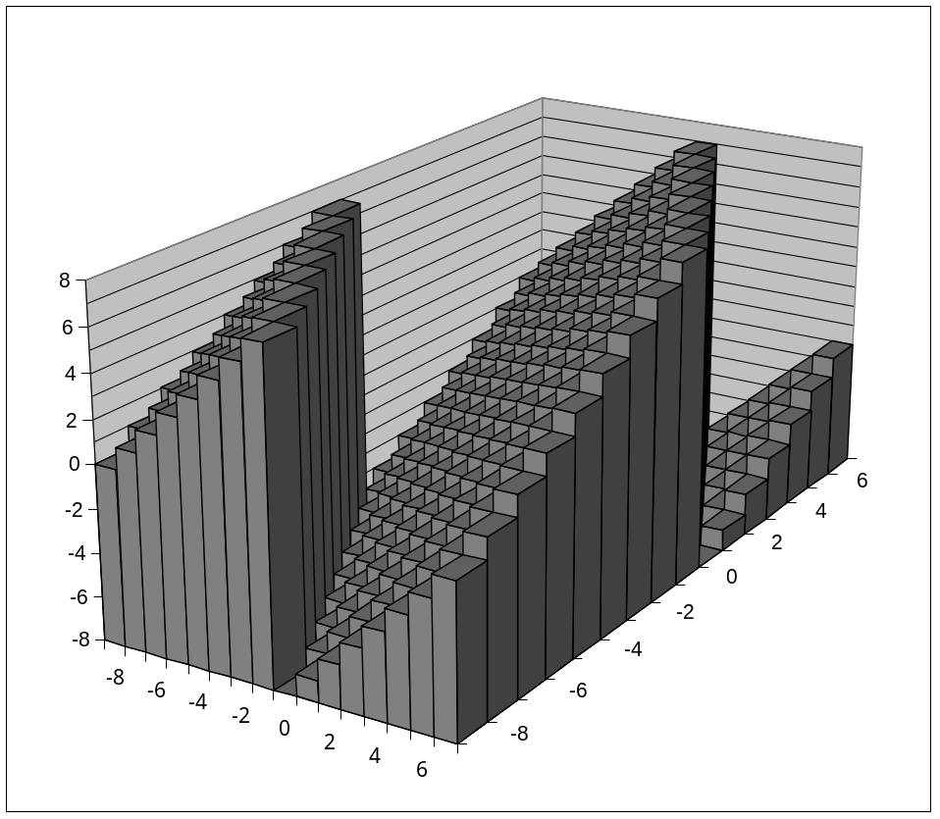
Visualizing 2’s Comp. Addition
NegOver
Values
  4-bit two’s comp.
  Range from -8 to +7
Wraps Around
  If sum ≥ 2^{w–1}
    Becomes negative
    At most once
  If sum < –2^{w–1}
    Becomes positive
    At most once
TAdd₄(u , v)
v
u
PosOver

Slide 33
Detecting 2’s Comp. Overflow
Task
  Given s = TAdd_{w}(u , v)
  Determine if s = Add_{w}(u , v)
  Example
  int s, u, v;
  s = u + v;
Claim
  Overflow iff either:
    u, v < 0, s ≥ 0 (NegOver)
    u, v ≥ 0, s < 0 (PosOver)
  ovf = (u<0 == v<0) && (u<0 != s<0);
2^{w}–1
PosOver
2^{w –1}
0
NegOver

Slide 34
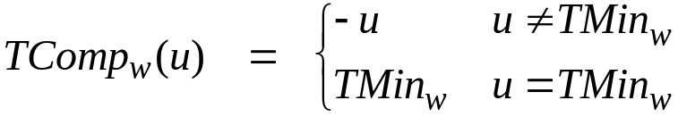
Mathematical Properties of TAdd
Isomorphic Algebra to UAdd
  TAdd_{w}(u , v) = U2T(UAdd_{w}(T2U(u ), T2U(v)))
    Since both have identical bit patterns
Two’s Complement Under TAdd Forms a Group
  Closed, Commutative, Associative, 0 is additive identity
  Every element has additive inverse
    Let TComp_{w} (u ) = U2T(UComp_{w}(T2U(u ))
    TAdd_{w}(u , TComp_{w} (u )) = 0

Slide 35
Multiplication
Computing Exact Product of w-bit numbers x, y
  Either signed or unsigned
Ranges
  Unsigned: 0 ≤ x * y ≤ (2^{w} – 1) ² = 2^{2w} – 2^{w+1} + 1
    Up to 2w bits
  Two’s complement min: x * y ≥ (–2^{w–1})*(2^{w–1}–1) = –2^{2w–2} + 2^{w–1}
    Up to 2w–1 bits
  Two’s complement max: x * y ≤ (–2^{w–1}) ² = 2^{2w–2}
    Up to 2w bits, but only for (TMin_{w})²
Maintaining Exact Results
  Would need to keep expanding word size with each product computed
  Done in software by “arbitrary precision” arithmetic packages

Slide 36
Unsigned Multiplication in C
u
• • •
Operands: w bits
*
v
• • •
True Product: 2*w bits
u · v
• • •
• • •
Discard w bits: w bits
UMult_{w}(u , v)
• • •
Standard Multiplication Function
  Ignores high order w bits
Implements Modular Arithmetic
  UMult_{w}(u , v) = u · v mod 2^{w}

Slide 37
Code Security Example #2
SUN XDR library
  Widely used library for transferring data between machines
void* copy_elements(void *ele_src[], int ele_cnt, size_t ele_size);
ele_src
malloc(ele_cnt * ele_size)

Slide 38
XDR Code
void* copy_elements(void *ele_src[], int ele_cnt, size_t ele_size) {
/*
* Allocate buffer for ele_cnt objects, each of ele_size bytes
* and copy from locations designated by ele_src
*/
void *result = malloc(ele_cnt * ele_size);
if (result == NULL)
/* malloc failed */
return NULL;
void *next = result;
int i;
for (i = 0; i < ele_cnt; i++) {
/* Copy object i to destination */
memcpy(next, ele_src[i], ele_size);
/* Move pointer to next memory region */
next += ele_size;
}
return result;
}

Slide 39
XDR Vulnerability
malloc(ele_cnt * ele_size)
What if:
  ele_cnt = 2²⁰ + 1
  ele_size = 4096 = 2¹²
  Allocation = ??
How can I make this function secure?

Slide 40
Unsigned vs. Signed Multiplication
Unsigned Multiplication
  unsigned ux = (unsigned) x;
  unsigned uy = (unsigned) y;
  unsigned up = ux * uy
  Truncates product to w-bit number up = UMult_{w}(ux, uy)
  Modular arithmetic: up = ux ⋅ uy mod 2^{w}
Two’s Complement Multiplication
  int x, y;
  int p = x * y;
  Compute exact product of two w-bit numbers x, y
  Truncate result to w-bit number p = TMult_{w}(x, y)

Slide 41
Unsigned vs. Signed Multiplication
Unsigned Multiplication
  unsigned ux = (unsigned) x;
  unsigned uy = (unsigned) y;
  unsigned up = ux * uy
Two’s Complement Multiplication
  int x, y;
  int p = x * y;
Relation
  Signed multiplication gives same bit-level result as unsigned
  up == (unsigned) p

Slide 42
Power-of-2 Multiply with Shift
Operation
  u << k gives u * 2^{k}
  Both signed and unsigned
Examples
  u << 3 == u * 8
  u << 5 - u << 3 == u * 24
  Most machines shift and add much faster than multiply
    Compiler generates this code automatically
k
u
• • •
Operands: w bits
*
2^{k}
0
•••
0
1
0
•••
0
0
True Product: w+k bits
u · 2^{k}
• • •
0
•••
0
0
Discard k bits: w bits
UMult_{w}(u , 2^{k})
•••
0
•••
0
0
TMult_{w}(u , 2^{k})

Slide 43
Compiled Multiplication Code
C Function
int mul12(int x)
{
return x*12;
}
Compiled Arithmetic Operations
Explanation
leal (%eax,%eax,2), %eax
sall $2, %eax
t <- x+x*2
return t << 2;
C compiler automatically generates shift/add code when multiplying by constant

Slide 44
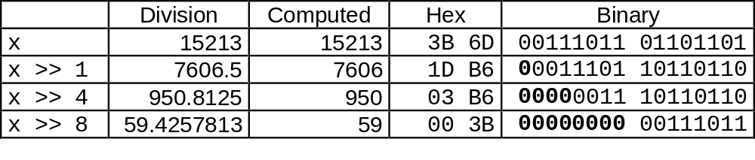
Unsigned Power-of-2 Divide with Shift
Quotient of Unsigned by Power of 2
  u >> k gives ⎣ u / 2^{k} ⎦
  Uses logical shift
k
u
•••
•••
Binary Point
Operands:
/
2^{k}
0
•••
0
1
0
•••
0
0
Division:
u / 2^{k}
0
•••
•••
.
•••
Result:
⎣ u / 2^{k} ⎦
0
•••
•••

Slide 45
Compiled Unsigned Division Code
C Function
unsigned udiv8(unsigned x)
{
return x/8;
}
Compiled Arithmetic Operations
Explanation
shrl $3, %eax
# Logical shift
return x >> 3;
Uses logical shift for unsigned
For Java Users
  Logical shift written as >>>

Slide 46
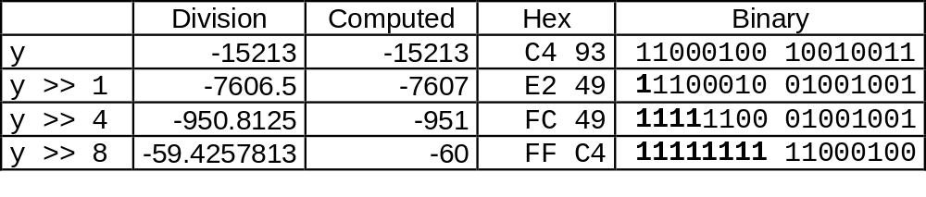
Signed Power-of-2 Divide with Shift
Quotient of Signed by Power of 2
  x >> k gives ⎣ x / 2^{k} ⎦
  Uses arithmetic shift
  Rounds wrong direction when u < 0
k
0
x
•••
•••
Binary Point
Operands:
/
2^{k}
0
•••
0
1
0
•••
0
0
Division:
x / 2^{k}
0
•••
•••
.
•••
Result:
RoundDown(x / 2^{k})
0
•••
•••

Slide 47
Correct Power-of-2 Divide
Quotient of Negative Number by Power of 2
  Want ⎡ x / 2^{k} ⎤ (Round Toward 0)
  Compute as ⎣ (x+2^{k}-1)/ 2^{k} ⎦
    In C: (x + (1<<k)-1) >> k
    Biases dividend toward 0
Case 1: No rounding
k
Dividend:
u
1
•••
0
•••
0
0
+2^{k} +–1
0
•••
0
0
1
•••
1
1
Binary Point
1
•••
1
•••
1
1
Divisor:
/
2^{k}
0
•••
0
1
0
•••
0
0
⎡ u / 2^{k} ⎤
.
0
1
•••
1
1
1
•••
1
•••
1
1
    Biasing has no effect

Slide 48
Correct Power-of-2 Divide (Cont.)
Case 2: Rounding
k
Dividend:
x
1
•••
•••
+2^{k} +–1
0
•••
0
0
1
•••
1
1
1
•••
•••
Incremented by 1
Binary Point
Divisor:
/
2^{k}
0
•••
0
1
0
•••
0
0
⎡ x / 2^{k} ⎤
.
0
1
•••
1
1
1
•••
•••
    Biasing adds 1 to final result
Incremented by 1

Slide 49
Compiled Signed Division Code
C Function
int idiv8(int x)
{
return x/8;
}
Compiled Arithmetic Operations
Explanation
testl %eax, %eax
js L4
L3:
sarl $3, %eax
ret
L4:
addl $7, %eax
jmp L3
if x < 0
x += 7;
# Arithmetic shift
return x >> 3;

Slide 50
Arithmetic: Basic Rules
Addition:
  Unsigned/signed: Normal addition followed by truncate,
  same operation on bit level
  Unsigned: addition mod 2^{w}
    Mathematical addition + possible subtraction of 2^{w}
  Signed: modified addition mod 2^{w} (result in proper range)
    Mathematical addition + possible addition or subtraction of 2^{w}
Multiplication:
  Unsigned/signed: Normal multiplication followed by truncate, same operation on bit level
  Unsigned: multiplication mod 2^{w}
  Signed: modified multiplication mod 2^{w} (result in proper range)

Slide 51
Arithmetic: Basic Rules
Unsigned ints, 2’s complement ints are isomorphic rings: isomorphism = casting
Left shift
  Unsigned/signed: multiplication by 2^{k}
  Always logical shift
Right shift
  Unsigned: logical shift, div (division + round to zero) by 2^{k}
  Signed: arithmetic shift
    Positive numbers: div (division + round to zero) by 2^{k}
    Negative numbers: div (division + round away from zero) by 2^{k}
    Use biasing to fix

Slide 52
Properties of Unsigned Arithmetic
Unsigned Multiplication with Addition Forms Commutative Ring
  Addition is commutative group
  Closed under multiplication
    0 ≤ UMult_{w}(u , v) ≤ 2^{w} –1
  Multiplication Commutative
    UMult_{w}(u , v) = UMult_{w}(v , u)
  Multiplication is Associative
    UMult_{w}(t, UMult_{w}(u , v)) = UMult_{w}(UMult_{w}(t, u ), v)
  1 is multiplicative identity
    UMult_{w}(u , 1) = u
  Multiplication distributes over addtion
    UMult_{w}(t, UAdd_{w}(u , v)) = UAdd_{w}(UMult_{w}(t, u ), UMult_{w}(t, v))

Slide 53
Properties of Two’s Comp. Arithmetic
Isomorphic Algebras
  Unsigned multiplication and addition
    Truncating to w bits
  Two’s complement multiplication and addition
    Truncating to w bits
Both Form Rings
  Isomorphic to ring of integers mod 2^{w}
Comparison to (Mathematical) Integer Arithmetic
  Both are rings
  Integers obey ordering properties, e.g.,
    u > 0 ⇒ u + v > v
    u > 0, v > 0 ⇒ u · v > 0
  These properties are not obeyed by two’s comp. arithmetic
    TMax + 1 == TMin
    15213 * 30426 == -10030 (16-bit words)

Slide 54
Why Should I Use Unsigned?
Don’t Use Just Because Number Nonnegative
  Easy to make mistakes
    unsigned i;
    for (i = cnt-2; i >= 0; i--)
    a[i] += a[i+1];
Do Use When Performing Modular Arithmetic
  Multiprecision arithmetic
Do Use When Using Bits to Represent Sets
  Logical right shift, no sign extension

Slide 55
C Puzzle Answers
  Assume machine with 32 bit word size, two’s comp. integers
  TMin makes a good counterexample in many cases
x < 0 ⇒ ((x*2) < 0) False: TMin
ux >= 0 True: 0 = UMin
x & 7 == 7 ⇒ (x<<30) < 0 True: x₁ = 1
ux > -1 False: 0
x > y ⇒ -x < -y False: -1, TMin
x * x >= 0 False: 30426
x > 0 && y > 0 ⇒ x + y > 0 False: TMax, TMax
x >= 0 ⇒ -x <= 0 True: –TMax < 0
x <= 0 ⇒ -x >= 0 False: TMin
x < 0 ⇒ ((x*2) < 0)
ux >= 0
x & 7 == 7 ⇒ (x<<30) < 0
ux > -1
x > y ⇒ -x < -y
x * x >= 0
x > 0 && y > 0 ⇒ x + y > 0
x >= 0 ⇒ -x <= 0
x <= 0 ⇒ -x >= 0

