Slide 1
DPLL(T)
Formal Methods Foundation
Baojian Hua
bjhua@ustc.edu.cn

Slide 2
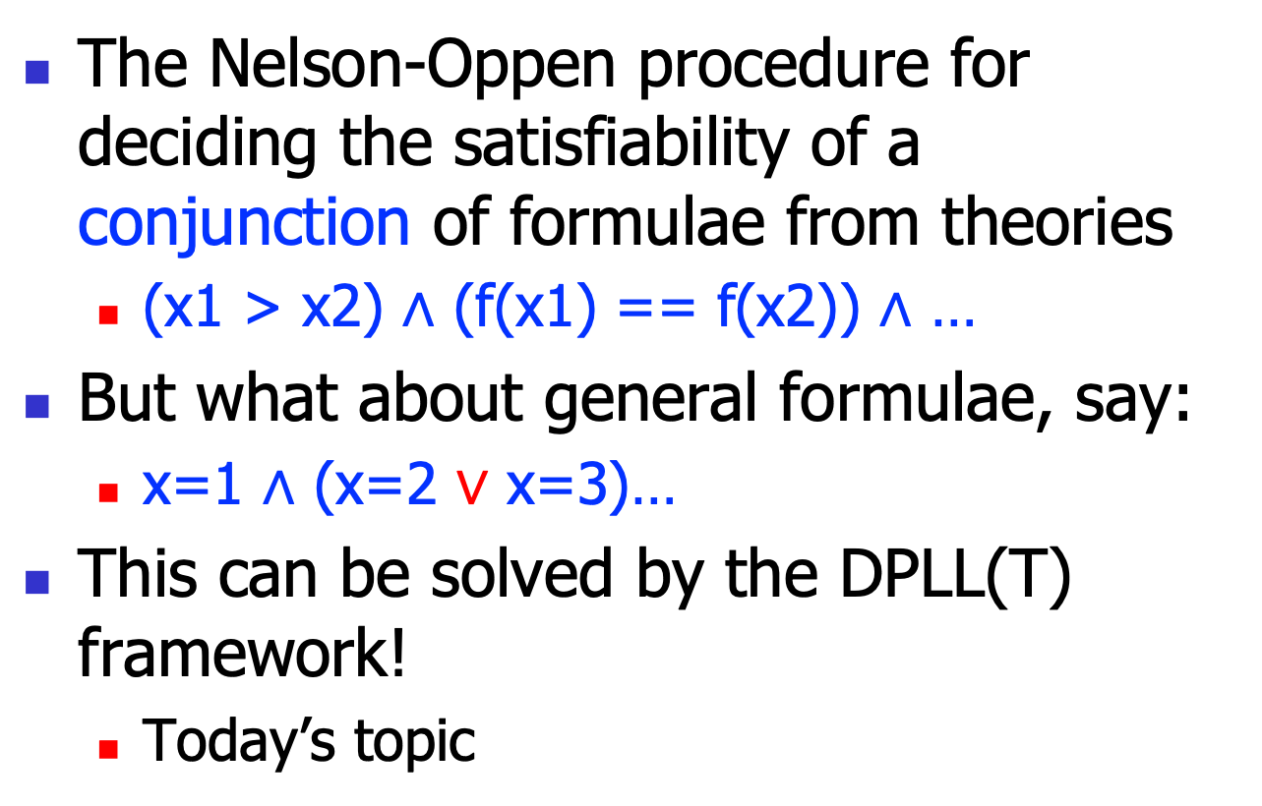
We’ve learned…
The Nelson-Oppen procedure for deciding the satisfiability of a conjunction of formulae from theories
(x1 > x2) $∧$ (f(x1) == f(x2)) $∧$ …
But what about general formulae, say:
x=1 $∧$ (x=2 $∨$ x=3)…
This can be solved by the DPLL(T) framework!
Today’s topic

Slide 3
DPLL recap
We’ve discussed the general DPLL algorithm for SAT:
Based on the truth table assignment
Resolution + propagation
SAT solver can be used as a black box
Input a formulae, output a model, or UNSAT

Slide 4
DPLL(T)
The key idea for DPLL(T) is to combine SAT solvers and theory solvers
Thus, the SAT solvers is parameterized by the theory solvers
Hence the name DPLL(T)
With theory T the parameters
Can process FOL formulae without any quantifications

Slide 5
Architecture
FOL formulae
Propositional skeleton (boolean abstraction)
DPLL
Propositional concreate
(Boolean refinement)
Nelson-Oppen
Theory
1
Theory
2
Theory
n
…

Slide 6
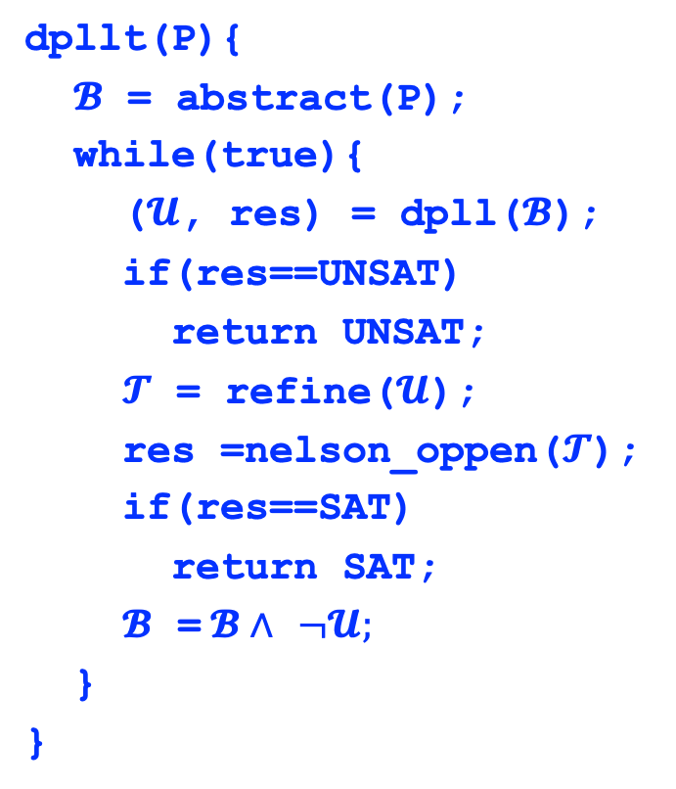
DPLL(T) algorithm
FOL formulae
dpllt(P){
$𝓑$ = abstract(P);
while(true){
($𝓤$, res) = dpll($𝓑$);
if(res==UNSAT)
return UNSAT;
$𝓣$ = refine($𝓤$);
res =nelson_oppen($𝓣$);
if(res==SAT)
return SAT;
$𝓑$ =$𝓑∧$ $¬𝓤;$
}
}
DPLL
Nelson-Oppen
Theory
1
Theory
2
Theory
n
…

Slide 7





DPLL(T) example
FOL formulae
P = (x=1) $∧$((x=2) $∨$(x=3))
$𝓑$ = A $∧$(B $∨$C)
DPLL
$𝓤$ = A $∧$B $∧$~C, res=SAT
$𝓣$ = (x=1) $∧$(x=2) $∧$~(x=3)
Nelson-Oppen
UNSAT
$𝓑$ = A $∧$(B $∨$C) $∧$~ $𝓤$
Theory
1
Theory
2
Theory
n
…

Slide 8




DPLL(T) example
FOL formulae
P = (x=1) $∧$((x=2) $∨$(x=3))
$𝓑$ = A $∧$(B $∨$C)/\(~A $∨$~B $∨$C)
DPLL
$𝓤$ = A $∧$~B $∧$C, res=SAT
$𝓣$ = (x=1) $∧$~(x=2) $∧$(x=3)
Nelson-Oppen
UNSAT
$𝓑$ = $𝓑∧$~ $𝓤$
Theory
1
Theory
2
Theory
n
…

Slide 9


DPLL(T) example
FOL formulae
P = (x=1) $∧$((x=2) $∨$(x=3))
$𝓑$ = A $∧$(B $∨$C) $∧$(~A $∨$~B $∨$C)/\(~A $∨$B $∨$~C)
DPLL
$𝓤$ = A $∧$B $∧$C, res=SAT
$𝓣$ = (x=1) $∧$(x=2) $∧$(x=3)
Nelson-Oppen
UNSAT
$𝓑$ = $𝓑∧$~ $𝓤$
Theory
1
Theory
2
Theory
n
…

Slide 10
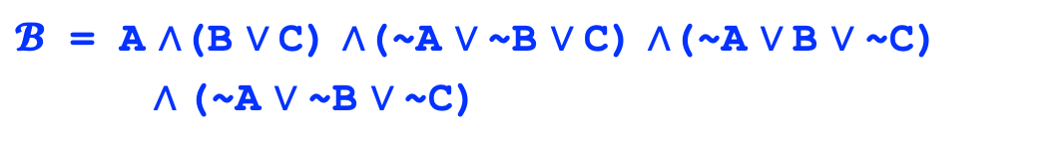
DPLL(T) example
FOL formulae
P = (x=1) $∧$((x=2) $∨$(x=3))
$𝓑$ = A $∧$(B $∨$C) $∧$(~A $∨$~B $∨$C) $∧$(~A $∨$B $∨$~C)
$∧$(~A $∨$~B $∨$~C)
DPLL
UNSAT!
Nelson-Oppen
The algorithm terminates with an UNSAT result.
Theory
1
Theory
2
Theory
n
…

Slide 11
Properties
This algorithm is often called offline
the SAT solver is used as a black box
good software engineering practice
This algorithm is slow
We just block one assignment a time
Many improvements are developed

Slide 12
Summary
DPLL(T) is a general framework to combine SAT and theory solvers
This finishes all our discussion of logics and decision procedures
from next lecture, we’ll discuss how to apply all these theories and tools to practical problems

