Slide 1
Operational semantics
Formal Methods Foundation
Baojian Hua
bjhua@ustc.edu.cn

Slide 2
Semantics
We need to talk about the semantics of a program rigorously
There are different styles for defining semantics:
Operational semantics
build a virtual machine, compile to the VM
Axiomatic semantics
Add specifications, compile to logic
Denotational semantics
Build model, compile to math

Slide 3
Semantics
In this course, we‘ll discuss both the operational semantics (this lecture), and the axiomatic semantics (the next few lectures)
Both of them are very successful in defining language semantics and in widely use

Slide 4
A very small language: C--
bop ::= + | - | * | / | == | != | > | < | >= | …
E ::= n | x | E bop E
S ::= skip
| x=E
| S;S
| f(E1, …, En)
| if(E, S, S)
| while(E, S)
F ::= f(x1, …, xn){S; return E;}
// In verification literature, the mostly used
// language is IMP, here I’ve modify IMP to be
// more C-like, but untyped for simplicity.

Slide 5
Sample programs
sum(n){
s = 0;
i = 0;
while(i <= n){
s = s+i;
i = i+1;
}
return s;
}
max(m, n){
c = m;
if(n>c)
c = n;
return c;
}
gcd(m, n){
while(m!=n){
if(m>=n)
m = m-n;
else
n = n-m;
}
return m;
}

Slide 6

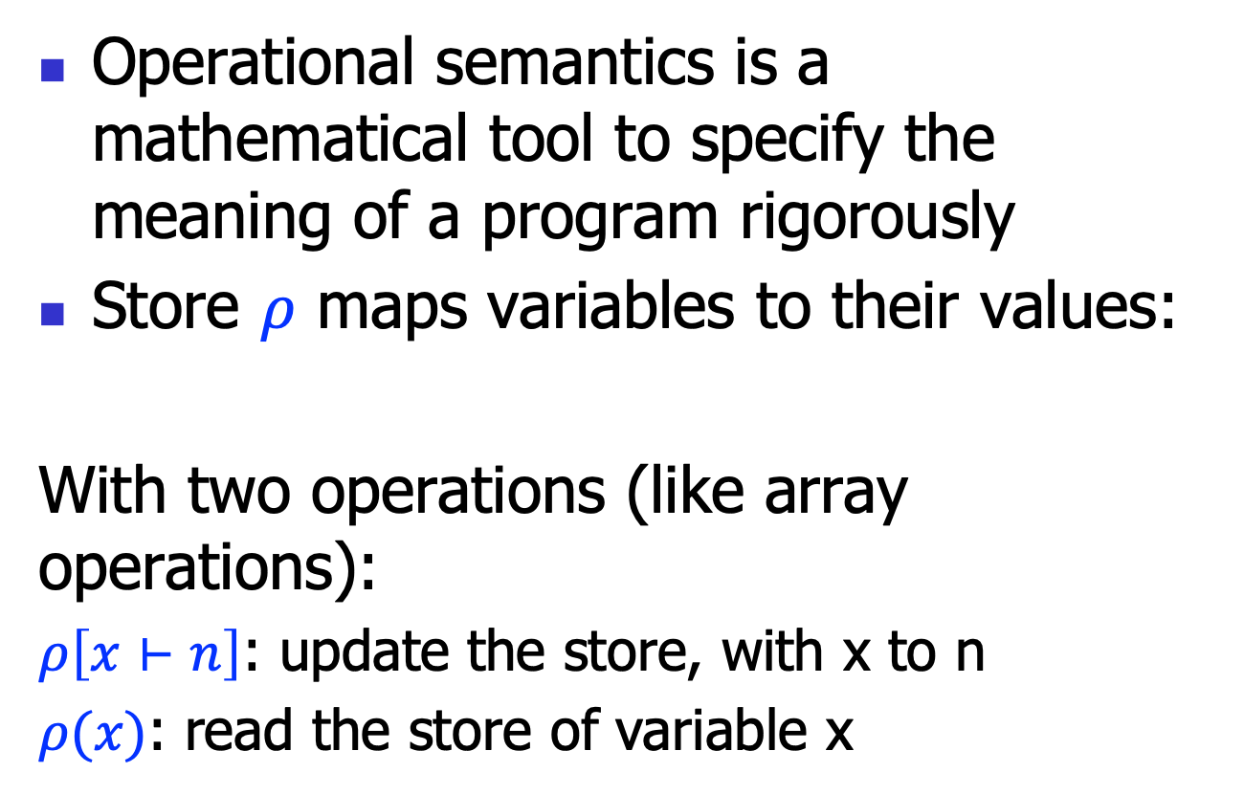
Operational semantics: store
Operational semantics is a mathematical tool to specify the meaning of a program rigorously
Store $ρ$ maps variables to their values:
With two operations (like array operations):
$ρ\left[x⊢n\right]$: update the store, with x to n
$ρ(x)$: read the store of variable x
$$ρ:x→n$$

Slide 7

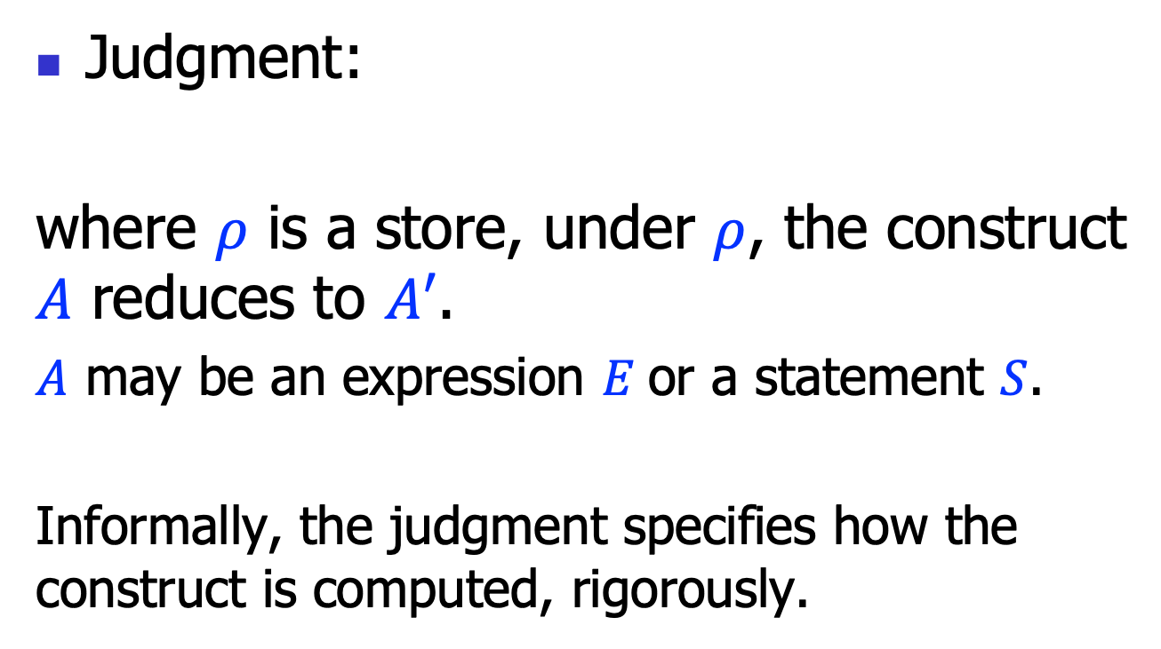
Operational semantics: judgment
Judgment:
where $ρ$ is a store, under $ρ$, the construct $A$ reduces to $A′$.
$A$ may be an expression $E$or a statement $S$.
Informally, the judgment specifies how the construct is computed, rigorously.
$$ρ⊢A→A′$$

Slide 8


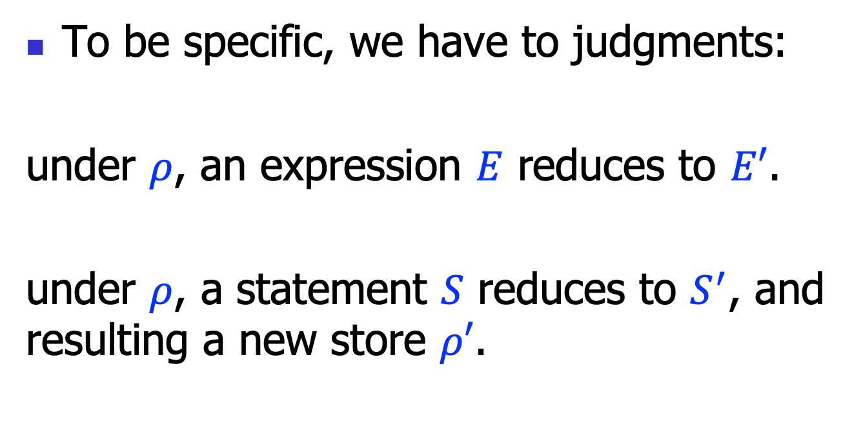
Operational semantics
To be specific, we have to judgments:
under $ρ$, an expression $E$ reduces to $E′$.
under $ρ$, a statement $S$ reduces to $S^{′}$, and resulting a new store $ρ′$.
$$ρ⊢E→E′$$
$ρ⊢S→S^{′};ρ$’

Slide 9
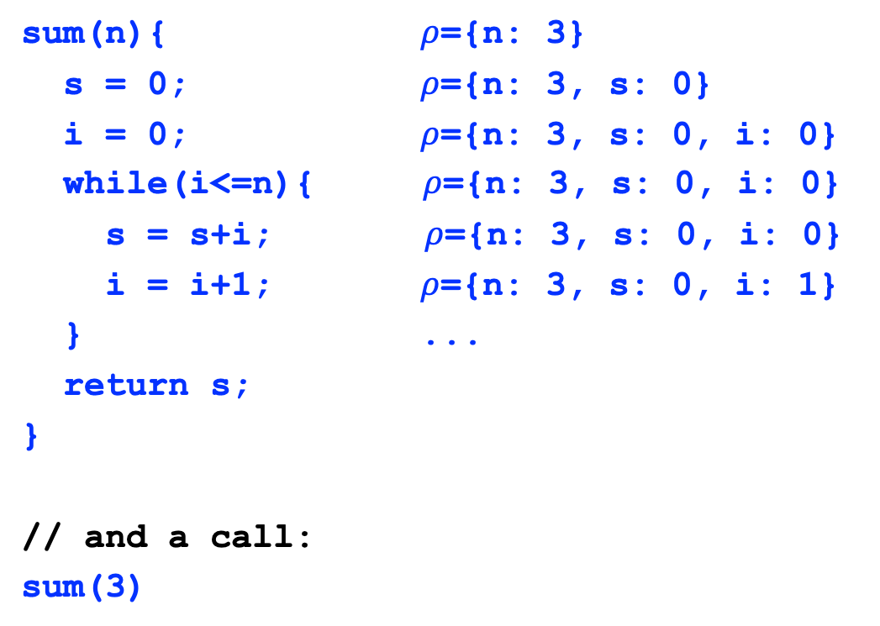
Example
sum(n){ $ρ$={n: 3}
s = 0; $ρ$={n: 3, s: 0}
i = 0; $ρ$={n: 3, s: 0, i: 0}
while(i<=n){$ρ$={n: 3, s: 0, i: 0}
s = s+i; $ρ$={n: 3, s: 0, i: 0}
i = i+1; $ρ$={n: 3, s: 0, i: 1}
} ...
return s;
}
// and a call:
sum(3)

Slide 10

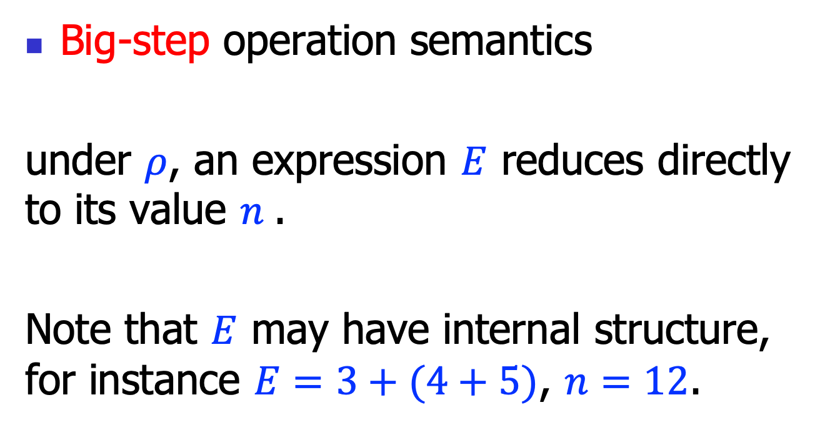
Operational semantics styles
Big-step operation semantics
under $ρ$, an expression $E$ reduces directly to its value $n$.
Note that $E$ may have internal structure, for instance $E=3+(4+5)$, $n=12$.
$$ρ⊢E⟹n$$

Slide 11

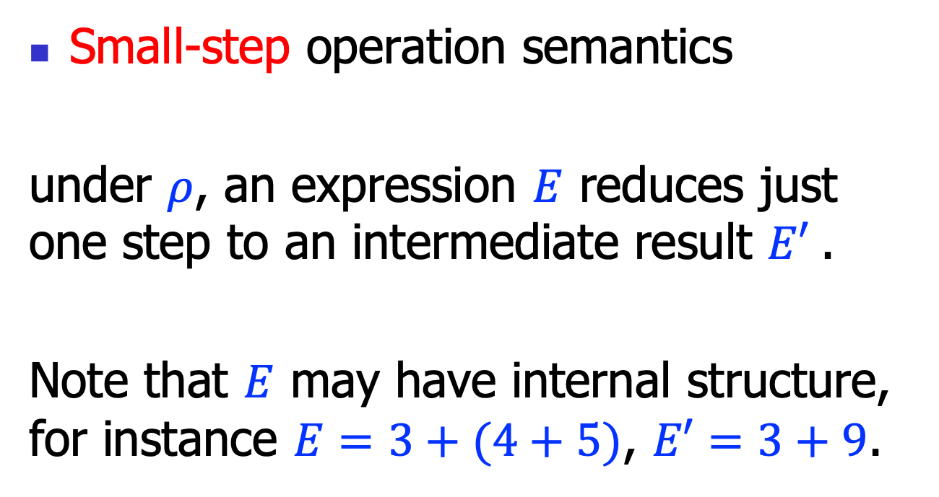
Operational semantics styles
Small-step operation semantics
under $ρ$, an expression $E$ reduces just one step to an intermediate result $E′$.
Note that $E$ may have internal structure, for instance $E=3+(4+5)$, $E′=3+9$.
$$ρ⊢E→E′$$

Slide 12
Big-step Operational Semantics

Slide 13









Rules for expressions (1)
$$(E−n)$$
$$ρ⊢n⟹n$$
$$ρ\left(x\right)=n$$
$$(E−x)$$
$$ρ⊢x⟹n$$
$$ρ⊢E1⟹n1$$
$$ρ⊢E2⟹n2$$
$$n=n1+n2$$
$$(E−+)$$
$$ρ⊢E1+E2⟹n$$

Slide 14










Rules for expressions (2)
$$ρ⊢E1⟹n1$$
$$ρ⊢E2⟹n2$$
$$n=n1−n2$$
$$(E−−)$$
$$ρ⊢E1−E2⟹n$$
$$ρ⊢E1⟹n1$$
$$ρ⊢E2⟹n2$$
$$n=n1∗n2$$
$$(E−∗)$$
$$ρ⊢E1∗E2⟹n$$
$$ρ⊢E1⟹n1$$
$$ρ⊢E2⟹n2$$
$$n=n1/n2$$
$$(E−/)$$
$$ρ⊢E1/E2⟹n$$

Slide 15










Rules for expressions (3)
$$ρ⊢E1⟹n1$$
$$ρ⊢E2⟹n2$$
$$n1==n2$$
$$(E−==1)$$
$$ρ⊢E1==E2⟹1$$
$$ρ⊢E1⟹n1$$
$$ρ⊢E2⟹n2$$
$$n1≠n2$$
$$(E−==2)$$
$$ρ⊢E1==E2⟹0$$
$$ρ⊢E1⟹n1$$
$$ρ⊢E2⟹n2$$
$$n1==n2$$
$$(E−≠1)$$
$$ρ⊢E1!=E2⟹0$$
$$ρ⊢E1⟹n1$$
$$ρ⊢E2⟹n2$$
$$n1≠n2$$
$$(E−≠2)$$
$$ρ⊢E1!=E2⟹1$$

Slide 16








Rules for expressions (4)
$$ρ⊢E1⟹n1$$
$$ρ⊢E2⟹n2$$
$$n1>n2$$
$$(E−>1)$$
$$ρ⊢E1>E2⟹1$$
$$ρ⊢E1⟹n1$$
$$ρ⊢E2⟹n2$$
$$n1≯n2$$
$$(E−>2)$$
$$ρ⊢E1>E2⟹0$$
$$ρ⊢E1⟹n1$$
$$ρ⊢E2⟹n2$$
$$n1≥n2$$
$$(E−≥1)$$
$$ρ⊢E1>=E2⟹1$$
$$ρ⊢E1⟹n1$$
$$ρ⊢E2⟹n2$$
$$n1<n2$$
$$(E−≥2)$$
$$ρ⊢E1>=E2⟹0$$

Slide 17







Rules for expressions (5)
$$ρ⊢E1⟹n1$$
$$ρ⊢E2⟹n2$$
$$n1<n2$$
$$(E−<1)$$
$$ρ⊢E1<E2⟹1$$
$$ρ⊢E1⟹n1$$
$$ρ⊢E2⟹n2$$
$$n1≮n2$$
$$(E−<2)$$
$$ρ⊢E1<E2⟹0$$
$$ρ⊢E1⟹n1$$
$$ρ⊢E2⟹n2$$
$$n1≤n2$$
$$(E−≤1)$$
$$ρ⊢E1<=E2⟹1$$
$$ρ⊢E1⟹n1$$
$$ρ⊢E2⟹n2$$
$$n1≰n2$$
$$(E−≤2)$$
$$ρ⊢E1<=E2⟹0$$

Slide 18








Rule for statement (1)
$$(E−Skip)$$
$$ρ⊢skip⟹ρ$$
$$ρ⊢E⟹n$$
$$(E−Assign)$$
$$ρ⊢x=E⟹ρ[x⊢n]$$
$$ρ⊢S1⟹ρ1$$
$$ρ1⊢S2⟹ρ2$$
$$(E−Seq)$$
$$ρ⊢S1;S2⟹ρ2$$

Slide 19







Rule for statement (2)
$$ρ⊢E⟹1$$
$$ρ⊢S1⟹ρ1$$
$$(E−If1)$$
$$ρ⊢if\left(E;S1;S2\right)⟹ρ1$$
$$ρ⊢E⟹0$$
$$ρ⊢S2⟹ρ2$$
$$(E−If2)$$
$$ρ⊢if(E;S1;S2)⟹ρ2$$

Slide 20





Rule for statement (3)
$$ρ⊢E⟹0$$
$$(E−While1)$$
$$ρ⊢while\left(E;S\right)⟹ρ$$
$$ρ⊢E⟹1$$
$$ρ⊢S⟹ρ′$$
$$ρ′⊢while(E;S)⟹ρ′′$$
$$(E−While2)$$
$$ρ⊢while\left(E;S\right)⟹ρ′′$$

Slide 21
Small-step Operational Semantics

Slide 22











Operational semantics rules
$$ρ\left(x\right)=n$$
$$(E−x)$$
$$ρ⊢x→n$$
$$ρ⊢E1→E1^{′}$$
$$(E−+1)$$
$$ρ⊢E1+E2→E1^{′}+E2$$
$$ρ⊢E2→E2^{′}$$
$$(E−+2)$$
$$ρ⊢n1+E2→n1+E2′$$
$$n=n1+n2$$
$$(E−+3)$$
$$ρ⊢n1+n2→n$$

Slide 23








Operational semantics rules
$$ρ⊢E1→E1^{′}$$
$$(E−−1)$$
$$ρ⊢E1−E2→E1^{′}−E2$$
$$ρ⊢E2→E2^{′}$$
$$(E−−2)$$
$$ρ⊢n1−E2→n1−E2′$$
$$n=n1−n2$$
$$(E−−3)$$
$$ρ⊢n1−n2→n$$

Slide 24






Operational semantics rules
$$ρ⊢E1→E1^{′}$$
$$(E−∗1)$$
$$ρ⊢E1∗E2→E1^{′}∗E2$$
$$ρ⊢E2→E2^{′}$$
$$(E−∗2)$$
$$ρ⊢n1∗E2→n1∗E2′$$
$$n=n1∗n2$$
$$(E−∗3)$$
$$ρ⊢n1∗n2→n$$

Slide 25






Operational semantics rules
$$ρ⊢E1→E1^{′}$$
$$(E−/1)$$
$$ρ⊢E1/E2→E1^{′}/E2$$
$$ρ⊢E2→E2^{′}$$
$$(E−/2)$$
$$ρ⊢n1/E2→n1/E2′$$
$$n=n1/n2$$
$$(E−/3)$$
$$ρ⊢n1/n2→n$$

Slide 26








Operational semantics rules
$$ρ⊢E1→E1^{′}$$
$$(E−==1)$$
$$ρ⊢E1==E2→E1^{′}==E2$$
$$ρ⊢E2→E2^{′}$$
$$(E−==2)$$
$$ρ⊢n1==E2→n1==E2′$$
$$n1==n2$$
$$(E−==3)$$
$$ρ⊢n1==n2→1$$
$$n1≠n2$$
$$(E−==4)$$
$$ρ⊢n1==n2→0$$

Slide 27









Operational semantics rules
$$ρ⊢E1→E1^{′}$$
$$(E−≠1)$$
$$ρ⊢E1≠E2→E1^{′}≠E2$$
$$ρ⊢E2→E2^{′}$$
$$(E−≠2)$$
$$ρ⊢n1≠E2→n1≠E2′$$
$$n1≠n2$$
$$(E−≠3)$$
$$ρ⊢n1≠n2→1$$
$$n1==n2$$
$$(E−≠4)$$
$$ρ⊢n1≠n2→0$$

Slide 28








Operational semantics rules
$$ρ⊢E1→E1^{′}$$
$$(E−>1)$$
$$ρ⊢E1>E2→E1^{′}>E2$$
$$ρ⊢E2→E2^{′}$$
$$(E−>2)$$
$$ρ⊢n1>E2→n1>E2′$$
$$n1>n2$$
$$(E−>3)$$
$$ρ⊢n1>n2→1$$
$$n1≯n2$$
$$(E−>4)$$
$$ρ⊢n1>n2→0$$

Slide 29









Operational semantics rules
$$ρ⊢E1→E1^{′}$$
$$(E−≥1)$$
$$ρ⊢E1≥E2→E1^{′}≥E2$$
$$ρ⊢E2→E2^{′}$$
$$(E−≥2)$$
$$ρ⊢n1≥E2→n1≥E2′$$
$$n1≥n2$$
$$(E−≥3)$$
$$ρ⊢n1≥n2→1$$
$$n1≱n2$$
$$(E−≥4)$$
$$ρ⊢n1≥n2→0$$

Slide 30








Operational semantics rules
$$ρ⊢E1→E1^{′}$$
$$(E−<1)$$
$$ρ⊢E1<E2→E1^{′}<E2$$
$$ρ⊢E2→E2^{′}$$
$$(E−<2)$$
$$ρ⊢n1<E2→n1<E2′$$
$$n1<n2$$
$$(E−<3)$$
$$ρ⊢n1<n2→1$$
$$n1≮n2$$
$$(E−<4)$$
$$ρ⊢n1<n2→0$$

Slide 31









Operational semantics rules
$$ρ⊢E1→E1^{′}$$
$$(E−≤1)$$
$$ρ⊢E1≤E2→E1^{′}≤E2$$
$$ρ⊢E2→E2^{′}$$
$$(E−≤2)$$
$$ρ⊢n1≤E2→n1≤E2′$$
$$n1≤n2$$
$$(E−≤3)$$
$$ρ⊢n1≤n2→1$$
$$n1≰n2$$
$$(E−≤4)$$
$$ρ⊢n1≤n2→0$$

Slide 32





Operational semantics rules
$$(E−Skip)$$
$$ρ⊢skip→ .;ρ$$
$$ρ⊢E→E′$$
$$(E−Assign1)$$
$$ρ⊢x=E→x=E^{′};ρ$$
$$(E−Assign2)$$
$$ρ⊢x=n→.;ρ[x⊢n]$$

Slide 33




Operational semantics rules
$$ρ⊢S1→S1′;ρ′$$
$$(E−Seq1)$$
$$ρ⊢S1;S2→S1^{′};S2;ρ′$$
$$ρ⊢S1→ .;ρ′$$
$$(E−Seq2)$$
$$ρ⊢S1;S2→S2; ρ′$$

Slide 34



Operational semantics rules
$$ρ⊢E→E′$$
$$(E−If1)$$
$$ρ⊢if\left(E;S1;S2\right)→if\left(E′;S1;S2\right); ρ$$
$$(E−If2)$$
$$ρ⊢if(1;S1;S2)→S1; ρ$$
$$(E−If3)$$
$$ρ⊢if(0;S1;S2)→S2; ρ$$

Slide 35




Operational semantics rules
$$ρ⊢E→E′$$
$$(E−While1)$$
$$ρ⊢while\left(E;S\right)→while\left(E′;S\right); ρ$$
$$E=1$$
$$(E−While2)$$
$$ρ⊢while\left(E;S\right)→S;while\left(E;S\right); ρ$$
$$(E−While3)$$
$$ρ⊢while\left(0;S\right)→ .;ρ$$

Slide 36
Operational semantics rules
Function calls and returns as special syntactic sugar
x = f(E1, …, En)
-->
x1 = E1;
…;
xn = En;
S_{f};
x = f;
return E;
-->
f = E;

Slide 37
Summary
We discussed operational semantics
For a very small imperative language
The operational semantics rules can be implemented
often called an interpreter (or concrete execution)
This is also the key idea for VMs

