Slide 1
Context-free Grammar
Formal Methods Foundation
Baojian Hua
bjhua@ustc.edu.cn

Slide 2
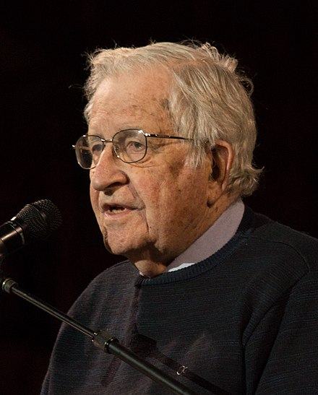
Context-free Grammar: History
Developed by Noam Chomsky in 1956
To study linguistics
A long time standing question in understanding natural languages (even to today’s deep learning)
First used in the design of the Algo language
Backus, Naur, 1957-60
Expressive enough to encode language syntax, yet simple enough to write parsers

Slide 3
Context-free Grammar (CFG)
A CFG consists of 4 components:
a set of terminals (tokens): T
a set of nonterminals: N
a set of production rules: P
s -> t1 t2 … tn
with s∈N, and t1, …, tn ∈(T ∪N)
a unique start nonterminal: S

Slide 4
Example
// SLP as in Tiger book chap. 1 (simplified):
N = {S, E}
T = {SEMICOLON, ID, NUM, PLUS, TIMES, IF, ASSIGN,
PRINT, LPAREN, RPAREN}
S = S
S -> S SEMICOLON S
| ID ASSIGN E
| PRINT LPAREN E RPAREN
E -> ID
| NUM
| E PLUS E
| E TIMES E

Slide 5
Derivation
A derivation:
Starts with the unique start nonterminal S
repeatedly replacing a right-hand nonterminal T by the body of a production rule of the nonterminal T
stop when right-hand are all terminals
The final string consists only of terminals and is called a sentence (program)

Slide 6
Example
S -> S ; S
| id := E
| print (E)
E -> …
S -> … (a choice)
derive me
x := 5;
print (x)

Slide 7
Example
S -> S ; S
| id := E
| print (E)
E -> id
| num
| E + E
| E * E
S -> S ; S
-> x := E ; S
-> x := 5 ; S
-> x := 5 ; print (E)
-> x := 5 ; print (x)
derive me
x := 5;
print (x)

Slide 8
Another Try to Derive the same Program
S -> S ; S
| id := E
| print (E)
E -> …
S -> x := E
-> x := 5
-> ??? // stuck! :-(
derive me
x := 5;
print (x)

Slide 9
Derivation推导
For same string, there may exist many different derivations
left-most derivation
right-most derivation
Parsing is the problem of taking a string of terminals and figure out whether it could be derived from a CFG
If not, error-detection

Slide 10
Parse Trees
Derivation can also be represented as trees
useful to understand AST (discussed later)
Idea:
each internal node is labeled with a nonterminal
each leaf node is labeled with a terminal
each use of a rule in a derivation explains how to generate children in the parse tree from the parent

Slide 11
Example
S -> S ; S
| …
S
S
;
S
x
:=
E
print
(
E
)
derive me
x := 5;
print (x)
5
x

Slide 12
Parse Tree has Meanings: post-order traversal
S -> S ; S
| …
S
S
;
S
x
:=
E
print
(
E
)
derive me
x := 5;
print (x)
5
x

Slide 13
Ambiguous Grammars
A grammar is ambiguous if the same sequence of tokens can give rise to two or more different parse trees

Slide 14
Example
E -> num
| id
| E + E
| E * E
E -> E + E
-> 3 + E
-> 3 + E * E
-> 3 + 4 * E
-> 3 + 4 * 5
E -> E * E
-> E + E * E
-> 3 + E * E
-> 3 + 4 * E
-> 3 + 4 * 5
derive me
3+4*5

Slide 15
Example
E
E
+
E
E -> num
| id
| E + E
| E * E
3
E
*
E
4
5
E -> E + E
-> 3 + E
-> 3 + E * E
-> 3 + 4 * E
-> 3 + 4 * 5
E
E
*
E
E -> E * E
-> E + E * E
-> 3 + E * E
-> 3 + 4 * E
-> 3 + 4 * 5
E
+
E
5
3
4

Slide 16
Ambiguous Grammars
Problem: compilers make use of parse trees to interpret the meaning of parsed programs
different parse trees have different meanings
eg: 4 + 5 * 6 is not (4 + 5) * 6
languages with ambiguous grammars are DISASTROUS; the meaning of programs isn’t well-defined! You can’t tell what your program might do!
Solution: rewrite grammar to equivalent forms

Slide 17
Eliminating ambiguity
For programming language syntax, ambiguity often arises from missing operator precedence or associativity
* is of high precedence than +
both + and * are left-associative
Why or why not?
Rewrite grammar to take account of this

Slide 18
Example
E -> num
| id
| E + E
| E * E
E -> E + T
| T
T -> T * F
| F
F -> num
| id
Q: is the right grammar ambiguous? Why or why not?
The layered approach is very effective in eliminating ambiguity. To be discussed later.

Slide 19
Summary
Context-free grammar is a math tool for specifying language syntax
among others…
Writing parsers for general grammar is hard and costly
But there are efficient enough algorithms
Refer to your favorite compile textbook

