Slide 1
Induction归纳法
Formal Methods Foundation
Baojian Hua
bjhua@ustc.edu.cn

Slide 2
Motivation
Induction is a powerful math. tool to prove interesting properties
We‘ve studied mathematical induction
In this lecture, we study two others:
The structural induction结构化归纳法
Well-founded induction良基归纳法
There are more in the assigned reading

Slide 3
Mathematical induction
To prove a property P(n), for any natural number n
We follow the next two steps:
Prove P(0);
Assume P(k), to prove P(k+1).
The hard part

Slide 4
Mathematical induction
The mathematical induction makes sense, for the Piano numbers:
n ::= O
| S n
Example: 0 : O
1 : S O
2 : S S O
…
The base case
The inductive case

Slide 5
Structural induction
Do induction on any recursive defined structures
e ::= n
| x
| e + e
| (e)
Theorem: for any expression e, the number of left parenthesis “(“ is equal to the number of right parenthesis “)”.
A constant
A variable
Addition
Parenthesis

Slide 6
Structural induction
Do induction on any recursive defined structures
e ::= n
| x
| e + e
| (e)
Theorem: for any expression e, the number of left parenthesis “(“ is equal to the number of right parenthesis “)”.
A constant
A variable
Addition
Proof (only sketch). Do case analysis on the possible syntax structure of e.
If e=x or e=x, then all 0;
If e = e1+e2, then based on the assumption …, …
If e = (e1), then based on …, …
Parenthesis

Slide 7
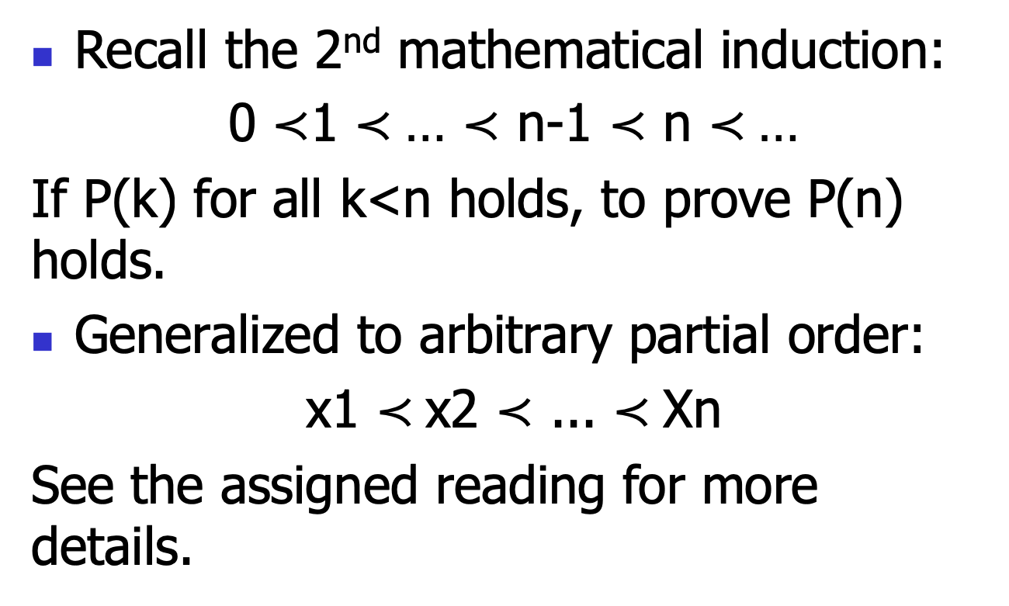
Well-founded induction
Recall the 2nd mathematical induction:
0 $≺$1 $≺$… $≺$ n-1 $≺$ n $≺$…
If P(k) for all k<n holds, to prove P(n) holds.
Generalized to arbitrary partial order:
x1 $≺$x2 $≺$ ... $≺$Xn
See the assigned reading for more details.

