Slide 1
Theory Combination
Formal Methods Foundation
Baojian Hua
bjhua@ustc.edu.cn

Slide 2
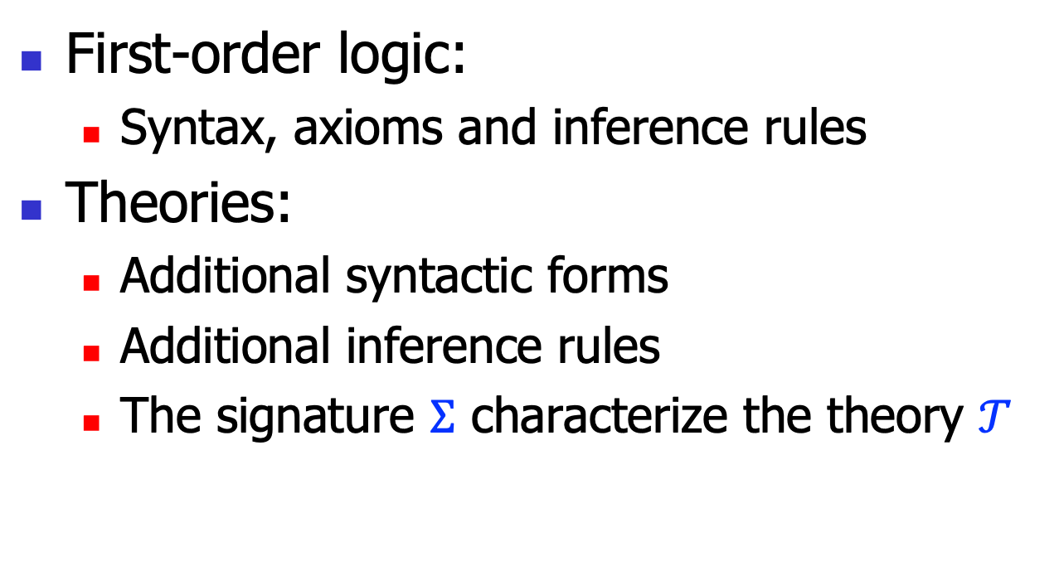
Recall: theories and signatures
First-order logic:
Syntax, axioms and inference rules
Theories:
Additional syntactic forms
Additional inference rules
The signature $Σ$ characterize the theory $𝒯$

Slide 3
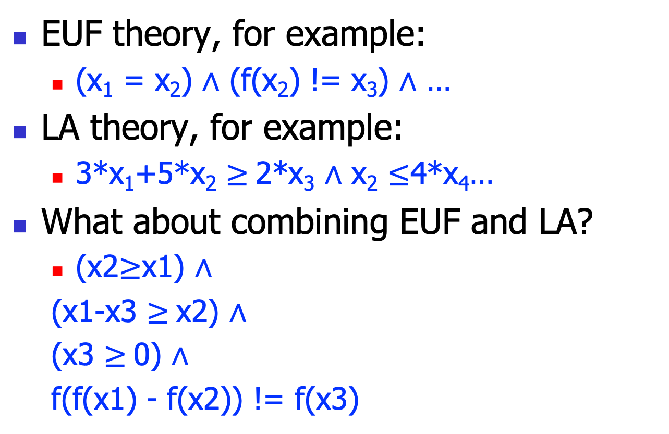
We’ve learned…
EUF theory, for example:
(x₁ = x₂) $∧$ (f(x₂) != x₃) $∧$ …
LA theory, for example:
3*x₁+5*x₂ $≥$2*x₃ $∧$ x₂ $≤$4*x₄…
What about combining EUF and LA?
(x2$≥$x1) $∧$
(x1-x3 $≥$x2) $∧$
(x3 $≥$0) $∧$
f(f(x1) - f(x2)) != f(x3)

Slide 4
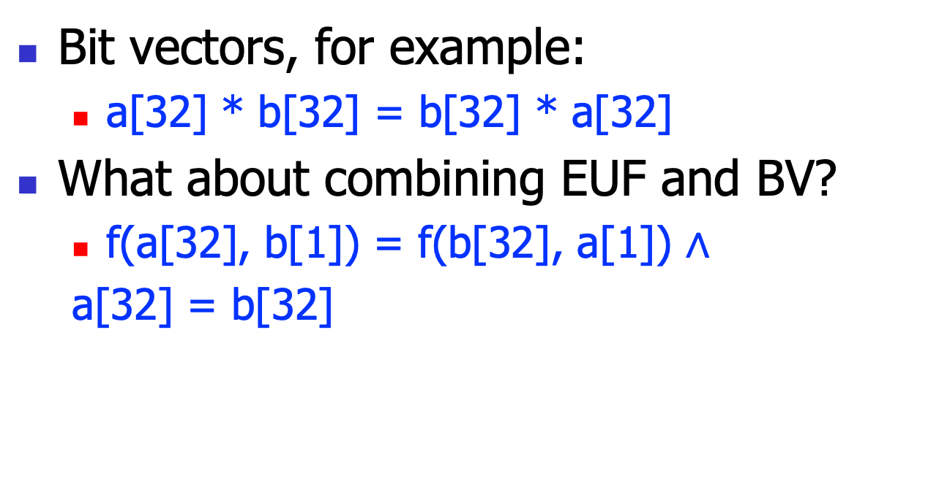
And also
Bit vectors, for example:
a[32] * b[32] = b[32] * a[32]
What about combining EUF and BV?
f(a[32], b[1]) = f(b[32], a[1]) $∧$
a[32] = b[32]

Slide 5
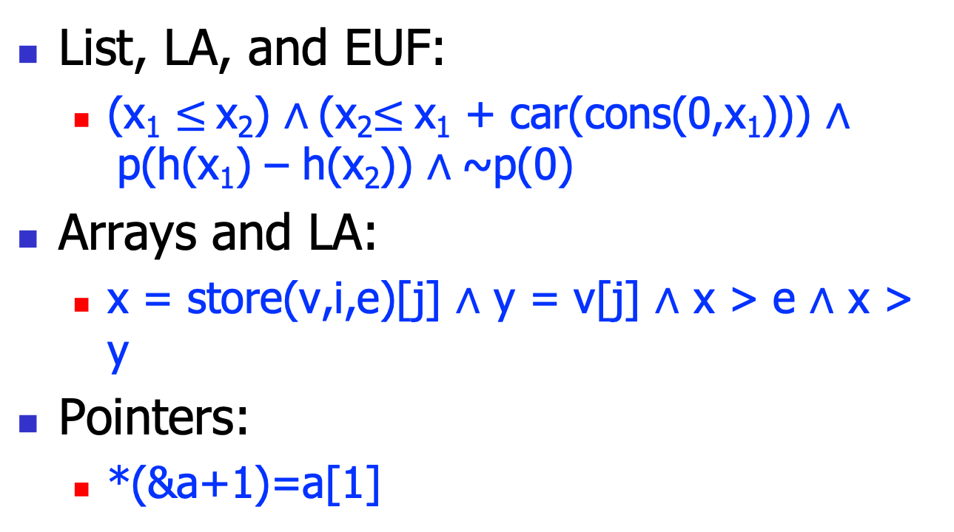
And more
List, LA, and EUF:
(x₁ $≤$x₂) $∧$(x₂$≤$x₁ + car(cons(0,x₁))) $∧$p(h(x₁) – h(x₂)) $∧$~p(0)
Arrays and LA:
x = store(v,i,e)[j] $∧$ y = v[j] $∧$ x > e $∧$ x > y
Pointers:
*(&a+1)=a[1]

Slide 6
Question
Given 2 or more theories, whether or not their combination is still decidable?
if so, what’s the combined decision procedure?
This is the problem of theory combination

Slide 7
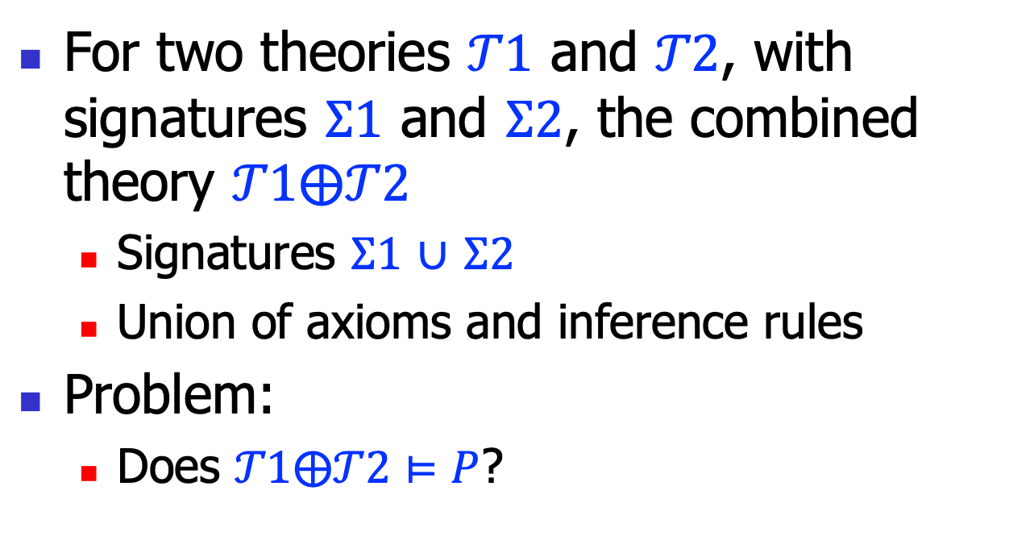
Theory combination
For two theories $𝒯1$ and $𝒯2$, with signatures $Σ1$ and $Σ2$, the combined theory $𝒯1⨁𝒯2$
Signatures $Σ1$ $∪$ $Σ2$
Union of axioms and inference rules
Problem:
Does $𝒯1⨁𝒯2⊨P$?

Slide 8
Theory combination
Approach #1: reduce all theories to propositional logic, and use SAT
In previous lectures, we‘ve seen reductions for various theories, say BV
Approach #2: combine theories directly
We’ll discuss the Nelson-Oppen method
Greg Nelson and Derek Oppen, Simplification by cooperating decision procedures, 1979

Slide 9
Nelson-Oppen Method

Slide 10
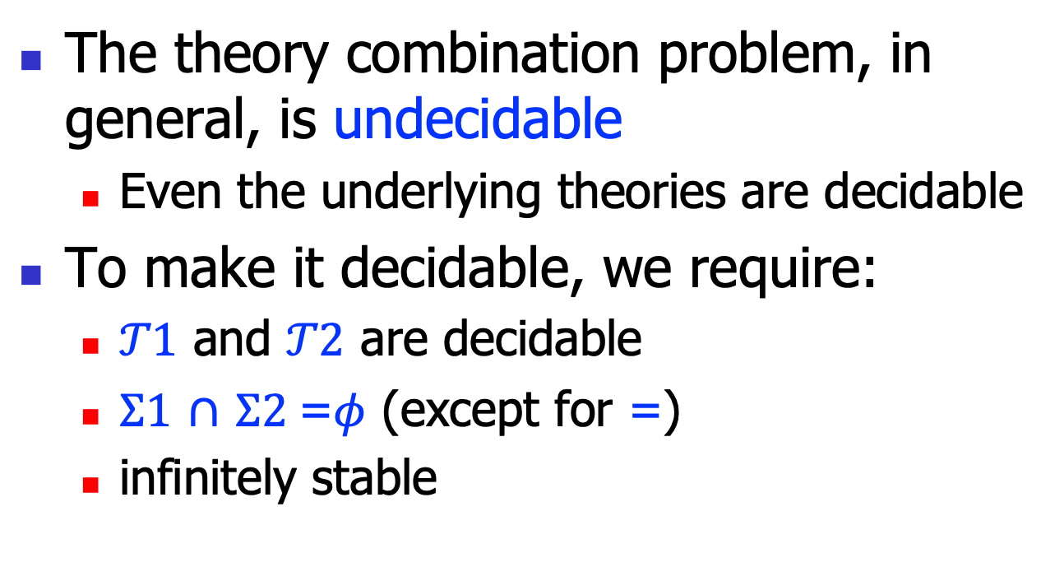
Basic results
The theory combination problem, in general, is undecidable
Even the underlying theories are decidable
To make it decidable, we require:
$𝒯1$ and $𝒯2$ are decidable
$Σ1$ $∩$ $Σ2$=$φ$ (except for =)
infinitely stable

Slide 11
Nelson-Oppen Architecture
Conjunctive formulae
Purification
Nelson-Oppen
Equality broadcast
Theory
1
Theory
2
Theory
n
…

Slide 12
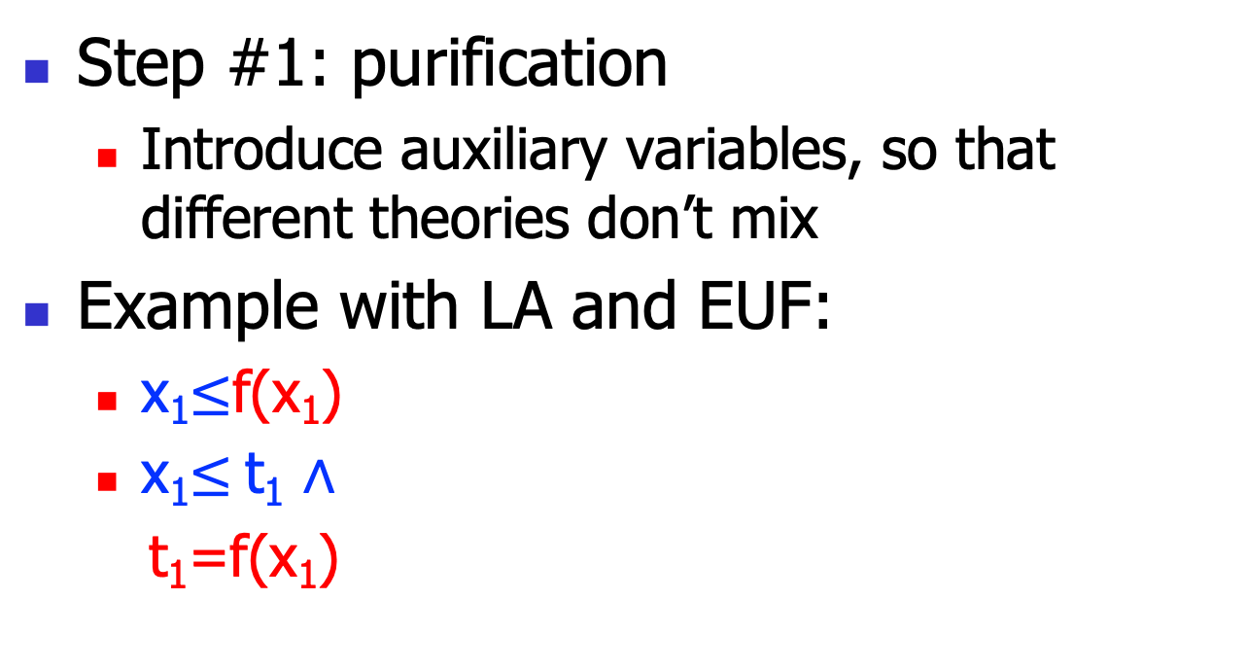
Nelson-Oppen
Step #1: purification
Introduce auxiliary variables, so that different theories don’t mix
Example with LA and EUF:
x₁$≤$f(x₁)
x₁$≤$t₁ $∧$
t₁=f(x₁)

Slide 13
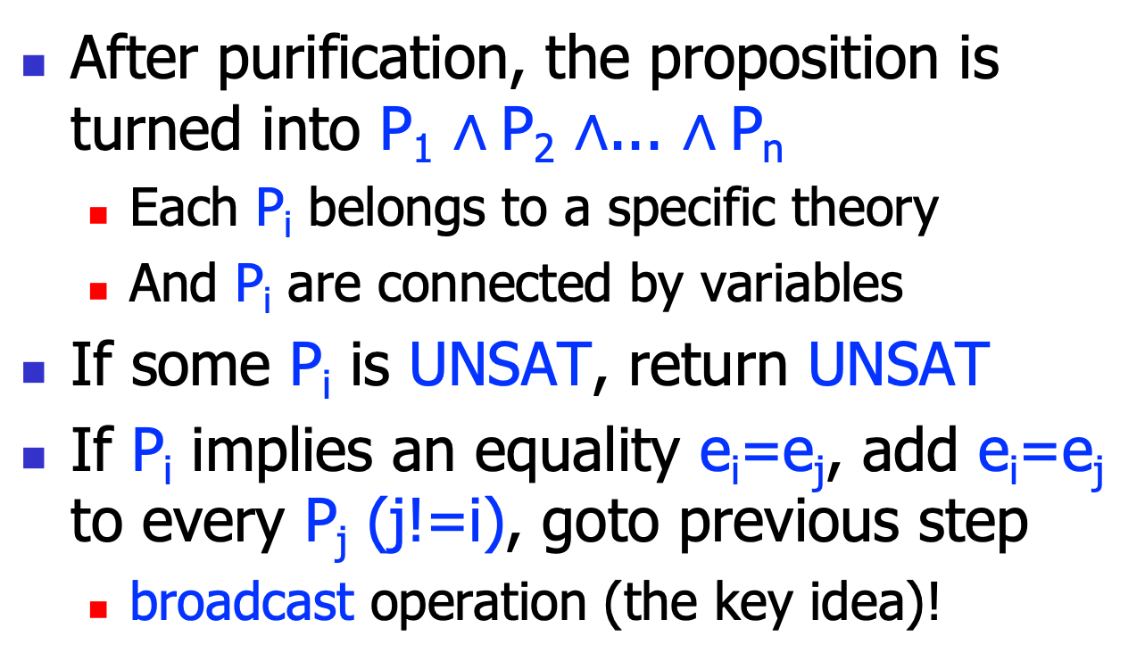
#2: Equality propagation
After purification, the proposition is turned into P₁ $∧$P₂ $∧$... $∧$P_{n}
Each P_{i} belongs to a specific theory
And P_{i} are connected by variables
If some P_{i} is UNSAT, return UNSAT
If P_{i} implies an equality e_{i}=e_{j}, add e_{i}=e_{j} to every P_{j} (j!=i), goto previous step
broadcast operation (the key idea)!

Slide 14
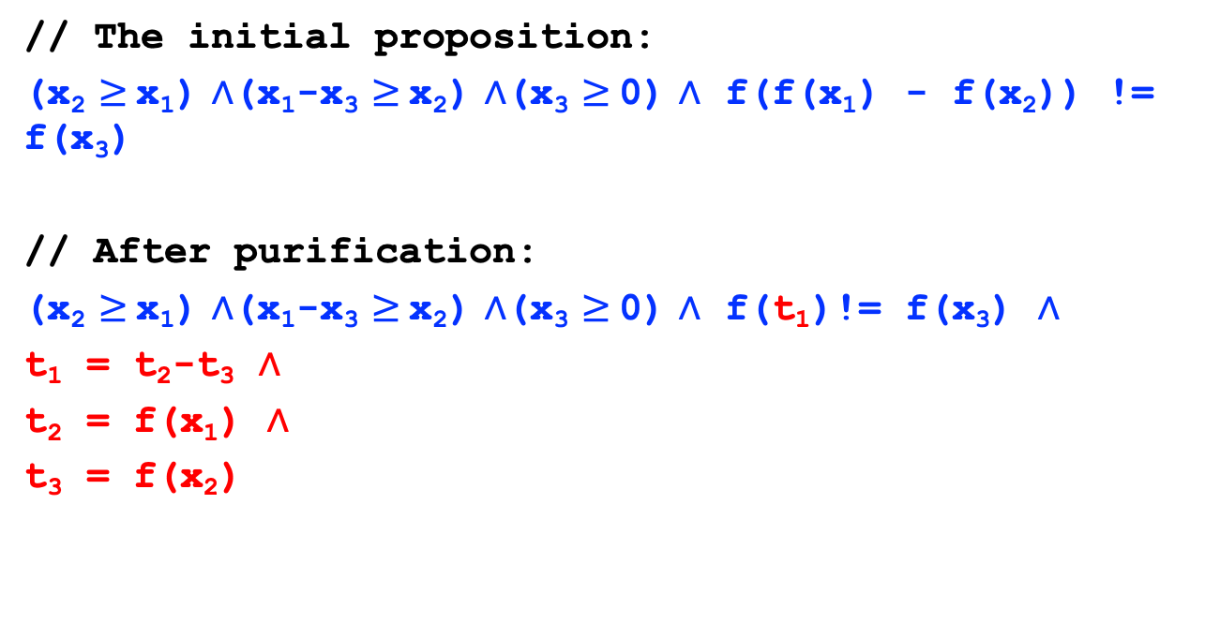
Example 1
// The initial proposition:
(x₂ $≥$x₁) $∧$(x₁-x₃ $≥$x₂) $∧$(x₃ $≥$0) $∧$ f(f(x₁) - f(x₂)) != f(x₃)
// After purification:
(x₂ $≥$x₁) $∧$(x₁-x₃ $≥$x₂) $∧$(x₃ $≥$0) $∧$ f(t₁)!= f(x₃) $∧$
t₁ = t₂-t₃ $∧$
t₂ = f(x₁) $∧$
t₃ = f(x₂)

Slide 15
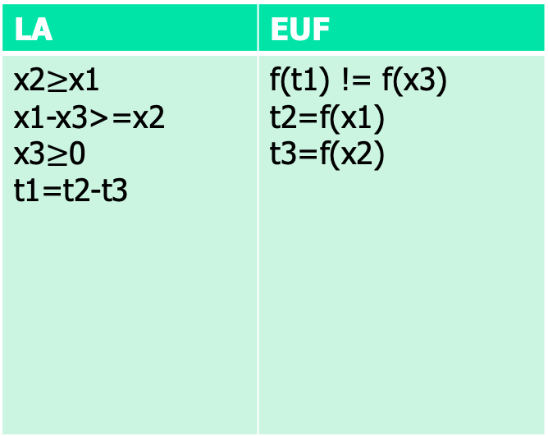
Example 1, cont’
LA | EUF
 | f(t1) != f(x3) t2=f(x1) t3=f(x2)
f(0) != f(0)
x3=0
broadcast
x3=0
x1=x2
x1=x2
t2=t3
t2=t3
t1=0
t1=0
UNSAT

Slide 16
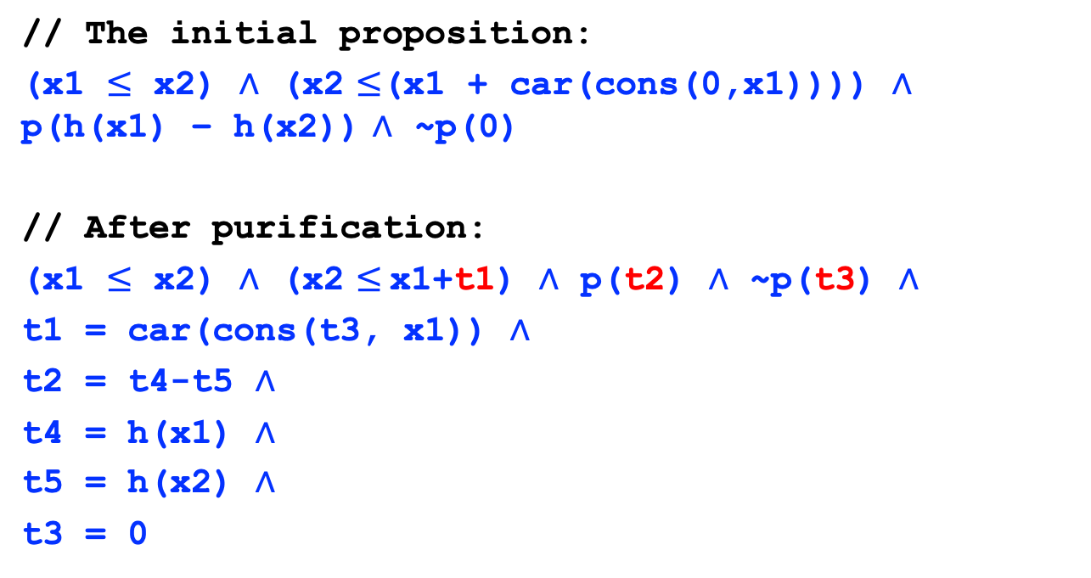
Example 2
// The initial proposition:
(x1 $≤$ x2) $∧$ (x2 $≤$(x1 + car(cons(0,x1)))) $∧$ p(h(x1) – h(x2)) $∧$ ~p(0)
// After purification:
(x1 $≤$ x2) $∧$ (x2 $≤$x1+t1) $∧$ p(t2) $∧$ ~p(t3) $∧$
t1 = car(cons(t3, x1)) $∧$
t2 = t4-t5 $∧$
t4 = h(x1) $∧$
t5 = h(x2) $∧$
t3 = 0

Slide 17
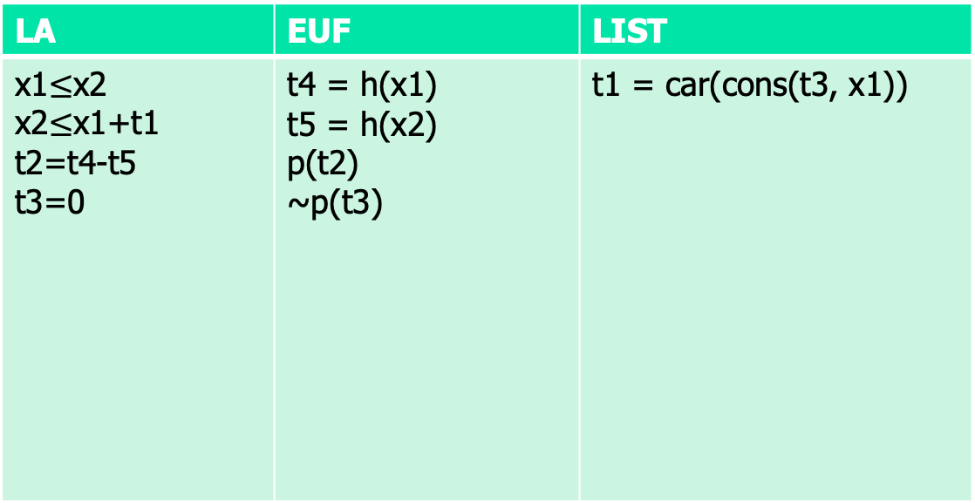
Example 2, cont’
LA | EUF | LIST
 | t4 = h(x1) t5 = h(x2) p(t2) ~p(t3) | t1 = car(cons(t3, x1))
t1=t3
t1=t3
t1=t3
x1=x2
x1=x2
x1=x2
t4=t5
t4=t5
t4=t5
t2=t3
t2=t3
t2=t3
UNSAT

Slide 18
Convexity

Slide 19
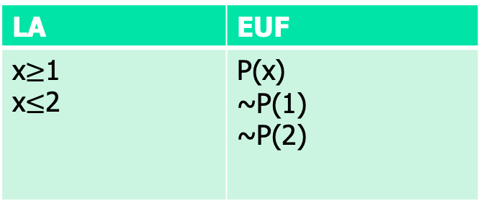
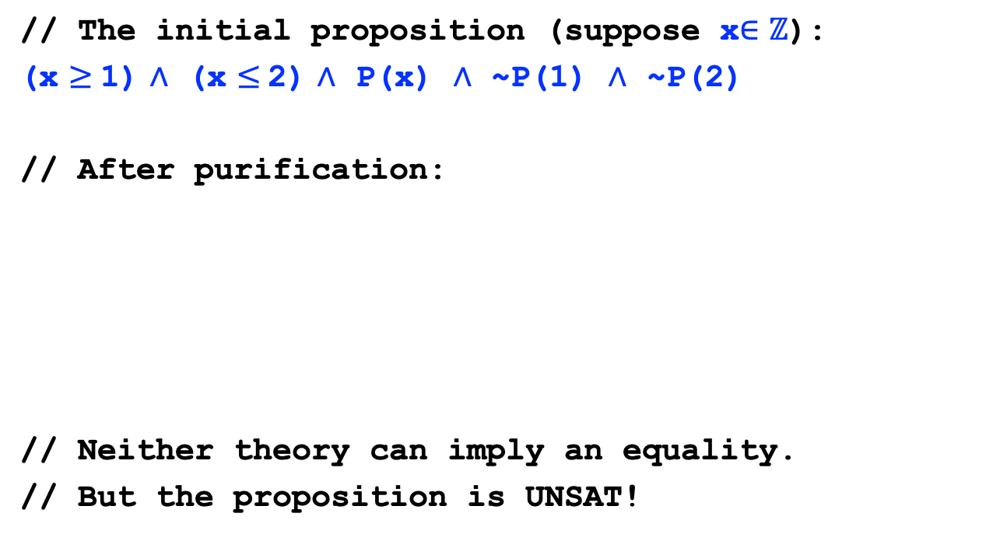
Not always so simple…
// The initial proposition (suppose x$∈ℤ$):
(x $≥$1) $∧$ (x $≤$2) $∧$ P(x) $∧$ ~P(1) $∧$ ~P(2)
// After purification:
// Neither theory can imply an equality.
// But the proposition is UNSAT!
LA | EUF
 | P(x) ~P(1) ~P(2)

Slide 20
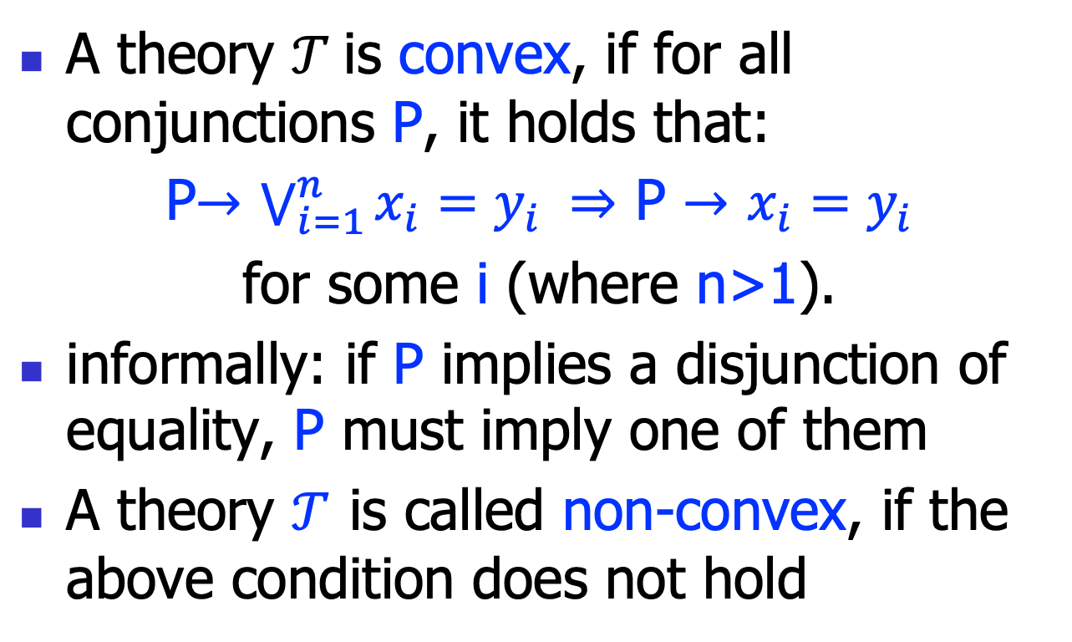
Theory Convexity
A theory $𝒯$is convex, if for all conjunctions P, it holds that:
P$→$ $\bigvee_{i=1}^{n}{x_{i}=y_{i}} ⇒$ P $→$ $x_{i}=y_{i}$
for some i (where n>1).
informally: if P implies a disjunction of equality, P must imply one of them
A theory $𝒯$ is called non-convex, if the above condition does not hold

Slide 21
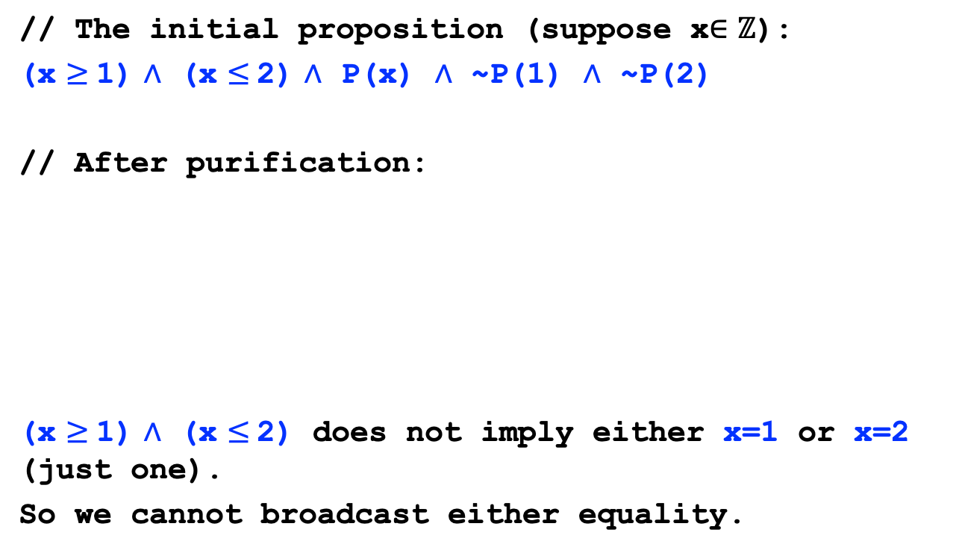
Non-convex theory example
// The initial proposition (suppose x$∈ℤ$):
(x $≥$1) $∧$ (x $≤$2) $∧$ P(x) $∧$ ~P(1) $∧$ ~P(2)
// After purification:
(x $≥$1) $∧$ (x $≤$2) does not imply either x=1 or x=2 (just one).
So we cannot broadcast either equality.
LA | EUF
 | P(x) ~P(1) ~P(2)

Slide 22

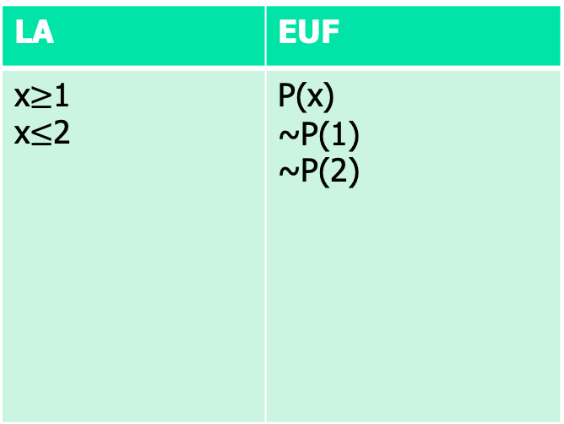

Non-convexity introduces splitting
// The initial proposition (suppose x$∈ℤ$):
(x $≥$1) $∧$ (x $≤$2) $∧$ P(x) $∧$ ~P(1) $∧$ ~P(2)
// After purification:
LA | EUF
 | P(x) ~P(1) ~P(2)
State split!
x=1 $∨$ x=2
x=1
x=2
UNSAT
UNSAT

Slide 23
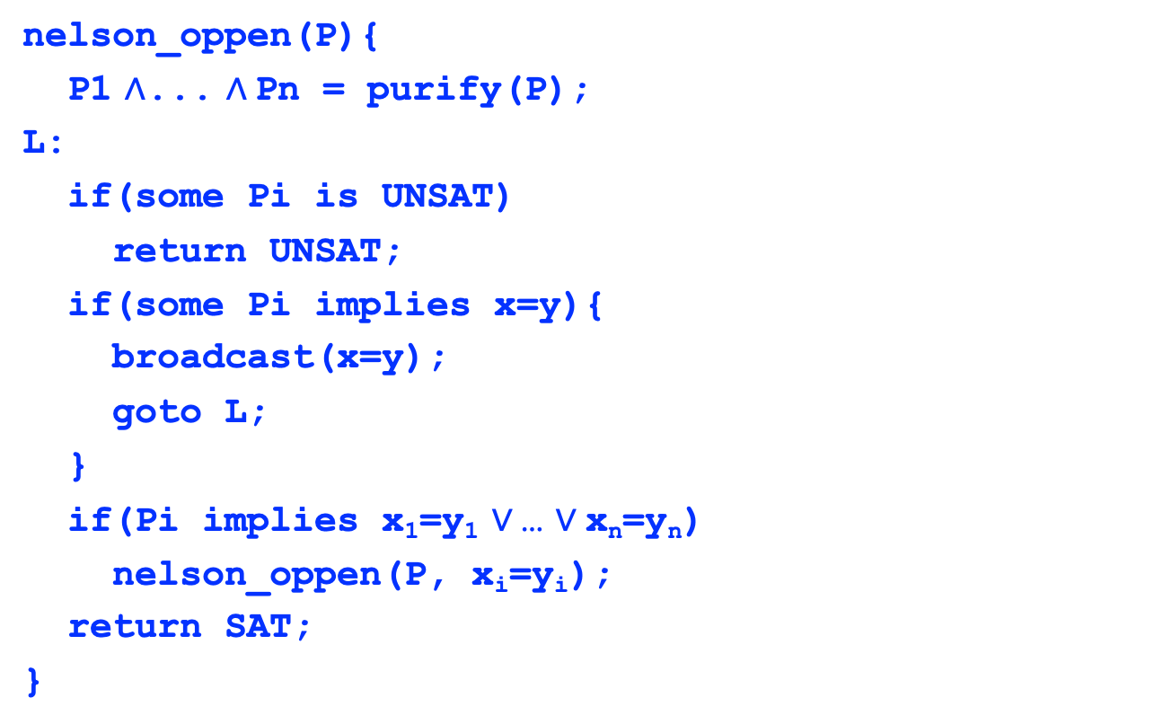
Nelson-Oppen algorithm
nelson_oppen(P){
P1 $∧$... $∧$Pn = purify(P);
L:
if(some Pi is UNSAT)
return UNSAT;
if(some Pi implies x=y){
broadcast(x=y);
goto L;
}
if(Pi implies x₁=y₁ $∨$… $∨$x_{n}=y_{n})
nelson_oppen(P, x_{i}=y_{i});
return SAT;
}

Slide 24
Soundness and completeness
Soundness: if the Nelson-Oppen decision procedure return SAT, the proposition is satisfiable
easy to prove
Completeness:
if the NO procedure returns UNSAT, the proposition is unsatisfiable
hard to prove, how do we know the propagation is enough (read the assigned)

Slide 25
Summary
Nelson-Oppen is a combined decision procedure for combine theories
This method is non-trivial:
Equality (EUF) was first studied by Ackerman, 1924
Arithmetic (LA) studied by Fourier, 1826
But EUF+LA only in 1979

