Slide 1
Hoare logic
Formal Methods Foundation
Baojian Hua
bjhua@ustc.edu.cn

Slide 2
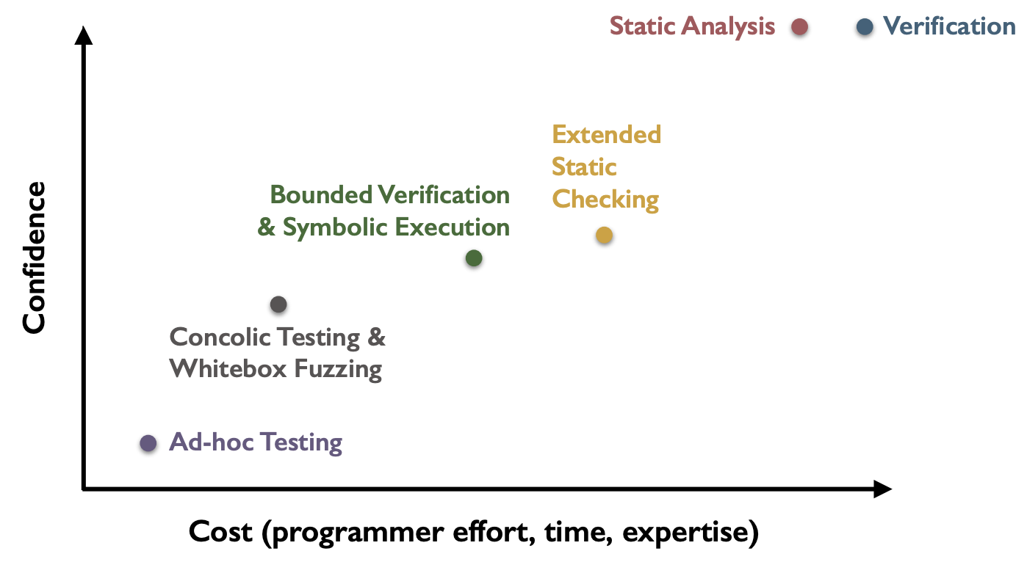
Spectrum of program validation methods
This topic

Slide 3
Overview
We talk about program correctness in this lecture
based on Hoare logic
One of the deepest ideas in CS
Still relevant today
due to the advancement in proof theory and constraint solvers/theorem provers
many practical applications in many fields

Slide 4

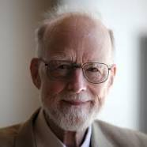
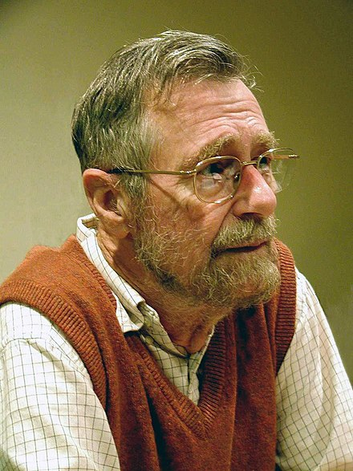
A bit of history
1967: Assigning Meaning to Programs (Floyd)
1978 Turing Award
1969: An Axiomatic Basis for Computer Programming (Hoare)
1980 Turing Award
1975: Guarded Commands, Nondeterminacy and Formal Derivation of Programs (Dijkstra)
1972 Turing Award

Slide 5
Motivation
logical formulae
For the right program, how can we guarantee n==5?
Note that program testing is not effective for this:
we cannot enumerate all possible values for n!
// pre: n<0
// post: n==5
sum(n){
while(n<5)
n = n+1;
return n;
}

Slide 6
Big picture
Logic
Hoare logic connects the logic and program!
Programs
prover/
solver

Slide 7
Recall the IMP language
O ::= + | - | * | / | == | != | > | < | >= | <=
E ::= n | x | E O E
S ::= pass
| x=E
| S;S
| f(E1, …, En)
| if(E, S, S)
| while(E, S)
F ::= f(x1, …, xn){S; return E;}

Slide 8
Hoare logic: Hoare Triple

Slide 9

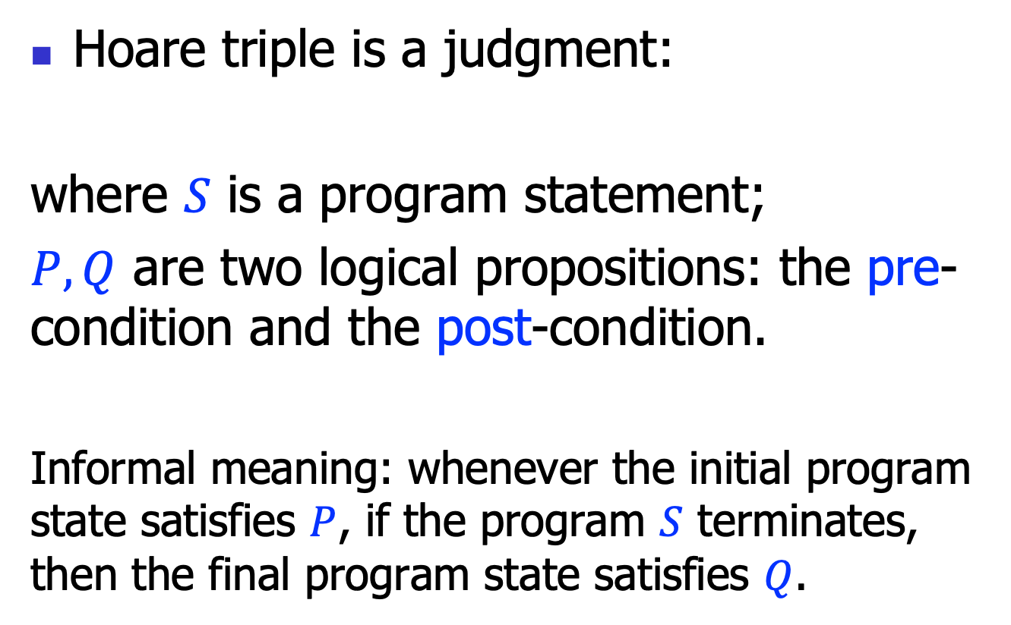
Hoare triple
Hoare triple is a judgment:
where $S$ is a program statement;
$P, Q$ are two logical propositions: the pre-condition and the post-condition.
Informal meaning: whenever the initial program state satisfies $P$, if the program $S$ terminates, then the final program state satisfies $Q$.
$$\left\{P\right\} S \{Q\}$$

Slide 10
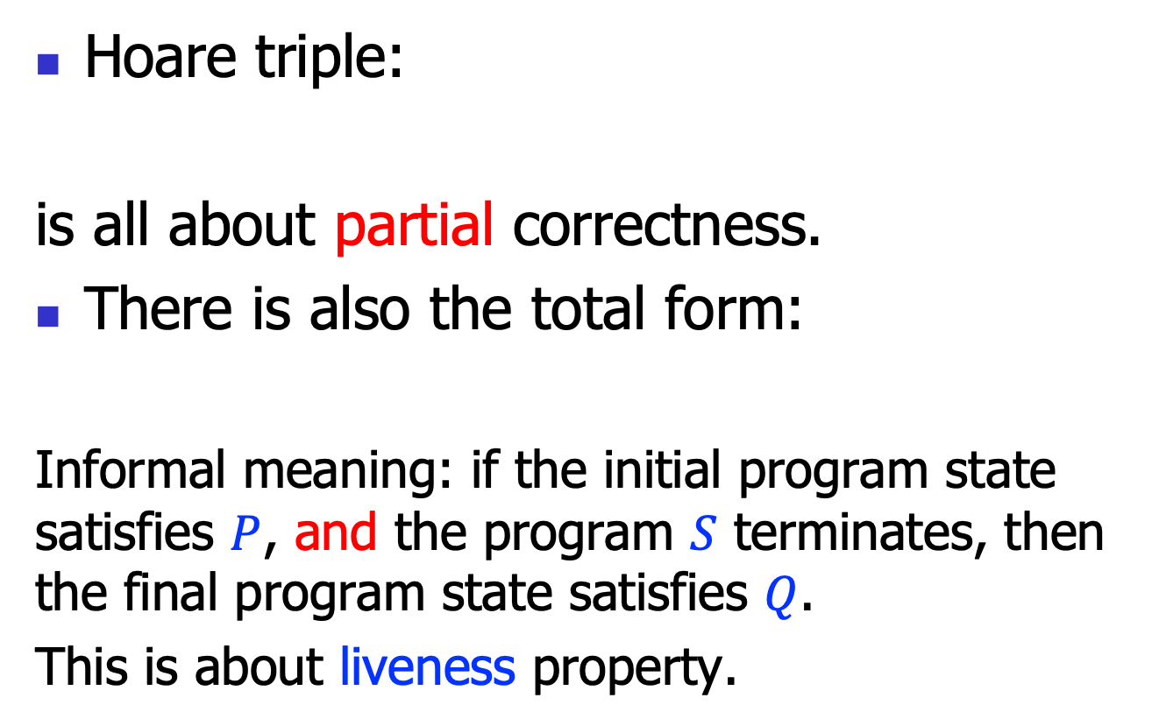

Partial and total correctness
Hoare triple:
is all about partial correctness.
There is also the total form:
Informal meaning: if the initial program state satisfies $P$, and the program $S$ terminates, then the final program state satisfies $Q$.
This is about liveness property.
$$\left\{P\right\} S \{Q\}$$
$$\left[P\right] S [Q]$$

Slide 11
Hoare triple example
{n==0}
n = n+1
{n==1}
FOL propositions, to be specific, the linear arithmetic theory propositions!

Slide 12
Hoare triple example 2
{n<0}
sum(n){
while(n<5)
n = n+1;
return n;
}
{result==5}
FOL propositions, to be specific, the linear arithmetic theory propositions!
Also note that we use “result” (like a reserved key word) to represent the return result of this function.

Slide 13
Hoare triple semantics
For the Hoare triple:
Let’s define the semantics more formally:
what’s the formal language to define the propositions?
When we can say a proposition holds in a given program state?
$$\left\{P\right\} S \{Q\}$$

Slide 14
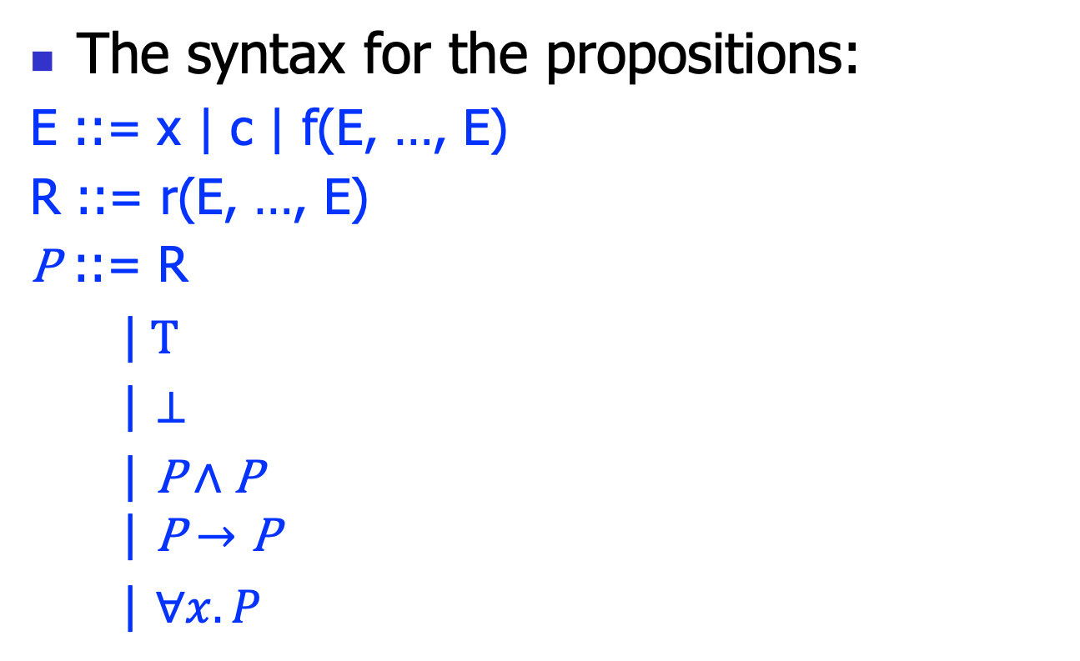
Proposition syntax
The syntax for the propositions:
E ::= x | c | f(E, …, E)
R ::= r(E, …, E)
P ::= R
|$T$
| $⊥$
$\text{|} \text{P}∧\text{P}$
$$\text{|} \text{P}→\text{P}$$
| $∀x.P$

Slide 15
Proposition syntax
Essentially, we use a fragment of the FOL
In practice, other variants exist, say Temporal logic (for protocols), etc..
Also can contain domain specific relations (user extensible)
Say: type(x, T) to indicate x has type T
A tradeoff between simplicity and expressiveness (design art)

Slide 16
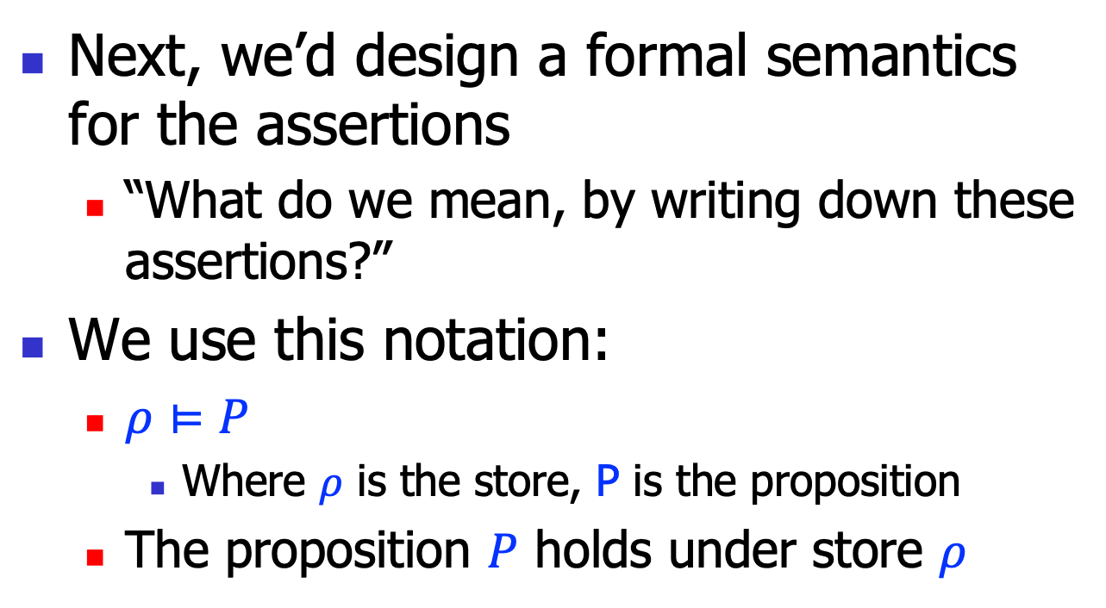
Proposition semantics
Next, we’d design a formal semantics for the assertions
“What do we mean, by writing down these assertions?”
We use this notation:
$ρ⊨P$
Where $ρ$ is the store, P is the proposition
The proposition $P$ holds under store $ρ$

Slide 17
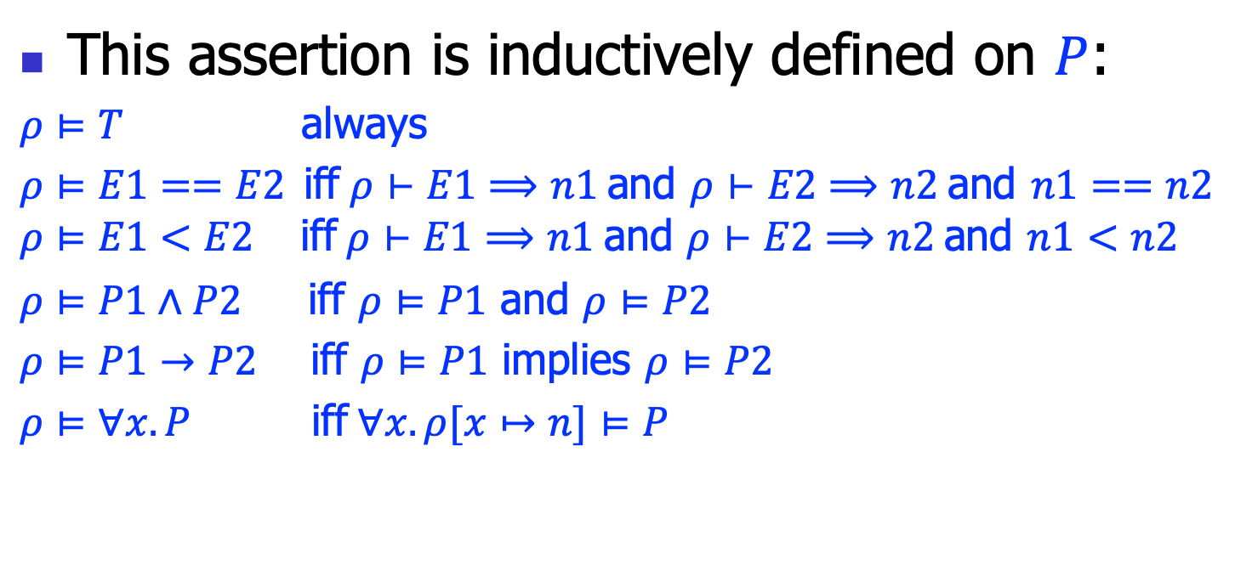
Proposition semantics
This assertion is inductively defined on $P$:
$ρ⊨T$ always
$ρ⊨E1==E2$iff$ρ⊢E1⟹n1$ and $ρ⊢E2⟹n2$ and $n1==n2$
$$ρ⊨E1<E2 \text{iff} ρ⊢E1⟹n1 \text{and} ρ⊢E2⟹n2 \text{and} n1<n2$$
$ρ⊨P1∧P2$ iff $ρ⊨P1$ and $ρ⊨P2$
$ρ⊨P1→P2$ iff $ρ⊨P1$ implies $ρ⊨P2$
$ρ⊨∀x.P$ iff$∀x.ρ[x↦n]⊨P$

Slide 18
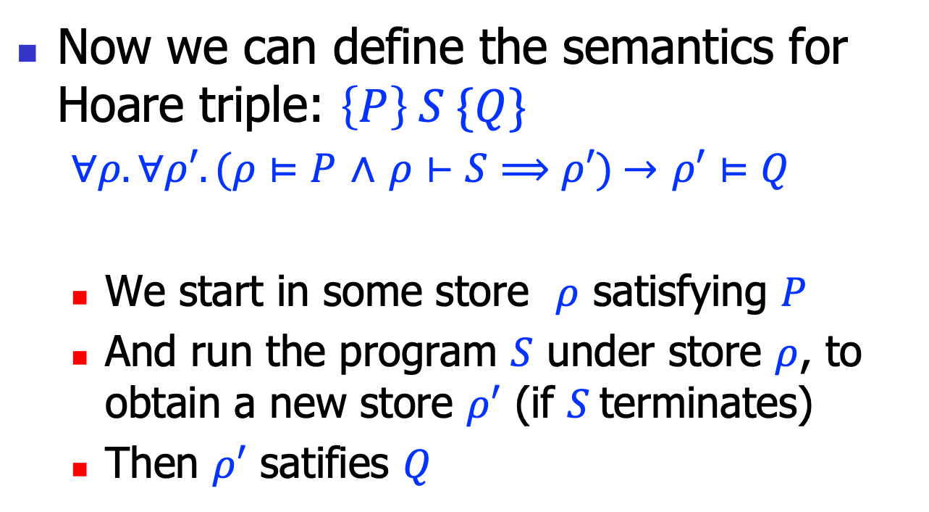
Hoare triple semantics
Now we can define the semantics for Hoare triple: $\left\{P\right\} S \{Q\}$
$∀ρ.∀ρ′.(ρ⊨P$ $∧$ $ρ⊢S⟹ρ′)$ $→$ $ρ′⊨Q$
We start in some store $ρ$ satisfying $P$
And run the program $S$ under store $ρ$, to obtain a new store $ρ′$ (if $S$terminates)
Then $ρ′$ satifies $Q$

Slide 19
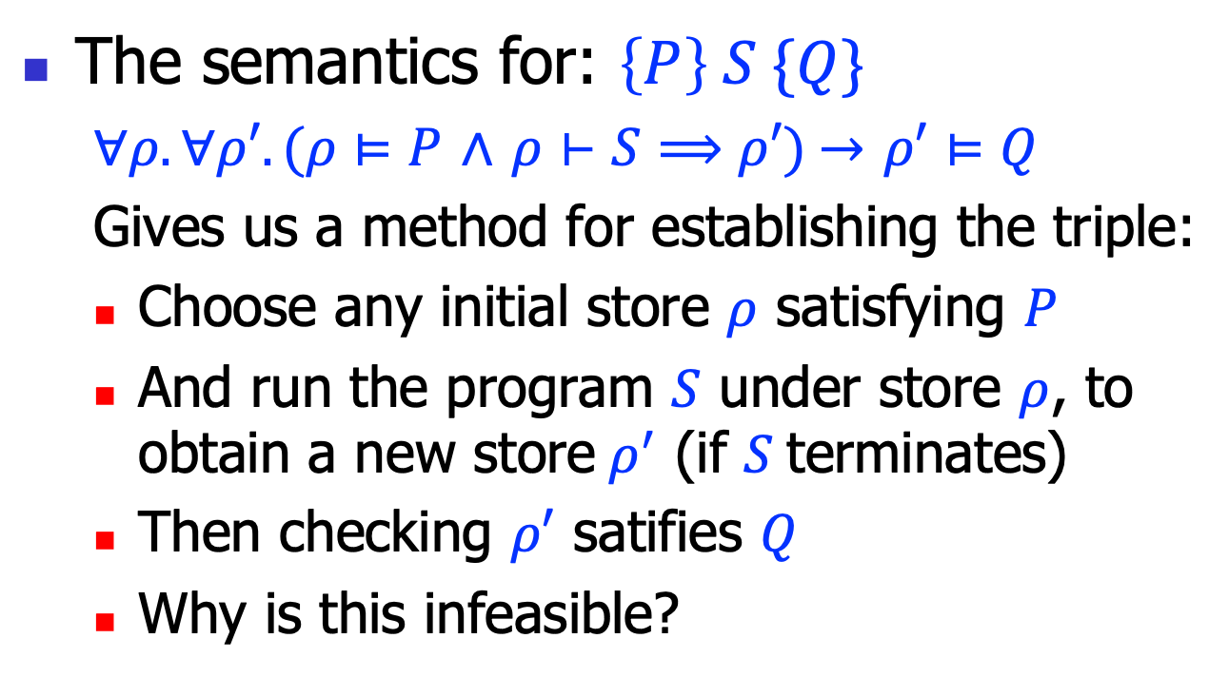
Exhausted testing
The semantics for: $\left\{P\right\} S \{Q\}$
$∀ρ.∀ρ′.(ρ⊨P$ $∧$ $ρ⊢S⟹ρ′)$ $→$ $ρ′⊨Q$
Gives us a method for establishing the triple:
Choose any initial store $ρ$ satisfying $P$
And run the program $S$ under store $ρ$, to obtain a new store$ρ^{′}$ (if $S$terminates)
Then checking $ρ′$ satifies $Q$
Why is this infeasible?

Slide 20
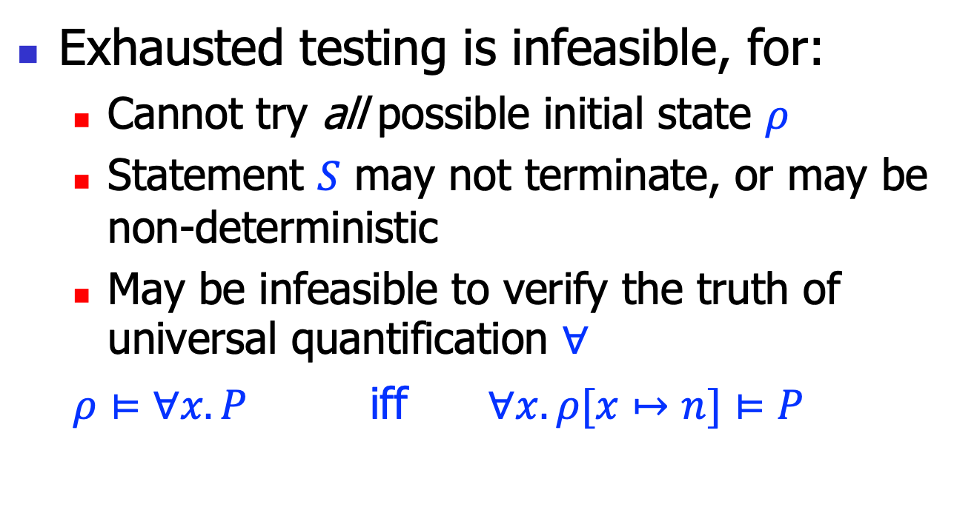
Exhausted testing, cont’
Exhausted testing is infeasible, for:
Cannot try all possible initial state $ρ$
Statement $S$ may not terminate, or may be non-deterministic
May be infeasible to verify the truth of universal quantification $∀$
$ρ⊨∀x.P$ iff $∀x.ρ[x↦n]⊨P$

Slide 21
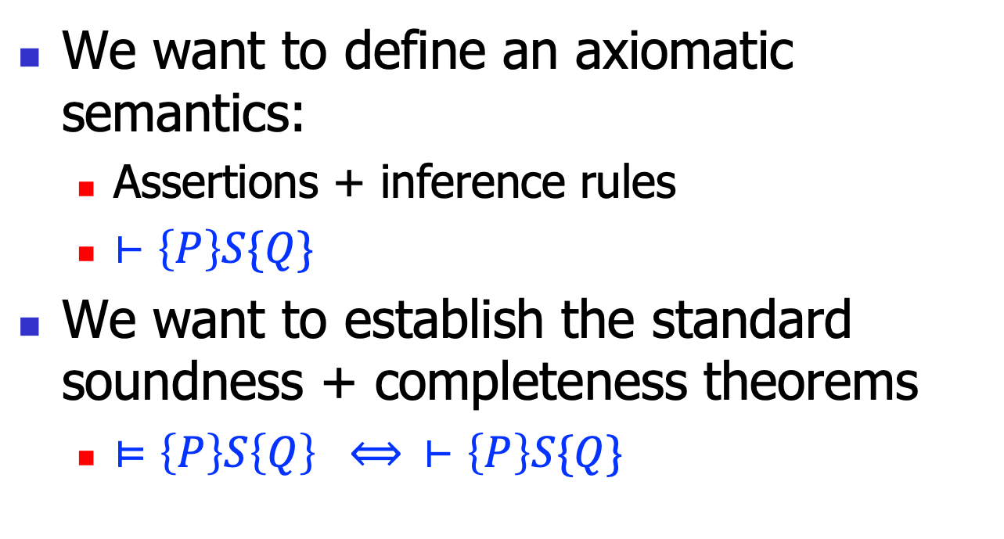
Axiomatic semantics
We want to define an axiomatic semantics:
Assertions + inference rules
$⊢\left\{P\right\}S\{Q\}$
We want to establish the standard soundness + completeness theorems
$⊨\left\{P\right\}S\left\{Q\right\} ⟺ ⊢\left\{P\right\}S\{Q\}$

Slide 22
Hoare logic: inference rules

Slide 23
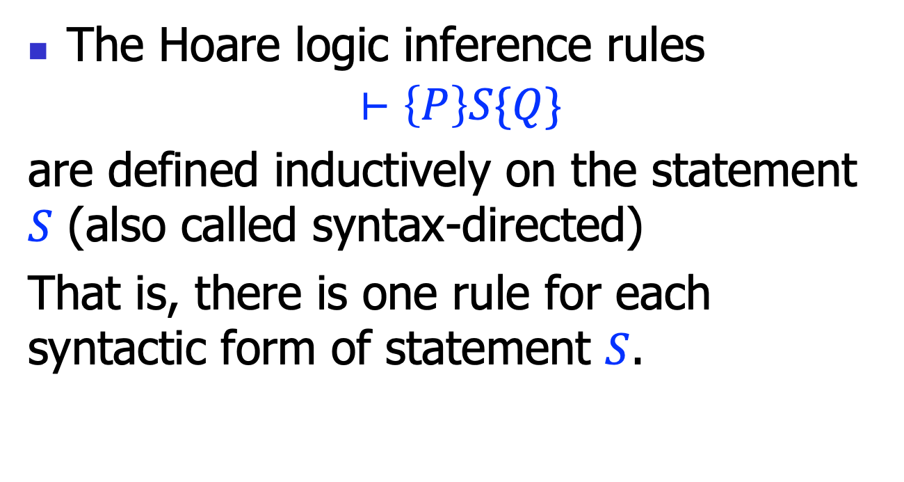
Inference rules
The Hoare logic inference rules
$$⊢\left\{P\right\}S\{Q\}$$
are defined inductively on the statement $S$ (also called syntax-directed)
That is, there is one rule for each syntactic form of statement $S$.

Slide 24


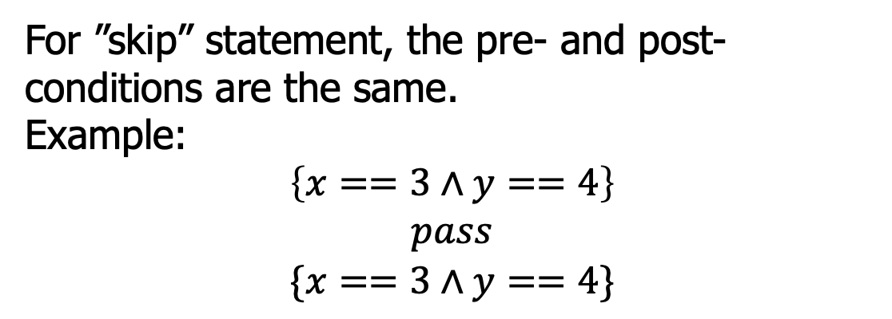
Hoare logic rules: empty
$$(H−Skip)$$
$$\left\{P\right\}pass\{P\}$$
For ”skip” statement, the pre- and post-conditions are the same.
Example:
$$\left\{x==3∧y==4\right\}$$
$$pass$$
$$\{x==3∧y==4\}$$

Slide 25


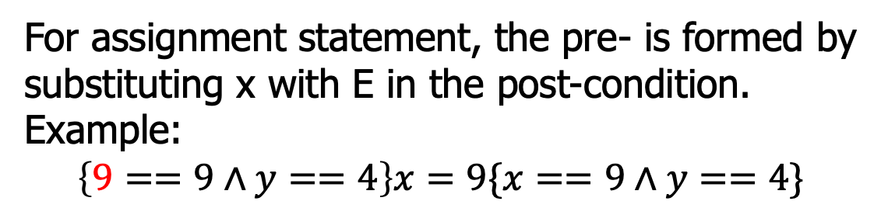
Hoare logic rules: assignment
$$(H−Assign)$$
$$\left\{P[x↦E]\right\}x=E\{P\}$$
For assignment statement, the pre- is formed by substituting x with E in the post-condition.
Example:
$$\left\{9==9∧y==4\right\}x=9\{x==9∧y==4\}$$
$$\left\{y+z>k\right\}x=y+z\{x>k\}$$
$$\left\{x+1>k\right\}x=x+1\{x>k\}$$

Slide 26


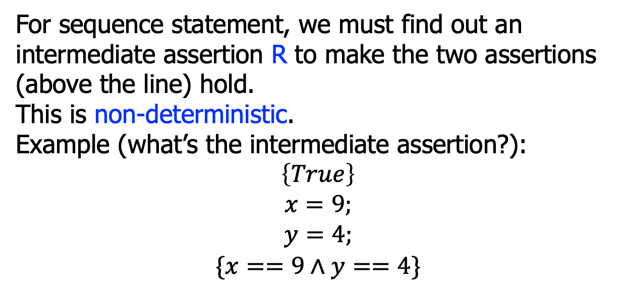


Hoare logic rules: sequence
$$\left\{P\right\}S1\{R\}$$
$$\left\{R\right\}S2\{Q\}$$
$$(H−Seq)$$
$$\left\{P\right\} S1;S2 \{Q\}$$
For sequence statement, we must find out an intermediate assertion R to make the two assertions (above the line) hold.
This is non-deterministic.
Example (what’s the intermediate assertion?):
$$\left\{True\right\}$$
$$x=9;$$
$$y=4;$$
$$\{x==9∧y==4\}$$

Slide 27


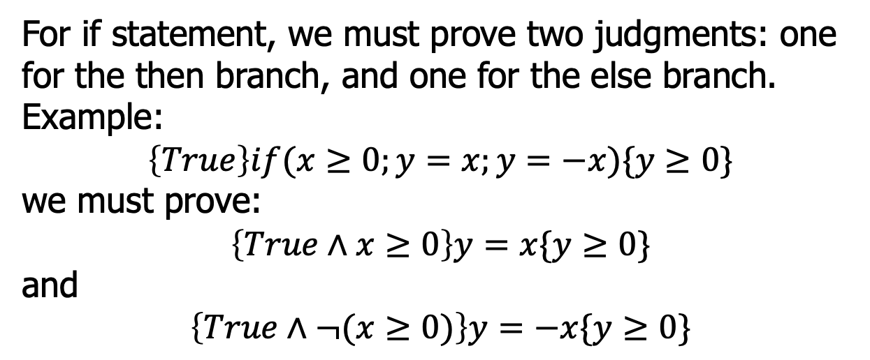


Hoare logic rules: if
$$\left\{P∧E\right\}S1\{Q\}$$
$$\left\{P∧¬E\right\}S2\{Q\}$$
$$(H−If)$$
$$\left\{P\right\}if\left(E;S1;S2\right)\{Q\}$$
For if statement, we must prove two judgments: one for the then branch, and one for the else branch.
Example:
$$\left\{True\right\}if(x≥0;y=x;y=−x)\{y≥0\}$$
we must prove:
$$\left\{True∧x≥0\right\}y=x\{y≥0\}$$
and
$$\left\{True∧¬(x≥0)\right\}y=−x\{y≥0\}$$

Slide 28


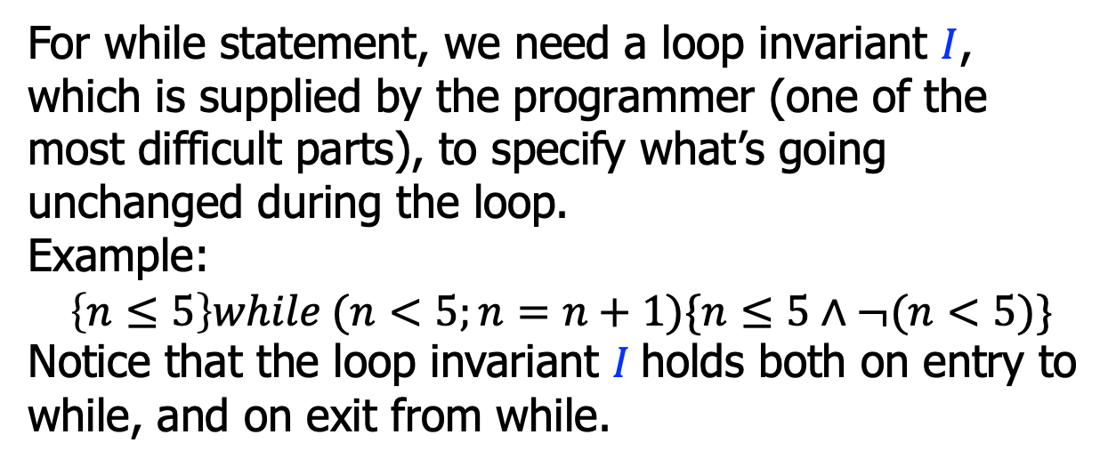

Hoare logic rules: while
$$\left\{I∧E\right\}S\{I\}$$
$$(H−While)$$
$$\left\{I\right\}while(E;S)\{I∧¬E\}$$
For while statement, we need a loop invariant $I$, which is supplied by the programmer (one of the most difficult parts), to specify what’s going unchanged during the loop.
Example:
$$\left\{n≤5\right\}while (n<5;n=n+1)\{n≤5∧¬(n<5)\}$$
Notice that the loop invariant $I$holds both on entry to while, and on exit from while.

Slide 29
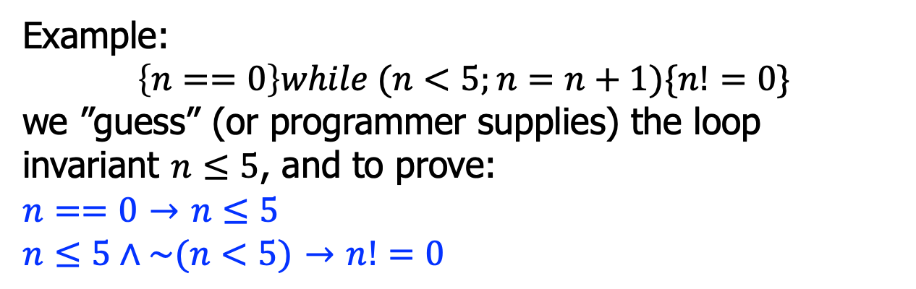

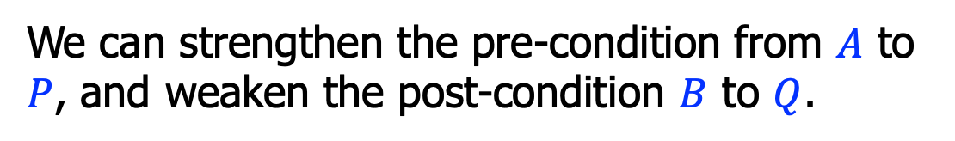




Hoare logic rules: consequence
$$P→A$$
$$\left\{A\right\}S\{B\}$$
$$B→Q$$
$$(H−Conseq)$$
$$\left\{P\right\}S\{Q\}$$
We can strengthen the pre-condition from $A$ to $P$, and weaken the post-condition $B$ to $Q$.
Example:
$$\left\{n==0\right\}while (n<5;n=n+1)\{n!=0\}$$
we ”guess” (or programmer supplies) the loop invariant $n≤5$, and to prove:
$n==0$ $→$ $n≤5$
$n≤5∧\sim (n<5)$ $→$ $n!=0$

Slide 30

Hoare logic rules: example
To prove this judgment:
using the assignment rule:
$$\left\{True\right\}x=5\{x==5\}$$
$$(H−Assign)$$
$$\left\{P[x↦E]\right\}x=E\{P\}$$
$$\left\{\left(x==5\right)[x↦5]\right\}x=5\{x==5\}$$
$$\left\{\left(5==5\right)\right\}x=5\{x==5\}$$
Using the consequence rule:
$$True→5==5$$

Slide 31



Or, the proof tree
To prove:
$$\left\{True\right\}x=5\{x==5\}$$
$$(H−Assign)$$
$$True→(5==5)$$
$$\left\{\left(x==5\right)[x↦5]\right\}x=5\{x==5\}$$
$$(H−Conseq)$$
$$\left\{True\right\}x=5\{x==5\}$$

Slide 32






Hoare logic rules: example
To prove this judgment:
the proof tree:
$$\left\{True\right\}if(y≤0;x=1;x=y)\{x>0\}$$
$$True∧y≤0→1>0$$
$$\left\{1>0\right\}x=1\{x>0\}$$
$$…$$
$$\left\{True∧y≤0\right\}x=1\{x>0\}$$
$$\left\{True∧¬(y≤0)\right\}x=y\{x>0\}$$
$$(H−If)$$
$$\left\{True\right\}if(y≤0;x=1;x=y)\{x>0\}$$

Slide 33





Hoare logic rules: example
To prove this judgment:
the proof tree:
$$\left\{x<0\right\}while\left(x<5;x=x+1\right)\{x==5\}$$
$$(x≤5∧x<5)→((x+1)≤5)$$
$$\left\{(x+1)≤5\right\}x=x+1\{x≤5\}$$
$$\left\{x≤5∧x<5\right\}x=x+1\{x≤5\}$$
$$x<0→x≤5$$
$$\left\{x≤5\right\}while(x<5;x=x+1)\{x≤5∧¬(x<5)\}$$
$$…$$
$$\left\{x<0\right\}while(x<5;x=x+1)\{x==5\}$$

Slide 34

Hoare logic rules: example
To prove this judgment:
the proof tree for “while”:
{n>=0}
s = 0;
i = 0;
while(i<=n){
s=s+i;
i=i+1;
}
{2*s==n*(n+1)}
$$i≤\left(n+1\right)∧s=Sum\left(i−1\right)∧i≤n → \text{(}i+1)≤\left(n+1\right)∧s+i=Sum\left(i\right)$$
$$\text{(}i+1)≤\left(n+1\right)∧s+i=Sum\left(i\right)$$
($i+1)≤\left(n+1\right)∧s=Sum\left(i+1−1\right)$
$$\left\{i≤\left(n+1\right)∧s=Sum\left(i−1\right)∧i≤n\right\}s=s+i;i=i+1\{i≤\left(n+1\right)∧s=Sum\left(i−1\right)\}$$
$$\left\{i≤\left(n+1\right)∧s=Sum\left(i−1\right)\right\}while(…)\{i≤\left(n+1\right)∧s=Sum(i−1)∧¬(i≤n)\}$$

Slide 35
Summary
We discussed Hoare logic
An axiomatic system to specify program semantics
FOL, judgments and inference rules
To prove program properties formally, requires considerable proof engineering efforts
But we can establish some automatic techniques, to be discussed next

