Slide 1
Program synthesis
Formal Methods Foundation
Baojian Hua
bjhua@ustc.edu.cn

Slide 2
Overview
Program synthesis is all about computer programming computer!
Or automated programming
The task is to find out a program which satisfies some properties (specifications)
This is the holy grail of CS since 1950’s

Slide 3
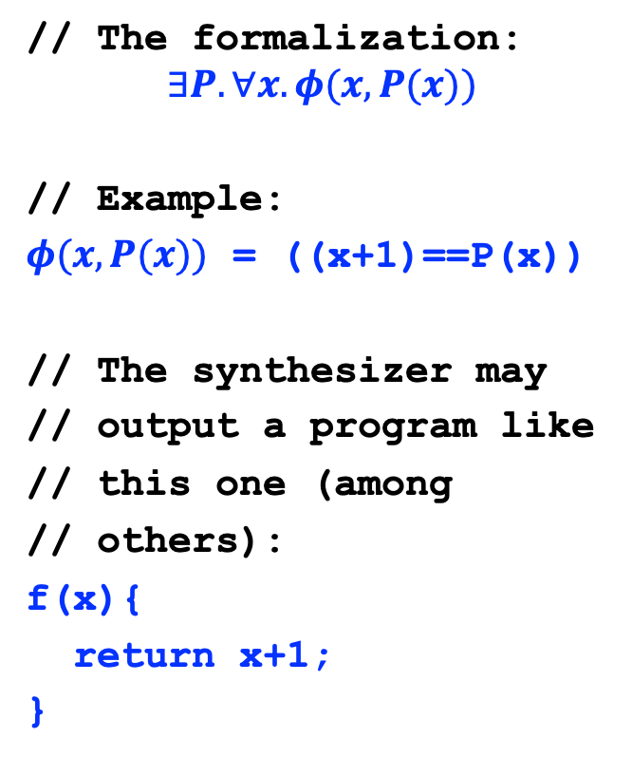
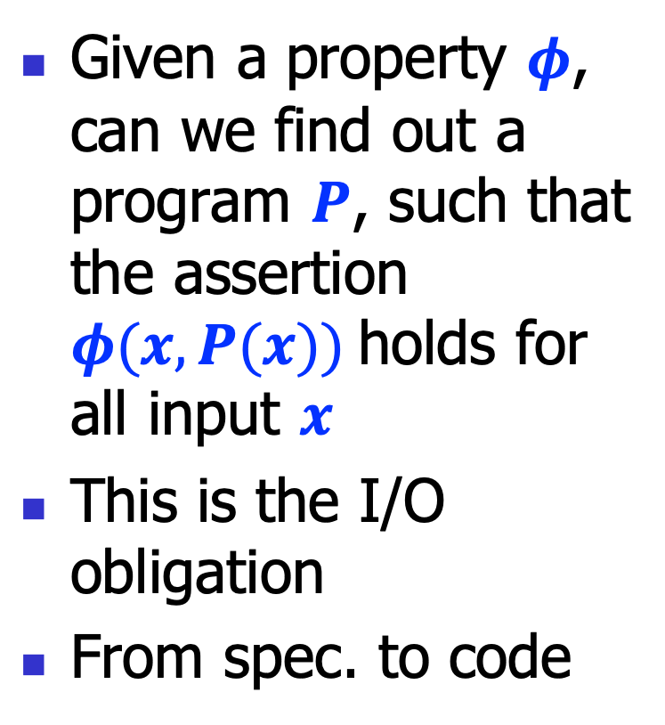
Motivation
Given a property $φ$, can we find out a program $P$, such that the assertion $φ(x, P(x))$holds for all input $x$
This is the I/O obligation
From spec. to code
// The formalization:
$$∃P.∀x.φ(x, P(x))$$
// Example:
$φ(x, P(x))$ = ((x+1)==P(x))
// The synthesizer may
// output a program like
// this one (among
// others):
f(x){
return x+1;
}

Slide 4
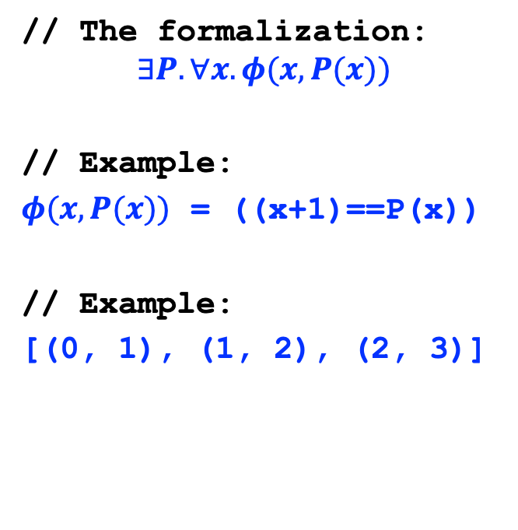
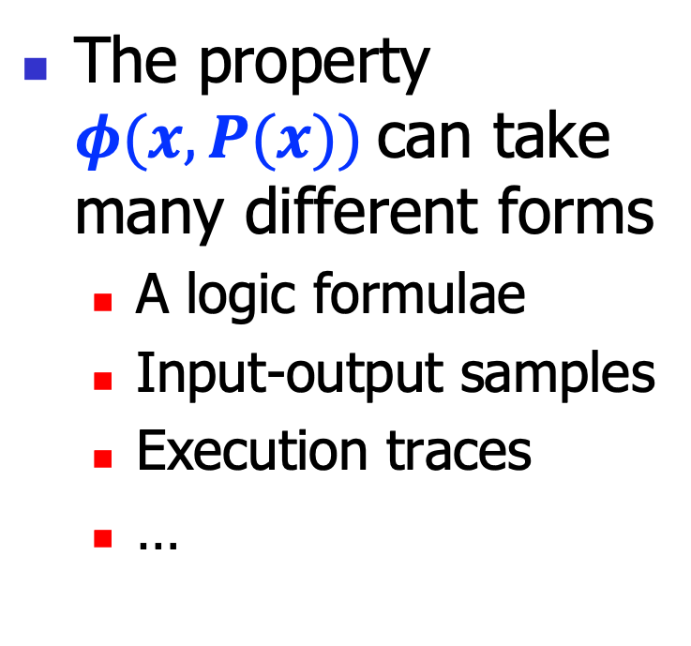
Properties
The property $φ(x, P(x))$can take many different forms
A logic formulae
Input-output samples
Execution traces
…
// The formalization:
$$∃P.∀x.φ(x, P(x))$$
// Example:
$φ(x, P(x))$ = ((x+1)==P(x))
// Example:
[(0, 1), (1, 2), (2, 3)]

Slide 5
Inductive Syntax-directed Synthesis

Slide 6
Inductive syntax-directed synthesis: architecture
Input properties
Synthesizer
Output program
Syntax
Input properties: the desired properties a program should meet
Syntax: a syntax skeleton the program (also called a sketch)
Output program: the synthesized programs

Slide 7
Property generation
Input properties
Synthesizer
Output program
(0, 0)->0, (1, 0)->1, (0, 1)->1
Syntax
// Target program:
def f(x, y):
res = ??
return res
The symbol ?? is a hole in the program, the task of the synthesizer is to fill in this hole, by synthesizing a program fragment.
We present the input properties, by giving some I/O samples.

Slide 8
Sketch
Input properties
Synthesizer
Output program
(0, 0)->0, (1, 0)->1, (0, 1)->1
H ::= V O V
V ::= x | y
O ::= + | -
Syntax
The insight here is to allow only binary operations “+” or “-”, on atomic variables “x” and “y”.
// Target program:
f(x, y){
res = ??
return res
}
H
Nevertheless to say, without any restrictions, the search space to fill in the hole is infinite, say:
x+y, x|y, max(x, y), …
We need the syntax sketch, to limit the search space!

Slide 9
Sketch encoding
Input properties
Synthesizer
Output program
(0, 0)->0, (1, 0)->1, (0, 1)->1
H ::= V O V
V ::= x | y
O ::= + | -
Syntax
How to encode the “hole” within a solver?
// Target program:
def f(x, y):
res = ??
return res
+/-
x/y
H
def hole_op(h, l, r):
If(h==0, l+r, l-r)
def hole_var(h, x, y):
If(h==0, x, y)

Slide 10
Sketch encoding
Input properties
Synthesizer
Output program
(0, 0)->0, (1, 0)->1, (0, 1)->1
H ::= V O V
V ::= x | y
O ::= + | -
Syntax
h0 = Int(‘h0’)
h1 = Int(‘h1’)
h2 = Int(‘h2’)
def hole(x, y):
hole_op(h0,
hole_var(h1, x, y),
hole_var(h2, x, y))
+/-
// Target program:
def f(x, y):
res = ??
return res
x/y
x/y
H

Slide 11
Adding constraints
Input properties
Synthesizer
Output program
(0, 0)->0, (1, 0)->1, (0, 1)->1
H ::= V O V
V ::= x | y
O ::= + | -
Syntax
h0 = Int(‘h0’)
h1 = Int(‘h1’)
h2 = Int(‘h2’)
def hole(x, y):
hole_op(h0,
hole_var(h1, x, y),
hole_var(h2, x, y))
+/-
// Target program:
def f(x, y):
res = ??
return res
x/y
x/y
H
hole(0,0)==0
hole(1,0)==1
hole(0,1)==1

Slide 12
The model
Input properties
Synthesizer
Output program
(0, 0)->0, (1, 0)->1, (0, 1)->1
H ::= V O V
V ::= x | y
O ::= + | -
Syntax
h0 = Int(‘h0’)
h1 = Int(‘h1’)
h2 = Int(‘h2’)
def hole(x, y):
hole_op(h0,
hole_var(h1, x, y),
hole_var(h2, x, y))
+/-
// Target program:
def f(x, y):
res = ??
return res
}
x/y
x/y
H
hole(0,0)==0
hole(1,0)==1
hole(0,1)==1
h0 = 0
h1 = 0
h1 = 1

Slide 13
Generate programs
Input properties
Synthesizer
Output program
(0, 0)->0, (1, 0)->1, (0, 1)->1
x + y
H ::= V O V
V ::= x | y
O ::= + | -
Syntax
h0 = Int(‘h0’)
h1 = Int(‘h1’)
h2 = Int(‘h2’)
def hole(x, y):
hole_op(h0,
hole_var(h1, x, y),
hole_var(h2, x, y))
+/-
// Target program:
def f(x, y):
res =
return res
x/y
x/y
hole
hole(0,0)==0
hole(1,0)==1
hole(0,1)==1
x + y
h0 = 0
h1 = 0
h1 = 1

Slide 14
To enumerate all programs
Two key observations:
#1: The synthesized program may not be correct
after all, we are synthesizing from the partial known facts
later, we’ll see how to verify this
#2: we can enumerate all possible programs
negate the solution (we’ve seen several times)

Slide 15
To enumerate all programs
// Suppose the first solution gives us:
[h0=0, h1=0, h2=1]
// +, x, y
// By negating this, we have:
solver.append(Not(And(h0==0, h1==0, h2==1))
// Asking the solver:
solver.check()
m = solver.model()
// we get:
[h0=0, h1=1, h2=0]
// +, y, x
// we can get other solutions in a similar manner

Slide 16
Scaling the synthesizer
Input properties
Synthesizer
Output program
(0, 0)->0, (1, 0)->1, (0, 1)->1
(1, 1)->1
H ::= V O V
V ::= x | y
O ::= + | -
| & | |
Syntax
We have one more I/O sample: (1, 1)->1
If we apply the above procedure, we’ll get “UNSAT”.
This is not surprising, as we can verify that no combinations can obtain the result.
Let’s scale the sketch a little bit.
// Target program:
def f(x, y):
res =
return res
H

Slide 17
Scaling the synthesizer
Input properties
Synthesizer
Output program
(0, 0)->0, (1, 0)->1, (0, 1)->1
(1, 1)->1
x | y
H ::= V O V
V ::= x | y
O ::= + | -
| & | |
Syntax
def hole_op(h, l, r):
If(h==0,
l+r,
If(h==1,
l-r,
If(h==2,
l&r,
l|r)))
// Target program:
def f(x, y):
res =
return res
hole
x | y

Slide 18
Summary
We discussed program synthesis
to produce a program, from some sort of specification
The inductive syntax-directed approach
programmers specify the specification, along with some syntax sketch
the solver solves the constraints

