Slide 1
SE Supervisor Meeting
SEvivor

Slide 2
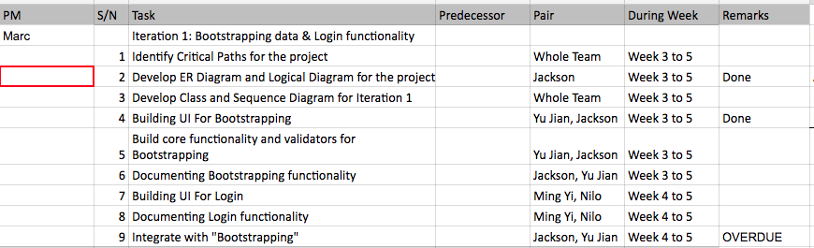
Progress for the past two weeks
Documentation, diagrams, drawing
Bootstrap of data
Login – Half implementation

Slide 3
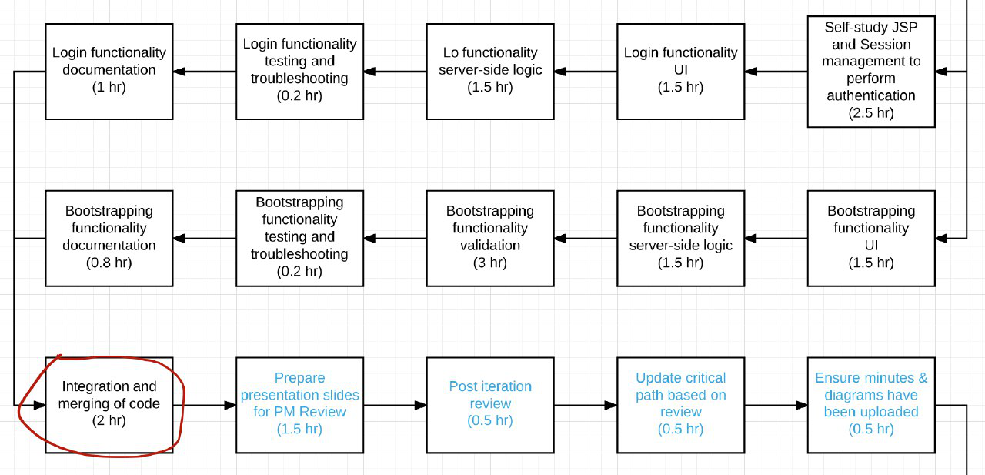
Any deviation from the planned schedule?
We don’t know need to upload non-programming tasks on pplog previously.
We hardcoded Login UI – Haven integrate it fully with bootstrap. So we are 4.83hours (based on our calculation from the metrics on Pplog + critical path) behind.
Notes:
3.25 3.43
Difference =
3.00
3.25
Difference =
4.00
6.00
Difference =
2.00
2.25
Difference =

Slide 4
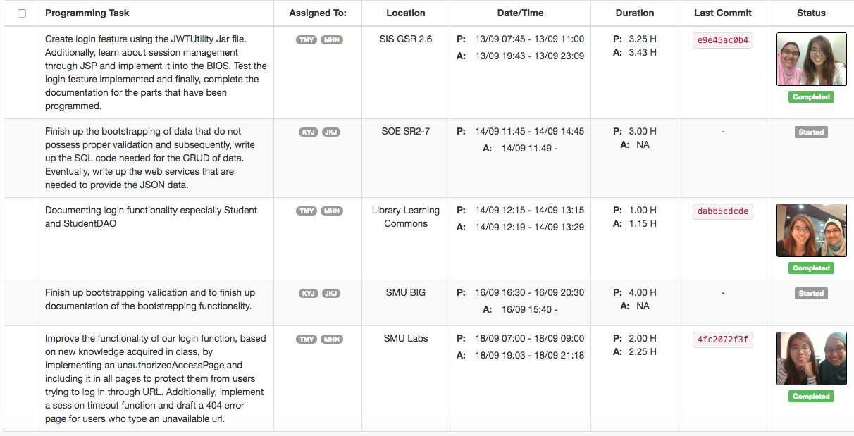

Slide 5
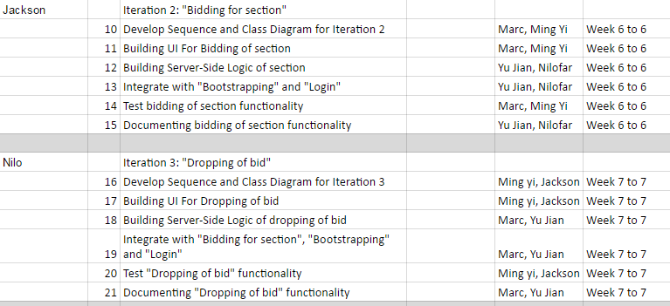
Goal(s) for the coming two weeks and immediate milestone PMs

Slide 6
Any problems (existing or potential) that threaten the successful, on-time completion of your project.
Existing Threat
Yujian hold classes to teach other groups (once off, now would not) focus on group learning first before helping other groups.
Public holiday on Monday which is our common timeslot. Check the public holiday from now on and reschedule.
Potential Threat
Recess week - overseas trips?
Reschedule other common time slot since it is recess week, not necessarily need to meet on Monday

Slide 7
What we have learnt?
We underestimated the learning curve
Learning new tool got unforeseeable problem
Understand the complexity of backlog tracking

Slide 8
Questions?
If we have overdue tasks - does the same pair needs to complete it? Or it is possible to pass to other team members?
Can the pplog and the GIT differs? What if we encounter unforeseeable situation?
Example my git experiencing error, I re-install . What should I do?
Computer Hang
Iteration confusion? 1 and 2 – Confused by interface
Does the category field in the pplog needs to be planned out and standardized?
Could you advise us on area of improvement based on our current progress?

