Slide 1

Supervisor Meeting (Week 11)
G7T5
Jackson Kwa
Kong Yu Jian
Marc Xu
M Has Nilofar
Teh Ming Yi

Slide 2
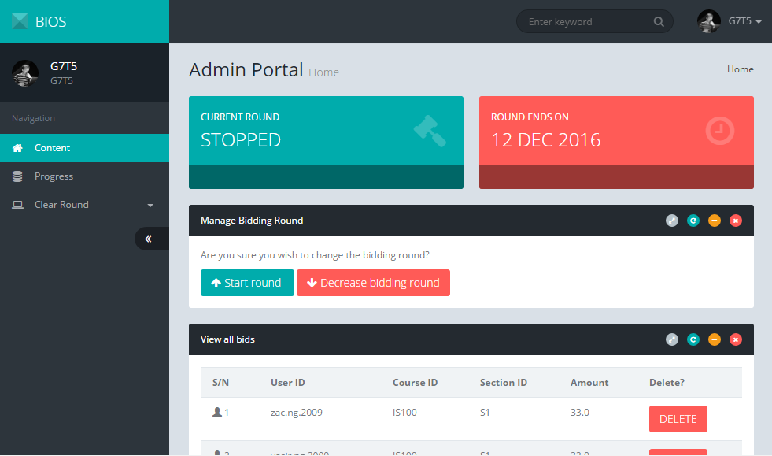
Content:
Progress
Deviations
Goals
Problems
Roles
Metrics
Demo
Supervisor Meeting (Week 11)
G7T5
Jackson Kwa
Kong Yu Jian
Marc Xu
M Has Nilofar
Teh Ming Yi
Content

Slide 3
Progress for the past 2 weeks:
In-Class Demo
Clearing Round 1 & 2 (Iteration 5)
Functionalities:
Drop Section, Timetable
Web services:
Authenticate, Bootstrap, Delete Bid, Dump Table, Start Round, Stop Round, Update Bid, Drop Section, Dump User, Dump Bid, Dump Section
Supervisor Meeting (Week 11)
G7T5
Jackson Kwa
Kong Yu Jian
Marc Xu
M Has Nilofar
Teh Ming Yi
Content
Progress
Deviations
Goals
Problems
Roles
Metrics
Demo

Slide 4
Progress for the past 2 weeks:
Consultation with both profs:
Improvements:
Reshifted our GIT repository
Clarification on all metrics that Iteration 1 is invalid
Regression Testing on both localhost and AWS (added deployment to AWS before Regression Testing 2)
Added units to numbers
Supervisor Meeting (Week 11)
G7T5
Jackson Kwa
Kong Yu Jian
Marc Xu
M Has Nilofar
Teh Ming Yi
Content
Progress
Deviations
Goals
Problems
Roles
Metrics
Demo

Slide 5
Deviations from the planned schedule:
Currently on schedule
Buffer days : 3 days (last debugging session is on 28/10/2016)
Supervisor Meeting (Week 11)
G7T5
Jackson Kwa
Kong Yu Jian
Marc Xu
M Has Nilofar
Teh Ming Yi
Content
Progress
Deviations
Goals
Problems
Roles
Metrics
Demo

Slide 6
Goals for the upcoming 2 weeks:
Milestones
UAT (3rd Nov 2016)
Mainly regression testing and debugging next week
Regression Testing on Localhost (22nd Oct 2016)
Regression Testing on AWS (27th Oct 2016)
Supervisor Meeting (Week 11)
G7T5
Jackson Kwa
Kong Yu Jian
Marc Xu
M Has Nilofar
Teh Ming Yi
Content
Progress
Deviations
Goals
Problems
Roles
Metrics
Demo

Slide 7
Problems:
Existing
Family issues
(18th Nov -> 23rd Nov)
(23rd Nov -> 26th Nov)
Potential
Report submissions & major assessments
(Regression Testing on 28th Nov)
Supervisor Meeting (Week 11)
G7T5
Jackson Kwa
Kong Yu Jian
Marc Xu
M Has Nilofar
Teh Ming Yi
Content
Progress
Deviations
Goals
Problems
Roles
Metrics
Demo

Slide 8
Roles:
Iteration 6 Project Manager (Ming Yi)
Supervisor Meeting (Week 11)
G7T5
Jackson Kwa
Kong Yu Jian
Marc Xu
M Has Nilofar
Teh Ming Yi
Content
Progress
Functionalities:
Login (Ming Yi & Nilofar)
Bootstrap (Jackson & Yu Jian)
Bid for Section (Ming Yi & Marc)
Start and Stop Round(Yu Jian & Nilo)
View Bid (Ming Yi & Jackson)
Deviations
Goals
Drop Bid (Yu Jian & Marc)
Clear Round 1 (Jackson & Nilofar)
Clear Round 2 (Yu Jian & Ming Yi)
Drop Section (Marc & Jackson)
Timetable (Yu Jian & Jackson)
Problems
Roles
Metrics
Demo

Slide 9
Roles:
Iteration 6 Project Manager (Ming Yi)
Supervisor Meeting (Week 11)
G7T5
Jackson Kwa
Kong Yu Jian
Marc Xu
M Has Nilofar
Teh Ming Yi
Content
Progress
Web services:
Authenticate (Yu Jian & Jackson)
Bootstrap (Yu Jian & Jackson)
Stop Round (Yu Jian & Jackson)
Update Bid (Yu Jian & Jackson)
Delete Bid (Ming Yi & Marc)
Dump Table (Ming Yi & Marc)
Start Round (Ming Yi & Marc)
Deviations
Goals
Drop Section (Jackson & Nilofar)
Dump User (Jackson & Nilofar)
Dump Bid(Yu Jian & Nilofar)
Dump Section (Yu Jian & Nilofar)
Problems
Roles
Metrics
Demo

Slide 10
Metrics:
Bug metric
Supervisor Meeting (Week 11)
G7T5
Jackson Kwa
Kong Yu Jian
Marc Xu
M Has Nilofar
Teh Ming Yi
Content
Progress
Deviations
Goals
Problems
Roles
Metrics
Demo

Slide 11
Metrics:
Pp metric
Supervisor Meeting (Week 11)
G7T5
Jackson Kwa
Kong Yu Jian
Marc Xu
M Has Nilofar
Teh Ming Yi
Content
Progress
Deviations
Goals
Problems
Roles
Metrics
Demo

Slide 12
Metrics:
Schedule metric
Supervisor Meeting (Week 11)
G7T5
Jackson Kwa
Kong Yu Jian
Marc Xu
M Has Nilofar
Teh Ming Yi
Content
Iteration | Planned (days) | Actual (days) | Mitigation Plan
Iteration 2 | 8 | 18.5 | Re-estimated the tasks for the future iterations. Allocate more time to tasks in the upcoming iterations.
 | 0.97
Iteration 3 | 6 | 6 | Our estimates were fairly accurate. Break down task a little bit more to get a better gauge of task timings.
 | 1.00
Iteration 4 | 7 | 7 | Our estimates were fairly accurate. Break down task a little bit more to get a better gauge of task timings.
 | 1.00
Iteration 5 | 13 | 13 | Our estimates were fairly accurate. Break down task a little bit more to get a better gauge of task timings.
 | 1.00
Iteration 6 | 9 | 9 | As of 24/10/2016, our estimates were fairly accurate.
 | 1.00
Progress
Deviations
Goals
Problems
Roles
Metrics
Demo

Slide 13
Thank You!

