Slide 1
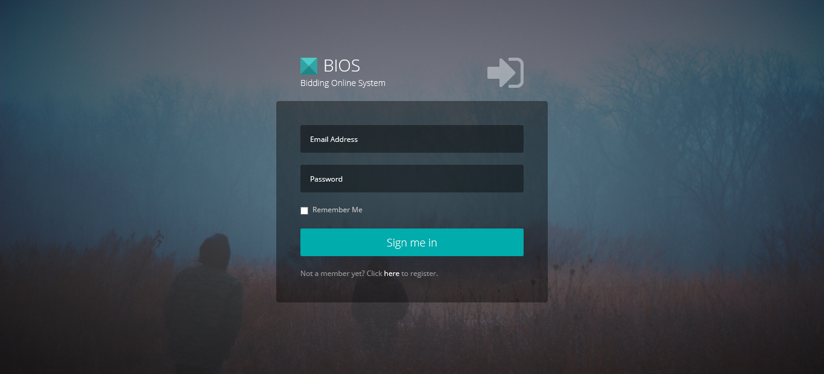
Global login page for both Admin and Users(Students)

Slide 2
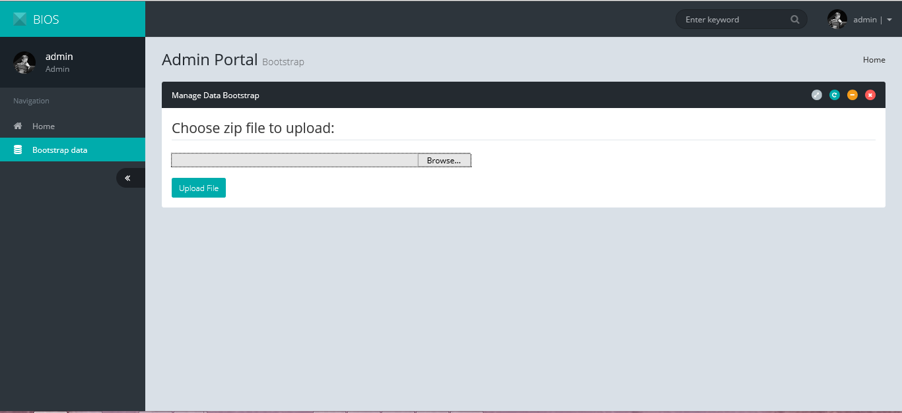
Admin : Bootstrap page – allow Admin to upload zip files that contains course details and student details

Slide 3
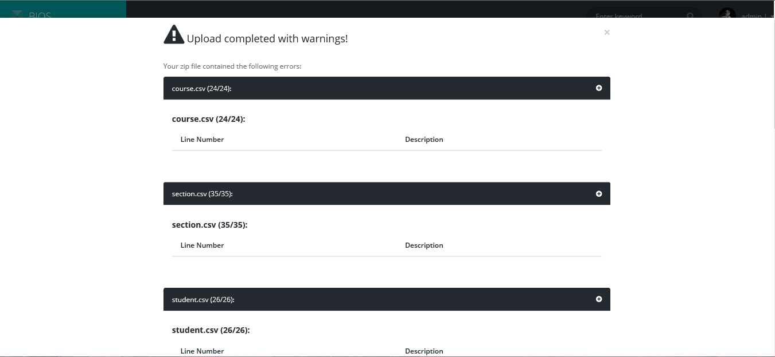
Admin : Bootstrap page (error popup) – warn Admin should there be any csv file uploaded with errors

Slide 4
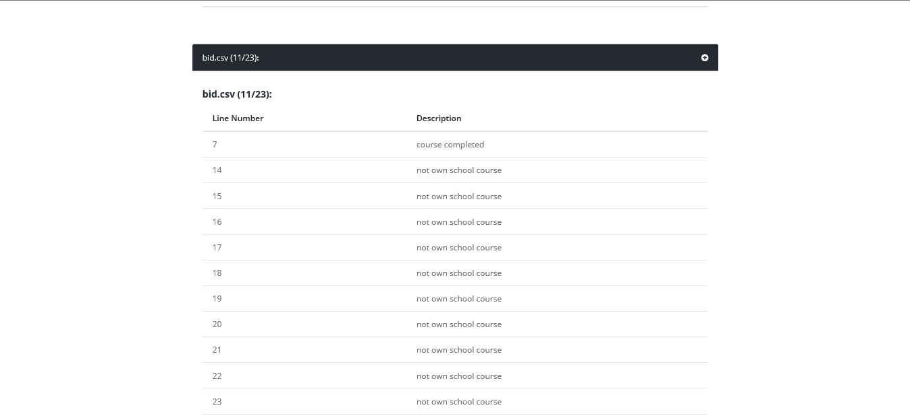
Admin : Bootstrap page (error popup) – warn Admin should there be any csv file uploaded with errors

Slide 5
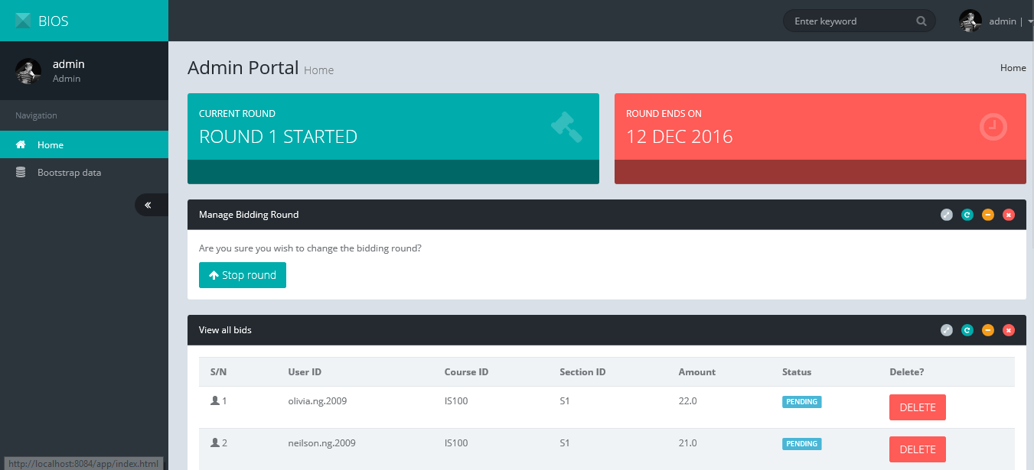
Admin : Homepage – allow Admin to view all bids by students and round status. Round 1 will automatically start once data is bootstrapped

Slide 6
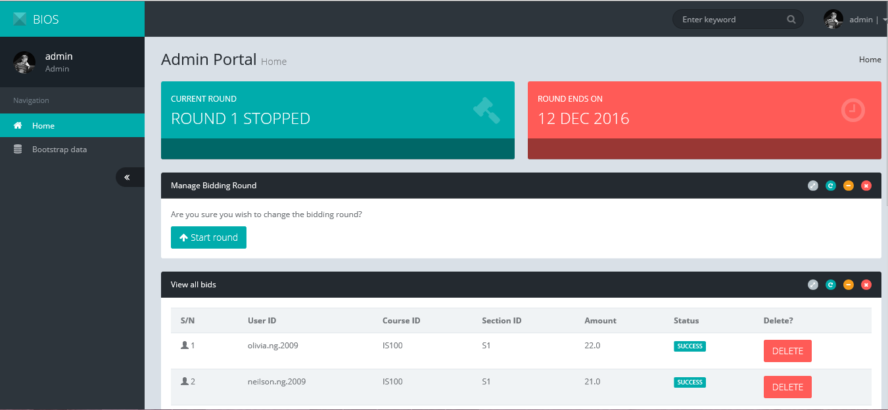
Admin : Homepage – When Round 1 is stopped, bid status will be shown (success or failed)

Slide 7
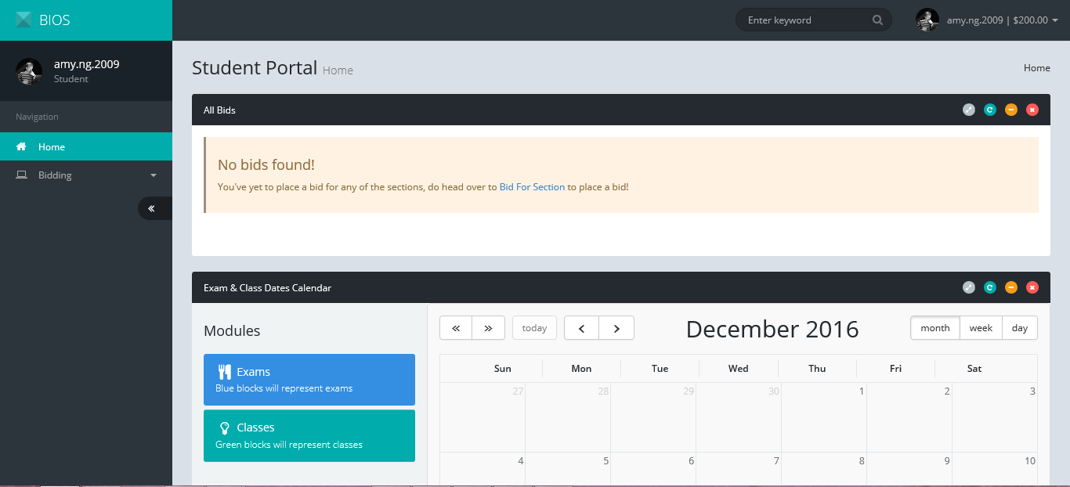
Student : Homepage – allow Student to view the bids placed by the respective student and a calendar that shows class and exam timings

Slide 8
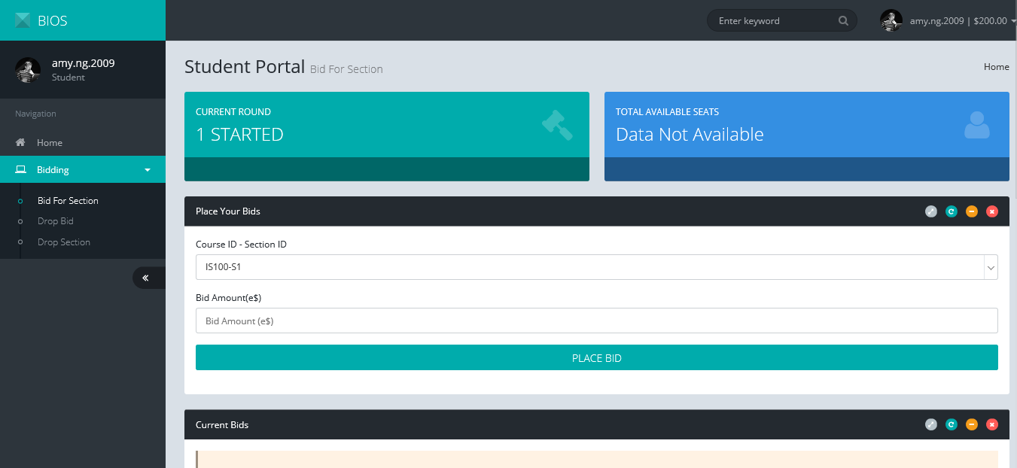
Student : Bid for Section page – allow Student to place a bid

Slide 9
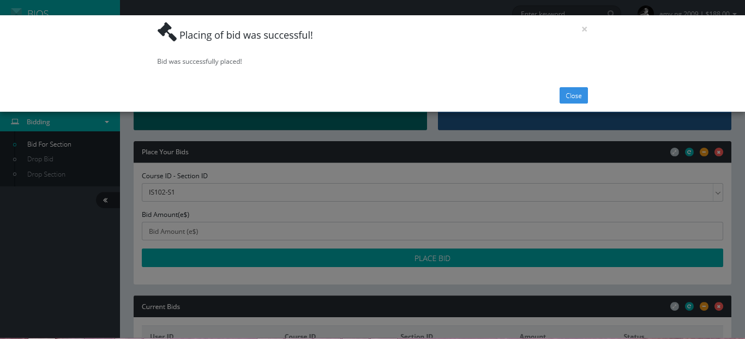
Student : Bid for Section page (success popup) – Student will be notified if the bid is placed successfully

Slide 10
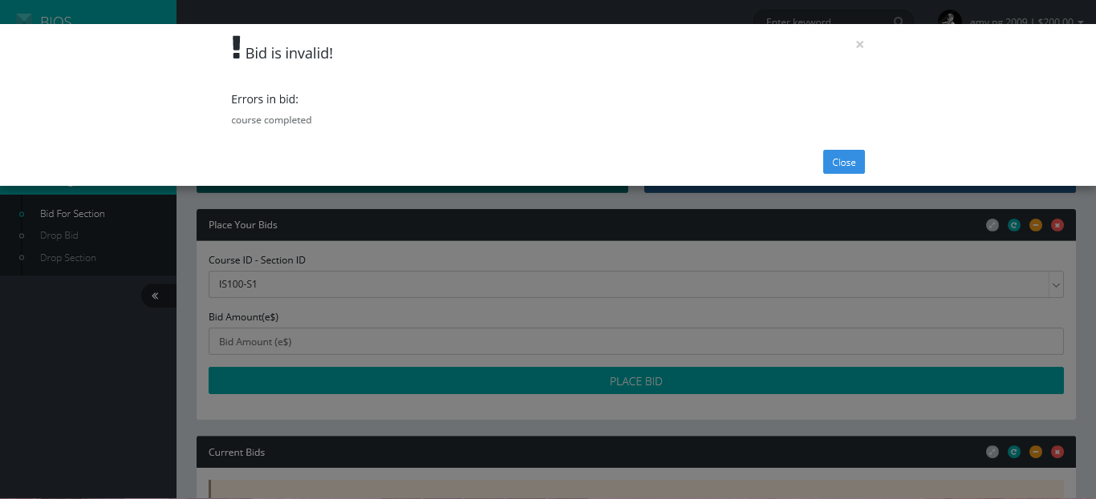
Student : Bid for Section page (error popup) – Student will not be able to bid if the bid is invalid. Error messages will be shown as well

Slide 11
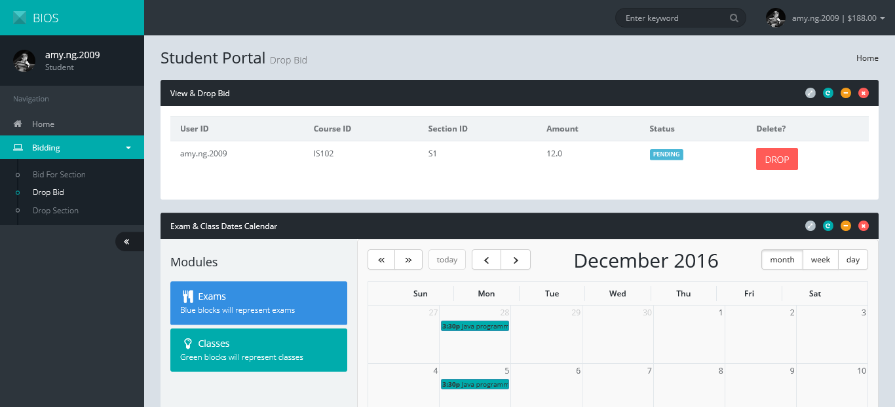
Student : Drop Bid page – Student can chose to drop a bid he/she placed previously

Slide 12
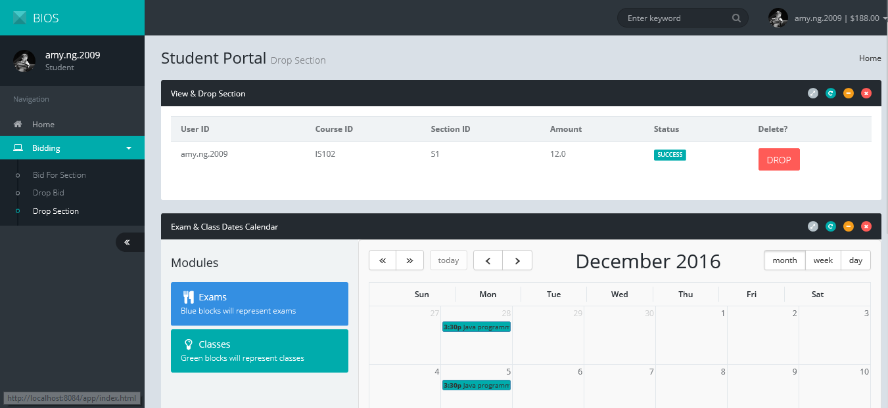
Student : Drop Section page – Student can chose to drop a bid he/she successfully placed previously

