Slide 1
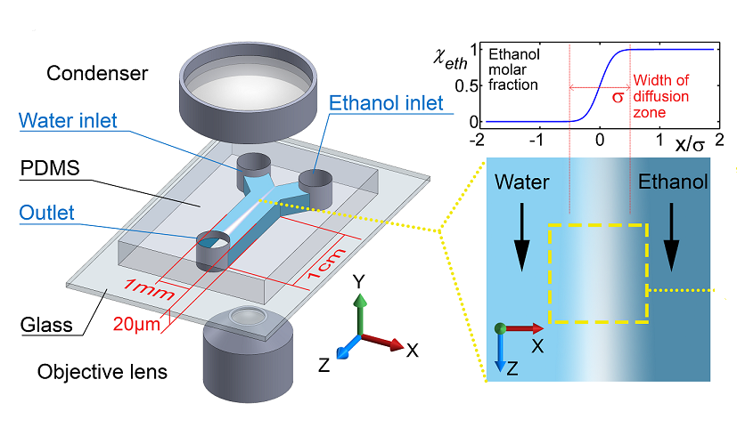
Gentle Exchange in a Diffusion Zone
high N.A. Objective lens
Water
Ethanol
50 μm

Slide 2
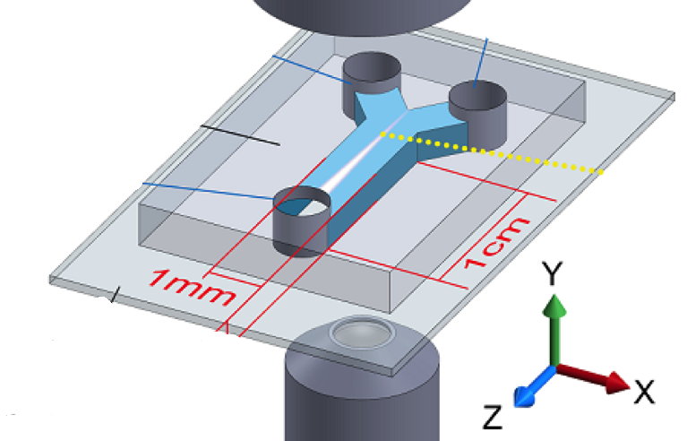
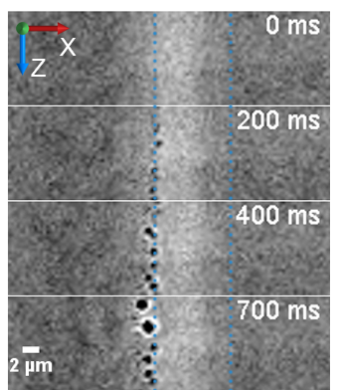
t = 0 when diffusion zone placed in the image’s center
flow

Slide 3
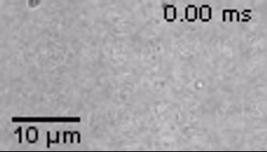
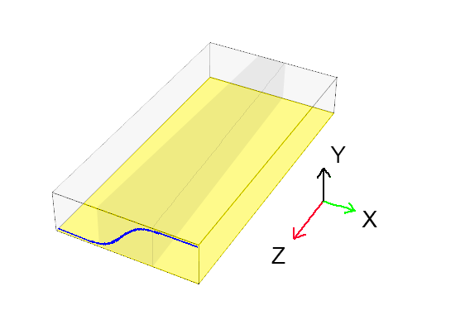
Nanobubble Nucleation in the Diffusion Zone
Flow
Water
Ethanol
Bubbles nucleate along a sharp boundary
Bubble grow and coalesce
Translate to the water side
Eventually they detach and are transported with the main flow

