Slide 2
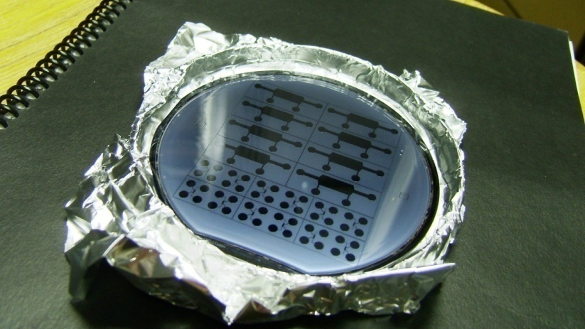
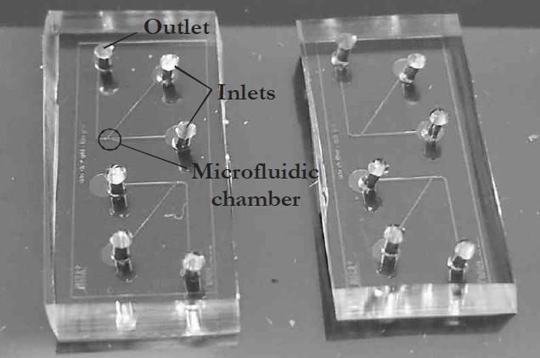
Microfluidic devices for beginners
1cm
Notes:
Fabrication, properties, see report

Slide 3
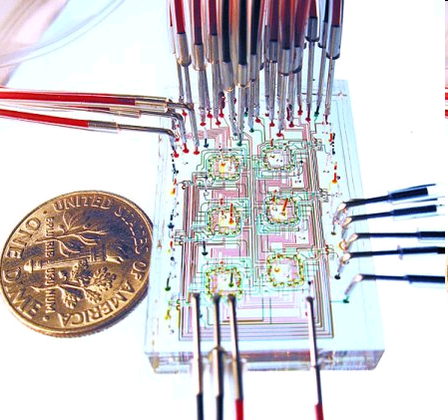
and the experts
from Steven Quake’s lab, Stanford.

Slide 4
Cell Treatment
Z. G. Li, A.Q. Liu, et al. in preparation.

Slide 5
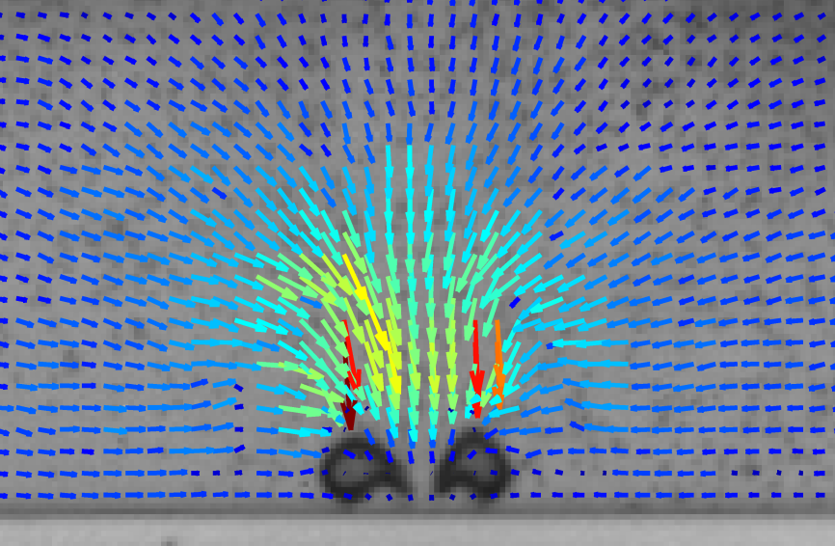
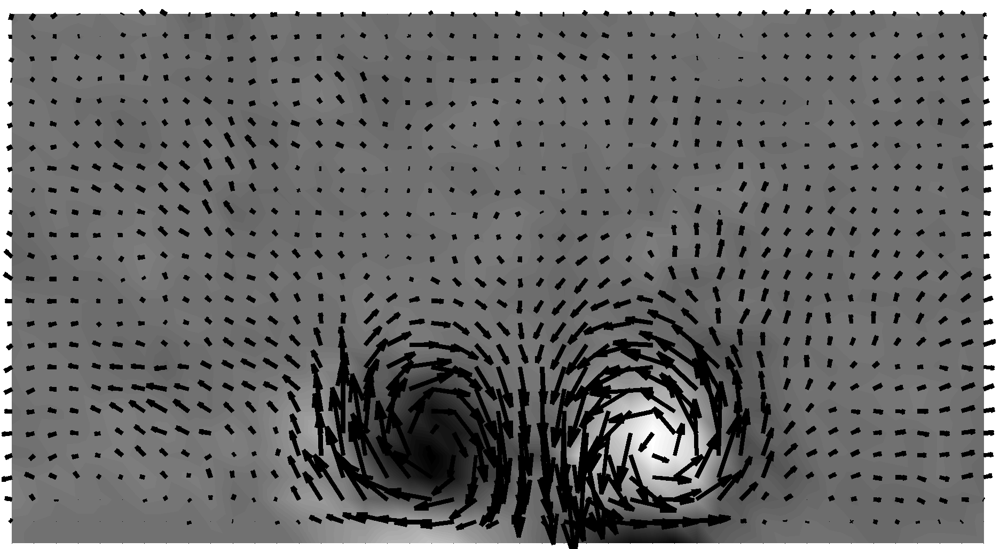
Visualization of the flow field with particle image velocimetry
Jetting
averaged flow field

Slide 6
Implementation of the bubble pump
Jetting flow (towards walls)
Generation of vorticity
Flow dies out slowly!
1 million frames/s
100μm
Dijkink, R., Ohl, C.D. Lab Chip 8 (2008) 1676-1681

Slide 7
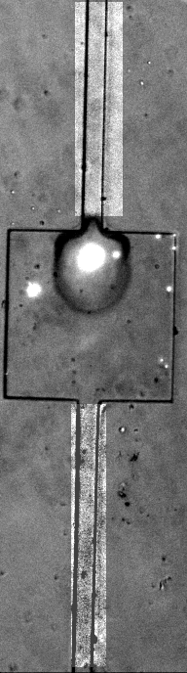
Continuous operation of the bubble pump
laser energy: 50μJ
repetition rate: 1Hz
approx. 5μm displacement stroke
20x20μm² channel crossection
Consecutive pictures taken
at maximum bubble radius.
200μm

Slide 8
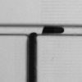
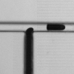
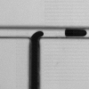
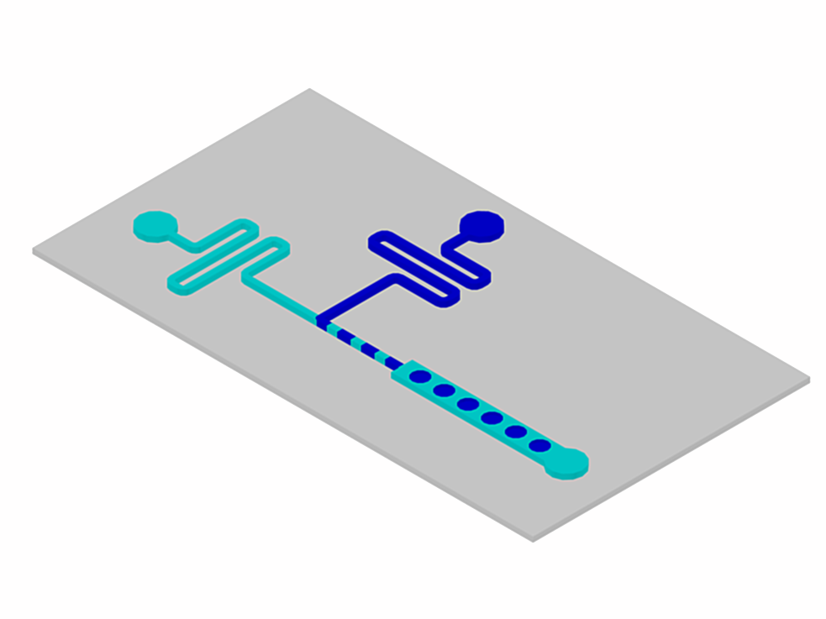
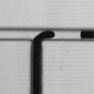
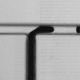
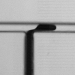
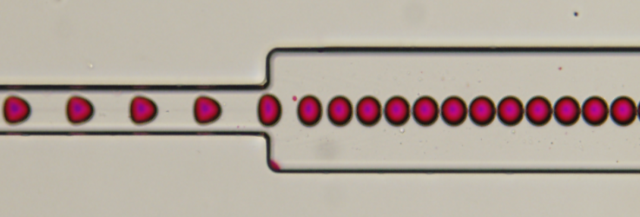
On Demand Droplet Fusion
(a)
(b)
(c)
Oil inlet
Water inlet
(d)
(e)
(f)
(g)
Laser bubble
The formation process of a droplet in a microchannel with T-junction

Slide 9

Droplet Coalescence

Slide 10
Droplet Focusing

