Slide 1
Tensor flow 第一步

Slide 2
Hand written recognition
MNIST: 机器视觉数据集
Training set: 55,000
Testing set: 10,000
Validation set: 5,000
from tensorflow.examples.tutorials.mnist import input_data
mnist = input_data.read_data_sets(“MNIST_data/”, one_hot = True)

Slide 3
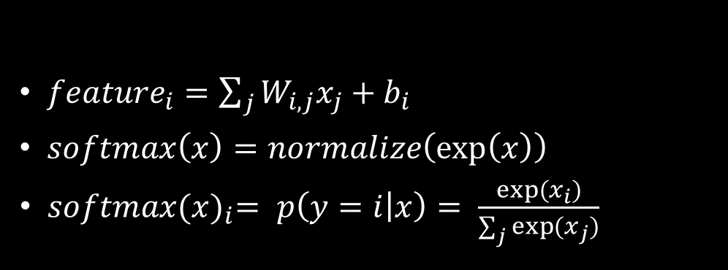
Softmax regression
${feature}_{i}=\sum_{j}{W_{i,j}x_{j}+b_{i}}$
$softmax\left(x\right)=normalize\left(\exp\left(x\right)\right)$
$softmax{(x)}_{i}= p\left(y=i | x\right)= \frac{exp⁡(x_{i})}{\sum_{j}{exp⁡(x_{j})}}$
x₁
+b₁
Softmax
y₁
x₂
+b₂
y₂
x₃
+b₃
y₃

Slide 4
SoftMAx Regression
Import tensorflow as tf
sess = tf.InteractiveSession()
#Create a new session to replace the default session
x = tf.placeholder(tf.float32, [None, 784])
#Create a place holder for input data, the first parameter is tensor’s type, the second parameter is tensor’s shape
W = tf.Variable(tf.zeros[784, 10])
#Create a variable to storage the weights, variable have long life cycle
b = tf.Variable(tf.zeros[10])
#Create a variable to storage the bias
y = tf.nn.softmax(tf.matmul(x, W) + b)

Slide 5
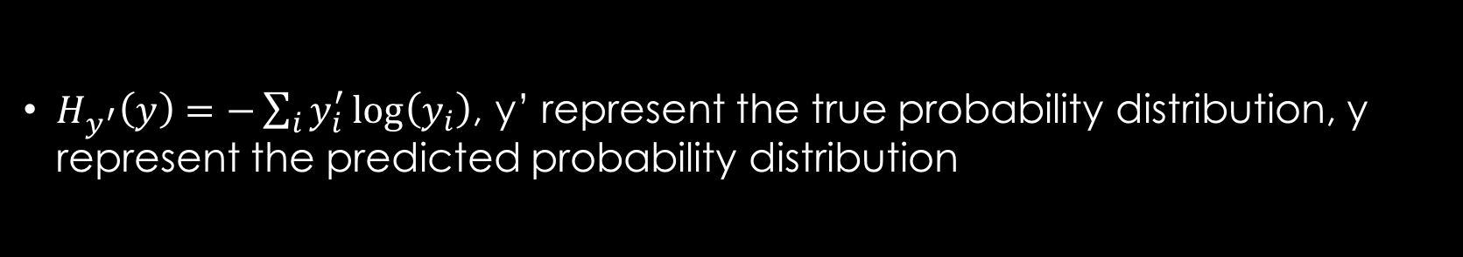
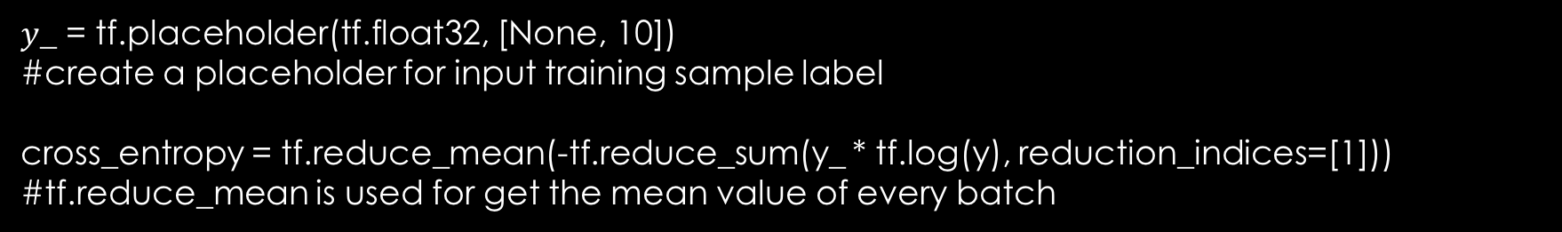
Loss function
$H_{y^{′}}\left(y\right)=−\sum_{i}{y_{i}^{′}\log\left(y_{i}\right)}$, y’ represent the true probability distribution, y represent the predicted probability distribution
$y$_ = tf.placeholder(tf.float32, [None, 10])
#create a placeholder for input training sample label
cross_entropy = tf.reduce_mean(-tf.reduce_sum(y_ * tf.log(y), reduction_indices=[1]))
#tf.reduce_mean is used for get the mean value of every batch

Slide 6

Optimizer
$train=tf.train.GradientDescentOptimizer\left(0.5\right).minimize\left(cross_{entropy}\right)$
#set the learning rate as 0.5, and set the optimization object as #cross_entropy

Slide 7
Initialize the parameters
tf.global_variables_initializer().run()
#Initialize the global variables

Slide 8
TrainNING
For I in range(1000):
batch_xs, batch_ys = mnist.train.next_batch(100)
#stochastic gradient descent
train_step.run({x:batch_xs, y_:batch_ys})
#feed data to placeholders

Slide 9
Evaluation
correct_prediction = tf.equal(tf.argmax(y, 1), tf.argmax(y_, 1))
# tf.argmax is used for finding the sequence number of the biggest data in that tensor
#tf.equal is used for testing the predicted label equal to true label
accuracy = tf.reduce_mean(tf.cast(correct_prediction, tf.float32))
#tf.cast is used for convert the data from bool type to float32 type
Print(accuracy.eval( {x: mnist.test.images, y_:mnist.test.labels} ))

