Slide 1
Tensorflow CNN

Slide 2
Convolutional neural network
Reception field – 1860s
Neocognitron – 1980s
LeNet5 – 1994

Slide 3
Convolution layer
Filter the image by many different convolutional kernel, and add bias to extract the local feature
Apply non-lineal activate function to the result
Max-pooling: keep the prominent feature (optional)
Local response normalization (optional)
Batch normalization (optional)

Slide 4
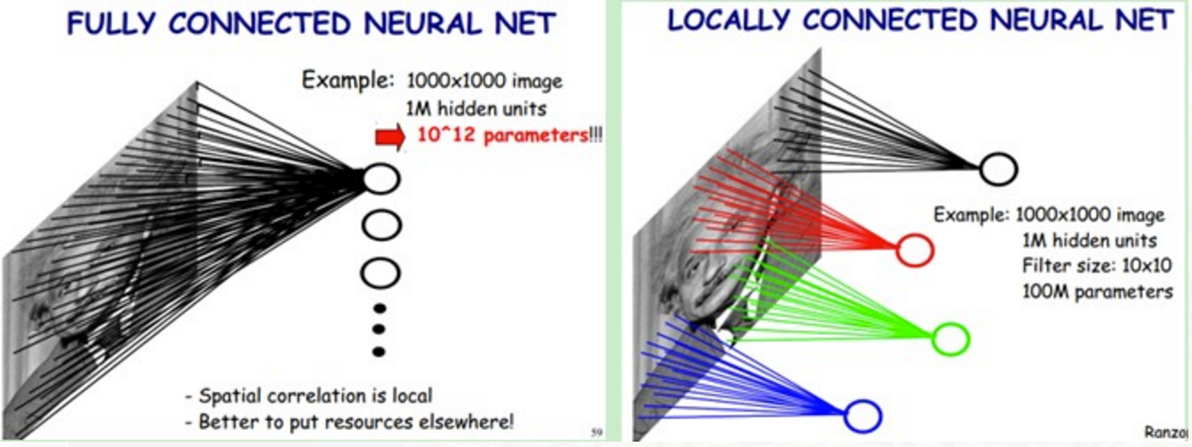
Fully connected vs locally connected

Slide 5
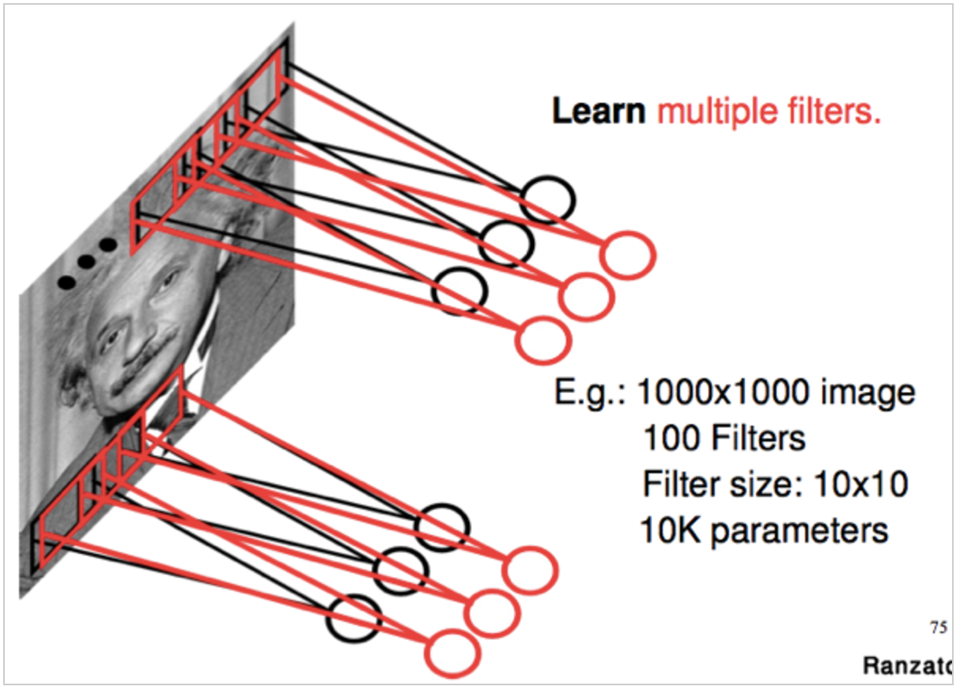
Weight sharing

Slide 6
Lenet 5
There are 3 components in every convolution layer, convolution, pooling, non-linear activation
Use convolution to extract spatial feature
Average pooling
Tanh or Sigmoid activation function
MLP is the last layer
Sparse connection between layers

Slide 7
Simple CNN
MNIST
Expected Accuracy: 99.2%
Network: 2 convolutional layer, 1 fully connected layer

Slide 8
Load data
from tensorflow.examples.tutorials.mnist import input_data
import tensorflow as tf
mnist = input_data.read_data_sets(‘MNIST_data/’, one_hot = True)
sess = tf.InteractiveSession()

Slide 9
InItialize function
def weight_variable(shape):
initial = tf.truncated_normal(shape, stddev=0.1)
return tf.Variable(initial)
def bias_variable(shape):
initial = tf.constant(0.1, shape=shape)
#in order to avoid dead neurons, so the bias is initialized by 0.1 not 0
return tf.Variable(initial)
Weight and bias will be created repeatedly in layers

Slide 10
Convolution and max pooling
def conv2d(x, W):
return tf.nn.conv2d(x, W, strides=[1,1,1,1], padding=‘SAME’)
#x is input, W is weight, i.e [5, 5, 1, 32], the first two number is kernel size, the third number is
#image channel, the fourth number is kernel number
def max_pool_2x2(x):
return tf.nn.max_pool(x, ksize=[1,2,2,1], strides=[1,2,2,1], padding=‘SAME’)
Convolution and max pooling will be used repeatedly in layers

Slide 11
Define placeholder
X = tf.placeholder(tf.float32, [None, 784])
y_ = tf.placeholder(tf.float32, [None, 10])
x_image = tf.reshape(x, [-1, 28, 28, 1])

Slide 12
Layer 1
W_conv1 = weight_variable([5, 5, 1, 32])
B_conv1 = bias_variable([32])
H_conv1 = tf.nn.relu(conv2d(x_image, W_conv1) + b_conv1)
h

Slide 13
def conv2d(x, W):

