Slide 1
Course Project
Xiaowei Zhao (xz2767)
Mingfeng Li (ml4209)

Slide 2
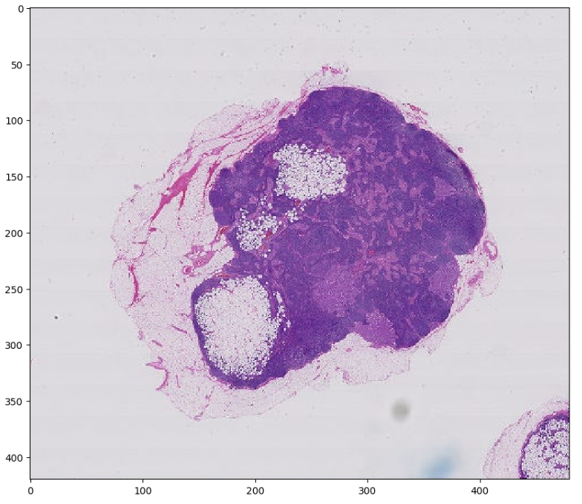
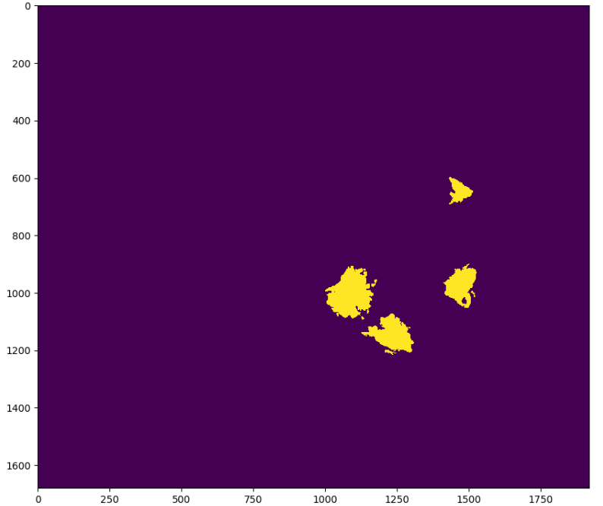
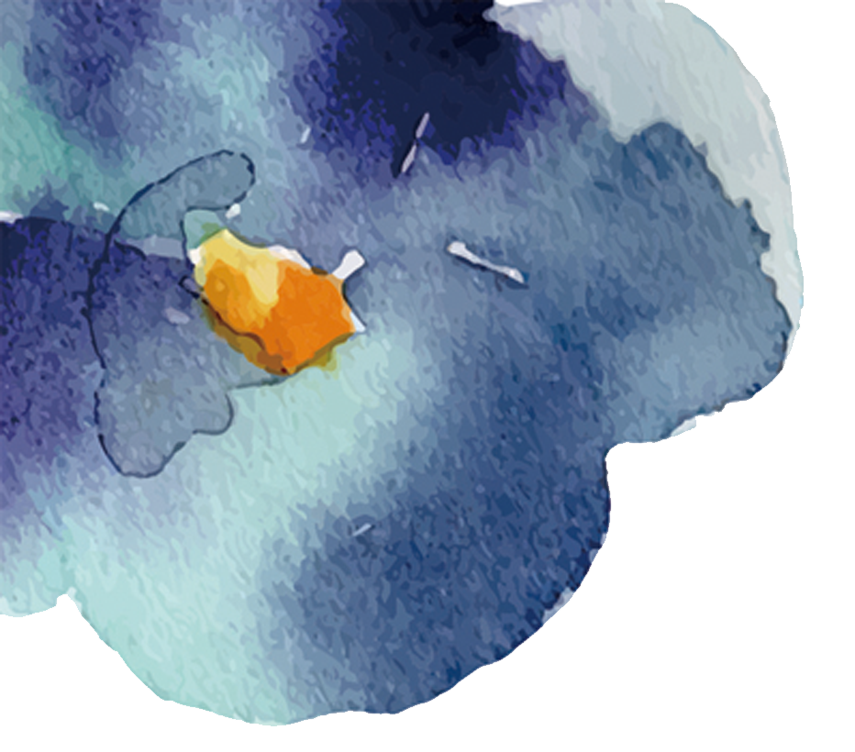
Problem:
Detecting Cancer Metastases on
Gigapixel Pathology Images
Get 299x299 patches of the slides and masks and make another dataset by zooming in these patches
01
Split the data into training and test set, then upsample the unbalanced dataset
02
Define the model by merging two sequential models
03
Train the model and make the predictions, then create heat maps
04

Slide 3
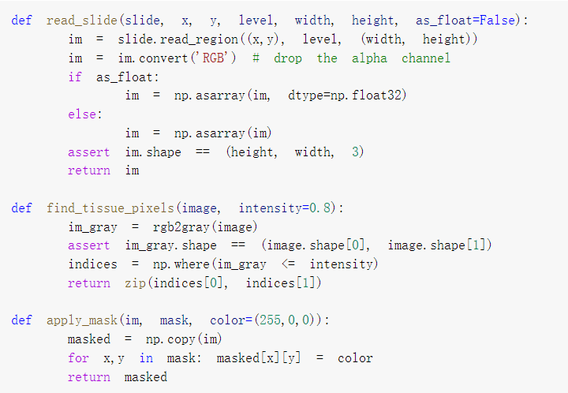
Starter Functions
Function read_slide is to read a region from the slide
Functions find_tissue_pixels and apply_mask are used to improve efficiency by ignoring non-tissue areas of the slide

Slide 4
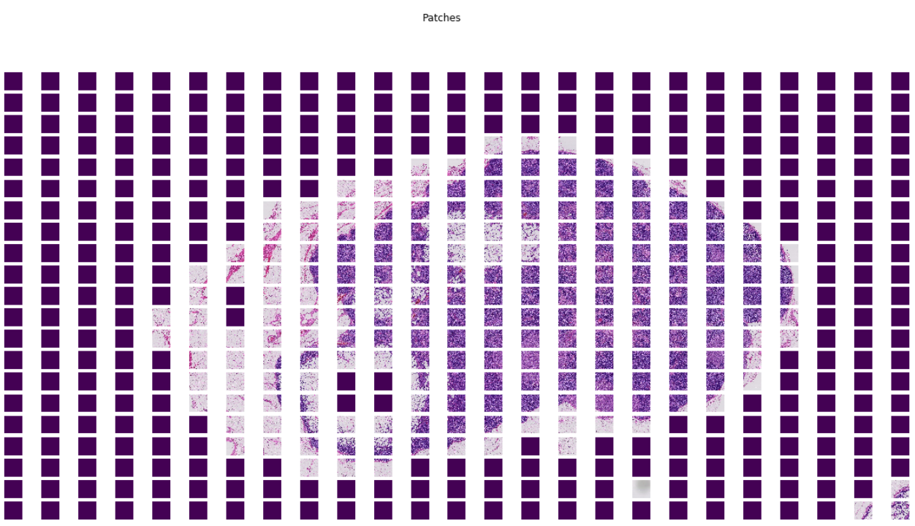
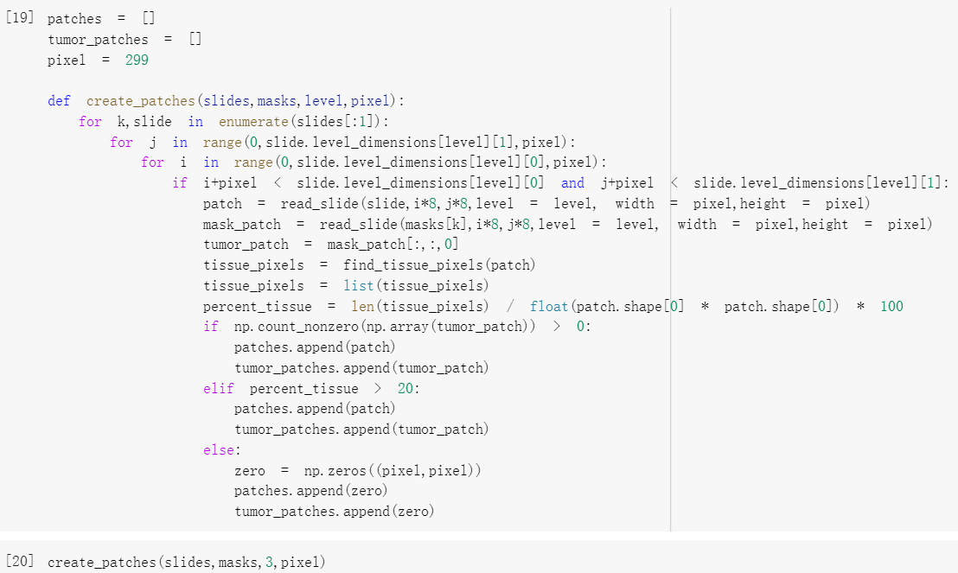
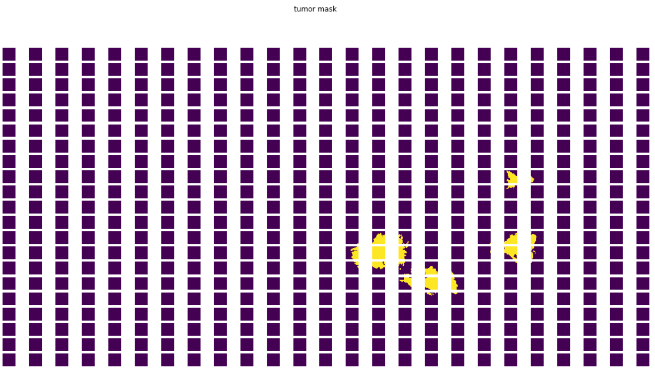
Creating patches
Sliding a window over the slides and masks and creating 299x299 patches of them. The level of origin image is 3.
For each patch, check the percentage tissue in that patch, if percentage tissue > 20%, let the patch be zero, then plot the graph to check if the process of image is right.

Slide 5
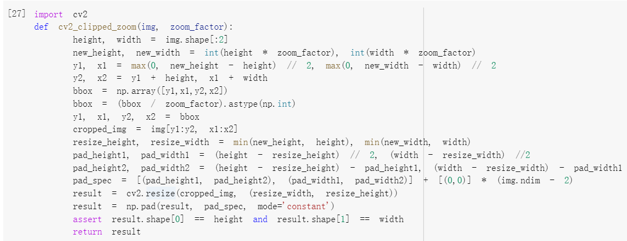
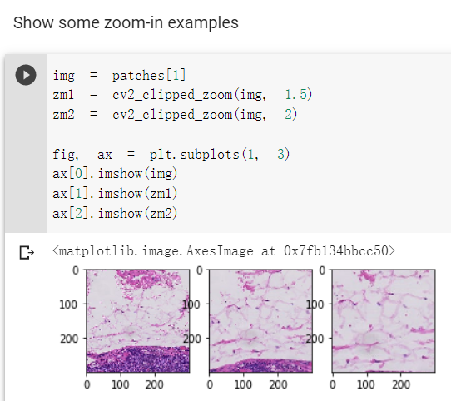
Zoom in all patches to make another dataset for training
The function is to zoom in the patches. Center zoom in of the given image and returning an enlarged view of the image without changing dimensions.

Slide 6
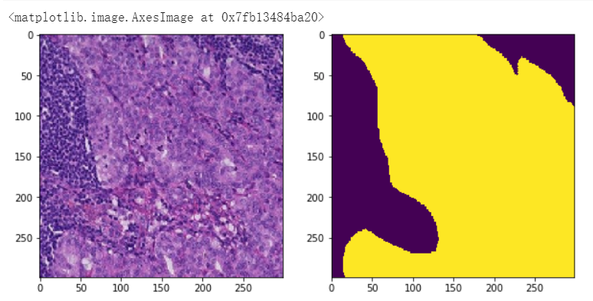
Assigning labels to each zoomed patch.
1 if there is at least one non-zero entry in the corresponding zoomed mask patch, 0 if not.

Slide 7
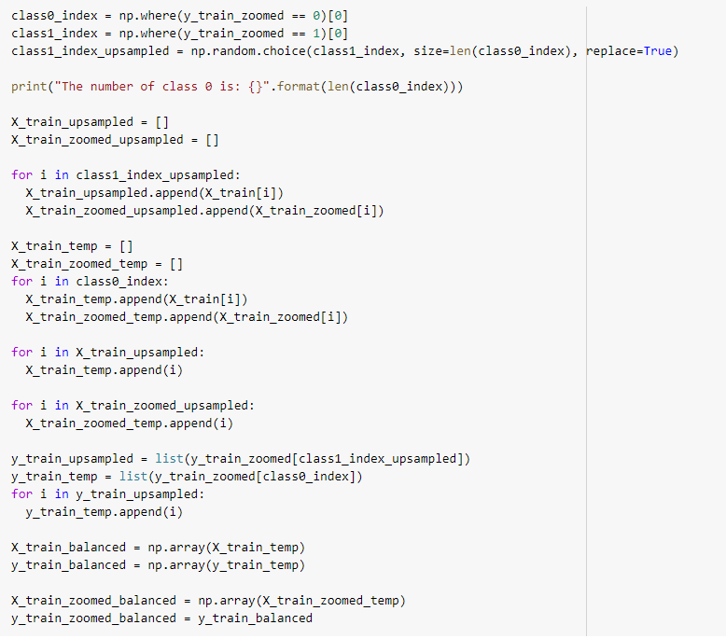
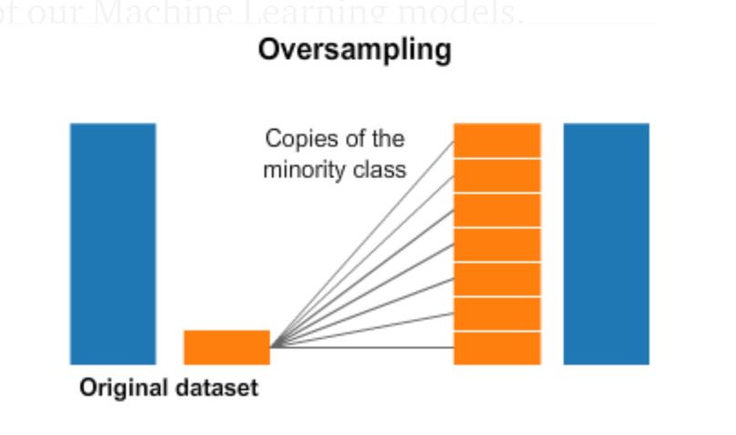
Preprocessing - Oversampling
Problem:
Data has high level of class imbalance. Target class (tumor patch, class 1) is only 13% of whole dataset.
Solution:
Random select copies of patches containing tumors to reach the same number as the normal cells' patches.

Slide 8
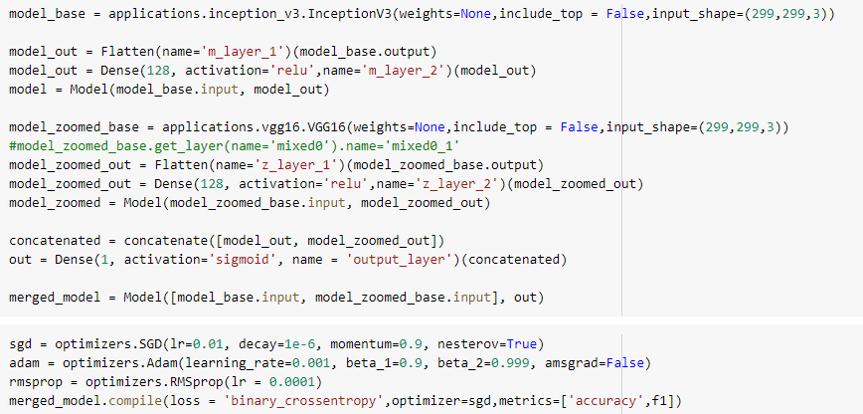
Defining Network
We concatenate two networks together to create a multi scale model, attempting to capture both details and contexts. Two scales used are 8X (level 3 dimension) and 12X.
Model Details:
Accuracy and F1 score are used as metrics to evaluate our model fitting on validation sets. The optimizer used is SGD with learning rate 0.1, decay at 1e-6 and momentum at 0.9.
Image
Model 1
Concatenate Feature
FC
Image
Model 2

Slide 9
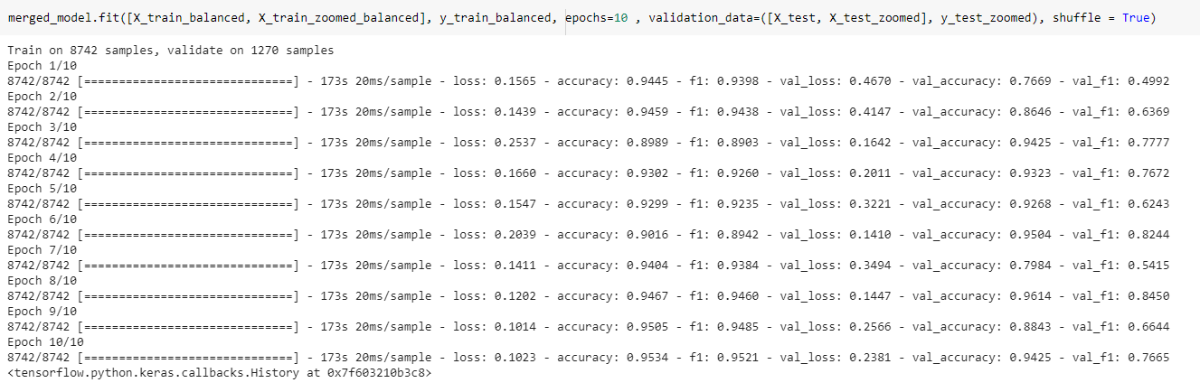
Training Model
~9K training patches in total.
Deep Learning is trained from scratch with 10 epochs and shuffling.
The accuracy reaches 96% and f1 score reaches 0.85.

Slide 10
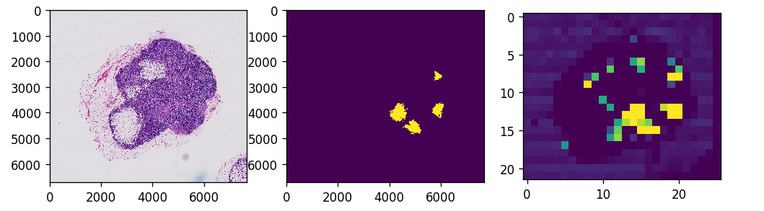
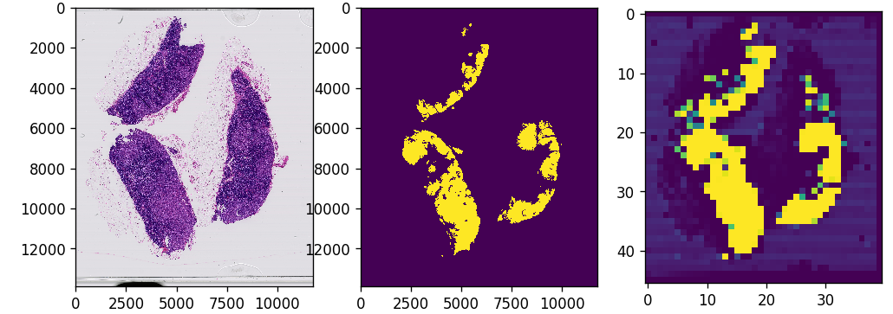
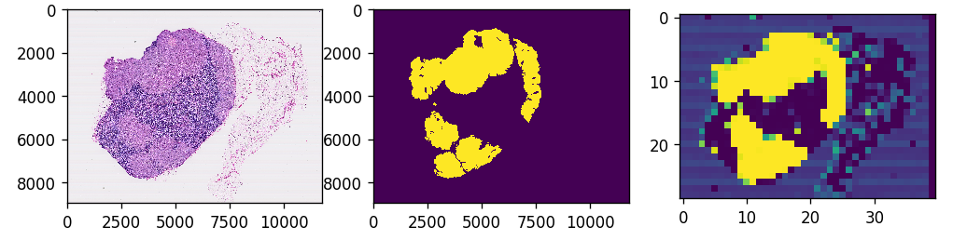
Evaluating Model
We generate tumor probability heatmap to evaluate the model’s predictions.
The heatmaps are shown along the original slide and mask images.
(left to right: original slide, mask image, predicted heatmap).

Slide 11
Conclusions
We developed a deep learning framework for detecting cancerous cells in gigapixel images.
Architecture:
Used Transfer Learning, based on InceptionV3 pretrained model.
Training:
Upsampled to create balanced training sets.
Evaluation:
generated tumor probability heatmaps that mimic the actual tumor masks.

Slide 12
Thank you
Video uploaded on the following link:
https://youtu.be/E159hjztAs4

