Slide 1
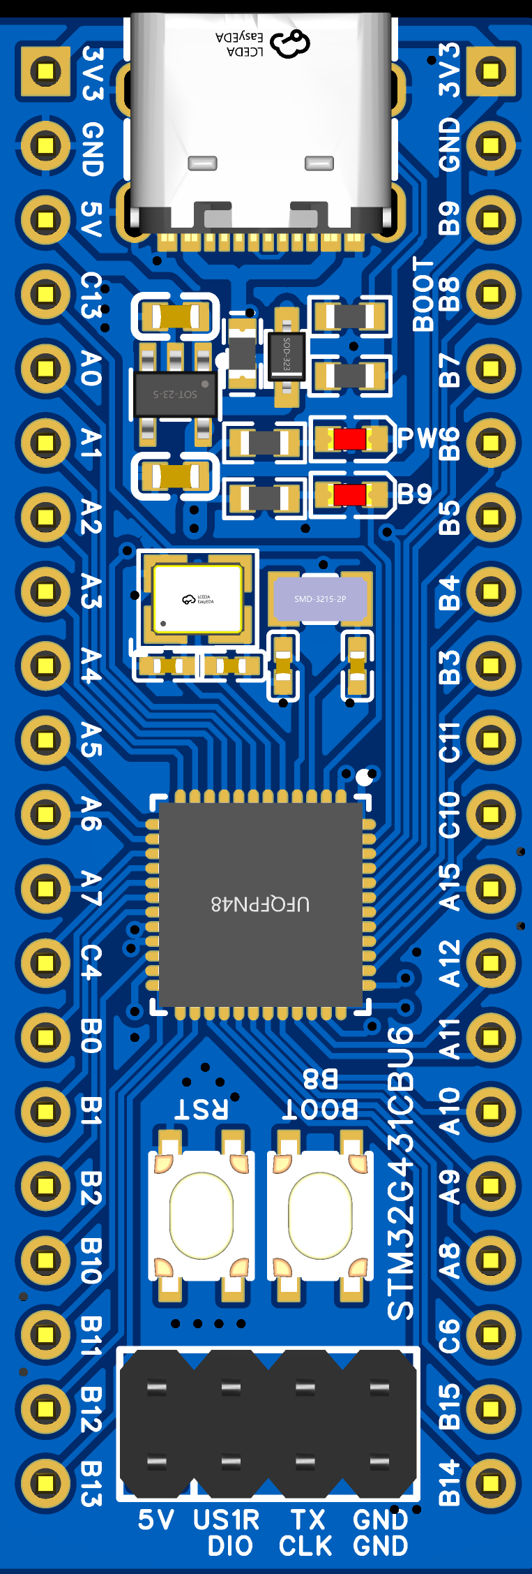
引脚功能_串行接口
GPIO
USART
GPIOB9
USART3_TX
I2C1_SDA
SPI
GPIOC13
GPIOB8
USART3_RX
I2C1_SCL
I2C
GPIOA0
GPIOB7
USART1_RX
I2C1_SDA
GPIOA1
GPIOB6
USART1_TX
USART2_TX
GPIOA2
GPIOB5
I2C3_SDA
SPI1_MOSI
SPI3_MOSI
USART2_RX
GPIOA3
GPIOB4
USART2_RX
SPI1_MISO
SPI3_MISO
GPIOA4
GPIOB3
USART2_TX
SPI1_SCK
SPI3_SCK
SPI1_SCK
GPIOA5
GPIOC11
USART3_RX
I2C3_SDA
SPI3_MISO
SPI1_MISO
GPIOA6
GPIOC10
USART3_TX
SPI3_SCK
SPI1_MOSI
GPIOA7
GPIOA15
USART2_RX
I2C1_SCL
I2C2_SCL
USART1_TX
GPIOC4
GPIOA12
GPIOB0
GPIOA11
SPI2_MOSI
GPIOB1
GPIOA10
USART1_RX
SPI2_MISO
GPIOB2
GPIOA9
USART1_TX
I2C2_SCL
USART3_TX
GPIOB10
GPIOA8
I2C3_SCL
I2C2_SDA
USART3_RX
GPIOB11
GPIOC6
GPIOB12
GPIOB15
SPI2_MOSI
SPI2_SCK
GPIOB13
GPIOB14
SPI2_MISO

Slide 2
引脚功能_AD/DA转换
GPIO
USART
GPIOB9
USART3_TX
I2C1_SDA
SPI
GPIOC13
GPIOB8
USART3_RX
I2C1_SCL
I2C
GPIOA0
GPIOB7
USART1_RX
I2C1_SDA
GPIOA1
GPIOB6
USART1_TX
USART2_TX
GPIOA2
GPIOB5
I2C3_SDA
SPI1_MOSI
SPI3_MOSI
USART2_RX
GPIOA3
GPIOB4
USART2_RX
SPI1_MISO
SPI3_MISO
GPIOA4
GPIOB3
USART2_TX
SPI1_SCK
SPI3_SCK
SPI1_SCK
GPIOA5
GPIOC11
USART3_RX
I2C3_SDA
SPI3_MISO
SPI1_MISO
GPIOA6
GPIOC10
USART3_TX
SPI3_SCK
SPI1_MOSI
GPIOA7
GPIOA15
USART2_RX
I2C1_SCL
I2C2_SCL
USART1_TX
GPIOC4
GPIOA12
GPIOB0
GPIOA11
SPI2_MOSI
GPIOB1
GPIOA10
USART1_RX
SPI2_MISO
GPIOB2
GPIOA9
USART1_TX
I2C2_SCL
USART3_TX
GPIOB10
GPIOA8
I2C3_SCL
I2C2_SDA
USART3_RX
GPIOB11
GPIOC6
GPIOB12
GPIOB15
SPI2_MOSI
SPI2_SCK
GPIOB13
GPIOB14
SPI2_MISO

Slide 3
USB_C接口
自恢复保险丝
肖特基二极管
LDO
POWER_LED
USER_LED
8MHz晶振
32.768KHz晶振
G431CBU6
RESET按键
BOOT按键

