Slide 1
ASCS Writing workshop
CVs
Notes:
English Title: Uppercase, Calibri size 60, XJTLU Navy
English Subtitle: Uppercase, Calibri size 36, XJTLU Navy

Slide 2

Overview
Notes:
Title: DIN-Bold, size 54, UPPERCASE, XJTLU Navy
Subtitle: DIN-Regular, size 32, UPPERCASE, XJTLU Navy

Slide 3

Introduction to Workshop
CV: What does it mean?
Why do you need a CV ?
Things you should avoid
Things you should consider
Common CV problems
How to construct your CV
Samples (critique)
Formatting tips in Word
Notes:
Header: Uppercase, Calibri size 28, XJTLU Navy
Body Text: Sentence case, Calibri size 14, Black

Slide 4
What does CV stand for?
The word CV comes from the Latin name: Curriculum Vitae Which means “course of life” or simply “Life Story”
Why do you need a CV?
To get a job?
To get an interview?
To go for further study?
A CV is an advertisement of your abilities.
What time and effort should you pay to prepare a two page CV that Promotes & Sells YOU?
Notes:
Header: Uppercase, Calibri size 28, XJTLU Navy
Body Text: Sentence case, Calibri size 14, Black

Slide 5

Why do you need a CV?
Discuss:
What do you want?
What does the reader want?
REMEMBER
Your CV will be scanned for the first time
in less than 10 seconds.
Notes:
Header: Uppercase, Calibri size 28, XJTLU Navy
Body Text: Sentence case, Calibri size 14, Black

Slide 6
Things that you should AVOID
ABBREVIATIONS OR ACRONYMS:
AFPCA , GHWIHT , MRSRM , ZESN , TWTN
Too Many abbreviations make your CV unreadable,
Avoid it unless it is commonly recognized: eg. WTO, UN, BBC, PRC, US, UK etc.
Remember: KISS
NEGATIVE WORDS:
Boring , Fired , Hate, Conflict, Blocked ..etc Catch the recruiter’s eye.
COLOURS:
It is not a show: Don’t use colours to make your CV attractive
Remember:
This is a serious task and using colours or animations takes away from this.
Keep It Simple & Smart
Notes:
Header: Uppercase, Calibri size 28, XJTLU Navy
Body Text: Sentence case, Calibri size 14, Black

Slide 7
Things that you should AVOID
WORD ARTS: Clip Arts, logos & Graphics:
SPELLING, GRAMMAR & PUNCTUATION MISTAKES:
Spelling mistakes are poison to your CV!
UNNECESSARY INFORMATION:
Gender , Religion and detailed Martial status are examples of unnecessary information in your CV.
Remember:
An employer doesn’t really care that much about your height, weight or family history!
Notes:
Header: Uppercase, Calibri size 28, XJTLU Navy
Body Text: Sentence case, Calibri size 14, Black

Slide 8
Things that you should AVOID
Using a very Big or very small font size & unusual fonts:
Fonts to be used (English):
Arial
Calibri
Verdana
Times New Roman
Tahoma
Fonts Size to be used: 10 - 12
Other Don’ts:
Don’t write CV at the top.
Don’t put a picture unless it is requested.
Don’t put any attachment unless it is requested.
Don’t use poor quality paper and printer.
Don’t use a photo-copied CV.
Don’t use Capital letters for the whole CV.
Common Problems:
Too long / too short
Hard to read
Wordy
Non-professional
Notes:
Header: Uppercase, Calibri size 28, XJTLU Navy
Body Text: Sentence case, Calibri size 14, Black

Slide 9
How to construct your CV?
Personal identification
Educational background
Work experience
Honours and awards received
Skills & trainings
Activities & Hobbies
References
Notes:
Header: Uppercase, Calibri size 28, XJTLU Navy
Body Text: Sentence case, Calibri size 14, Black

Slide 10
How to construct your CV?
Personal ID
Top Right/Middle of first page
Name is the title (no other titles)
Addresses; phone numbers; e-mail and/or fax addresses
Education:
Usually means post-secondary and can include special seminars, college and university
List the following:
Degrees.
Month/year obtained or expected.
Names and locations of schools.
Subject (s).
Grade average.
A brief summary of important courses you’ve taken might also be helpful.
Notes:
Header: Uppercase, Calibri size 28, XJTLU Navy
Body Text: Sentence case, Calibri size 14, Black

Slide 11
How to construct your CV?
Work experience:
Includes full-time paid jobs, part time jobs, training or volunteer work.
List the month/years you worked, position, name and location of employer or place, and responsibilities you had.
Use chronological format to emphasize most recent.
Write all job descriptions in parallel phrases. For example, if you use action verbs, continue this language structure for all descriptions: Assisted in research into domestic attitudes towards urban development … Led a project involving ….
List the most important responsibilities or successes first.
List your achievements in each job
Skills:
Computer and Software
Languages (indicating the grade of fluency)
Technical skills
Communication or Leadership among others (soft skills)
Match your skills and experience with a University/Employer’s needs
Notes:
Header: Uppercase, Calibri size 28, XJTLU Navy
Body Text: Sentence case, Calibri size 14, Black

Slide 12
How to construct your CV?
Activities:
In university or outside: Conferences, Clubs, charity.
Sports.
Hobbies:
Reading, Music (play an instrument?)
References:
Get from phd ppt
Notes:
Header: Uppercase, Calibri size 28, XJTLU Navy
Body Text: Sentence case, Calibri size 14, Black

Slide 13
Activities and Hobbies
Activities:
In university or outside: Conferences, Clubs, charity.
Sports.
Hobbies:
e.g. Reading, Music, … etc.
Notes:
Header: Uppercase, Calibri size 28, XJTLU Navy
Body Text: Sentence case, Calibri size 14, Black

Slide 14
References
Format:
Even though it is likely that your referee will be contacted by email, you should put full contact details.
Suggested order:
Prof/Dr/Mr/Ms Joe Bloggs
Director, Language Centre
Xi’an Jiaotong Liverpool University
FB241 No.111 Ren’ai Road
Suzhou Dushu Lake HE Town
Suzhou Industrial Park
Jiangsu Province
China 215123
Joe.Bloggs@xjtlu.edu.cn
+86 (0)512 8188 1234
Applications will require that you provide at least 2 references – professionals who will speak candidly about you to the employer or school. Academic Advisers or Supervisors are typical source.
Important : You must get the permission and suitable contact information of each person who will be a reference for you.
If it is required, you may have to give these on your CV.
A better approach is to make a statement that offers that “References will be provided upon request”.
References are usually requested after the first interview in a job application or in University applications
Name and title. You can leave off title these days.
Job title
Name of institution followed by full postal address.. FB241 is office number
Email address
Work phone number with international and domestic area codes..
Notes:
Header: Uppercase, Calibri size 28, XJTLU Navy
Body Text: Sentence case, Calibri size 14, Black

Slide 15
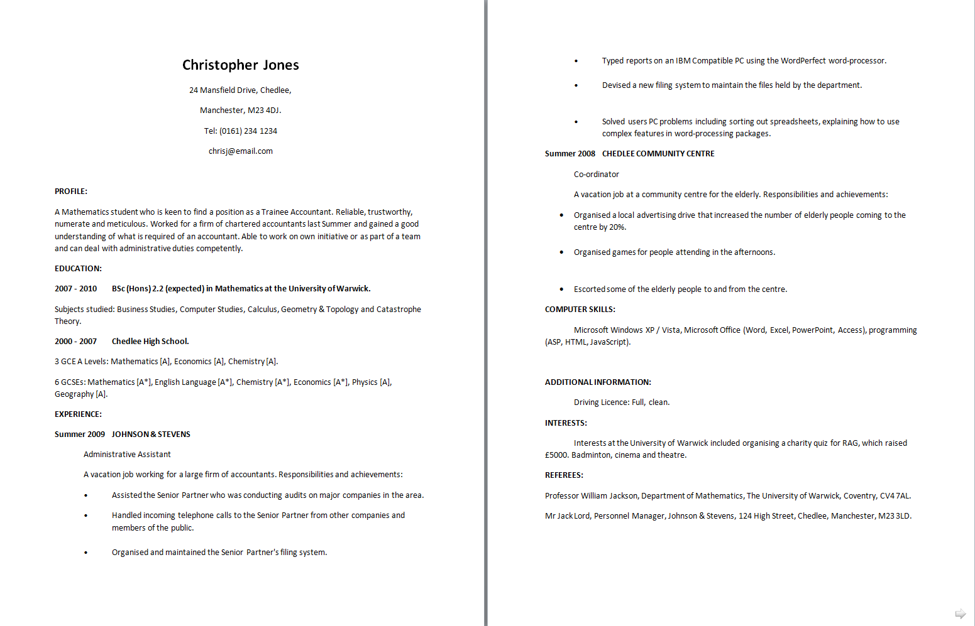
Samples
2 page CV for recent graduate: Looks like this student feels that spreading the information out makes it look like there is more to say.
Could be improved by removing spacing and some reformatting.
For Masters applications, perhaps 3rd and final year study can be given more detail. No need to list high school information.
Notes:
Header: Uppercase, Calibri size 28, XJTLU Navy
Body Text: Sentence case, Calibri size 14, Black

Slide 16
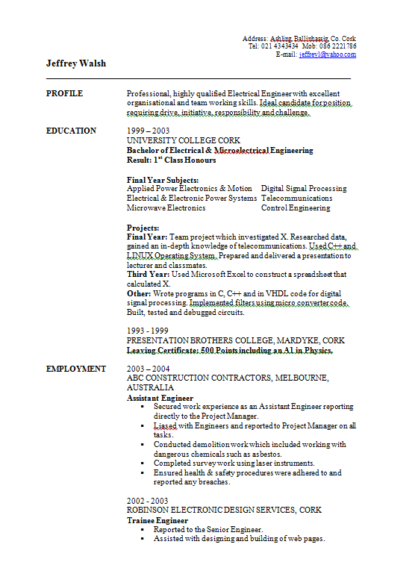
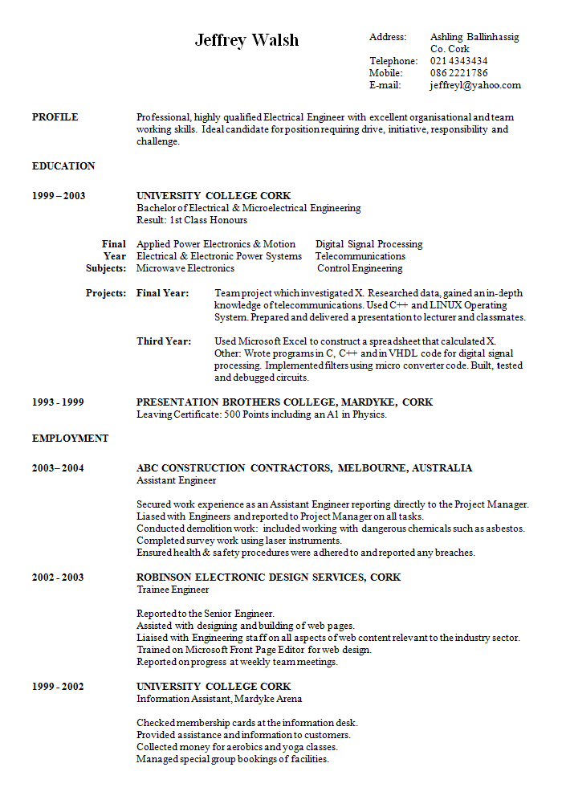
Samples
Name and address seems understated. Give full address. Name in slightly larger font.
Arranged in tabs but quite a lot of wasted space here.
Inner column looks quite crowded.
Dates could go here.
Highlighting heirarchy could be improved. Eg. Use of bold and capitals
BETTER? This is a table with the borders removed. More information is fitted in from page 2. Since a CV is read quickly, it is important that information is easy to scan
Notes:
Header: Uppercase, Calibri size 28, XJTLU Navy
Body Text: Sentence case, Calibri size 14, Black

Slide 17
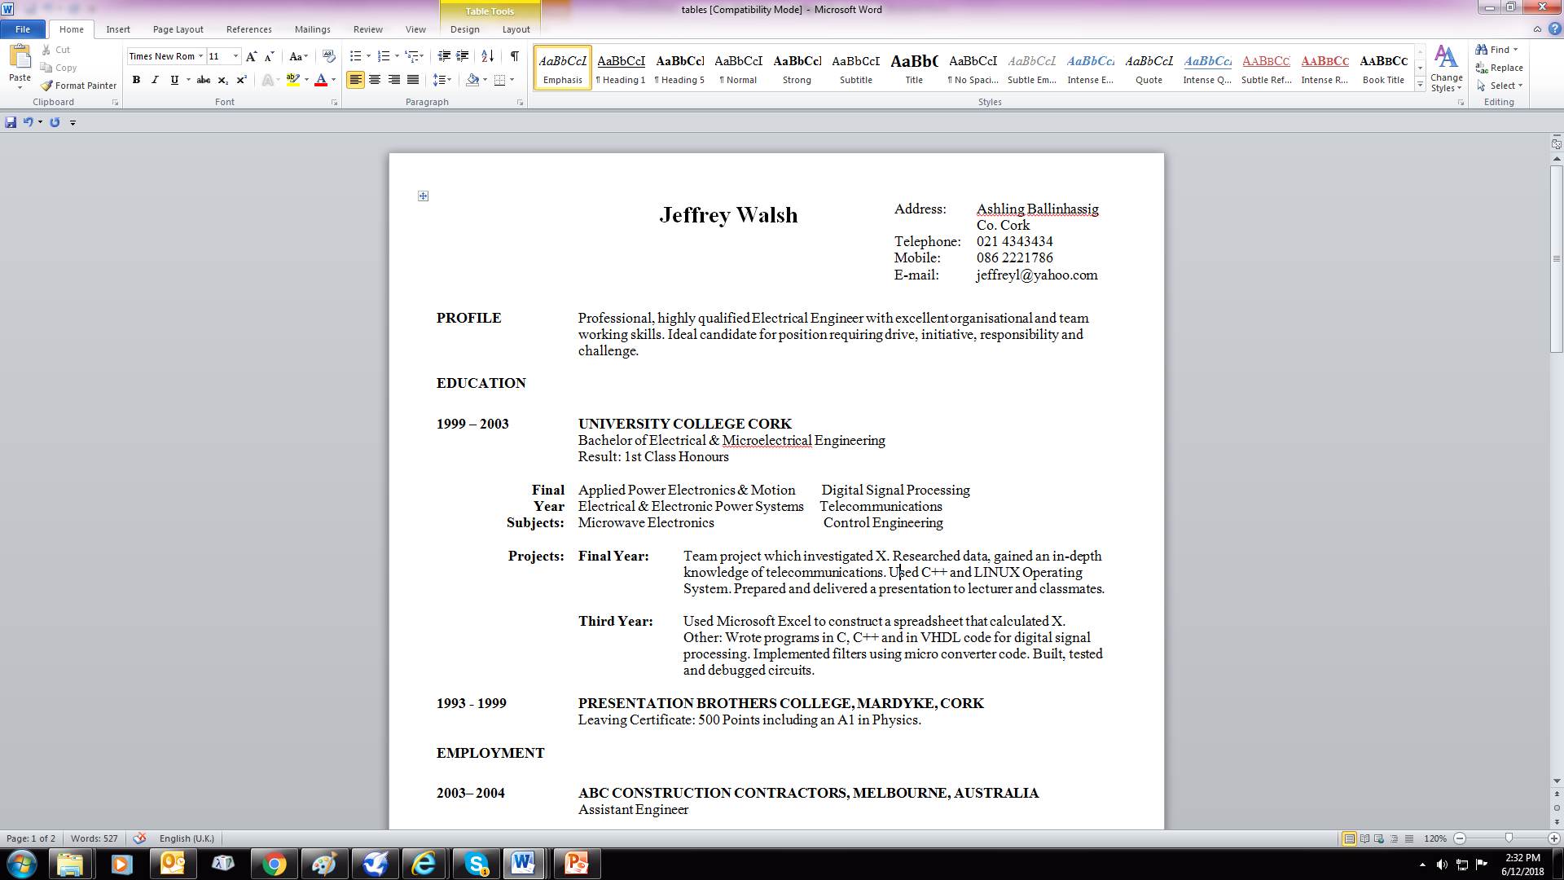
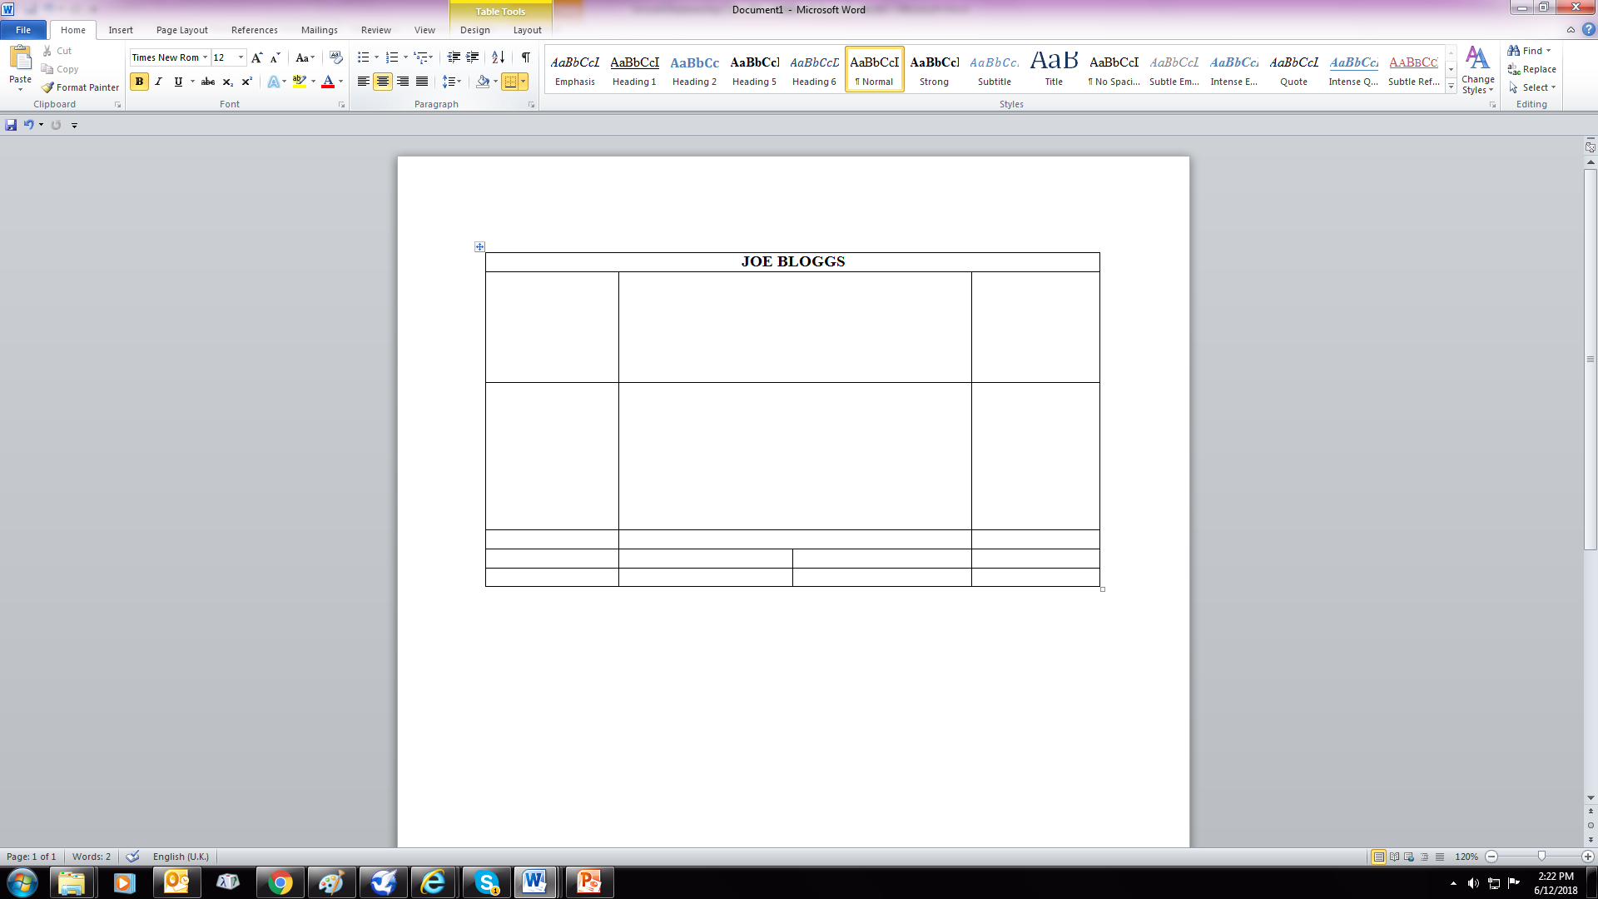
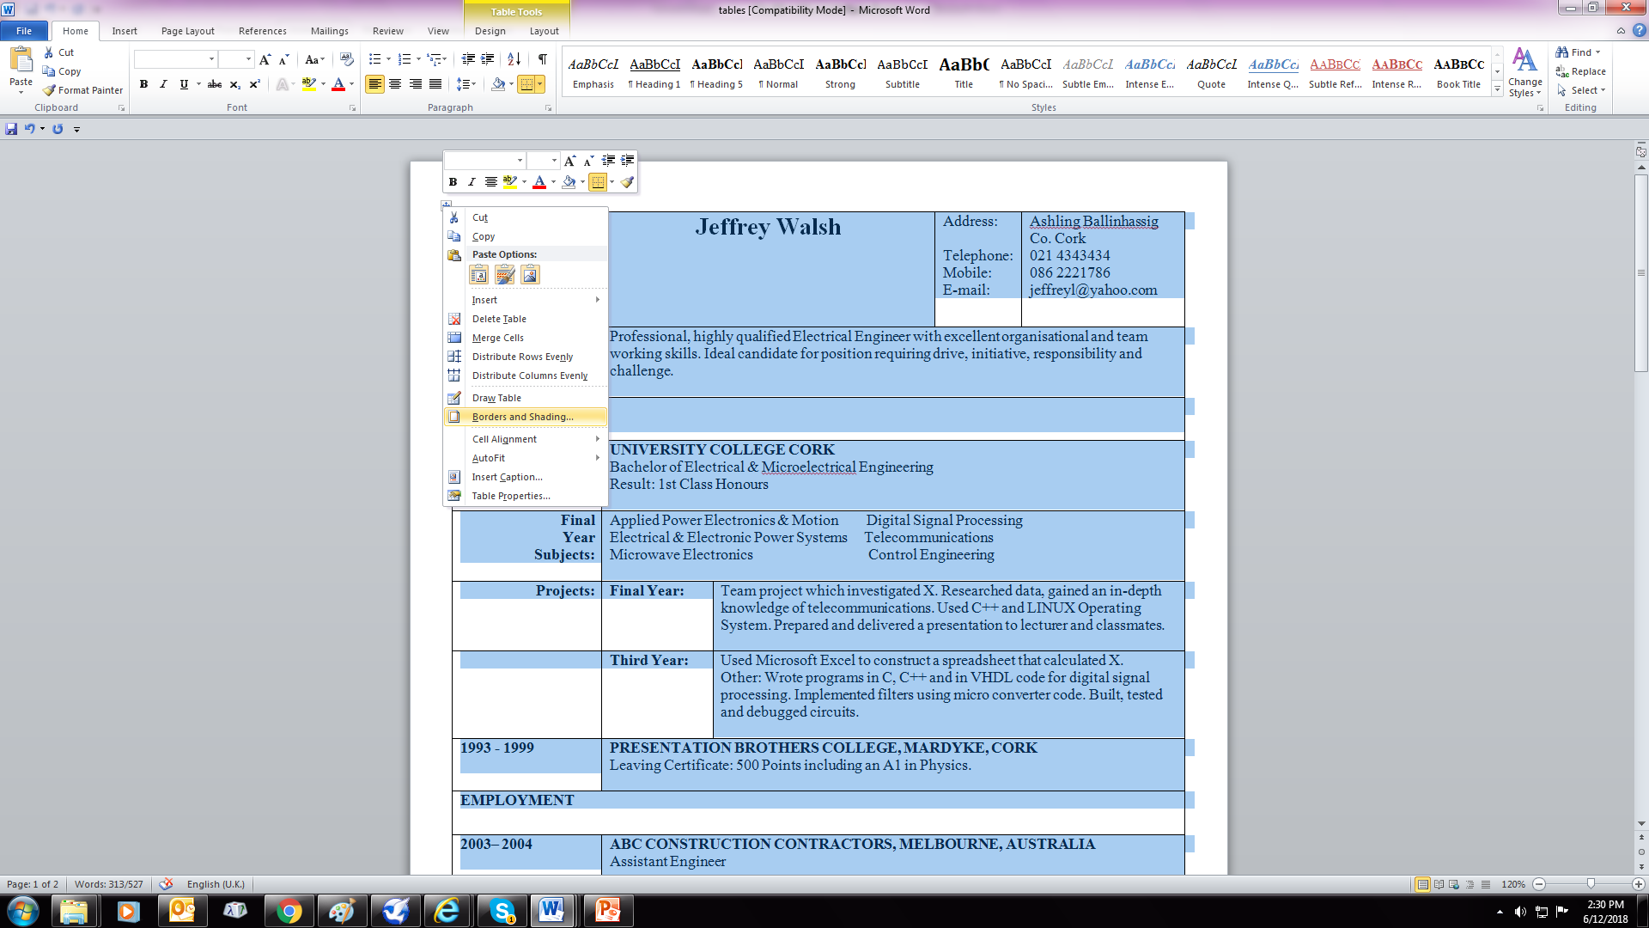
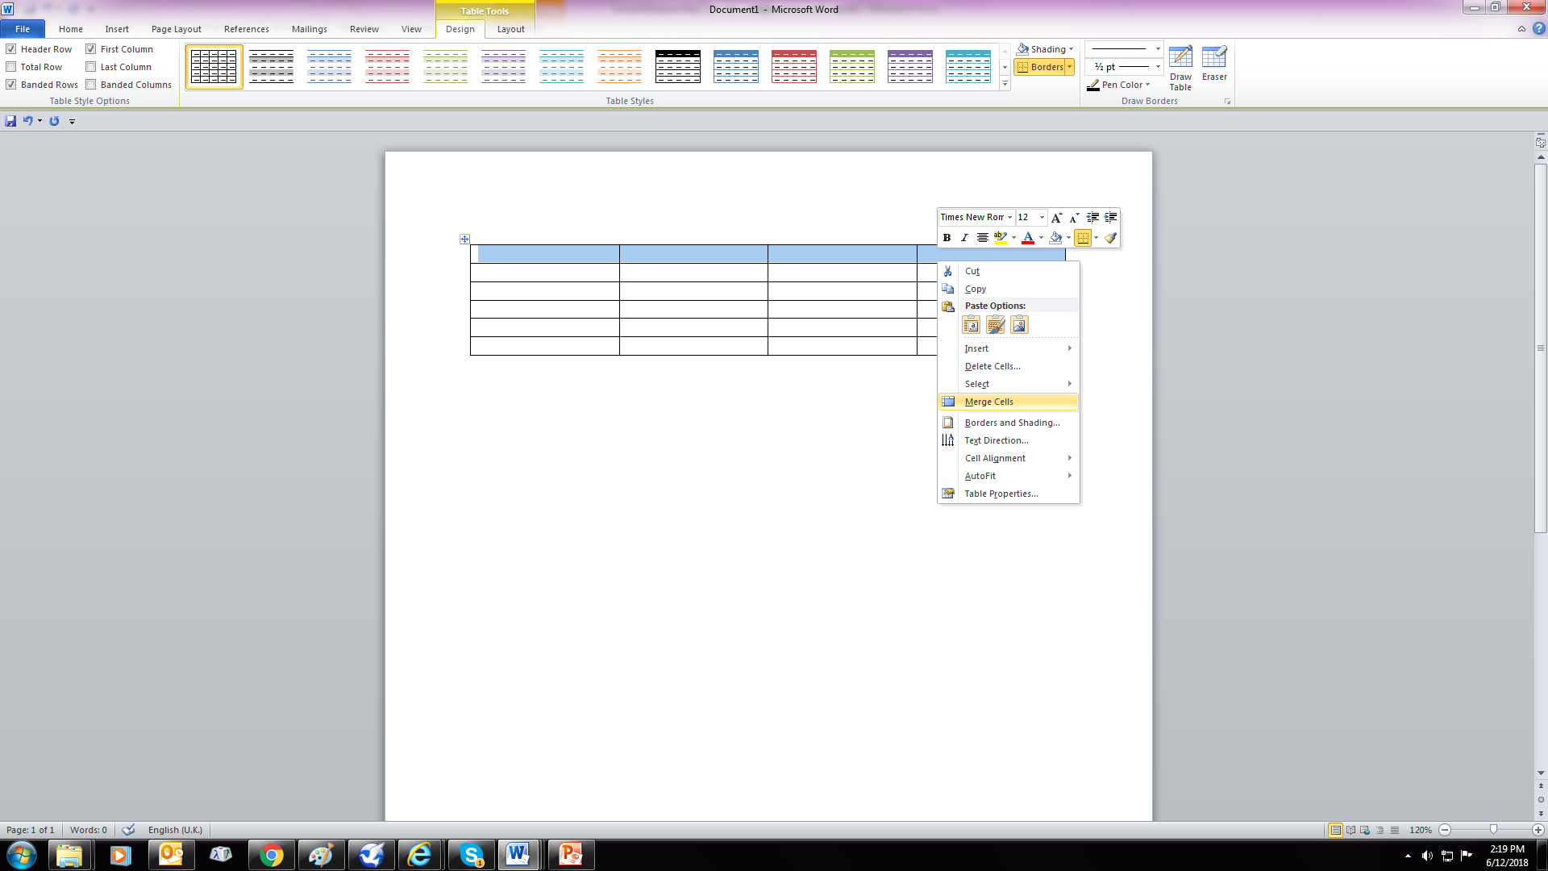
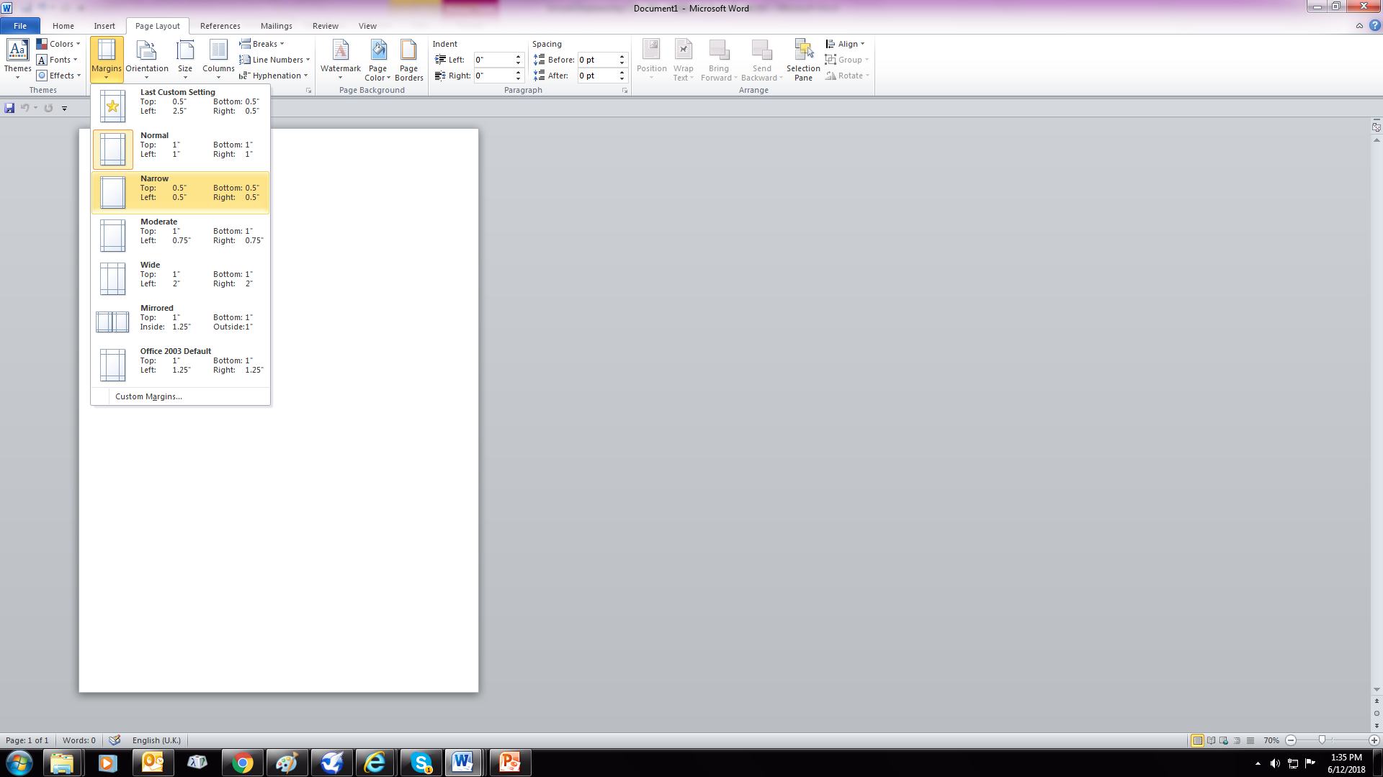
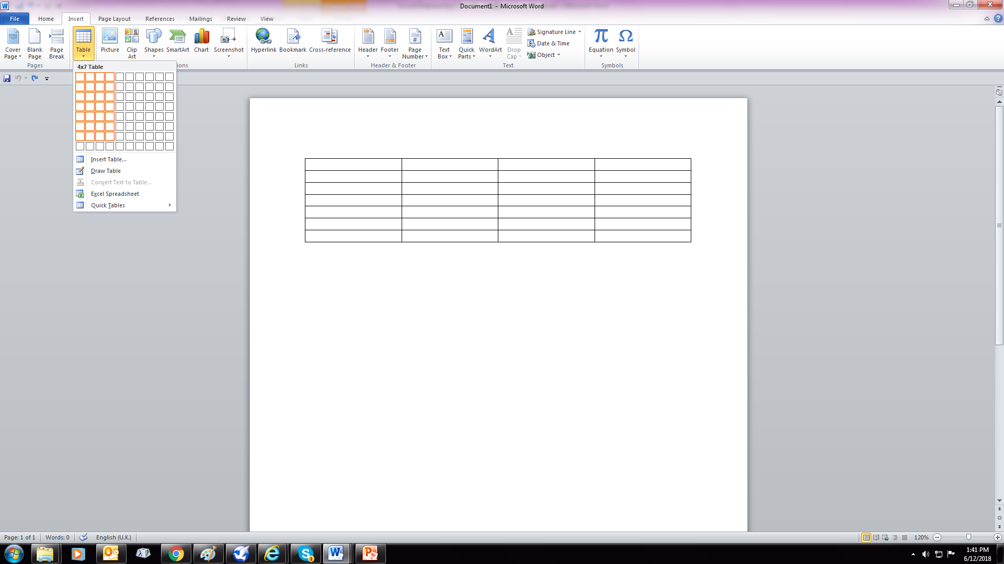

Formatting Tips in Microsoft Word
Set margins to narrow so you can fit more information in.
Set up a table with 3 or 4 columns and then you can organise your information more neatly.
Merge cells for different column spacings
When you are satisfied with the layout you can remove the borders by right clicking on the table
Notes:
Header: Uppercase, Calibri size 28, XJTLU Navy
Body Text: Sentence case, Calibri size 14, Black

Slide 18
Sources and further study
http://www.careers.manchester.ac.uk/applicationsinterviews/studyapplication/statement/
Link to the University of Edinburgh (Financial Management):
http://www.ed.ac.uk/studying/postgraduate/degrees/index.php?r=site/view&id=754
Application requirements:
https://www.star.euclid.ed.ac.uk/public/urd/sits.urd/run/siw_ipp_lgn.login?process=siw_ipp_app&code1=PTMSCFINMG1F&code2=0005
Notes:
Header: Uppercase, Calibri size 28, XJTLU Navy
Body Text: Sentence case, Calibri size 14, Black

Slide 19
THANK YOU
Notes:
Title: Uppercase, Calibri size 60, XJTLU Navy

Slide 20
谢谢
Notes:
Chinese Title: Heiti (黑体) Bold, size 60, XJTLU Navy

