Slide 1
LAML: Linear Algebra and Machine Learning
- A stand-alone Java library for linear algebra and machine learning
Mingjie Qian
Department of Computer Science
University of Illinois at Urbana-Champaign
July 13th, 2015

Slide 2
Features
Standalone, pure Java, and cross-platform
Built-in Linear Algebra (LA) library
Fast implementations for commonly-used machine learning methods and optimization algorithms
Well documented source code
Friendly API, very easy to use
Complete separation between feature engineering and model training
SourceForge: http://sourceforge.net/projects/lamal/ since 12/07/2013
Statstics: 1400+ downloads from 59 countries (regions)

Slide 3
LAML V.S. Liblinear
heart_scale with C = 1.0 and eps = 1e-2
LAML: 0.04s
Liblinear: 0.06s
Intel(R) Core(TM) i7 CPU M620 @ 2.67GHz with 4.00GB memory and 64-bit Windows 7

Slide 4
LAML V.S. JML
LAML is much faster than JML (more than 3 times faster).
JML relies on third party linear algebra library, i.e. Apache Commons-math. Sparse matrices and vectors have been deprecated in Commons-math 3.0+, and will be ultimately eliminated. Whereas LAML has its own built-in linear algebra library.
LAML also provides a lot of commonly used matrix functions in the same signature to Matlab, thus can also be used to manually convert MATLAB code to Java code.
In short, JML has been replaced by LAML.

Slide 5
LAML V.S. LibLAML
libLAML is a stand-alone pure C++ static library for linear algebra and machine learning
libLAML is at least 4 times faster than LAML
libLAML is not cross-platform

Slide 6
Built-in Linear Algebra Packages
la.decomposition
  EVD, LU, QR, and SVD
la.io
  IO functions
la.matrix
  DenseMatrix and SparseMatrix
la.vector
  DenseVector and SparseVector

Slide 7
Built-in Machine Learning Packages
ml.clustering
ml.regression
ml.classification
ml.topics
ml.optimization
ml.sequence
ml.subspace
ml.recommendation
...

Slide 8
Data Interface
la.io: IO for dense or sparse matrices
Load a matrix from a txt file
Save a matrix to a txt file
JMatIO can also be used to load and save MATLAB MAT files in Java
docTermCountArray2Matrix
  TextProcessor can transform a corpus to a docTermCountArray
readProblemFromStringArray + features2Matrix

Slide 9
Decomposition
Matrix A = hilb(m, n);
Matrix[] VD = EigenValueDecomposition.decompose(A);
Matrix[] LUP = LUDecomposition.decompose(A);
Matrix[] QRP = QRDecomposition.decompose(A);
Matrix[] USV = SingularValueDecomposition.decompose(A);

Slide 10
Matrix
Matrix interface:
  mtimes, times, plus, minus, transpose, operate, getEntry, setEntry, clear, copy, ...
DenseMatrix implements Matrix, Serializable
SparseMatrix implements Matrix, Serializable
  Standard compressed sparse column (CSC) and compressed sparse row (CSR)
  full control of the interior arrays in sparse matrices

Slide 11
Vector
Vector interface:
  times, plus, minus, operate, get, set, getDim, clear, and copy
DenseVector implements Vector, Serializable
SparseVector implements Vector, Serializable
  full control of the interior arrays in sparse vectors

Slide 12
Matlab
ml.utils.Matlab: Commonly used Matlab matrix functions with almost the same function input signature
  ones, zeros, eye, diag, rand, size, sparse, full
  sort, sum, max, min, vec, cat, vertcat, horzcat, repmat, reshape, kron, find, colon, display
  svd, eigs, ldivide, rdivide, mldivide, mrdivide, mtimes, times, plus, minus, power, norm, subplus, inv, rank
  not, and, or, eq, le, ge, lt, gt, isinf, isnan
  ...

Slide 13
Classification
ml.classification
  MCSVM, Regularized Logistic Regression, MaxEnt, AdaBoost
Classifier linearMCSVM = new LinearMCSVM(C, eps);
linearMCSVM.feedData(trainData); // double[][] or Matrix
linearMCSVM.feedLabels(labels); // double[][], int[], or Matrix
linearMCSVM.train();
linearMCSVM.predict(testData); // Predicted labels (int[])
Classifier logReg = new LogisticRegression(regularizationType, lambda);
logReg.feedData(data);
logReg.feedLabels(labels);
logReg.train();
logReg.predict(testData);

Slide 14
Regression
ml.regression
  LASSO and Linear Regression
Regression LASSO = new LASSO(options);
LASSO.feedData(data);
LASSO.feedDependentVariables(depVars);
LASSO.train();
Matrix Yt = LASSO.predict(testData);
Regression LR = new LinearRegression(options);
LR.feedData(data);
LR.feedDependentVariables(depVars);
LR.train();
Matrix Yt = LR.predict(testData);

Slide 15
Clustering
ml.clustering
  KMeans, NMFs, Spectral Clustering
Clustering spectralClustering = new SpectralClustering(options);
spectralClustering.feedData(data); // double[][] or Matrix
spectralClustering.clustering();
display(spectralClustering.getIndicatorMatrix());

Slide 16
Topic Modeling
ml.topics
  LDA // PLSA <=> NMF
  Read corpora with multiple format:
    int[][], DocTermCountArray, Matrix, LDAInput
int[][] documents = { {1, 4, 3, 2, 3, 1, 4, 3, 2, 3, 1, 4, 3, 2, 3, 6},
{2, 2, 4, 2, 4, 2, 2, 2, 2, 4, 2, 2},
{1, 6, 5, 6, 0, 1, 6, 5, 6, 0, 1, 6, 5, 6, 0, 0} };
LDA LDA = new LDA(LDAOptions);
LDA.readCorpus(documents); // Multiple corpus input format
LDA.train();
display(LDA.topicMatrix);
display(LDA.indicatorMatrix);

Slide 17
Sequence Labeling
ml.sequence
  Conditional Random Field Using L-BFGS
  Hidden Markov Models
HMM HMM = new HMM(numStates, numObservations, epsilon, maxIter);
HMM.feedData(Os);
HMM.feedLabels(Qs); // If not given, random initialization will be used
HMM.train();
HMM.evaluate(O);
HMM.predict(O);
CRF CRF = new CRF(epsilon);
CRF.feedData(Fs);
CRF.feedLabels(Ys);
CRF.train();
CRF.predict(F); // Also compute the probability via Viterbi algorithm

Slide 18
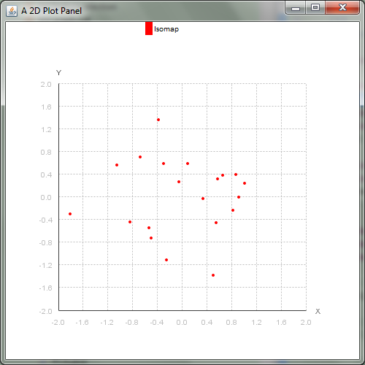
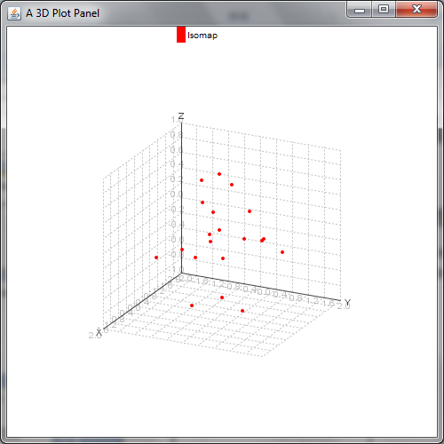
Dimensionality Reduction
ml.subspace
  PCA, KernelPCA, MDS, Isomap, and LLE
int n = 20; int p = 10; Matrix X = rand(p, n);
int K = 6; // number of nearest neighbors
int r = 3; // reduced dim
Matrix R = Isomap.run(X, K, r);

Slide 19
Matrix Recovery
ml.recovery
  Robust PCA and Matrix Completion
Matrix D = ... // Observation matrix
double lambda = 1.0;
RobustPCA robustPCA = new RobustPCA(lambda);
robustPCA.feedData(D);
robustPCA.run();
// Low-rank recovery of D
Matrix A_hat = robustPCA.GetLowRankEstimation();
// Error matrix between D and A
Matrix E_hat = robustPCA.GetErrorMatrix();

Slide 20
Recommendation
ml.recommendation
  Factorization Machines (FM), STructured Sparse Regression (STSR)
// Training
int idxStart = 0;
FM.feedTrainingData(trainFilePath, idxStart);
FM.allocateResource(k);
FM.feedParams(maxIter, lambda);
FM.initialize();
FM.train();
// Prediction
DataSet testData = FM.loadData(testFilePath, idxStart);
double[] Y_pred = FM.predict(testData.X);

Slide 21
General-Purpose Optimization
ml.optimization
  L-BFGS
  Proj L-BFGS (Simplex, Box, or Nonnegative)
  General Quadratic Programming (of course General Linear Programming)
  Nonlinear Conjugate Gradient
  Primal-Dual Interior-Point methods
  Accelerated Proximal Gradient
  Accelerated Gradient Descent

Slide 22
Utils
ml.utils
  ArrayOperator: commonly used double array operations
  InPlaceOperator: a set of in-place functions without memory allocation
  Printer: print matrices, vectors, arrays, and formatted strings
  Times: tic and toc
  ...

Slide 23
Others
ml.graph
  Minimum Spanning Tree and Shortest Path
ml.kernel
  'linear' | 'poly' | 'rbf' | 'cosine'
ml.manifold: semi-supervised/unsupervised
  Adjacency graph (directed or undirected)
  Laplacian regularization
  Local learning regularization
ml.random: Probability distributions
  Multivariate Gaussian Distribution

Slide 24
DataSet and Data
la.io.DataSet and la.io.Data
  readDataSet(ArrayList<String> feaArray)
  readDataSetFromFile(String filePath)
  writeDataSet(Matrix X, int[] Y, String filePath)
// Read a data set from a LIBSVM formatted string array or file
DataSet.IdxStart = 0;
trainDataSet = Data.readDataSetFromFile(featureFilePath);
Matrix X = trainDataSet.X; // n x p
int[] labels = trainDataSet.Y; // Used for classification or recommendation
Data.IdxStart = 0;
trainDataSet = Data.readDataSetFromFile(featureFilePath);
Matrix X = trainDataSet.X; // n x p
double[] labels = trainDataSet.Y; // Used for regression

Slide 25
Combine TextProcessor and LAML
For text mining, our input are text corpora, not sparse matrices.
Options options = new Options();
options.workSpacePath = "....";
options.mergedFileName = "";
options.dataDirName = "...";
options.ext = "txt";
TextProcessor textProcessor = new TextProcessor(options);
textProcessor.buildDocStringArray();
textProcessor.processStringArray(textProcessor.docStringArray);
/* Generate the dictionary, DocTermCountArray, GroundTruth, LabelIDMap, LDA format Input (file or stringArr), LIBSVM format input (file or stringArr) */
Matrix X = IO.docTermCountArray2Matrix(textProcessor.docTermCountArray);
int[] labelIDs = textProcessor.getLabelIDs();

Slide 26
Future Work
Multi-task learning
Multi-label learning
Multi-instance learning
Feature selection
Deep learning in Java (Parallel)

