Slide 1
chapter 7
Hypothesis testing using R
Instructor: Li, Han

Slide 2
Contents
Null hypothesis and alternative hypothesis
Steps for hypothesis testing
One/Two sample t test
Paired t test

Slide 3
Hypothesis testing
A statistical hypothesis is a hypothesis that is testable by observing the data. A statistical hypothesis test is a method of statistical inference.
Commonly, we propose two contradictive statistical hypothesis and use the a data set to compare which hypotheis is more likely to produce the observed data.

Slide 4
A research hypothesis typically states that there is a real change, a real difference, or real effect in the population or process. The hypothesis is often called H₁.
The opposite, null hypothesis, called H₀, then states that there is no real change, difference, or effect.

Slide 5
The basic strategy of hypothesis testing is to try to support a research hypothesis by showing that the sample results are highly unlikely, given the null hypothesis is true. However, the results are more likely to happen, if the research hypothesis is true. In a word, we try to reject H₀.

Slide 6
Steps for hypothesis testing
Declare the hypothesis
Select a test statistic
Specify the confidence level α
Specify the rejection region of the test statistic
Given the data, make a conclusion

Slide 7
Steps for hypothesis testing
Step 1. Declare the null hypothesis H₀ and the alternative hypothesis H₁.
In a mean estimation problem, for example the average housing price per square meters in Shenzhen in November, 2017, we may consider H₀: μ ≤ 35,000 and H₁: μ > 35,000.

Slide 8
A hypothesis that completely specifies the parameters is called simple. If it leaves some parameter undetermined it is composite.
A hypothesis is one-sided if it proposes that a parameter is larger than or less than a given value; it is two-sided if it says the parameter is not equal to a given value.
This difference results in different methods to calculate their p-values.

Slide 9
Step 2. Select a test statistic.
This is a summary statistic calculated from the data and it helps us to draw the conclusion whether to reject the null hypothesis or not. For the mean estimation problem, the choice would be the sample mean.

Slide 10
Rejecting H₀ when it is actually true is called a Type I Error. It means that we decide "there is some change" (accept H₁) but no change does happen (H₀ is true).
Step 3. Specify an acceptable level of Type I error, α, normally, 0.05 or 0.01.

Slide 11
α is the threshold used in deciding to reject H₀ or not. It is also called the confidence/signifance level. Given α = 0.05, if the probability of obtaining our data or more extreme data when H₀ is true, is 0.0001 (that's p-value), we reject H₀. If p-value > α, we think that the observed data is still normal, thus H₀ is probably to be true and we will not reject it.

Slide 12
Step 4. Identify the value of the test statistic that lead to rejection of the null hypothesis.
For the mean estimation problem, we reject the null hypothesis if the sample mean is too large such that its p-value is less than α. The starting value to reject H₀ is called the critical value.

Slide 13
p-value
p-value= P(test statistic equals the sample value or is more extreme | H₀ is true)
If p-value < α, we reject the null hypothesis, otherwise we retain H₀. p-value can be regarded as a measure of strength to support H₀.

Slide 14
Step 5. Obtain the data, calculate the value of the test statistic and compare it with the critical value or find its p-value. Finally draw the conclusion whether reject H₀ or not.

Slide 15
t.test()
The R function t.test() can be used to perform both one and two sample t-tests.
The function contains a variety of options and can be called as follows:
t.test(x, y = NULL, alternative = c("two.sided", "less", "greater"), mu = 0, paired = FALSE, var.equal = FALSE, conf.level = 0.95)

Slide 16
t.test(x, y = NULL, alternative = c("two.sided", "less", "greater"), mu = 0, paired = FALSE, var.equal = FALSE, conf.level = 0.95)
Here x, y are numeric vectors. If y is excluded, the function performs a one-sample t-test only using x. If y is included, it performs a two-sample t-test using both x and y.

Slide 17
t.test(x, y = NULL, alternative = c("two.sided", "less", "greater"), mu = 0, paired = FALSE, var.equal = FALSE, conf.level = 0.95)
The option mu is the value to compare. The option
alternative specifies the alternative hypothesis, and must be one of the following: "two.sided" (which is the default), "greater" or "less". For example, t.test(x, alternative = "less", mu = 10). It means
H₀: μ ≥ 10, H₁: μ <10.

Slide 18
t.test(x, y = NULL, alternative = c("two.sided", "less", "greater"), mu = 0, paired = FALSE, var.equal = FALSE, conf.level = 0.95)
The option paired indicates whether or not we want a paired t-test (TRUE = yes and FALSE = no). It default value is FALSE. The option var.equal indicates whether we assume the variance of x, y are equal or not.

Slide 19
t.test(x, y = NULL, alternative = c("two.sided", "less", "greater"), mu = 0, paired = FALSE, var.equal = FALSE, conf.level = 0.95)
Finally, the option conf.level=1-α determines the confidence level of the hypothesis testing and the reported confidence interval for μ in the one-sample case and μ₁ - μ₂ in the two-sample case.

Slide 20
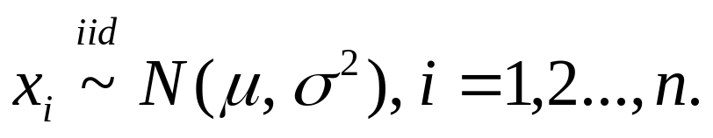
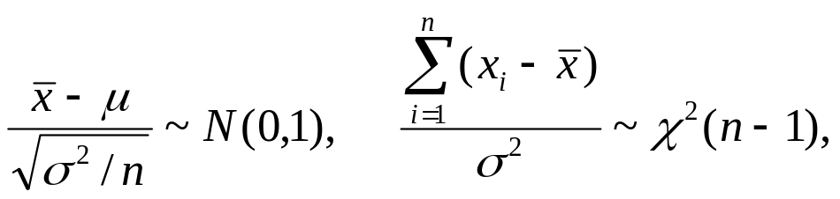
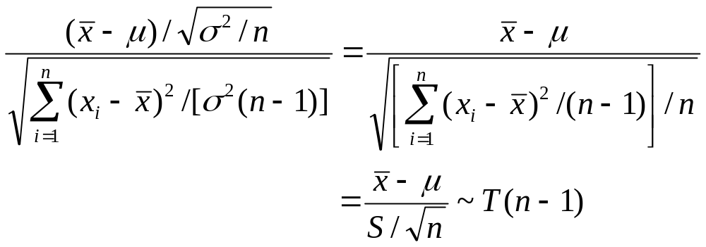
One sample t test
Assume we have n observations denoted as x₁,x₂,...,x_{n}. Suppose
We can derive that
Thus, by definition,
2

Slide 21
Example 1. (One sample t test)
An outbreak of Salmonella-related illness was attributed to ice cream produced at a certain factory. Scientists measured the level of Salmonella in 9 randomly sampled batches of ice cream. The levels (in MPN/g) were:
0.593 0.142 0.329 0.691 0.231 0.793 0.519 0.392 0.418

Slide 22
Is there evidence that the mean level of Salmonella in the ice cream is greater than 0.3
MPN/g?
Let μ be the mean level of Salmonella in all batches of ice cream. Here the hypothesis of interest can be expressed as:
H₀: μ ≤ 0.3, H₁: μ > 0.3.

Slide 23
Example 1
x = c(0.593, 0.142, 0.329, 0.691, 0.231, 0.793, 0.519, 0.392, 0.418)
t.test(x, alternative="greater", mu=0.3)

Slide 24
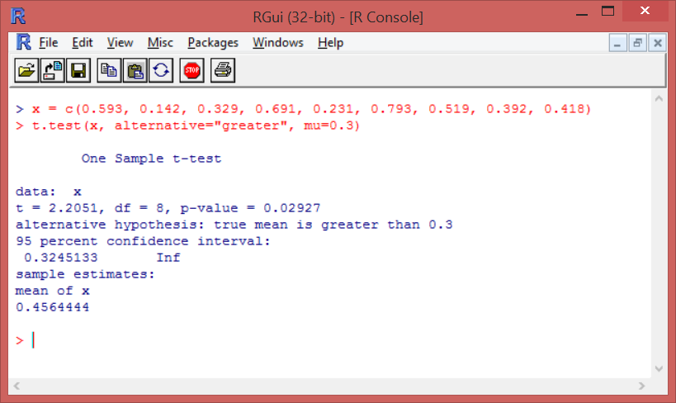

Slide 25
From the output we see that the p-value = 0.029. Hence, there is moderately strong evidence that the mean Salmonella level in the ice cream is above 0.3 MPN/g.

Slide 26
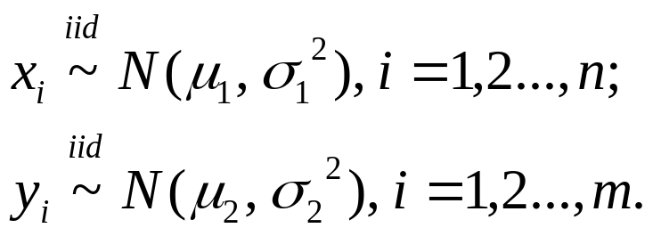

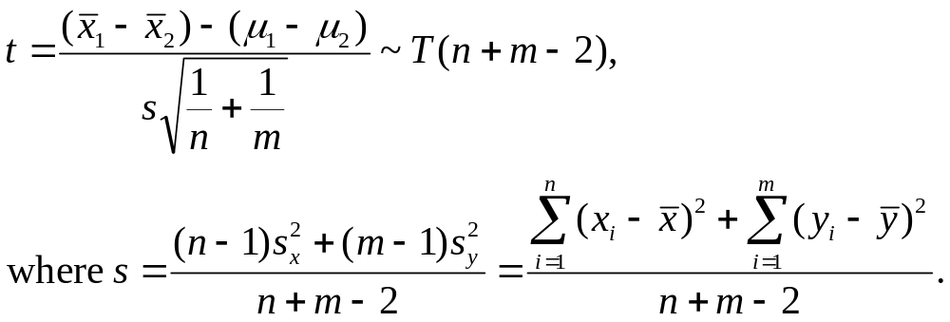
Two sample pooled t test
Assume for data set 1, we have n observations denoted as x₁,x₂,...,x_{n} ;for data set 2, we have m observations denoted as y₁,y₂,...,y_{m.} Suppose
Assuming that we can derive that

Slide 27
Example 2. (Two sample t test)
We want to check the effect of a new drug. 6 subjects were given the drug (treatment group) and an additional 6 subjects a placebo (control group). Their reaction time to a stimulus was measured (in ms). We want to perform a two-sample t-test for comparing the means of the treatment and control groups.

Slide 28
Let μ₁ be the mean of the population taking medicine and μ₂ the mean of the untreated
population. Here the hypothesis of interest can be expressed as:
H₀: μ₁-μ₂ ≥ 0, H₁: μ₁-μ₂ < 0.

Slide 29
Example 2.1
Treat = c(91, 87, 99, 77, 88, 91)
Control= c(101, 110, 103, 93, 99, 104)
t.test(Treat, Control, alternative="less", var.equal=TRUE)
In this example, we assume the variances of x and y are equal, thus df=n+m-2.

Slide 30
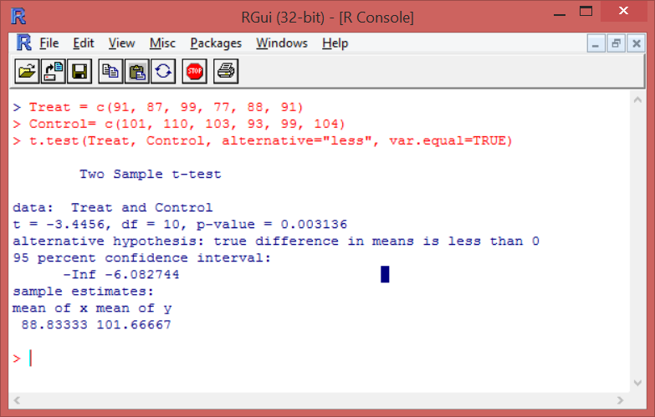

Slide 31
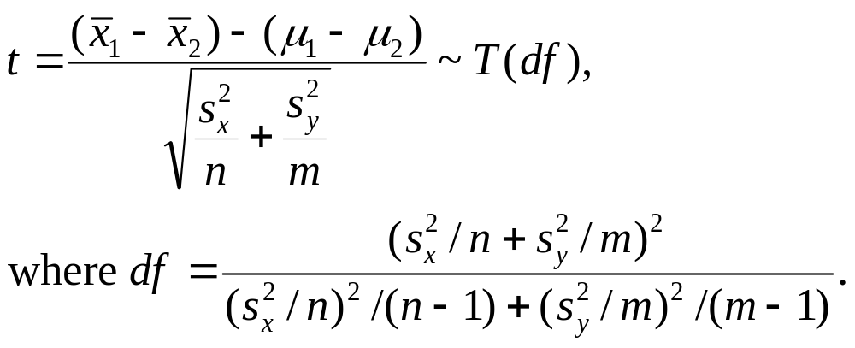
Welch t test
If the variance of the two samples are not equal, we need to change the formula for calculating t statistic and df. In this case,
To check whether the variance of the two samples are equal, we can use the box plot of the data or the F test.

Slide 32
Example 2.2
Treat = c(91, 87, 99, 77, 88, 91)
Control= c(101, 110, 103, 93, 99, 104)
t.test(Treat, Control, alternative="less")
In this example, we donot assume the variances of x and y are equal, thus the df changes!

Slide 33
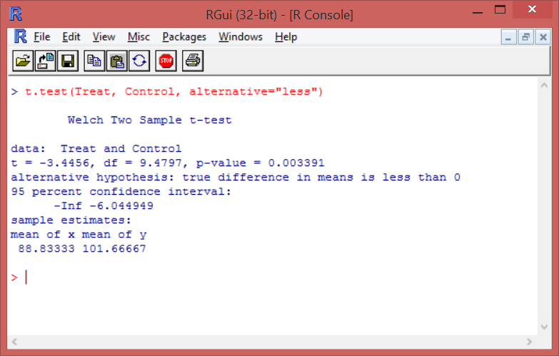

Slide 34
Here the pooled t-test and the Welsh t-test give roughly the same results (p-value = 0.0031 and 0.0033, respectively).

Slide 35
Paired t test
In a survey, one can measure each subject twice, before and after a treatment. In either of these situations we cannot use two-sample t-test since the independence assumption is not valid. Instead we need to use a paired t-test. This can be done using the option paired =TRUE. For paired t test, we first calculate the difference of the same object under two conditions, then use the one sample t test.

Slide 36
Example 3. (Paired t test)
A study was performed to test whether cars get better mileage on premium gas than on regular gas. Each of 10 cars was first filled with either regular or premium gas, decided by a coin toss, and the mileage for that tank was recorded. The mileage was recorded again for the same cars using the other kind of gasoline. We use a paired t test to determine whether cars get significantly better mileage with premium gas.

Slide 37
Example 3
reg = c(16, 20, 21, 22, 23, 22, 27, 25, 27, 28)
prem = c(19, 22, 24, 24, 25, 25, 26, 26, 28, 32)
t.test(prem, reg, alternative="greater", paired=TRUE)

Slide 38
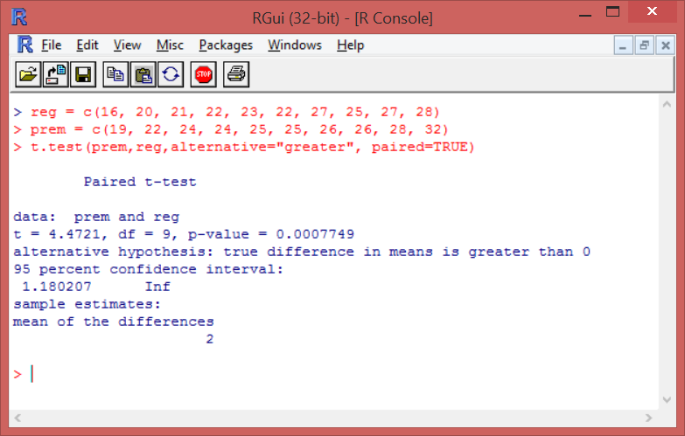

Slide 39
The results show that the t-statistic is equal to 4.47 and the p-value is 0.00077. Since the p-value is very low, we reject the null hypothesis. There is strong evidence of a mean increase in gas mileage between regular and premium gasoline.

Slide 40
Summary
In this session, we have learned
the procedures of hypothesis testing
how to conduct one/two/paired sample t test.

