Slide 1
Creating a dataset in R Instructor: Li, Han
chapter 2

Slide 2
Contents
objects: vector, matrix, data frame, factor, list...
input data from external files: text, Excel...

Slide 3
Object
name
types of objects: vector, matrix, array, data frame, factor, list
creation
assign a value
create a blank object, for example, list()

Slide 4
Different classes of objects

Slide 5
Assignment
“<-” used to indicate assignment
x <- 2
x <- c(1,2,3,4,5,6,7)
x <- 1:7
x <- seq(from=1,to=10,by=2)
x <- seq(1,10,2)
Note that we could also use "=" to assign the value.

Slide 6
Naming Convention
must start with a letter (A-Z or a-z)
can contain letters, digits (0-9), and/or periods “.”
case-sensitive
mydata is different from MyData
do not use underscore “_”

Slide 7
Vector
a one-dimensional array that can hold numerical, character or logical data
x <- c(...)
a <- c(1, 2, 5, 3, 6, -2, 4)
b <- c("one", "two", "three")
d <- c(TRUE, TRUE, TRUE, FALSE, TRUE, FALSE)

Slide 8
How to refer to the element of a vector
x[i]: i-th element
x[vec]: the elements whose positions are specified in vec

Slide 9
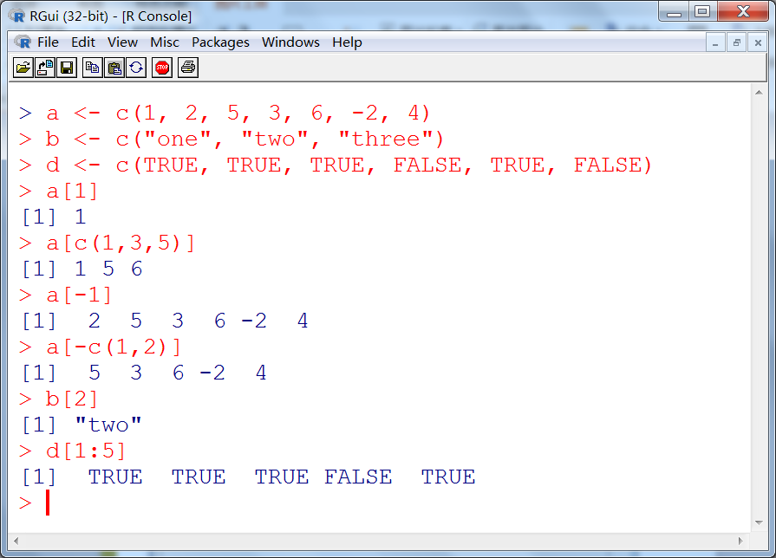

Slide 10
Matrix
a two-dimensional array that each element has the same mode (numeric, character, or logical)
mymatrix <- matrix(vector, nrow=?, ncol=?, byrow=TRUE/FALSE, dimnames=?)

Slide 11
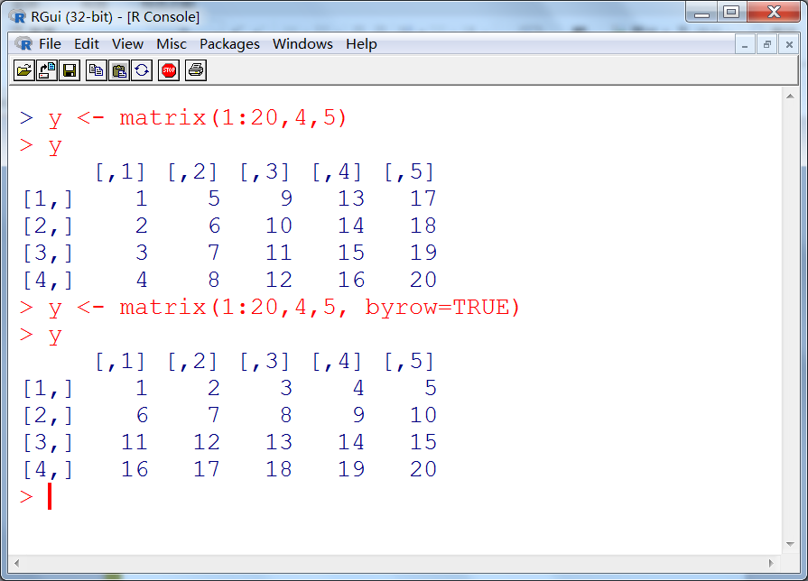

Slide 12
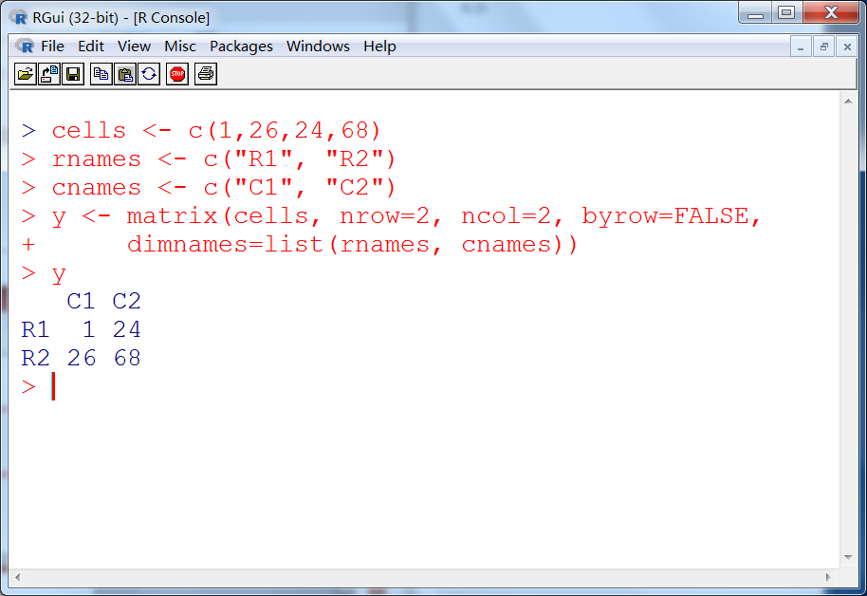

Slide 13
How to refer to the elements of a matrix
x[i,j]: i-th, j-th element
x[i, ]: i-th row
x[ ,j]: j-th column
x[vec1, vec2]: a submatrix

Slide 14
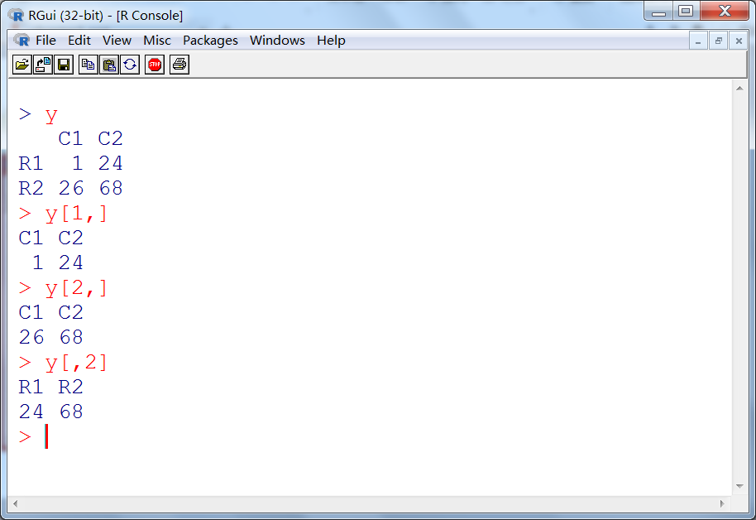

Slide 15
Array
Array is similar to matrix, but has more than two dimensions
myarray <- array(vector, dimensions=?, dimnames=?)

Slide 16
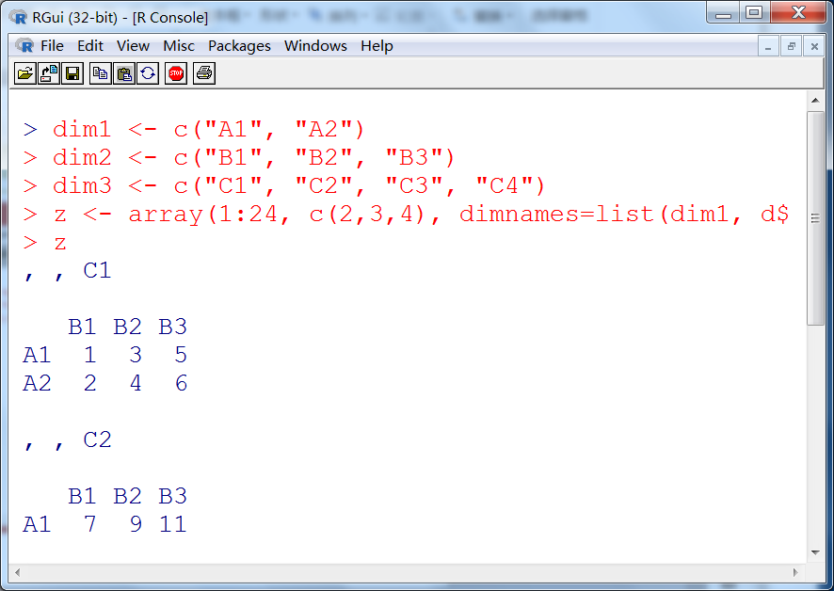

Slide 17
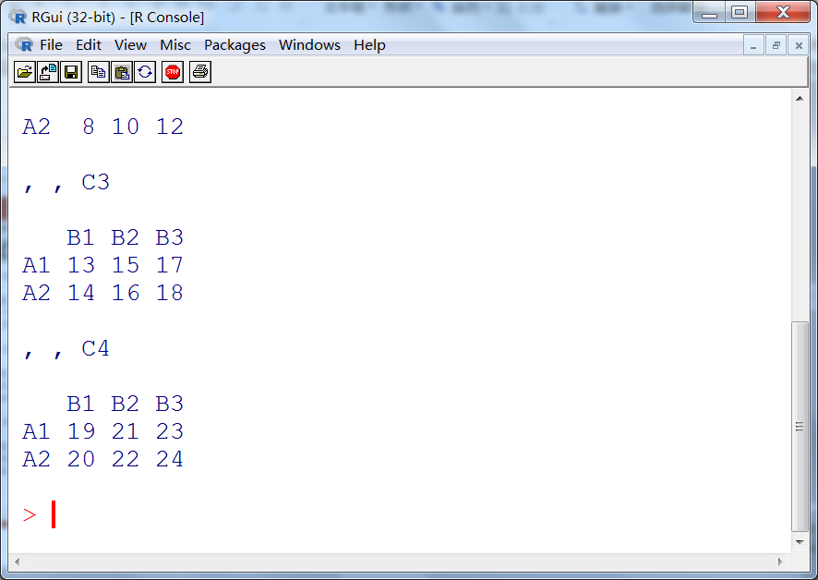

Slide 18
Data frame
Data frame is more general than a matrix because its columns can have different kinds of data.
mydata <- data.frame(col1, col2,...)

Slide 19
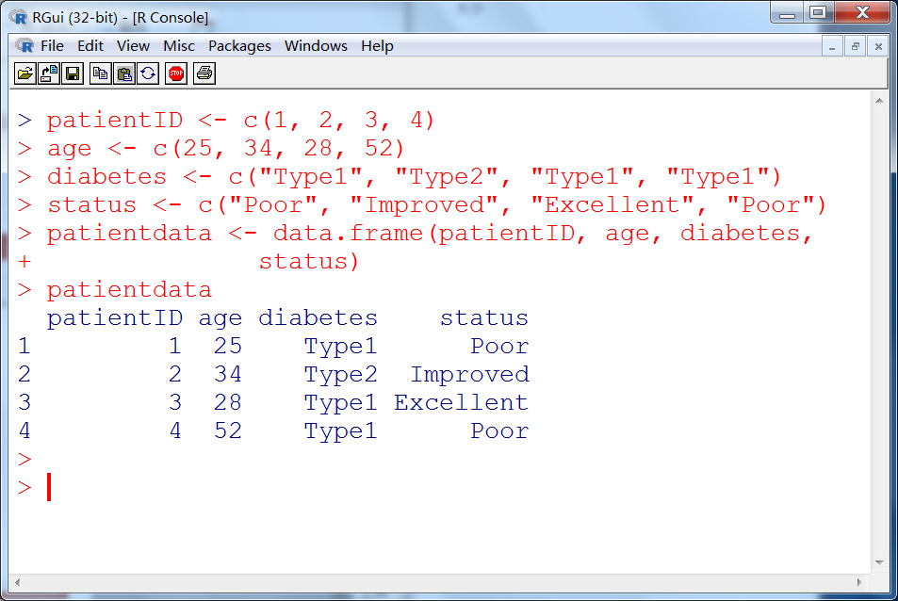

Slide 20
How to refer to elements of a data frame?
x[vec]: columns specified in vec
x[variable.names]
x$variable.name

Slide 21
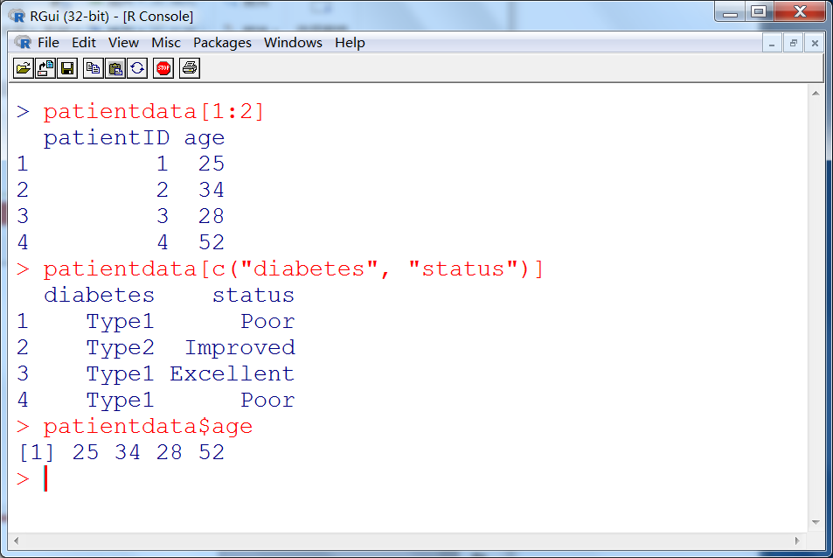

Slide 22
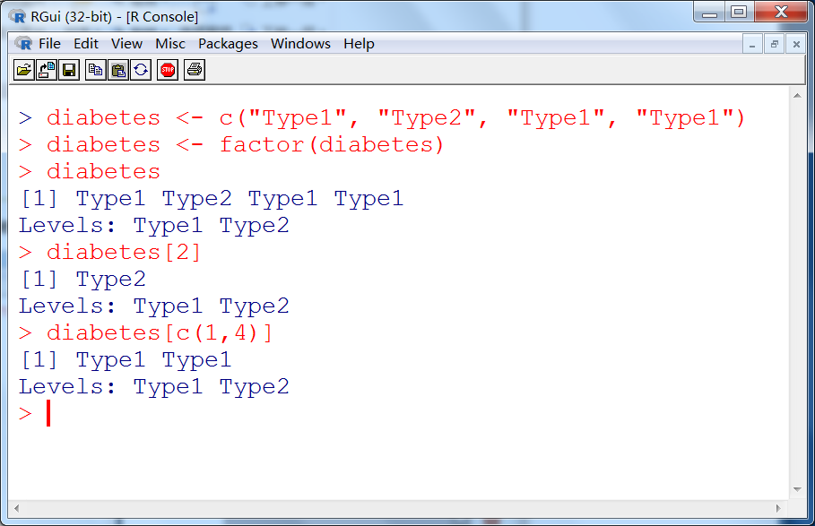
Factor
Factor is an ordinal or unordinal nominal variable.

Slide 23
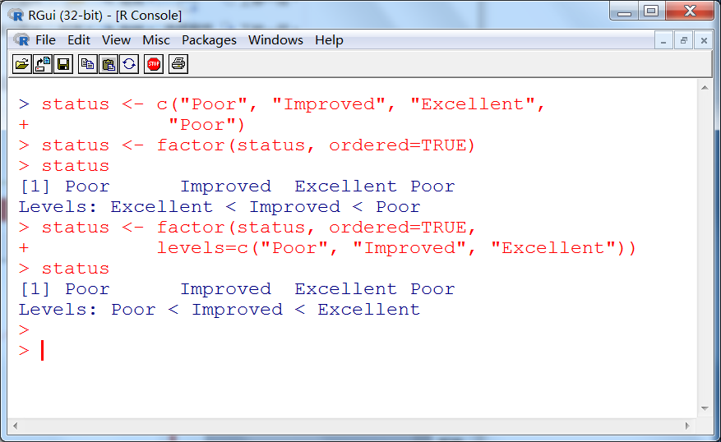

Slide 24
List
List is an ordered object that contains different kinds of sub-objects, for example, vectors, matrices, data frames and even lists.
mylist <- list(object1, object2,...)
How to refer to the elements of a list
x[[i]]:i-th compoent
x$variable.name

Slide 25
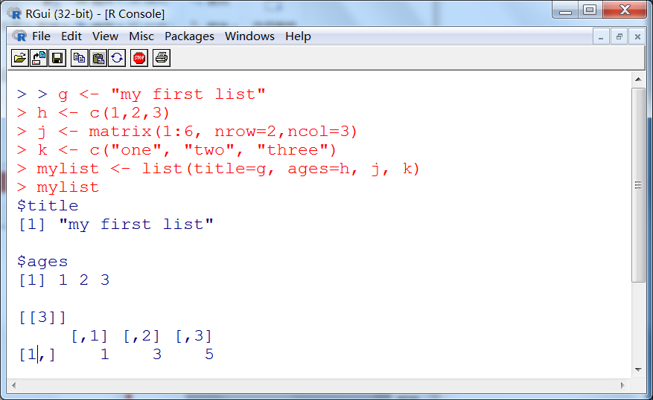

Slide 26
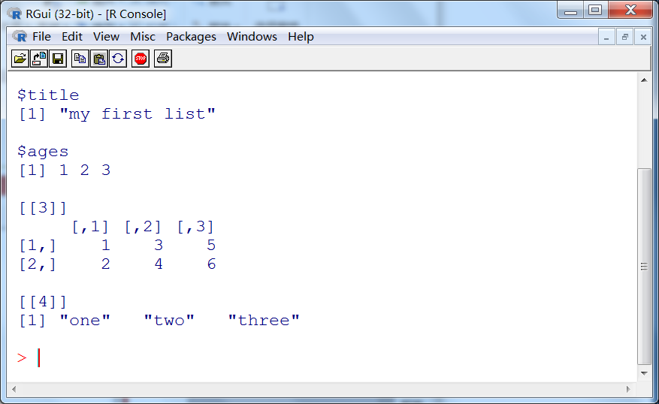

Slide 27
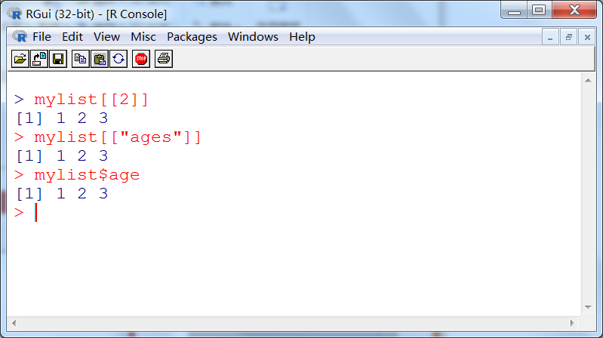

Slide 28
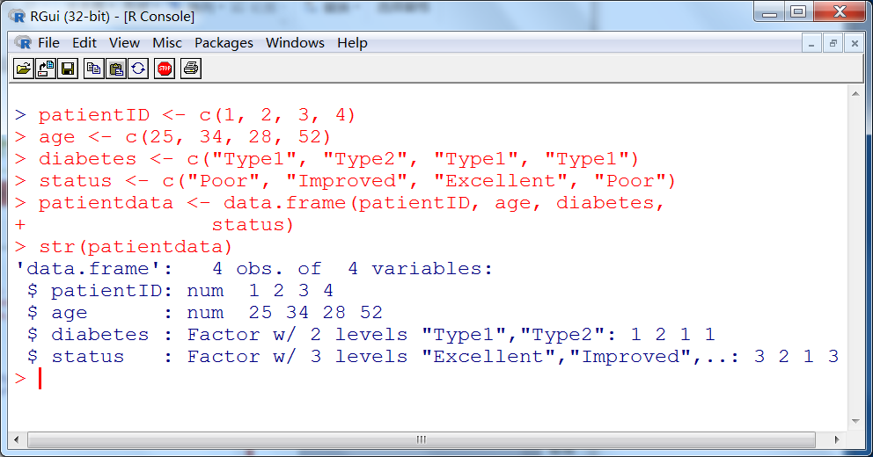
How does R deal with different objects

Slide 29
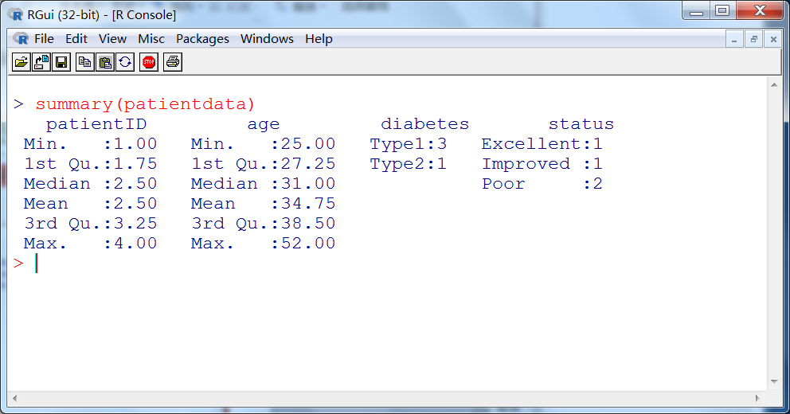

Slide 30
Attributes of an object
attributes
mode(object): numeric, character, logical
length(object): number of elements in an object
dim(object): dimension of a matrix/data frame
class(object): type of an object
str(object):structure of an object
names(object):names of components in an object

Slide 31
Import data
If we already have a data file, how can we directly import it into R instead of manually creating all its objects?

Slide 33
Import a data from a text file
mydataframe <- read.table(file, header=TRUE/FALSE, sep=?, row.names=?)

Slide 34
studentgrades.txt
StudentID, First, Last, Math, Science, Social Studies
011, Bob, Smith, 90, 80, 67
012, Jane, Weary, 75, , 80
010, Dan, "Thorn, III", 65, 75, 70
040, Mary, "O'Leary", 90, 95, 92

Slide 35
grades <- read.table("studentgrades.txt", header=TRUE, sep=",", row.names="StudentID")

Slide 36
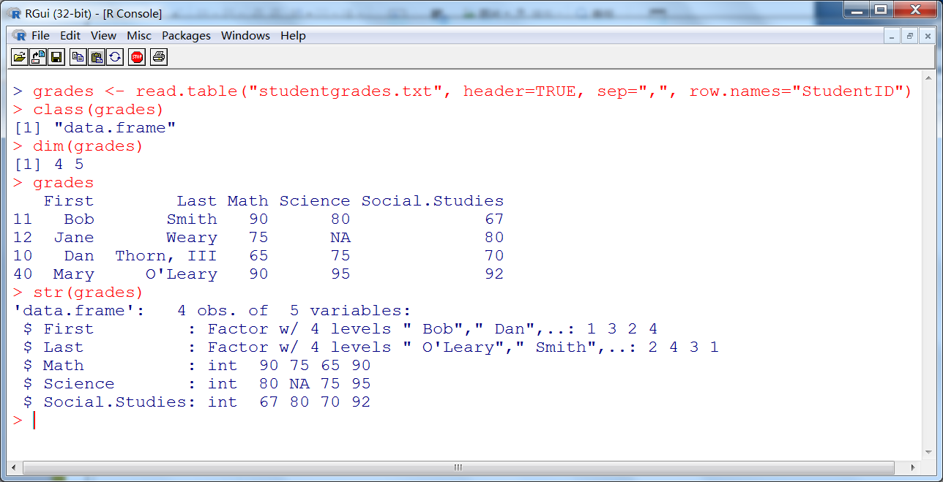

Slide 37
Import data from an excel file
The “xlsx” package can be used to access spreadsheets in excel format. Be sure to download and install the package before first use. The read.xlsx() function imports a worksheet from an XLSX file into a data frame.

Slide 38
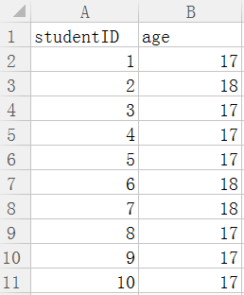
studentgrades2.xlsx

Slide 39
Import data from an excel file
install.packages("xlsx")
library(xlsx)
workbook <- “D:/studentgrades2.xlsx”
grades2 <- read.xlsx(workbook, 1)

Slide 40
Practice
Try all the examples by yourself.
Check the attributes of different objects.
Try to input text/excel files.

