Slide 1
Chapter 5
Advanced data management
Instructor: Li, Han

Slide 2
Contents
Statistics: mean, sd, var, median,quantile,…
Generate random variables from
  Binomial distribution
  Poisson distribution
  Normal distribution
  Uniform distribution
Pseudo-random variable
Inversion method

Slide 3
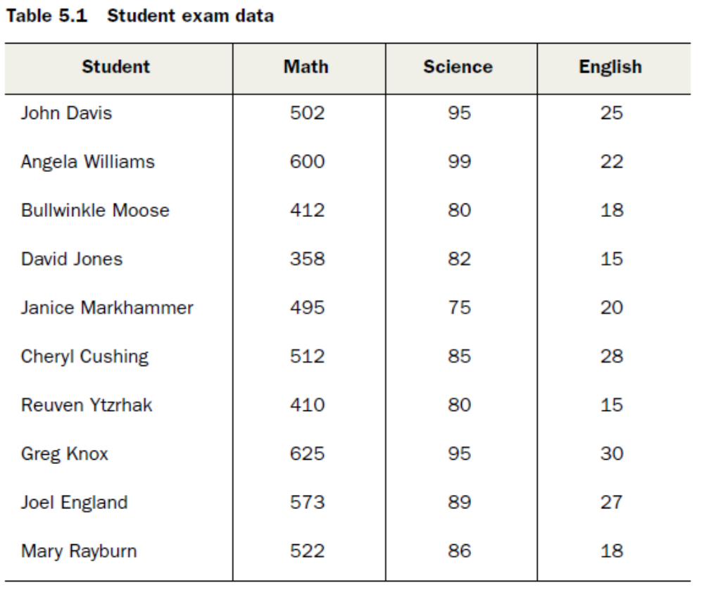

Slide 4
Statistical functions
mean: mean(x)
variance: var(x)
standard deviation: sd(x)
quantile: quantile(x, probs=c(...))
median: median(x)
covariance: cov(x,y)
correlation: cor(x, y)

Slide 5
min: min(x)
max: max(x)
range: range(x)
sum: sum(x)
scale: scale(x)
scale(x) means setting x*=(x-a)/b, such that mean(x*)=0, sd(x*)=1.

Slide 6
Example 5
x <- rnorm(100, 5, 1)
mean(x)
var(x)
sd(x)
quantile(x, probs=c(0.05, 0.5, 0.95))
median(x)

Slide 7
min(x)
max(x)
range(x)
sum(x)
x.new <- scale(x)
mean(x.new)
sd(x.new)
y <- runif(100, 0, 10)
cov(x, y)
cor(x, y)

Slide 8
Generate random variables
R could generate random variables from different distributions, for instance,
binomial distribution
poisson distribution
normal distribution
uniform distribution

Slide 9
[rdpq] distribution_abbreviation()
Where the first letter refers to the aspect of the distribution.
r=random generation
d=density
p=distribution function
q=quantile function

Slide 10
binomial distribution
X ~ binomial(m,p)
m independent trials, each with success probability p, and X is the total number of success.
rbinom(n, size, prob)
dbinom(x, size, prob, log = FALSE)
pbinom(q, size, prob, lower.tail = TRUE, log.p = FALSE)
qbinom(p, size, prob, lower.tail = TRUE, log.p = FALSE)
Here n=number of samples, size=m, prob=p.
lower.tail=TRUE means calculating P(X ≤x).

Slide 11
Example 1
#generate n=5000 samples with m=20, p=0.5
rv <- rbinom(5000, 20, 0.5)
pbinom(c(5, 10, 15, 20), size=20, prob=0.5)
qbinom(c(0.25, 0.5, 0.75, 1), 10, 0.5)

Slide 12
Poisson distribution
X ~ poisson(λ)
rpois(n, lambda)
dpois(x, lambda, log = FALSE)
ppois(q, lambda, lower.tail = TRUE, log.p = FALSE)
qpois(p, lambda, lower.tail = TRUE, log.p = FALSE)

Slide 13
Example 2
rv <- rpois(2000, 10)
ppois(c(5,10,15,20), lambda=10)
qpois(c(0.3, 0.6, 0.8), 10)

Slide 14
Normal distribution
X ~ N(μ,σ²)
rnorm(n, mean = 0, sd = 1)
dnorm(x, mean = 0, sd = 1, log = FALSE)
pnorm(q, mean = 0, sd = 1, lower.tail = TRUE, log.p = FALSE)
qnorm(p, mean = 0, sd = 1, lower.tail = TRUE, log.p = FALSE)

Slide 15
Example 3
pnorm(0)
round(qnorm(0.95),3)
rv1 <- rnorm(500, 0, 1)
rv2 <- rnorm(100000, 0, 1)

Slide 16
Uniform distributions
(1) discrete uniform distribution
P(X=x₁)=P(X=x₂)=...=P(X=x_{k})=1/k
sample(x, size, replace = FALSE, prob = NULL)
x: a vector of numbers to choose, here x=(x₁,...,x_{k}).
size: the number of samples
replace= FALSE: non-replacing sampling
prob=the corresponding probability to choose each item. By default, it is equal probability.

Slide 17
(2) continuous uniform distribution
runif(n, min = 0, max = 1)
By default, X ~ unif(0,1).
n: the number of samples
min: the minimum value of X
max: the maximum value of X
runif(n, min=a, max=b) means X ~ unif(a, b)

Slide 18
Example 4
sample(1:10, 5)
sample(1:10, 5, replace=TRUE)
sample(1:5,10, replace=TRUE, prob=c(0.5, 0.1, 0.2, 0.1, 0.1))
runif(10)
runif(20, 1, 10)

Slide 19
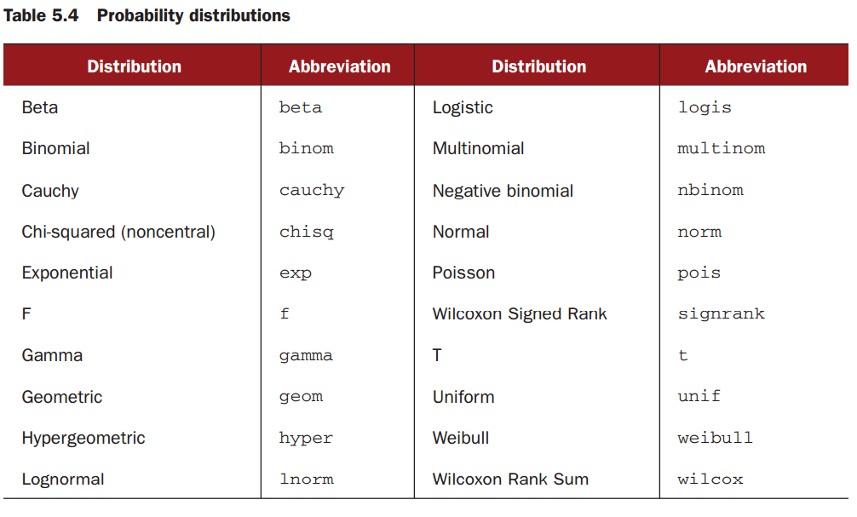
A summary of distributions

Slide 20
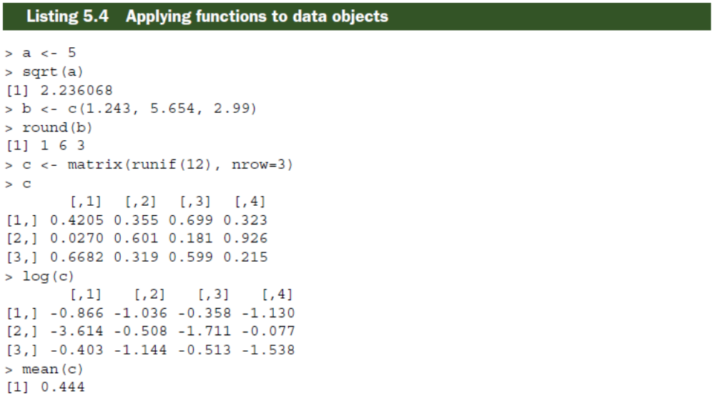
c is a matrix
mean(c) returns the average of all 12
elements of c

Slide 21
apply() function
apply() could calculate the statistics of a matrix or a data frame for all its rows or columns simultaneously.
apply(X, MARGIN, FUN, ...)
X: a matrix or data frame
MARGIN=1: calculation by row
MARGIN=2: calculation by column
FUN: the function to do the calculation

Slide 22
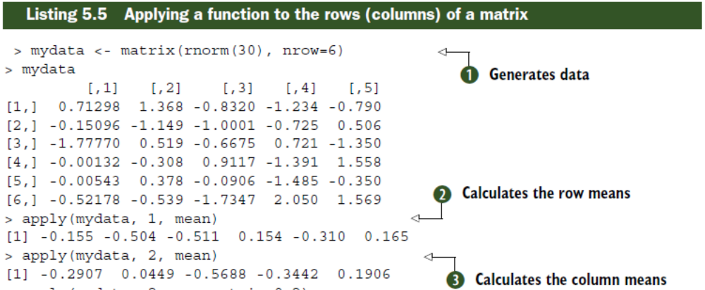

Slide 23
Example 6
x <- rnorm(10)
y <- rnorm(10, 5, 3)
z <- cbind(x, y)
z
apply(z, 1, mean)
apply(z, 2, mean)
apply(z, 1, sd)
apply(z, 2, sd)

Slide 24
Example 7
attach(mtcars)
z <- mtcars[c("mpg", "hp", "wt")]
apply(z, 2, mean)
apply(z, 2, sd)

Slide 25
"Random" variables
Random variables are really random?
Note that machine can only execute explicit commands. Thus we need to give a rule initially how to generate the samples, and this results in a pseudo-random variable, which are not actually random.

Slide 26
Pseudo-random variables
A sequence of pseudo-random numbers
x₁,...,x_{n}
Their statistical properties are very similar to those of true random variables, thus we regard them as if they were really random.

Slide 27
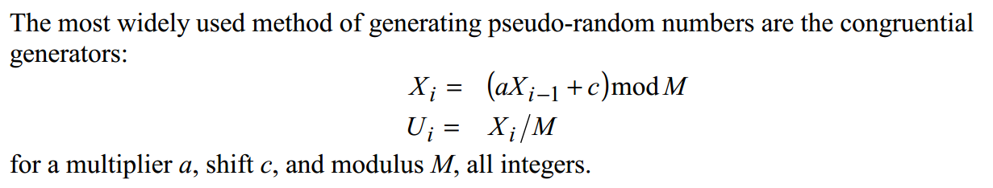
How to generate pseudo random variables?
Given M, the values of a and c are chosen to maximize the period of the numbers, and to ensure the generator has good statistical properties.

Slide 28
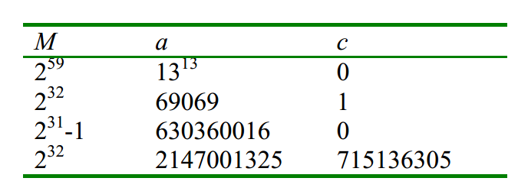
Some examples:

Slide 29
set. seed()
How to re-generate the same sequence of random variables? Use
set. seed()
Everytime you generate pseudo-random variables, the software uses a different seed, thus generate different samples. If you fix the seed, your results will be reproducible!

Slide 30
Example 8
runif(5)
runif(5)
set.seed(123)
runif(5)
set.seed(123)
runif(5)

Slide 31
Generate discrete distribution
Question:
How to generate random variables from a specified distribution that has probability p(k), k=0,1,…,N?

Slide 32
Inversion method
The inversion method reduces to searching for an index j that satisfies
p(0)+p(1)+...+p(j-1) ≤ U <p(0)+p(1)+...+p(j-1) +p(j),
Where U ~ Uniform(0,1).

Slide 33
Example 9
Assume p(0)=0.5, p(1)=0.3, p(2)=0.2, then
if 0 ≤ U <0.5, return X=0;
if 0.5 ≤ U <0.8, return X=1;
if 0.8 ≤ U <1, return X=2.

Slide 34
Question:
How to generate random variables from a specified continuous distribution F(.)?

Slide 35
Summary
how to generate random variables from different distributions
calculate the statistics, for instance, the mean, sd, quantile of sample variables
pseudo random variables
using inversion method to generate random variables from a specific discrete distribution

