Slide 1
chapter 8
Regression analysis I
Instructor: Li, Han

Slide 2
Contents
The framework of OLS regression
Fit the data using linear model
Fit the data using quadratic model
Analyze the output results
Check the model assumptions

Slide 3
Regression analysis
Regression analysis lives at the heart of statistics. It is a broad term for a set of methodologies used to analyze the functional relationship between a response variable and one or more explanatory(predictor) variables.
In general, regression analysis can
identify the relevant explanatory variables
describe the form of the relationships involved
predict the response for given explanatory variables.

Slide 4
A data example
An exercise physiologist might use regression analysis to develop an equation for predicting the expected number of calories a person will burn while exercising on a treadmill.

Slide 5
response variable:
the number of calories burned
explanatory variables:
duration of exercise (minutes)
percentage of time spent at their target heart rate
average speed (mph)
age (years), gender, and body mass index (BMI)

Slide 6
Questions:
What’s the relationship between exercise duration and calories burned? Is it linear or curvilinear?
How does effort (the percentage of time at the target heart rate, the average walking speed) factor in?
How many calories can a 30-year-old man with a BMI of 28.7 expect to burn if he walks for 45 minutes at an average speed of 4 miles per hour and stays within his target heart rate 80 percent of the time?

Slide 7
Effective regression analysis is an interactive, holistic process with many steps, and it involves many skills.
Given the data, we repeat the following steps until we are satisfied with the model/results:
propose a model
fit the model
check the model assumptions

Slide 8
Different regression models
Regression methods include the followings:
simple/multiple linear
polynomial
logistic
poisson
time series

Slide 9
OLS-based regression
Here we focus on regression methods called ordinary least squares (OLS) regression, including simple/multiple linear regression and polynomial regression.
In OLS regression, a quantitative dependent variable is predicted from a weighted sum of predictor variables, where the weights are parameters estimated from the data.

Slide 10
Linear model
Model assumptions:
Normality —For fixed values of the independent variables, the dependent variable is normally distributed.
Independence —The Yi values are independent of each other.
Linearity
Homoscedasticity —The variance of Yi values doesn’t vary with the levels of the independent variables.

Slide 11
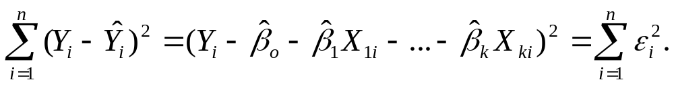
OLS selects model parameters (intercept and slopes) that minimize the difference between actual response values and those predicted by the model. Specifically, model parameters are selected to minimize the sum of squared residuals.

Slide 12
Fitting regression line with lm()
In R, the basic function for fitting a linear model is lm(). The format is
myfit <- lm(formula, data)
formula: the model, ususally it is y ~ x₁+...+ x_{k}.
data: the data frame for regression analysis, includes y, x_{1,}..., x_{k}.
myfit: a list containing various information about the regression results.

Slide 13
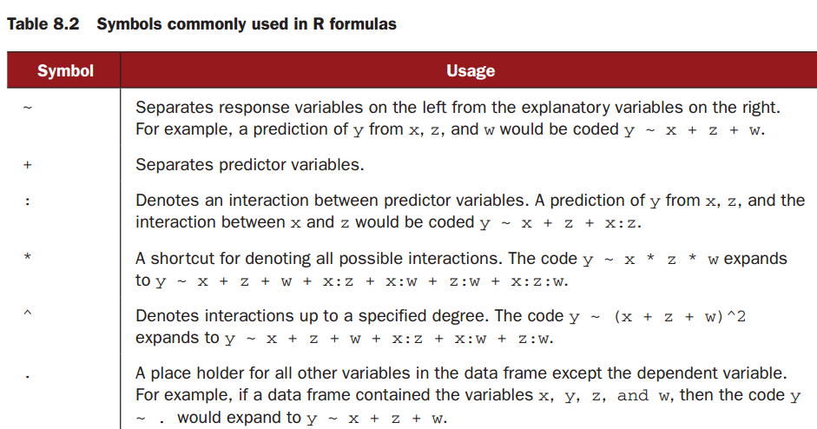

Slide 14
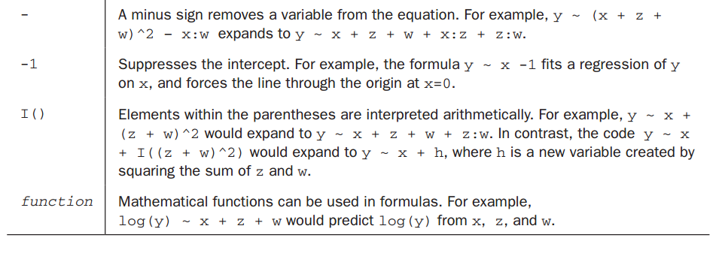

Slide 15
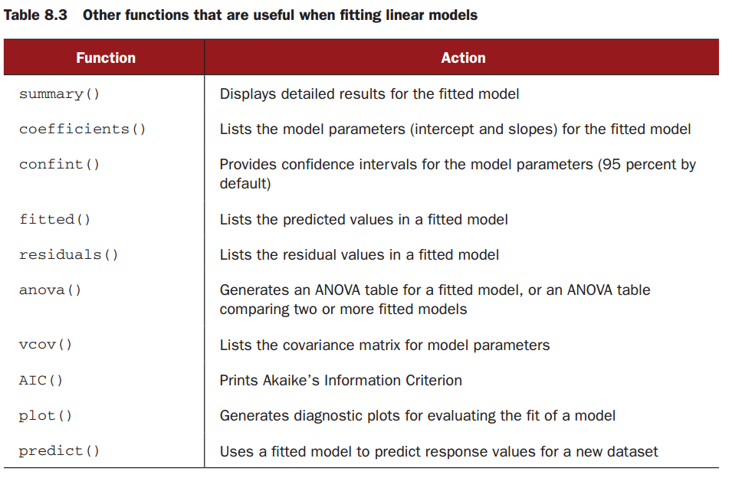

Slide 16
A data example
The dataset women in the base installation provides the height and weight for a set of 15 women ages 30 to 39. We want to predict weight from height. Having an equation
for predicting weight from height can help us to identify overweight or underweight individuals.

Slide 17
Example 1 (simple regression)
women
fit <- lm(weight ~ height, data=women)
summary(fit)
coefficients(fit)
confint(fit)
fitted(fit)
residuals(fit)
plot(women)
lines(women$height, fitted(fit))

Slide 18
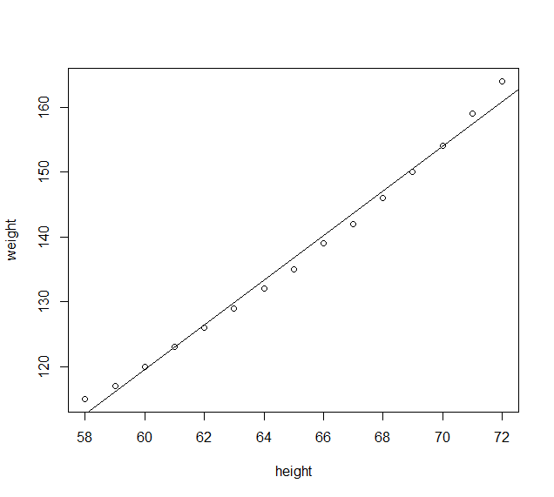

Slide 19
Polynomial regression
The above plot suggests that you might be able to improve your prediction using a regression with a quadratic term (that is, X² ).
You can fit a quadratic equation using the statement
fit2 <- lm(weight ~ height + I(height^2), data=women)

Slide 20
Example 2 (polynomial regression)
fit2 <- lm(weight ~ height + I(height^2), data=women)
summary(fit2)
plot(women, xlab="Height (in inches)", ylab="Weight (in lbs)")
lines(women$height, fitted(fit2))

Slide 21
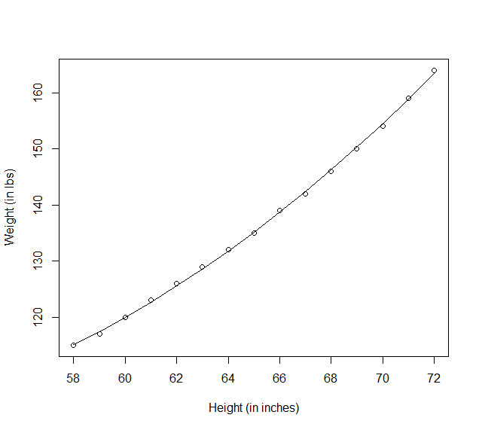

Slide 22
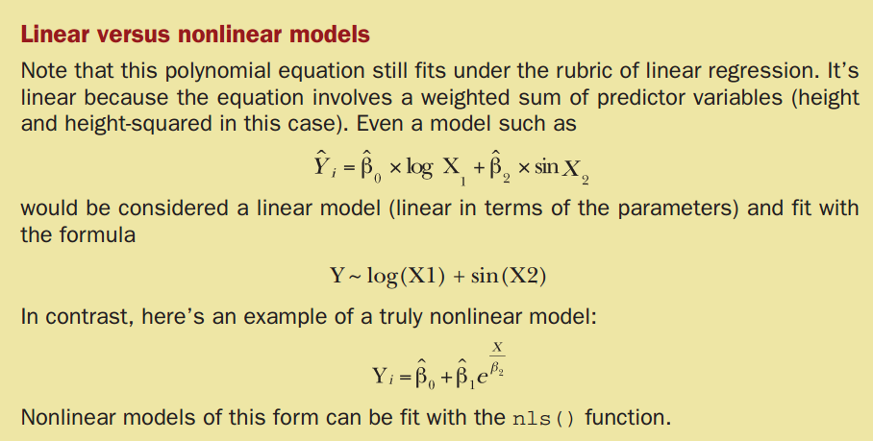
linear relationship

Slide 23
Multiple linear regression
When there's more than one predictor variable, simple linear regression becomes multiple linear regression, and the analysis becomes more involved. We'll use the state.x77 dataset in the base package for this example.
response variable: a state's murder rate
explanatory variables: population, illiteracy rate, average income, and frost levels (mean number of days below freezing).

Slide 24
Because the lm() function requires a data frame (and the state.x77 dataset is a matrix), we need to subset the original data and transform it to a data frame.
Example 3 (data transformation)
state.x77
class(state.x77)
states <- as.data.frame(state.x77[,c("Murder", "Population",
"Illiteracy", "Income", "Frost")])
states
class(states)
dim(states)

Slide 25
A good first step in multiple regression is to examine the relationships among the variables two at a time.
scatterplot
correlation matrix

Slide 26
Example 4 (multiple regression)
library(car)
scatterplotMatrix(states, spread=FALSE, lty=2, main="Scatter Plot Matrixs")
options(digits=2)
cor(states)

Slide 27
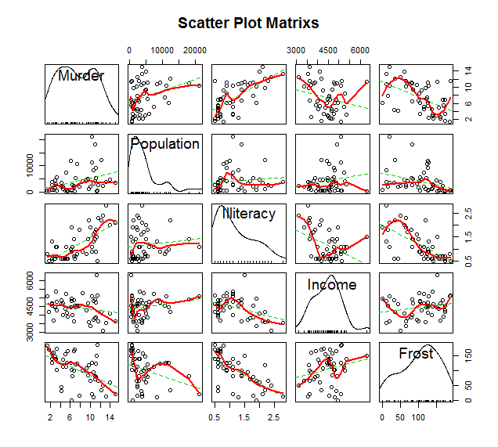
Scatterplot

Slide 28
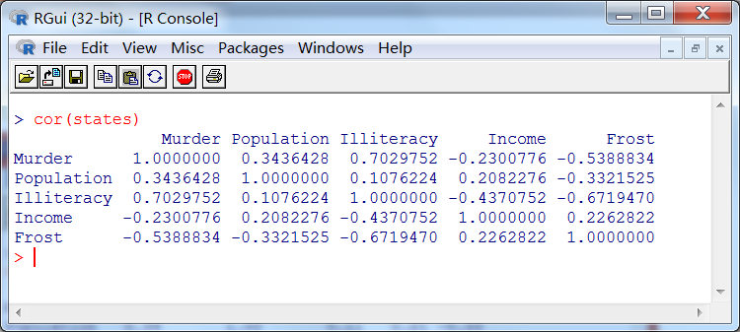

Slide 29
After we check that “murder rate” has medium or strong linear relationship with “population” and “ illiteracy”, we continue to do the linear regression.
Example 5 (linear regression)
fit <- lm(Murder ~ Population + Illiteracy + Income + Frost, data=states)
summary(fit)
coefficients(fit)
confint(fit)
residuals(fit)

Slide 30
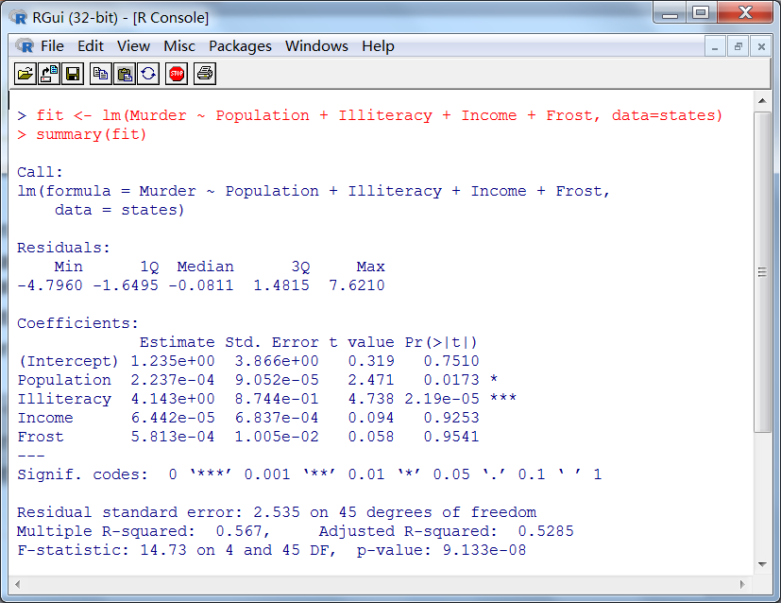

Slide 31
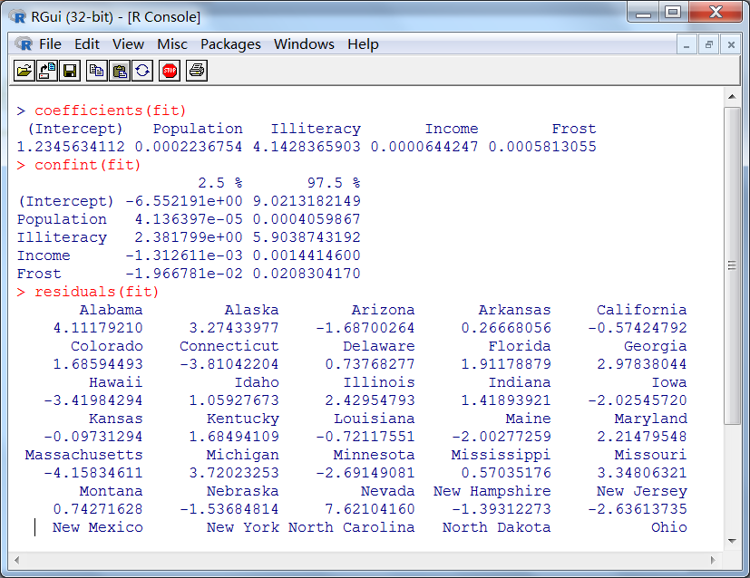

Slide 32
Regression diagnostics
summary() function outputs the model parameters and other statistics. But it does not tells us if the model we fit is appropriate.
Our confidence in inference of regression parameters depends on the degree to which the data have met the statistical assumptions of the OLS model.

Slide 33
> fit <- lm(weight ~ height, data=women)
> par(mfrow=c(2,2))
> plot(fit)

Slide 34
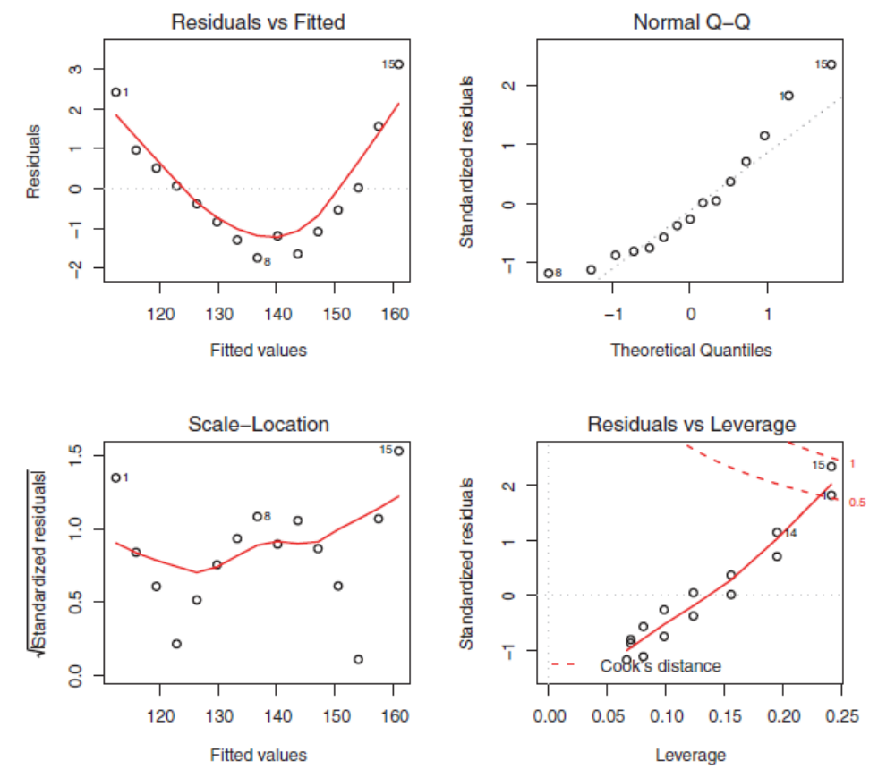

Slide 35
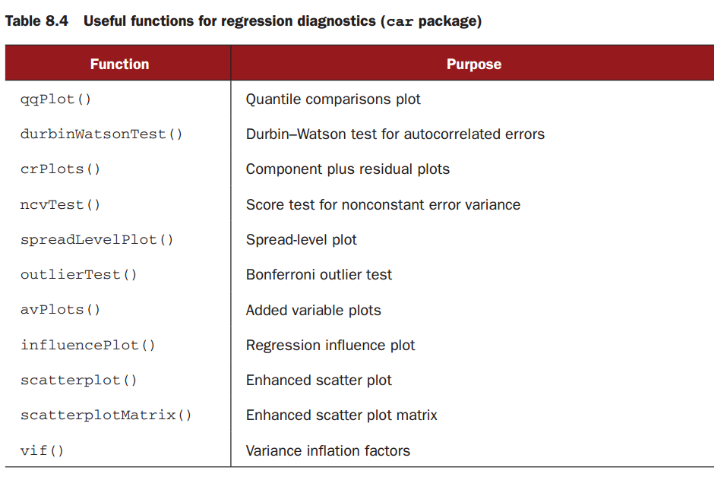
car package

Slide 36
Normality
The qqPlot() function provides an accurate method of assessing the normality assumption.
Example 6 (checking normality)
library(car)
fit <- lm(Murder ~ Population + Illiteracy + Income + Frost, data=states)
qqPlot(fit, distribution="norm", labels=row.names(states),
simulate=TRUE, main="Q-Q Plot")

Slide 37
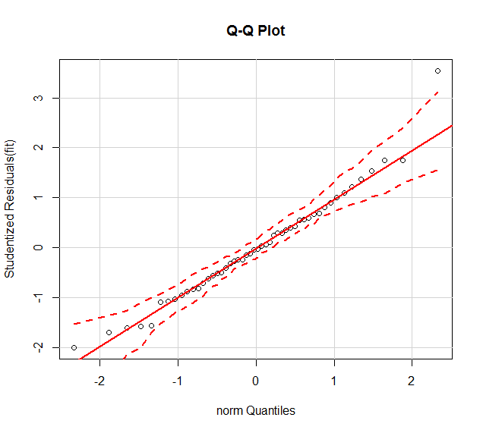
QQ plot

Slide 38
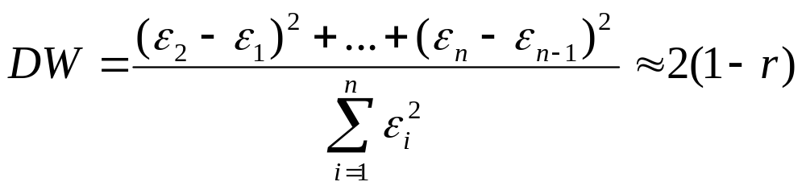
Independence of errors
Time series data will often display autocorrelation. Observations collected closer in time will be more correlated with each other than with observations distant in time. We can apply the Durbin–Watson test to the multiple regression problem.

Slide 39
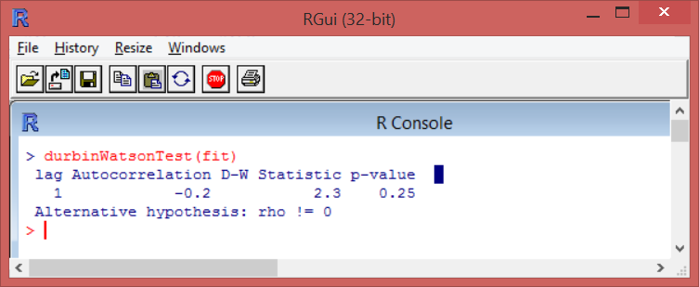
Example 6 (checking independence)
durbinWatsonTest(fit)
Output:

Slide 40
Homoscedasticity
The car package also provides two useful functions for identifying non-constant error variance.
ncvTest()
spreadLevelPlot()

Slide 41
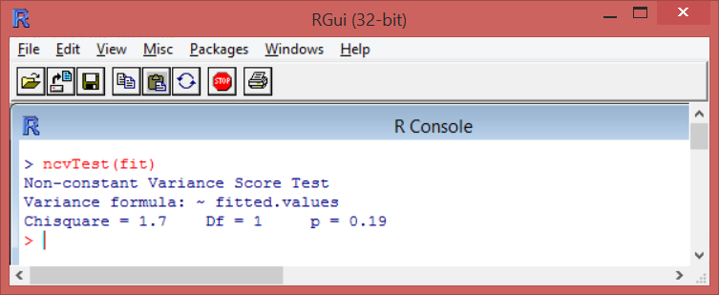
Example 7 (checking homoscedasticity)
ncvTest(fit)
spreadLevelPlot(fit)

Slide 42
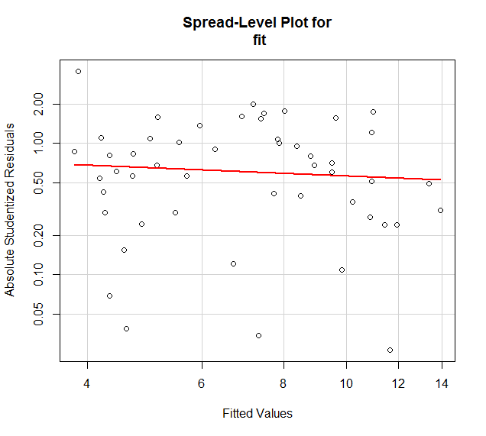

Slide 43
Summary
In this session, we have learned
How to fit linear/polynomial/multiple regression model.
Check the regression results by using summary() function.
How to test the model assumptions: normality, independence and homoscedasticity.

