Slide 1
chapter 10
Regression analysis II
Instructor: Li, Han

Slide 2
Contents
Regression diagnostics
Variance inflation factor
Outlier/leveraged/influential points

Slide 3
Linear model
Model assumptions:
Independence
Normality
Homoscedasticity

Slide 4
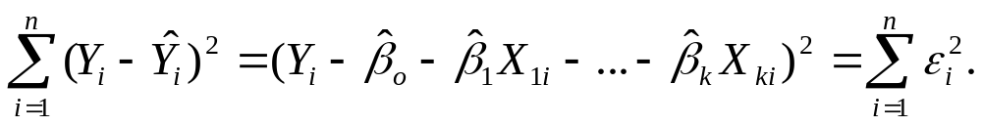
Ordinary Least Squares (OLS) finds parameters to minimize the sum of squared residuals.
In R, the basic function for fitting a linear model is lm().
fit <- lm(y ~ x1+x2+...+xk, data=dataframe)

Slide 5
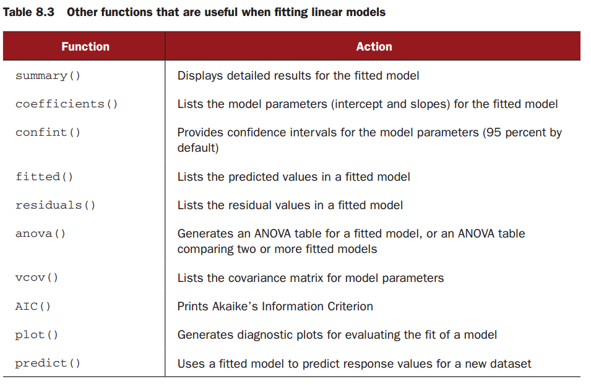
Regression results

Slide 6
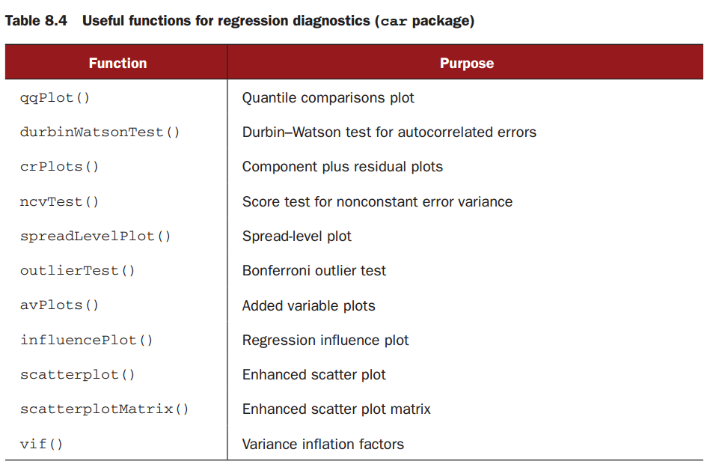
Regression diagnostics

Slide 7
Example 1 (fit the model and check model assumption)
library(car)
states <- as.data.frame(state.x77[,c("Murder", "Population", "Illiteracy", "Income","Frost")])
scatterplotMatrix(states, spread=FALSE, lty=2, main="Scatterplot Matrix")
cor(states)
fit <- lm(Murder ~ Population + Illiteracy + Income + Frost, data=states)

Slide 8
#calibration plot
plot(states$Murder,fitted(fit))
#residual plot
plot(residuals(fit),fitted(fit))
#checking model assumptions
qqplot(fit)
durbinWatsonTest(fit)
ncvTest(fit)

Slide 9
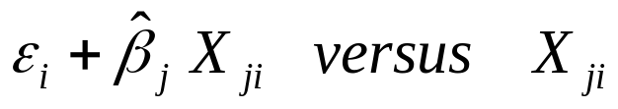
Check for linearity
To check whether the response variable and the explanatory variable have linear relationship after adujsting the effect of other variables, we could plot
It is called the component plus residual plots (also known as partial residual plots).

Slide 10
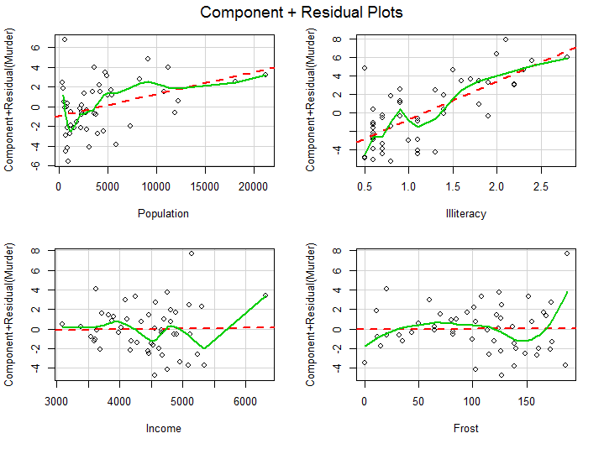

Slide 11
Multicollinearity
Multicolllinearity is a fact that the explainatory variables are highly correlated. It will result in unreliable parameter estimation and confidence intervals, though it does not violate the model assumptions.

Slide 12
Variance Inflation Factor (VIF)
Multicollinearity can be detected by the variance inflation factor (VIF). For any predictor variable, the square root of the VIF indicates the degree to which the standard deviation for that variable's regression parameter is expanded relative to a model with uncorrelated predictors (hence the name).

Slide 13
VIF values are provided by the vif() function in the car package. As a general rule, vif>4 indicates a multicollinearity problem.
Example 2 (VIF)
vif(fit)
> Population Illiteracy Income Frost
1.25 2.17 1.35 2.08

Slide 14
Unusual observations
A comprehensive regression analysis will also include a screening for unusual observations — namely outliers, high-leverage observations, and influential observations.
These are data points that warrant further investigation, either because they are different than other observations in some way, or because they exert a disproportionate amount of influence on the results.

Slide 15
Outliers
Outliers are observations that are not predicted well by the model. They have either unusually large positive or negative residuals.
The outlierTest() function reports the Bonferroni adjusted p-value for the largest absolute studentized residual.

Slide 16
Example 3 (Outlier dection)
library(car)
outlierTest(fit)
> rstudent unadjusted p-value Bonferonni p
Nevada 3.5 0.00095 0.048

Slide 17
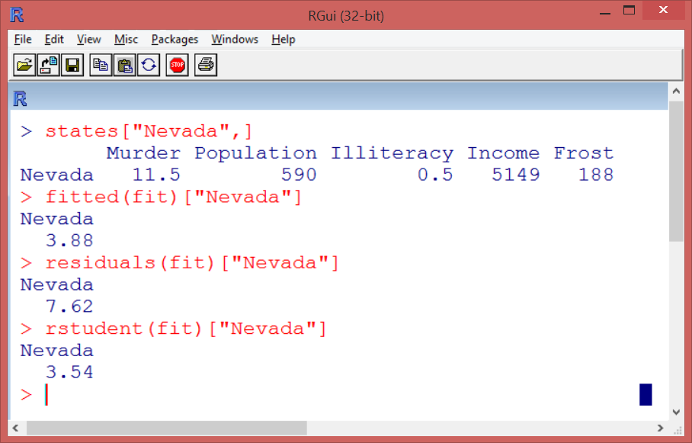

Slide 18
High leveraged points
Observations with high leverage are identified through the hat statistic (h_{ii}=x_{i}'(X'X)⁻¹x_{i}). For a given dataset, the average hat value is p/n, where p is the number of parameters estimated in the model (including the intercept) and n is the sample size.
Roughly speaking, an observation with a hat value greater than 2p/n or 3p/n should be examined.

Slide 19
Example 4 (high leveraged points)
hat.values=hatvalues(fit)
p <- length(coefficients(fit))
n <-length(fitted(fit))
plot(hat.values, main="Index Plot of Hat Values")
abline(h=c(2,3)*p/n, col="red", lty=2)
identify(1:n, hatvalues(fit), names(hat.values))

Slide 20
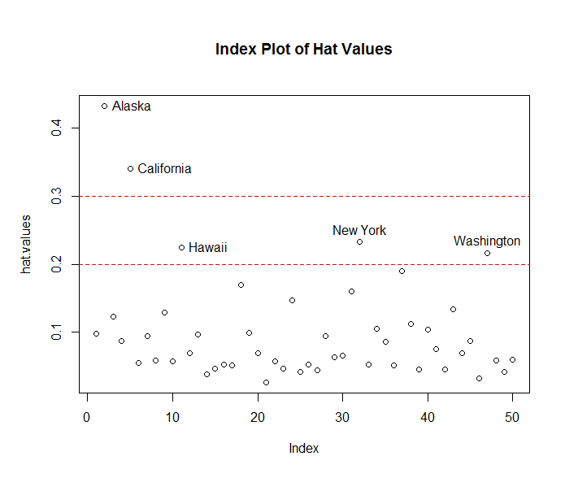

Slide 21
Influential observations
Influential observations are observations that have a disproportionate impact on the values of the model parameters. Imagine finding that your model changes dramatically with the removal of a single observation.
There are two methods for identifying influential observations: Cook's distance, or D statistic and added variable plots.

Slide 22
Cook's distance
Roughly speaking, Cook's D values greater than
4/(n-k-1), where n is the sample size and k is the number of predictor variables, indicate influential observations.
Example 5 (Cook's distance)
cutoff <- 4/(nrow(states)-length(fit$coefficients))
plot(fit, which=4, cook.levels=cutoff)
abline(h=cutoff, lty=2, col="red")

Slide 23
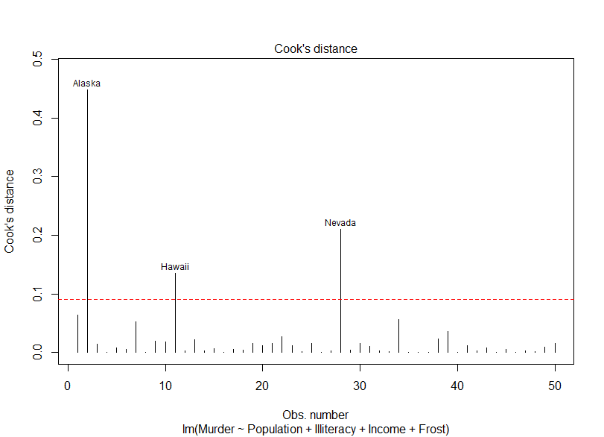

Slide 24
Added-variable plots
Added-variable plots provide information on how these observations affect the model. For each predictor X_{k} , plot the residuals from regressing the response variable on the other k-1 predictors versus the residuals from regressing X_{k} on the other k-1 predictors.
Example 6(Add variable plots)
library(car)
avPlots(fit, ask=FALSE, id.method="identify")

Slide 25
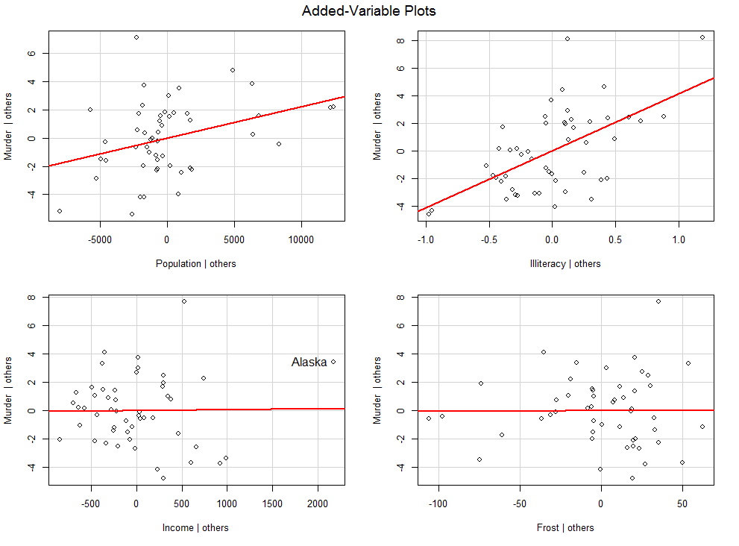

Slide 26
Unusual points in one plot
You can combine the information from outlier, leverage, and influence plots into one highly informative plot using the influencePlot() function from the car package.
Example 7 (Influence Plot)
influencePlot(fit, id.method="identify", main="Influence Plot", sub="Circle size is proportional to Cook's distance")

Slide 27
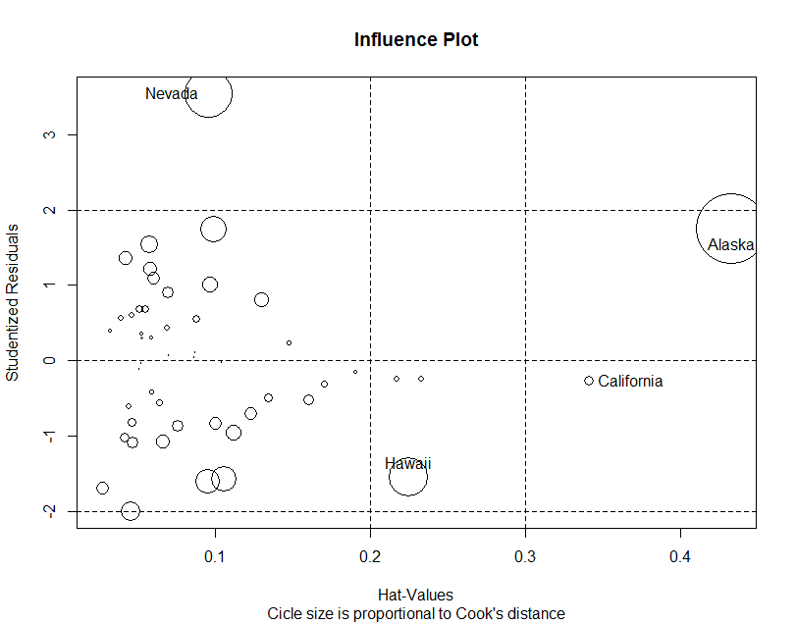

Slide 28
Summary
In this session, we have learned
check the lineariry of the variables
check the variance inflation factor
detect outlier/leveraged/influential points

