Slide 1
微算機原理與實習_七段顯示器
指導老師:周志學
班級:資工二A
學號:4070E022
學生:沈明楷

Slide 2
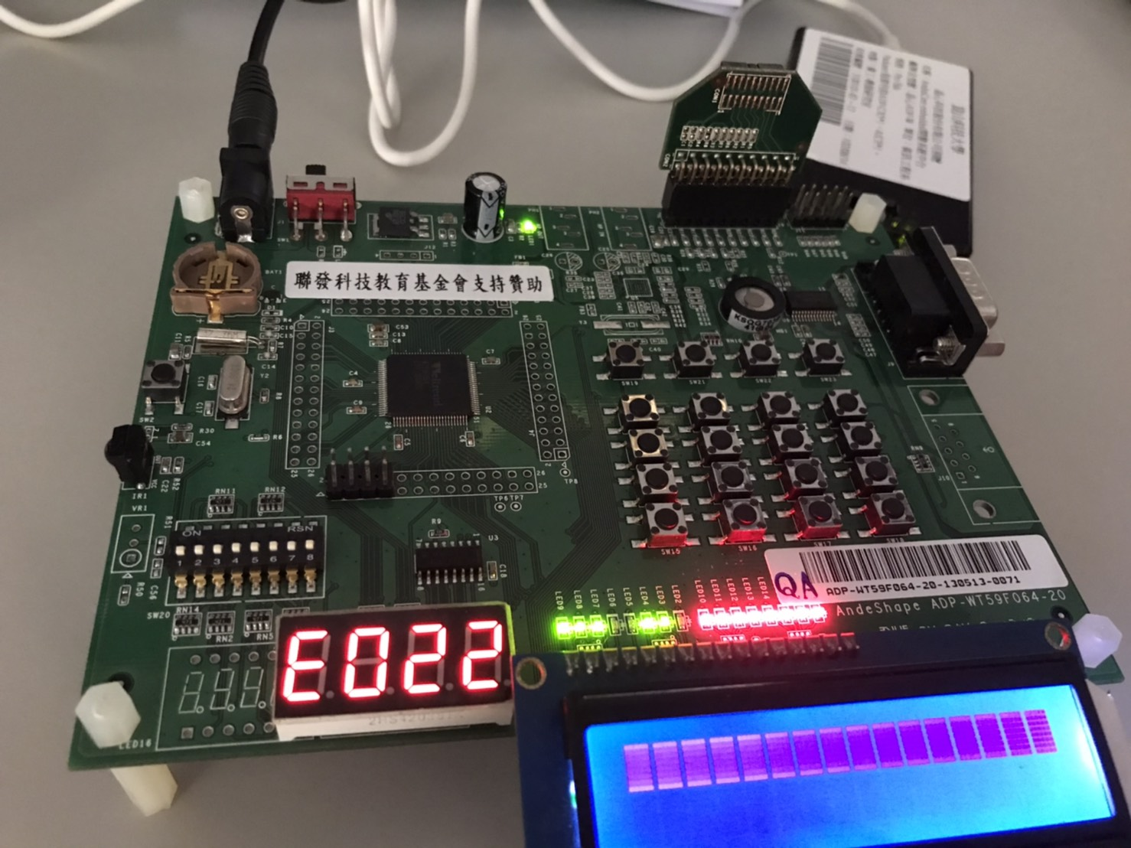
成果圖(學號末四碼)

Slide 3
程式碼(1)
include "WT59F064.h"
#define Digit_1 0x6000
#define Digit_2 0x4000
#define Digit_3 0x2000
#define Digit_4 0x0000
#define Digit_5 0xE000
#define Digit_6 0xC000
#define Digit_7 0xA000
#define Digit_8 0x8000
#define Number_0 0x3F3F
#define Number_1 0x0606
#define Number_2 0x5B5B
#define Number_3 0x4F4F
#define Number_4 0x6666
#define Number_5 0x6D6D
#define Number_6 0x7D7D
#define Number_7 0x2727
#define Number_8 0x7F7F
#define Number_9 0x6767
#define Number_E 0x7979
#define Number_Dot 0x8080

Slide 4
unsigned int Digit[]={Number_0, Number_1,Number_2,Number_3,Number_4,Number_5,
Number_6,Number_7,Number_8,Number_9,Number_E};
void delay1(unsigned int nCount)
{
unsigned int i;
for(i=0;i<nCount;i++);
}
int main()
{
outw(GPIO_B_BASE+GPIO_ACT_OFFSET, 0xFFFF); //Initialize GPIO_B PortB acts as GPIO
//GPIO_ACT_PB = 0xFFFF;
outw(GPIO_B_BASE+GPIO_OMOD_OFFSET, 0x0);//PUSH/PULL output mode
//GPIO_OMOD_PB = 0x0;
outw(GPIO_B_BASE+GPIO_OEN_OFFSET, 0x0);//Be set as output mode
//GPIO_OEN_PB = 0x0;
outw(GPIO_E_BASE+GPIO_ACT_OFFSET, 0xFFFF);//Be set as GPIO mode, PE0~PE7 = 7SEG_0 a, d,c,...,dp
//GPIO_ACT_PE = 0xFFFF; //Initialize GPIO_E
outw(+GPIO_E_BASE+GPIO_OMOD_OFFSET, 0x0);
//GPIO_OMOD_PE = 0x0;
outw(GPIO_E_BASE+GPIO_OEN_OFFSET, 0x0);
//GPIO_OEN_PE = 0x0;
//outw(GPIO_E_BASE+GPIO_DATAOUT_OFFSET, 0xFFFF);
//GPIO_DAT_PE = 0xFFFF; //Light all seg. and dp
//delay1(1000000);
程式碼(2)

Slide 5
while(1)
{
unsigned int i;
for (i=0; i<2; i++)
{
outw(GPIO_E_BASE+GPIO_DATAOUT_OFFSET, 0x79); //E
outw(GPIO_B_BASE+GPIO_DATAOUT_OFFSET, Digit_4); //Display the RDIG-4
//GPIO_DAT_PB = Digit_4;
delay1(500);
outw(GPIO_E_BASE+GPIO_DATAOUT_OFFSET, 0x3f); //0
outw(+GPIO_B_BASE+GPIO_DATAOUT_OFFSET, Digit_3);//Display the RDIG-3
//GPIO_DAT_PB = Digit_3;
delay1(500);
outw(GPIO_E_BASE+GPIO_DATAOUT_OFFSET, 0x5B); //2
outw(+GPIO_B_BASE+GPIO_DATAOUT_OFFSET, Digit_2);//Display the RDIG-2
//GPIO_DAT_PB = Digit_2;
delay1(500);
outw(GPIO_E_BASE+GPIO_DATAOUT_OFFSET, 0x06); //1
outw(+GPIO_B_BASE+GPIO_DATAOUT_OFFSET, Digit_1);//Display the RDIG-1
//GPIO_DAT_PB = Digit_1;
delay1(500);
}
}
程式碼(3)

