Slide 1
Yolov5練習
4070E022 沈明楷

Slide 2
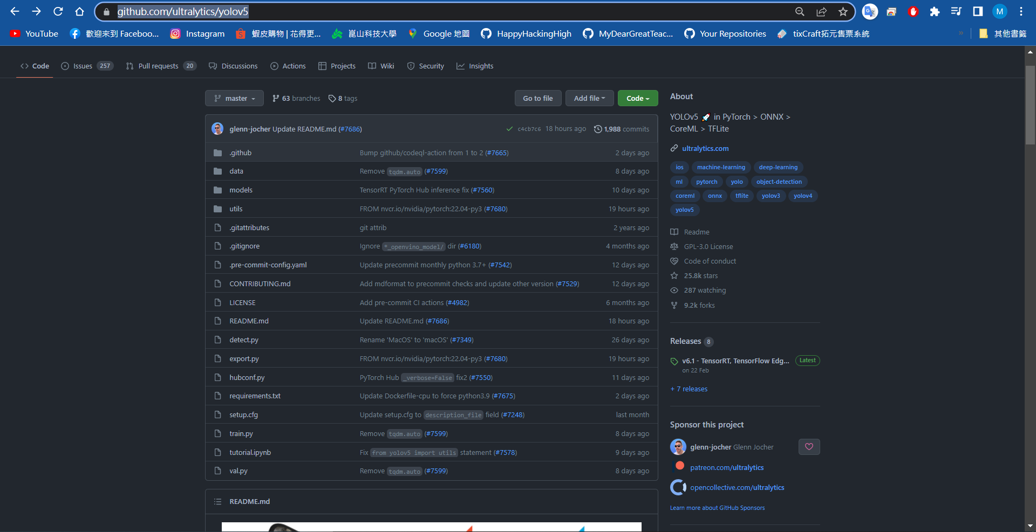
https://github.com/ultralytics/yolov5

Slide 3
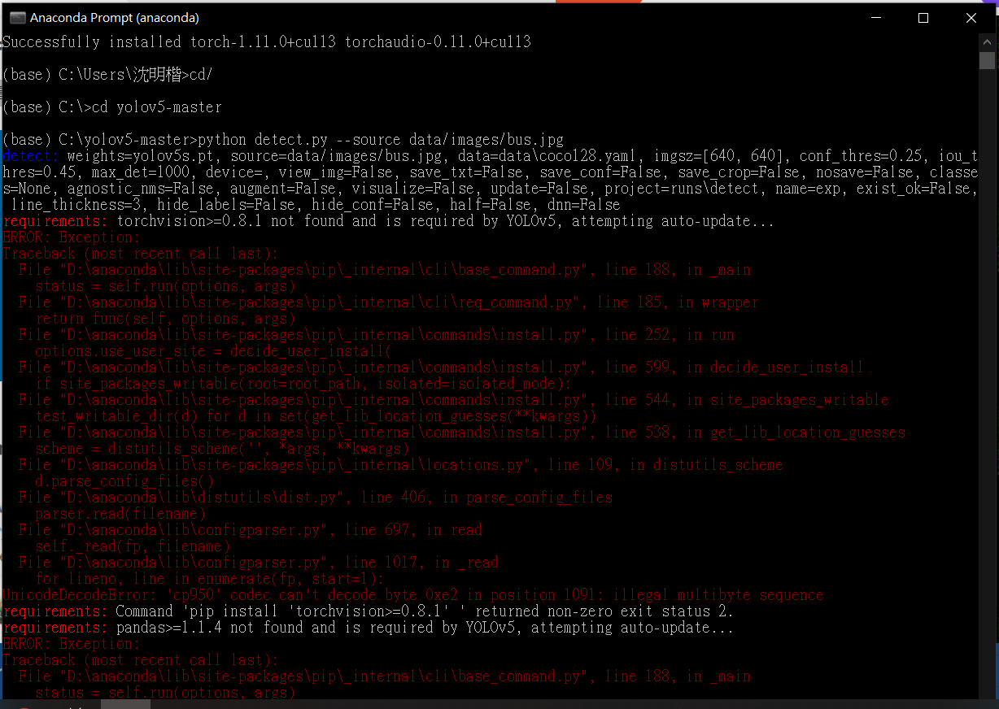
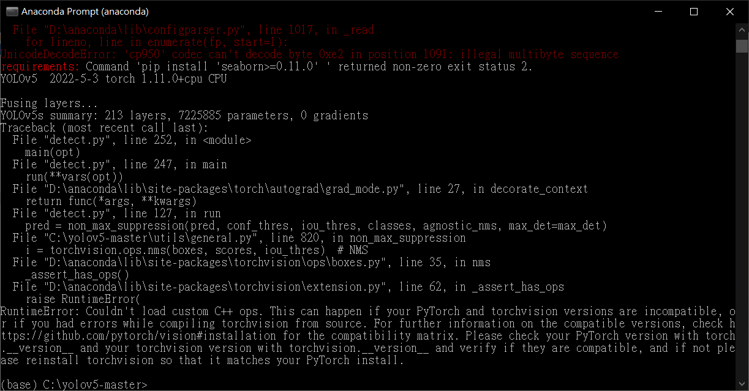

Slide 4
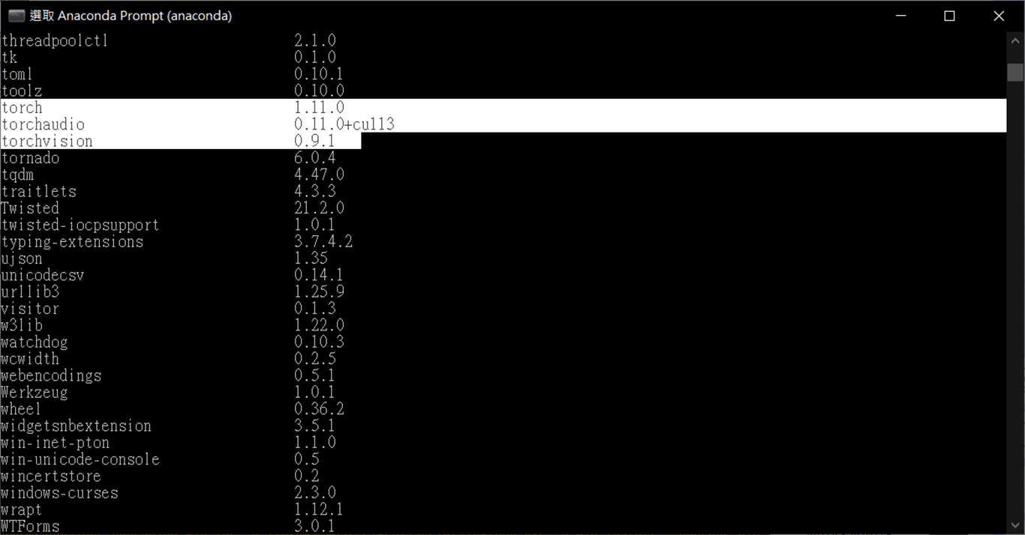
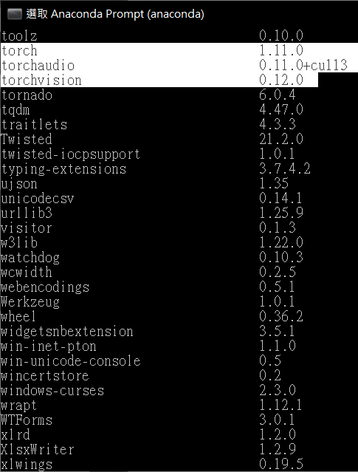
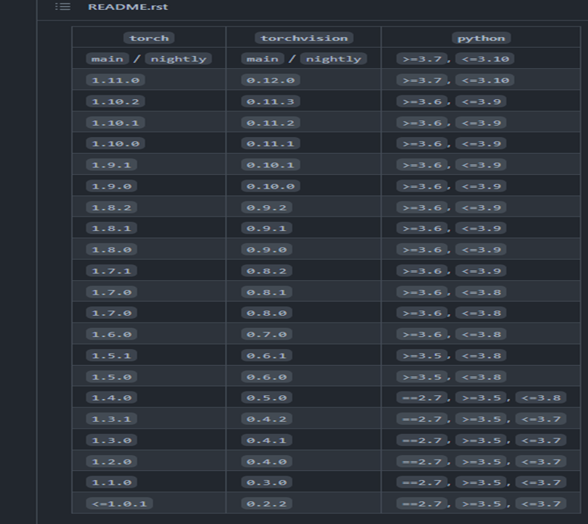

Torch與torchvision對應版本問題
https://blog.csdn.net/qq_41251196/article/details/114108223
https://github.com/pytorch/vision#installation

Slide 5

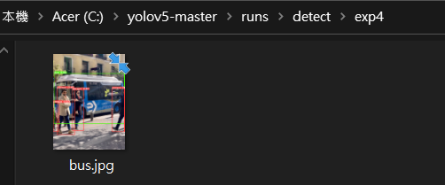

Slide 6
