Slide 1
Improved Reinforcement Learning Game for Score Following
Presenter: Minglang Tuo
Supervisor: Dr. Shengchen Li
Notes:
Hello, everyone. Today, my presentation topic is reforcement learning game for score following.

Slide 2
Content
Problem
Background (Literature Review)
Experiment: REINFORCE vs A2C
Evaluation
Conclusion
Notes:
The presentation can be divided into 5 parts.
First of all, I will talk about the defination of score following and some demos implemented with renforecement learning.
Next, the relevent litureature review will be shown. Also, some basic algorithms in the demo will be illurated.
Thirdly, the experiment will be designed for the algorithms.
As for evaluation, we utilize some data analysis for getting the optimized parameters.
Finally, the conclusion will be introduced.

Slide 3
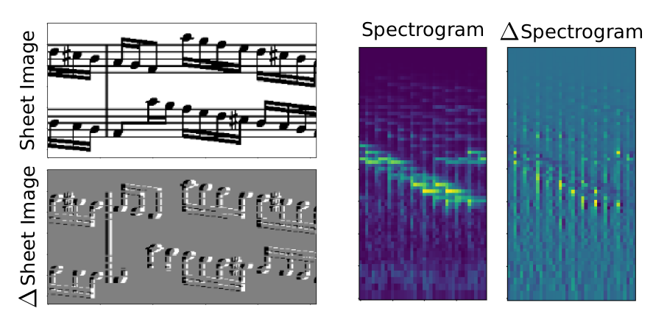
Problem
Score Following Game: Alignment
Demo
Demo by Human control
Demo by RL control
Notes:
Firstly, we need to know what’s the score following. The defination for score following in sheet music image is building automatic score following system, which follows a musical performance with respect to a known symbolical representation, the score.
We can look the figure, the left picture shows the sheet image of music. And the right picture displays audio files.
The demo of human control is human controling the speed of alignment between them.
And the demo of reinforcement utilize the advantage actor critic reinforcement algorithm to control.

Slide 4
Background
Literature Review
Subsequent Area of Music Information Retrieval (MIR)
Traditional Method: Optical Music Recognition
Advanced Method: Multi-modal Neural network
State-of-the-art Method: Reinforcement Learning Algorithm
Notes:
As for literature review, the histroy of score following can be tracked into Music information retrieval. automatic page turning [2], automatic accompaniment [6,23] are classical examples.
Optical Music Recognition is the traditional method. However, there exists obvious drawback that cannot handle complex music.
Recently, some people propose multi-model deep neural network. More specifically, The network will learn to predict the position in a given score image that best matches the current audio excerpt.
Nowadays, the reinforcement learning algorithms were implemented in the score following, which increasing the performance of system.

Slide 5
Background
Reinforcement Learning Algorithm:
REINFORCE with Baseline
Synchronous Advantage Actor Critic
1. Actor sees the current state of the game and makes an action.
2.Critical gives the actor a score based on both state and action
3.Actor adjusts his strategy (actor neural network parameters) according to the score of critical (judge) to strive to do better next time
4.Critical adjusts its scoring strategy (critical neural network parameters) according to the reward (equivalent to ground truth) given by the system and the scoring (critical target) of other judges
Notes:
Reinforcement learning can be seen as a computational approach to learning from interaction to achieve a certain predefined goal.
In the score following game, the two subset algorithms were implemented in the game.
One is reinforecement algorithm with baseline. Another is Synchronous Advantage Actor Critoir method.
In the following experiment we will compare the two algorithms.

Slide 6
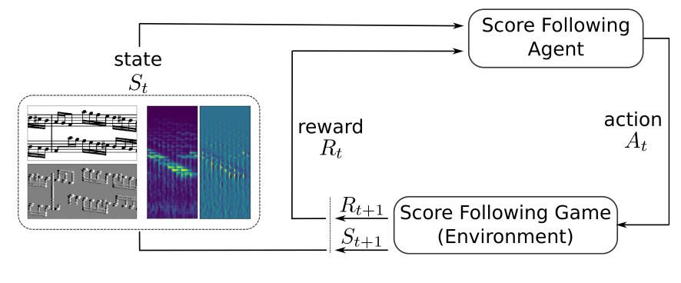
Background
Markov Chain:
Agent-Environment-Reward:
Markov Processing: S0, A0, R1, S1, A1, R2, S2, A2, R3, ...
Notes:
The mathematical foundation for reinforcement learning is Markov Decision Process.
In this problem, the score following agent is the active component that interacts with its environment.
The interaction takes place in a closed loop where the environment confronts the agent with a new situation (a state St) and the agent has to respond by making a decision, like deciding whether to increase, keeping or decreasing its speed in the score. After that, the agent will get the next state and reward indicating how well it’s doing in achieving the overall goal.
By running the interaction loop we end up with a sequence of states, actions and rewards S0, A0, R1, S1, A1, R2, S2, A2, R3, ..., which is the kind of experience an agent is learning its behavior from.

Slide 7
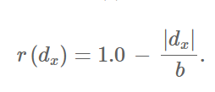
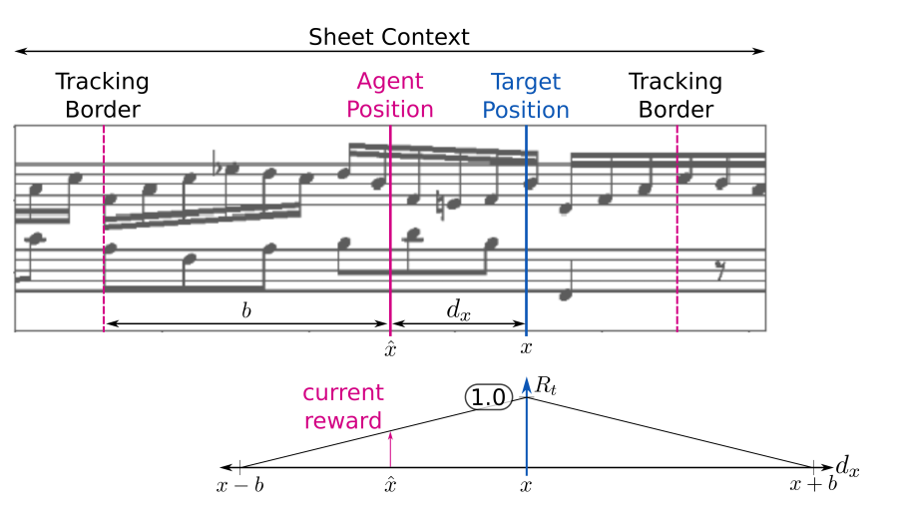
Background
Markov Chain:
Reward(Alignment):
dx = ˆx − x
Notes:
Now, the most important part in Markov is reward.
The figure summarizes the reward computation in our score following MDP for each onset time in the audio, the true target position x in the score. From this, the current position xˆ of the agent, we compute the current tracking error as the formulation, and define the reward signal r within a predefined tracking window between x−b to x+b around target position x as formulation( r = 1.0−|dx|/b).
Thus, the reward per time step reaches its maximum of 1.0 when the agent’s position is identical to the target position, and decays linearly towards 0.0 as the tracking error reaches the maximum permitted value b given by the window size.
Whenever the absolute tracking error exceeds b (the agent drops out of the window), we reset the score following game (back to start of score, first audio frame).
Agent’s sole objective is to maximize cumulative future reward, it will learn to match the correct position in the score and to not lose its target by dropping out of the window.

Slide 8
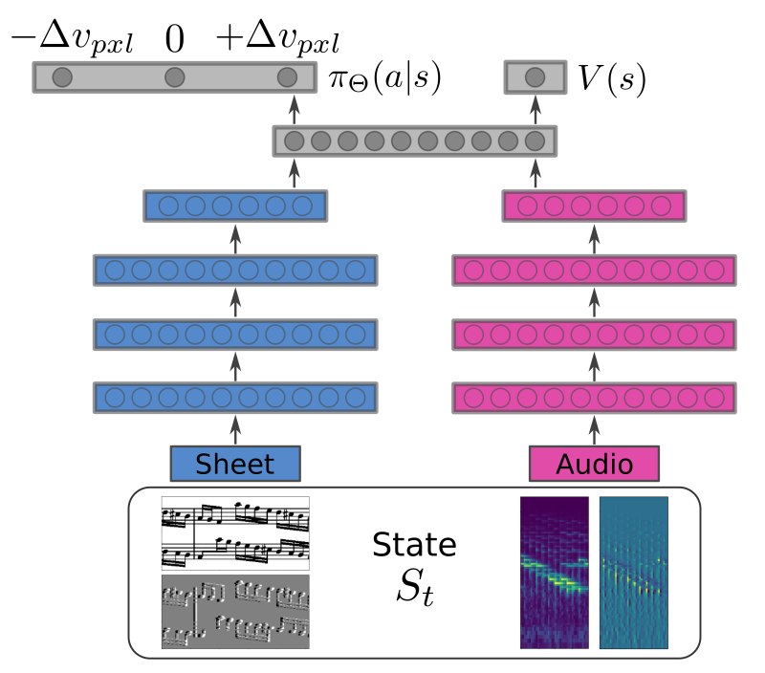
Background
Multimodel Network Architecture:
Network for Alignment:
Notes:
As for Advantage Actor Critic algorithm, we construct two network.
The actor is represented by policy and is responsible for selecting the appropriate action in each state. The critic is represented by the value function V (s) and helps the agent to judge how good the selected actions actually are.
The figure shows the structure. The left part of the network processes sheet images, the right part processed spectrogram excerpts .
After low-level representation learning, the two modalities are merged by concatenation and further processed using dense layers.
This architecture implies that policy and value network share the parameters of the lower layers, which is a common choice in reinforcement learning.
Finally, there are two output layers: the first represents our policy and predicts the action selection probability.
It contains three output converted into a valid probability distribution via soft max activation.
The second output layer consists of one linear output neuron predicting the value of the current state.

Slide 9
Experiment
Experiment Setup
Datasets:
Nottingham Dataset-296 monophonic melodies of folk music (training: 187, validation: 63, testing: 46).
Msmd Dataset-479 classical pieces by various composers(training: 360, validation: 19, testing: 100).
Computation rate:20 FPS
Spectrograms rate:22.05kHz
Notes:
After introducing the principle of audio processing and reinforcement learning.
We can start to set up experiment. Two different datasets will be used in our experiments, including Nottingham Dataset and Msmd Dataset.
The first one contains 296 melodies of folk music and another contains 479 classical pieces by various composers.
For audio processing we set the computation rate to 20 FPS and compute log-frequency spectrograms at a sample rate of 22.05kHz.

Slide 10
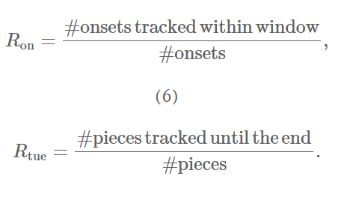
Experiment
Experiment Measure
Evaluation criteria based on statistics
Mean absolute tracking error |dx|
Standard deviation std(|dx|)
Ron of overall tracked onsets
Rtue
Notes:
As for the criteria for experiment, we divided into two aspects.
One is test the accuracy and another is robustness. we use some statistics calculation to compare two algorithms.
As we discussed in reward part, we talk about the dx. Now, we collect the dx for the test data and calculate the Mean absolute tracking error and Standard deviation for the dx.
As for another criterias is about robustness.
An onset counts as tracked if the agent reached it without dropping out of the tracking window. we calculate the ratio R_{on} of overall tracked onsets as well as the ratio of pieces R_{tue} tracked from beginning entirely to the end.

Slide 11
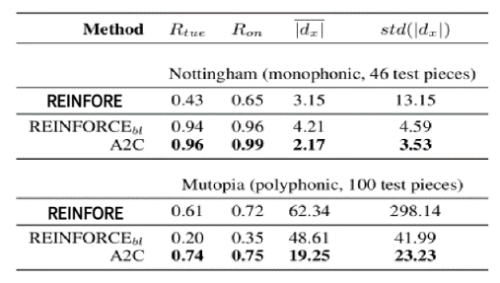
Experiment
Experiment Result
completely track all specimens
The average tracking error of A2C is low and shows a significantly lower standard deviation
The high standard deviation of REINFORCE is more obvious in polyphonic music
Notes:
Table provides a summary of the experimental results. Looking at the Nottingham dataset, we observe large gaps in performance between the different approaches.
Both reinforcement algorithms based methods manage to follow almost all of the test pieces completely to the end.
In addition, the mean tracking error is lower for advanced actor-critior and shows a substantially lower standard deviation.
The high standard deviation for reinforcement is even more evident in the polyphonic pieces.
The reason is that reinforcement is formulated as a localization task, predicting a location probability distribution over the score image given the current audio.

Slide 12
Evaluation
Parameters Analysis
Algorithm | REINFORCE | A2C
Computation rate | ?? | ??
Spectrograms rate | ?? | ??
Same Model | 30
Notes:
Then, I did some comparison experiments to adjust the parameters, hoping to obtain the best parameters for same dataset.
Now we comparing the parameter of Computation rate and Spectrograms rate.

Slide 13
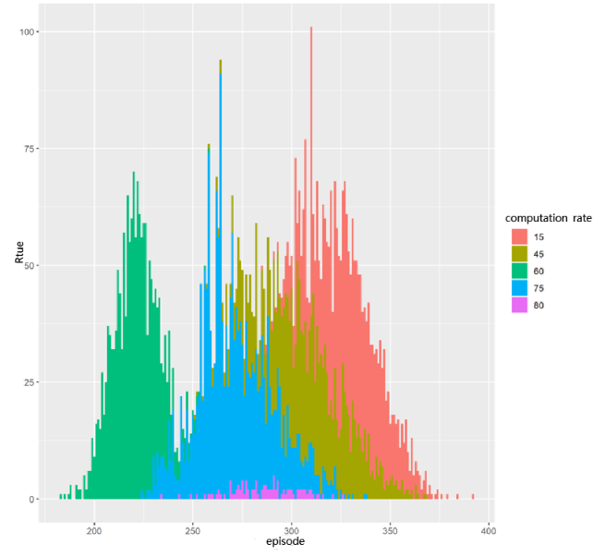
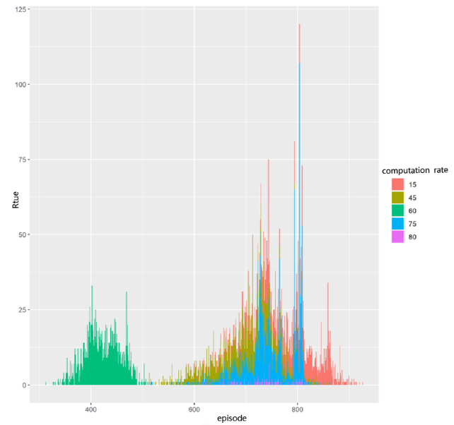
Evaluation
REINFORCE vs A2C
Notes:
As the figures shown, the left picture is the REINFORCE algorithm and the right picture is advanced acter-critiers algorithm.
we reset the computation rate from 15 to 80 and we found the red one has bigger R-tue, which means when the computation rate is 15, the robustness of model is more higher in both algorithms.

Slide 14
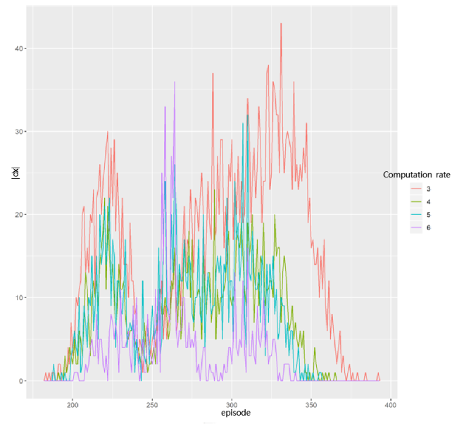
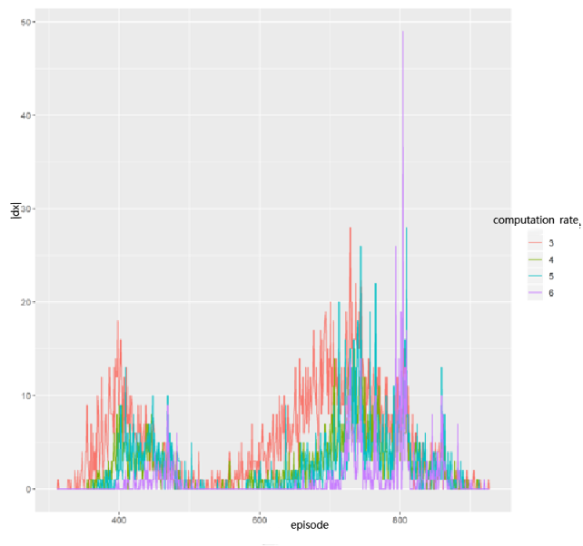
Evaluation
REINFORCE vs A2C
Notes:
Looking at these bar-charts, we set different parameters to comparing the accuracy of model.
We found that the higher computation rate that the model is more accuracy for both algorithms.

Slide 15
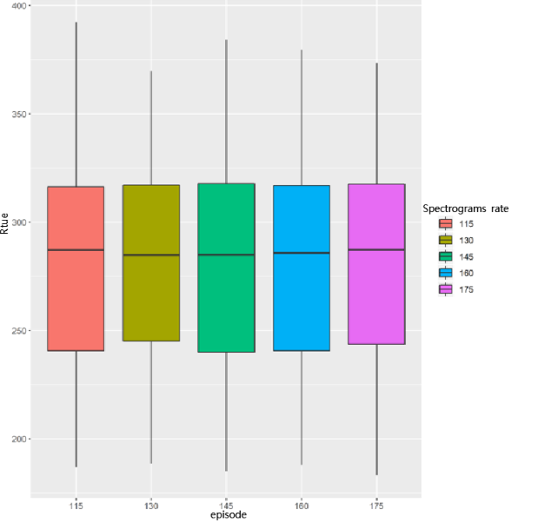
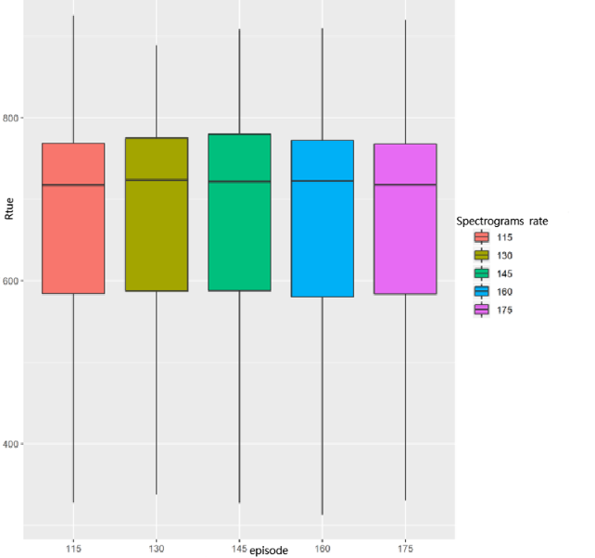
Evaluation
REINFORCE vs A2C
Notes:
And for these box diagrams, we found different between the two algorithms.
As for REINFORCE algorithm, we set spectrograms rate as 175, the R-thu is the highest which means the system is most robust.
However, for advanced-acter-critiors, the parameter is 145,the system is most robust.

Slide 16
Conclusion
Technique background
Experiment
Data Analysis
Improvement: Proximal Policy Optimization and other algorithms
Notes:
In conclusion. First of all, We have proposed a formulation of score following in sheet music images as a Markov decision process and showed how to address it with state-of-the-art deep reinforcement learning.
Then we implemented them in score following game and design the relevant experiment to test the efficiency of algorithm. We found the average tracking error of advanced-actor-critor is low and shows a significantly lower standard deviation and the high standard deviation of reinforcement is more obvious in polyphonic music.
Finally, we do some data analysis to get the optimize parameters for the test, such as Computation rate and Spectrograms rate. In the future, the improvements are extending other algorithms, such as Proximal Policy Optimization.

