Slide 1

Physical-informed Neural Networks for Solving Partial Differential Equations in Mechanics
Team LGD: Wei Cheng, Minglang Yin, Enrui Zhang, Zongren Zou
Deep Learning Final Presentation

Slide 2
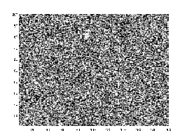
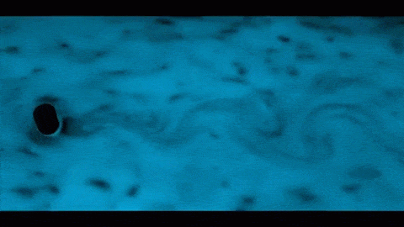
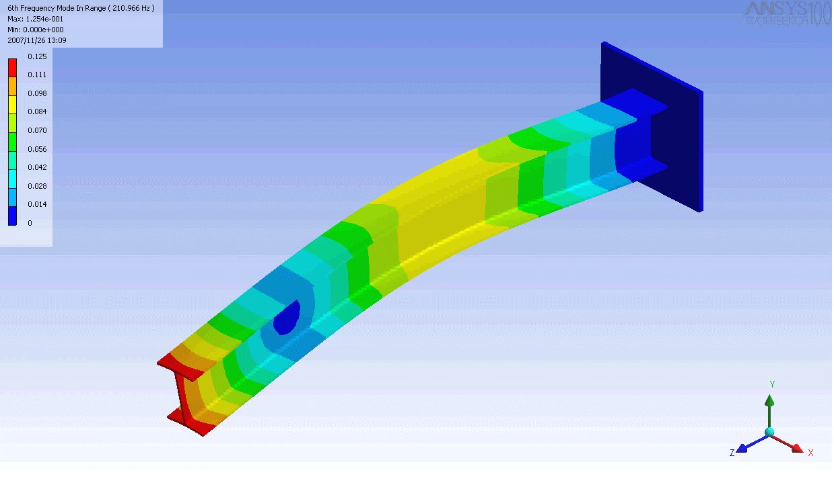
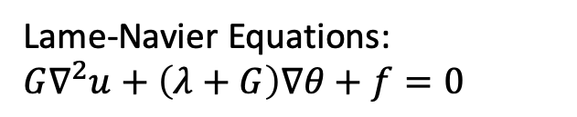
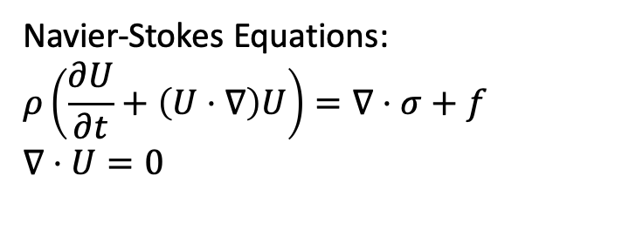
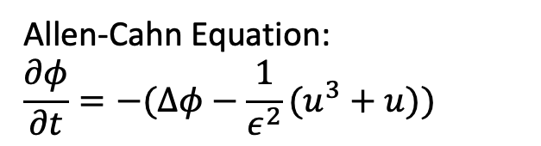
Introduction
Navier-Stokes Equations:
$$ρ\left(\frac{∂U}{∂t}+\left(U⋅∇\right)U\right)=∇⋅σ+f$$
$$∇⋅U=0$$
Allen-Cahn Equation:
$$\frac{∂φ}{∂t}=−(Δφ−{\frac{1}{ε^{2}}(u}^{3}+u))$$
Lame-Navier Equations:
$$G∇^{2}u+\left(λ+G\right)∇θ+f=0$$
  Partial Differential Equations (PDEs) dictates behaviors of physical systems. Traditional Solvers (Finite Difference method, Finite Element Method) can be used to solve these Equations.
  Significance: Break the curse of dimensionality; meshless method
  Goal: Use Deep Learning to solve PDEs(forward and inverse problem)
Notes:
Question:
What is the hemodynamics condition (flow and shear stress) for vessels before and undergoing the pruning process? How does that correlate with pruning effect

Slide 3
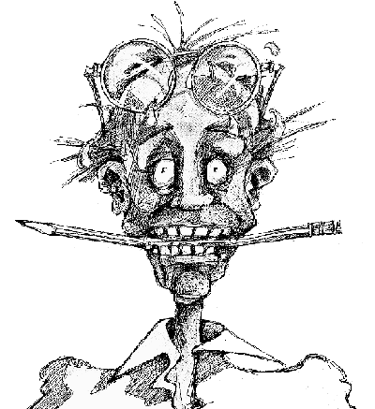

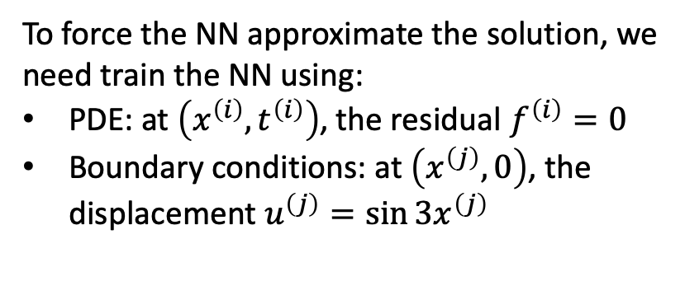

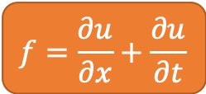
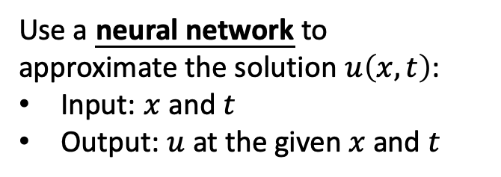

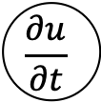
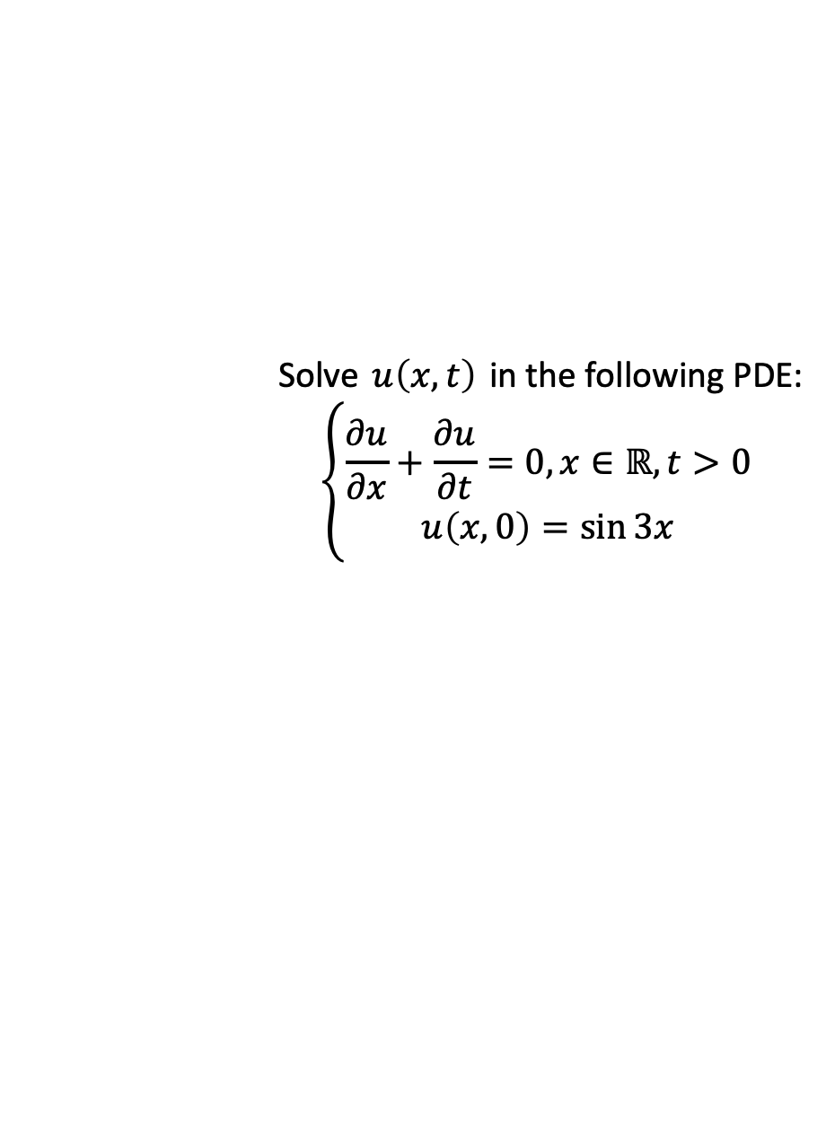

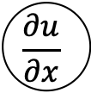
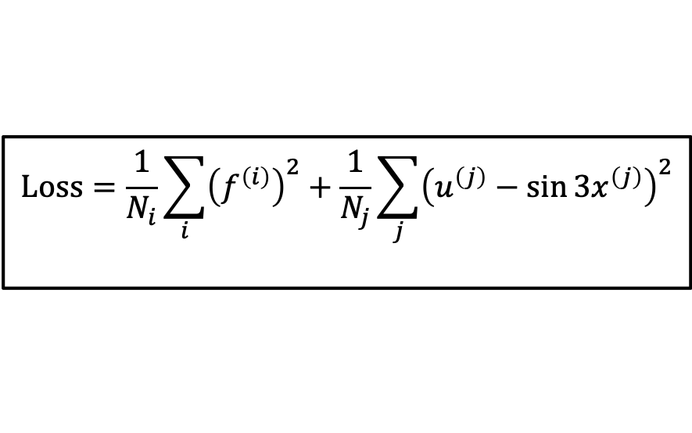
Methodology
PDE
Forward Problem
Neural Network
Solve $u\left(x,t\right)$ in the following PDE:
$$\left\{\begin{aligned}\frac{∂u}{∂x}+\frac{∂u}{∂t}=0, x∈ℝ,t>0 \\ u\left(x,0\right)=\sin{3x}\end{aligned}\right.$$
σ
σ
$$x$$
$$\frac{∂u}{∂x}$$
σ
σ
$$f=\frac{∂u}{∂x}+\frac{∂u}{∂t}$$
$$u$$
$$t$$
σ
σ
$$\frac{∂u}{∂t}$$
σ
σ
Use a neural network to approximate the solution $u\left(x,t\right)$:
Input: $x$ and $t$
Output: $u$ at the given $x$ and $t$
Boundary Conditions
N
$$<ε?$$
Loss
PDE
Done.
Y
To force the NN approximate the solution, we need train the NN using:
PDE: at $\left(x^{\left(i\right)},t^{\left(i\right)}\right)$, the residual $f^{\left(i\right)}=0$
Boundary conditions: at $\left(x^{\left(j\right)},0\right)$, the displacement $u^{\left(j\right)}=\sin{3x^{\left(j\right)}}$
$$Loss=\frac{1}{N_{i}}\sum_{i}{{\left(f^{\left(i\right)}\right)}^{2}}+\frac{1}{N_{j}}\sum_{j}{{（u^{\left(j\right)}−\sin{3x^{\left(j\right)}}）}^{2}}$$
PDE residual
BC residual
Training data all comes from PDE and boundary conditions
Notes:
Now let me introduce the methodology of our PINNs with a very simple PDE as an example.
Firstly, we consider forward problems. We want to solve uxt in this problem.
We use a NN to approximate its solution -- given the input x and t, it predicts the value of u. In addition, we use the AD to calculate the derivatives of u, and finally add the two terms together to get the residual of the PDE.
To train the NN, we need input-label pairs generated from the problem itself: for x-t points inside the domain, the residual of PDE is zero; for points on the boundary, the residual of BCs is zero.
Hence the loss function can be constructed with two terms, corresponding to the PDE residual and the BC residual respectively.
Simplest PDE for explaining methodology, instead of the actual PDEs we solve.
Approximation u with NN; get derivatives with AD (not only for calculating loss gradient!).
Loss: sum of residual of all given equalities (PDE & BC)
Training data: from PDE & BC – we know that the PDE should be satisfied (f=0) everywhere in the domain
This is for forward problem: fully specified problem, solve u.

Slide 4


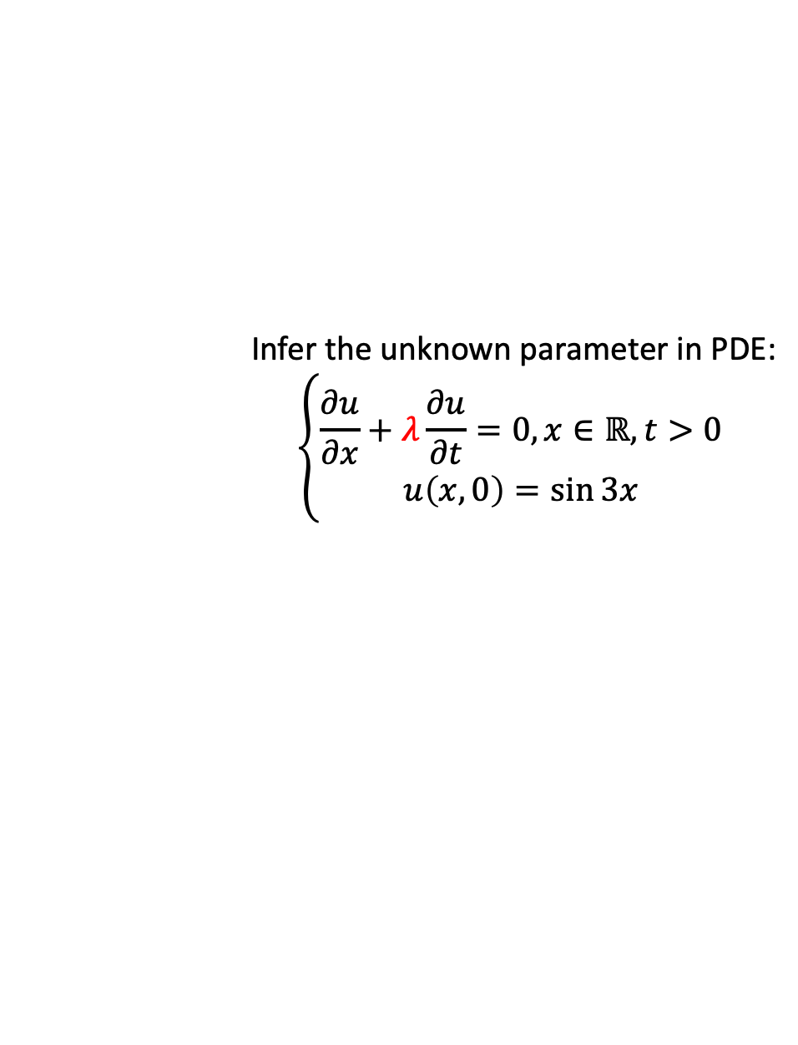
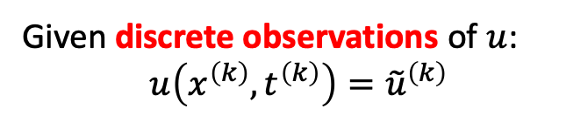
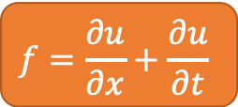

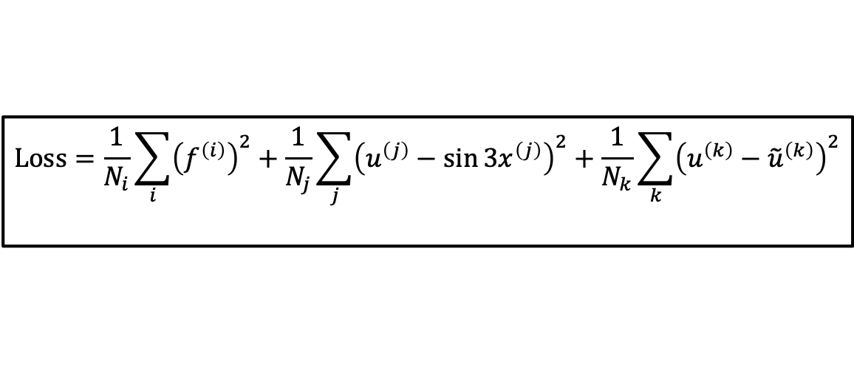

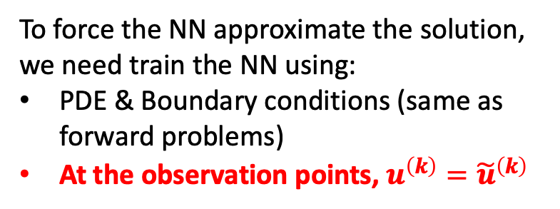

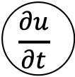
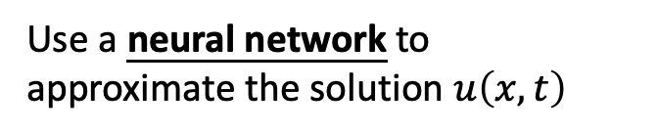

Methodology
Inverse Problem (Simple)
$$λ$$
PDE
Infer the unknown parameter in PDE:
$$\left\{\begin{aligned}\frac{∂u}{∂x}+λ\frac{∂u}{∂t}=0, x∈ℝ,t>0 \\ u\left(x,0\right)=\sin{3x}\end{aligned}\right.$$
Neural Network
$$x$$
σ
σ
$$\frac{∂u}{∂x}$$
σ
σ
$$f=\frac{∂u}{∂x}+\frac{∂u}{∂t}$$
$$t$$
$$u$$
σ
σ
$$\frac{∂u}{∂t}$$
Given discrete observations of $u$:
$$u\left(x^{\left(k\right)},t^{\left(k\right)}\right)={\tilde{u}}^{\left(k\right)}$$
σ
σ
Boundary Condition & Observations
Use a neural network to approximate the solution $u\left(x,t\right)$
N
$$<ε?$$
Loss
PDE
To force the NN approximate the solution, we need train the NN using:
PDE & Boundary conditions (same as forward problems)
At the observation points, $u^{\left(k\right)}={\tilde{u}}^{\left(k\right)}$
Done.
Y
$$Loss=\frac{1}{N_{i}}\sum_{i}{{\left(f^{\left(i\right)}\right)}^{2}}+\frac{1}{N_{j}}\sum_{j}{{（u^{\left(j\right)}−\sin{3x^{\left(j\right)}}）}^{2}}+\frac{1}{N_{k}}\sum_{k}{{（u^{\left(k\right)}−{\tilde{u}}^{\left(k\right)}）}^{2}}$$
PDE residual
BC residual
Error w.r.t. data
Training data comes from PDE, boundary conditions, and the finite element solver
Notes:
Another type of problems is called inverse problems.
Now we have an unknown constant parameter lambda in the PDE. Also, we know some observation data of the solution u. The target is to infer the value of lambda.
The architecture is similar to forward problems, but slightly different in that we now have one more trainable parameter lambda [click].
As for the training data, here we need one more set from the observation of u. This naturally gives us a third term in the loss function, the error between the predicted u and the given u.
(This is a simple version of inverse problem.)
Inverse problem: swap the known & unknown
On more unknown trainable variable in the architecture
Loss: one more term from the finite element solver

Slide 5
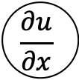



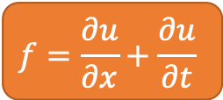



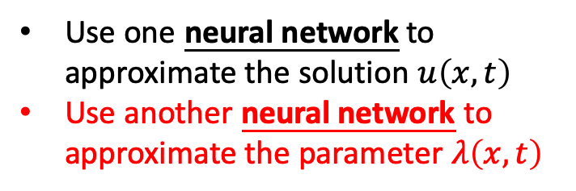
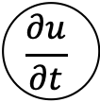

Methodology
Inverse Problem (Complex)
NN for Parameter Field
σ
σ
Infer the unknown parameter field:
$$\left\{\begin{aligned}\frac{∂u}{∂x}+λ(x,t)\frac{∂u}{∂t}=0, x∈ℝ,t>0 \\ u\left(x,0\right)=\sin{3x}\end{aligned}\right.$$
$$λ$$
σ
σ
σ
σ
PDE
NN for Solution Field
$$x$$
σ
σ
$$\frac{∂u}{∂x}$$
Given discrete observations of $u$:
$$u\left(x^{\left(k\right)},t^{\left(k\right)}\right)={\tilde{u}}^{\left(k\right)}$$
σ
σ
$$f=\frac{∂u}{∂x}+\frac{∂u}{∂t}$$
$$t$$
$$u$$
σ
σ
$$\frac{∂u}{∂t}$$
σ
σ
Use one neural network to approximate the solution $u\left(x,t\right)$
Use another neural network to approximate the parameter $λ\left(x,t\right)$
Boundary Condition & Observations
N
$$<ε?$$
Loss
PDE
Done.
Y
Notes:
We actually consider a more complicated version. Now the lambda is NOT a constant anymore. Instead, it is a variable depending on x and t. We propose to use a second NN to approximate the lambda field.
(In our project, we solve an inverse problem in solid mechanics using the architecture shown here.)
Complex inverse problem: parameter is not a constant. It’s a field!
Use a second NN to approximate its field.
NOBODY HAS DONE THIS BEFORE US!

Slide 6
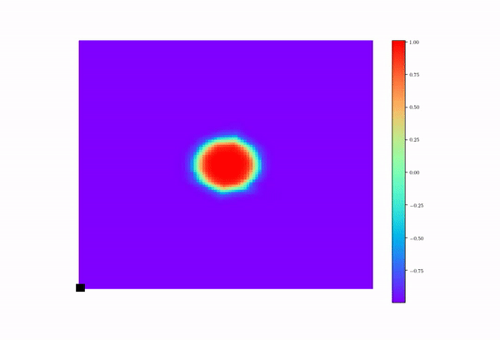
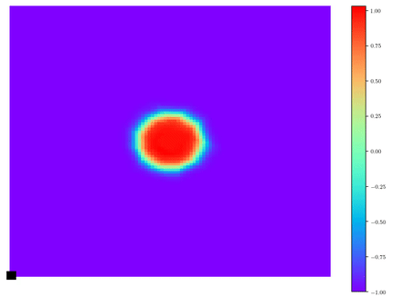
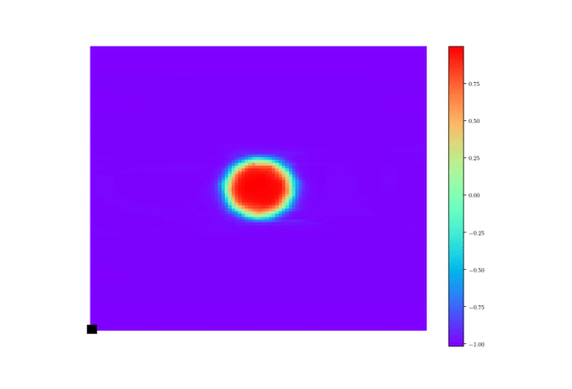
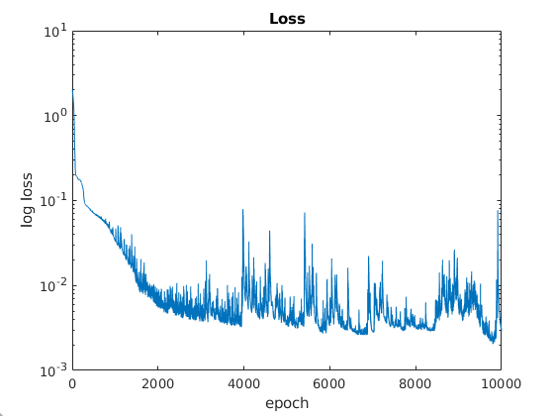
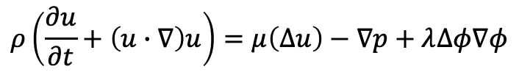
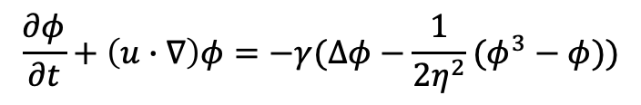

Results (Fluid Mechanics)
v = 0.1
v = 5
$$ρ\left(\frac{∂u}{∂t}+\left(u∙∇\right)u\right)=μ\left(∆u\right)−∇p+λ∆φ∇φ$$
v
$$∇∙u=0$$
$$\frac{∂φ}{∂t}+\left(u∙∇\right)φ=−γ(∆φ−\frac{1}{2η^{2}}(φ^{3}−φ))$$
v = 1
Discussion:
Noticed large error for v=5
This might be caused by limited training point and numerical dissipation
Possible solution: add more data, or adapted to discretized PINNs
Notes:
Forward problem in fluid mechanics

Slide 7
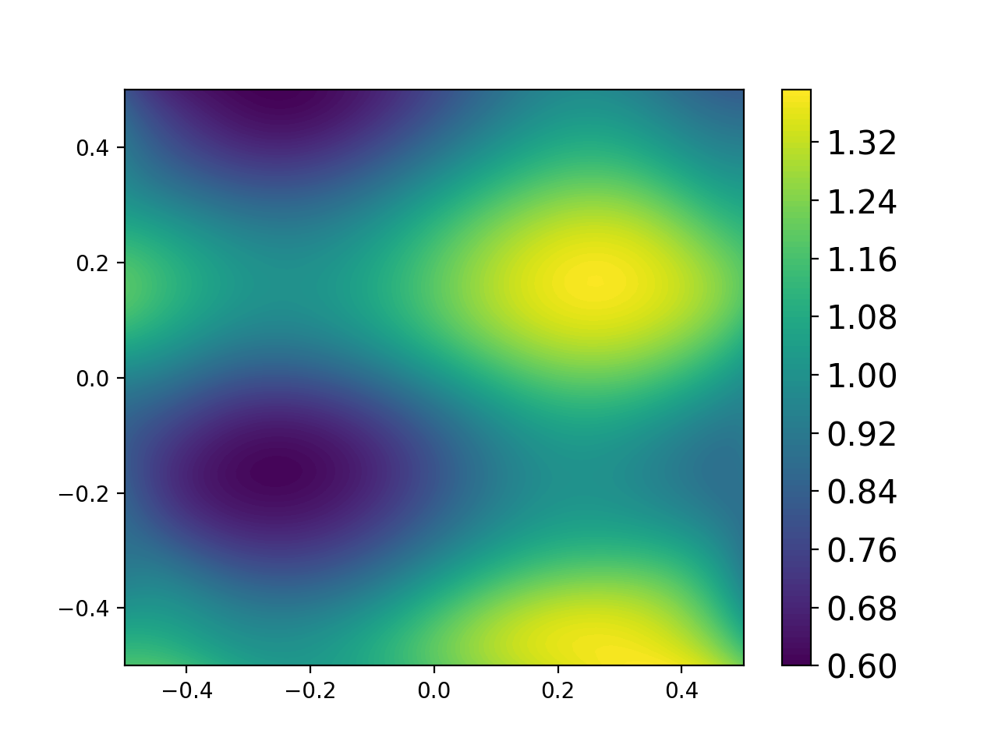

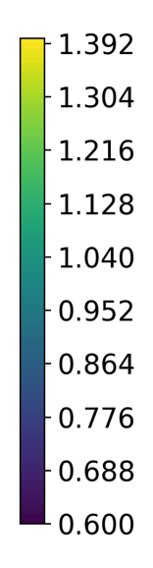
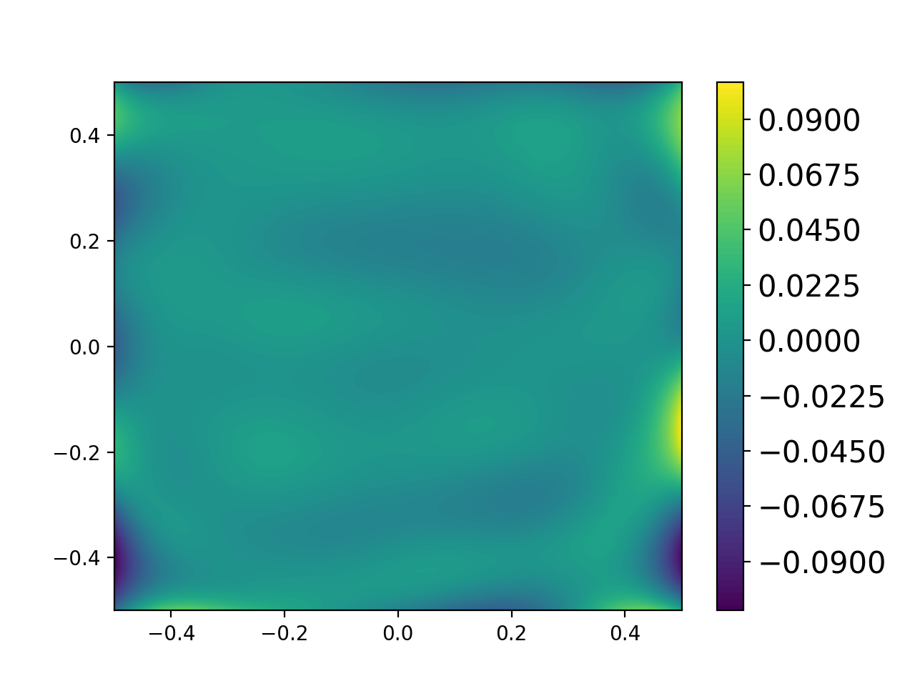
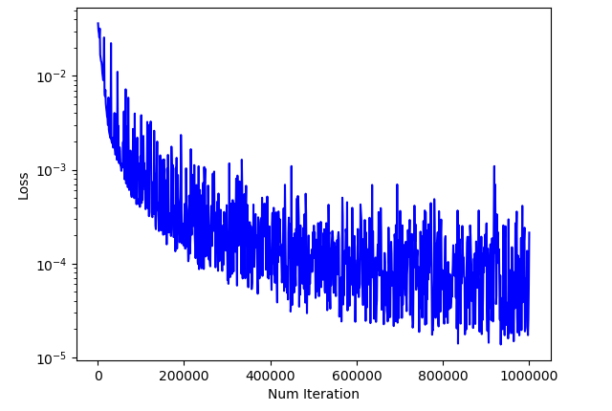



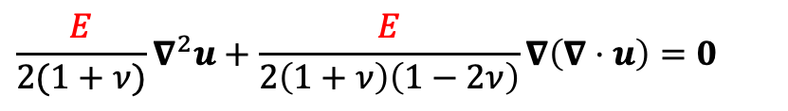

Results (Solid Mechanics)
Inferring Modulus (Inverse Problem)
$$\frac{E}{2(1+ν)}∇^{2}u+\frac{E}{2\left(1+ν\right)\left(1−2ν\right)}∇\left(∇⋅u\right)=0$$
Predicted E
True E
1.Inferred modulus is accurate
(L2 relative error: 0.0149).
2.Loss decreases to the order of 1e-5.
Discussion:
Noticed large error appears nears the edges.
This might be caused by missing neighbors of training points near the boundaries.
Possible solution: Provide strain data instead of displacement data.
Error of E
Loss
$${10}^{−2}$$
$${10}^{−3}$$
Loss
$${10}^{−4}$$
$${10}^{−5}$$
0 200000 400000 600000 800000 1000000
Num Iteration
Notes:
Inverse problem in solid mechanics
Example: square-shaped solid, known horizontal tension, infer the unknown inhomogeneous Youngs’ modulus field

Slide 8
References
https://en.wikipedia.org/wiki/Cahn%E2%80%93Hilliard_equation#/media/File:CahnHilliard_Animation.gif
https://www.google.com/search?biw=1680&bih=889&tbm=isch&sxsrf=ACYBGNQ_IzneSLAU9OFxJrw-XhLx7-SD2w%3A1576092622889&sa=1&ei=zkPxXeDiNcGV_Qal9YKwDw&q=euler+bernoulli+beam+gif&oq=euler+bernoulli+beam+gif&gs_l=img.3...3555.4784..4918...0.0..0.83.393.6......0....1..gws-wiz-img.......0i67j0j0i8i30j0i24j0i30.c1GmP2_LbGw&ved=0ahUKEwjgga7Hqq7mAhXBSt8KHaW6APYQ4dUDCAc&uact=5#imgrc=0tZMJgbORYbcuM:
Shen J. Modeling and numerical approximation of two-phase incompressible flows by a phase-field approach. InMultiscale modeling and analysis for materials simulation 2012 (pp. 147-195).
Raissi M, Perdikaris P, Karniadakis GE. Physics-informed neural networks: A deep learning framework for solving forward and inverse problems involving nonlinear partial differential equations. Journal of Computational Physics. 2019 Feb 1;378:686-707.

Slide 9

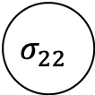

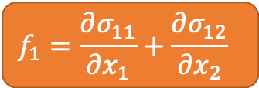
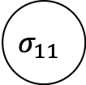


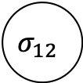
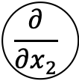


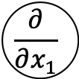

NN for Material Properties Field
σ
σ
Young’s Modulus
$$E$$
σ
σ
σ
σ
PDE
$$x_{1}$$
stress
$$x_{2}$$
$$σ_{11}$$
equilibrium
strain
σ
σ
$$f_{1}=\frac{∂σ_{11}}{∂x_{1}}+\frac{∂σ_{12}}{∂x_{2}}$$
displacement
$$\frac{∂}{∂x_{1}}$$
σ
σ
$$u_{1}$$
$$σ_{12}$$
σ
σ
$$u_{2}$$
$$\frac{∂}{∂x_{2}}$$
$$f_{2}=\frac{∂σ_{12}}{∂x_{1}}+\frac{∂σ_{22}}{∂x_{2}}$$
σ
σ
$$σ_{22}$$
NN for Displacement Field
N
$$<ε?$$
Displacement BC
Traction BC
Loss
Equilibrium
Done.
Y

Slide 10
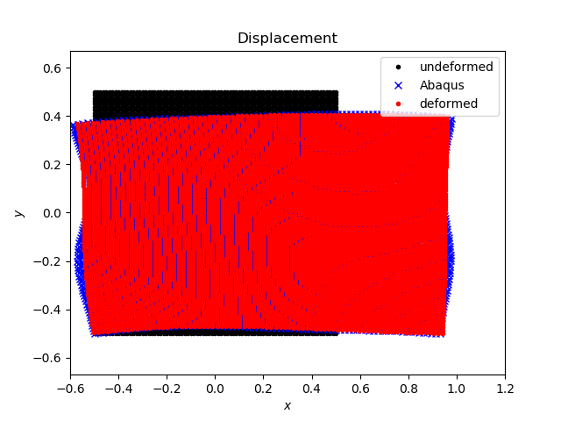
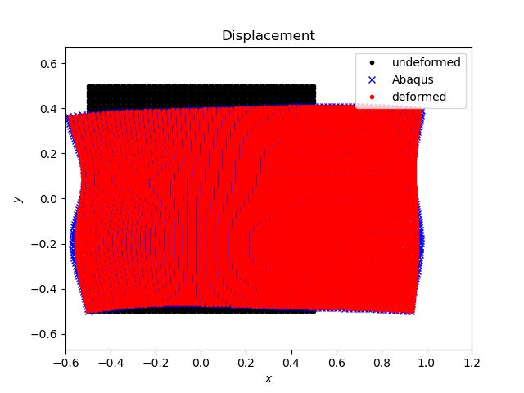
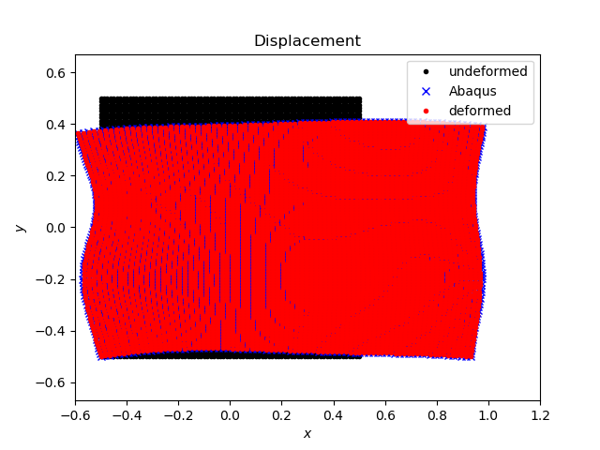
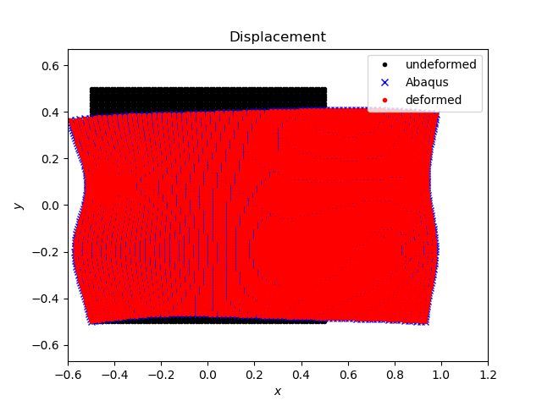
Displacement in Solid Mechanics Example:
10K Iterations
50K Iterations
Black: undeformed configuration
Blue: true solution from finite element solver
Red: solution from PINNs
200K Iterations
1M Iterations

Slide 11
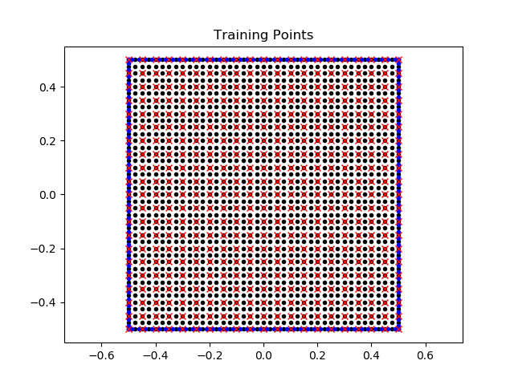
Training Points in Solid Mechanics Example:
Black dots: PDE
Blue dots: boundary conditions
  Left and right: uniform normal tension
  Bottom and Top: free boundary
Red xs: observation of displacement (from finite element solver)

