Slide 1


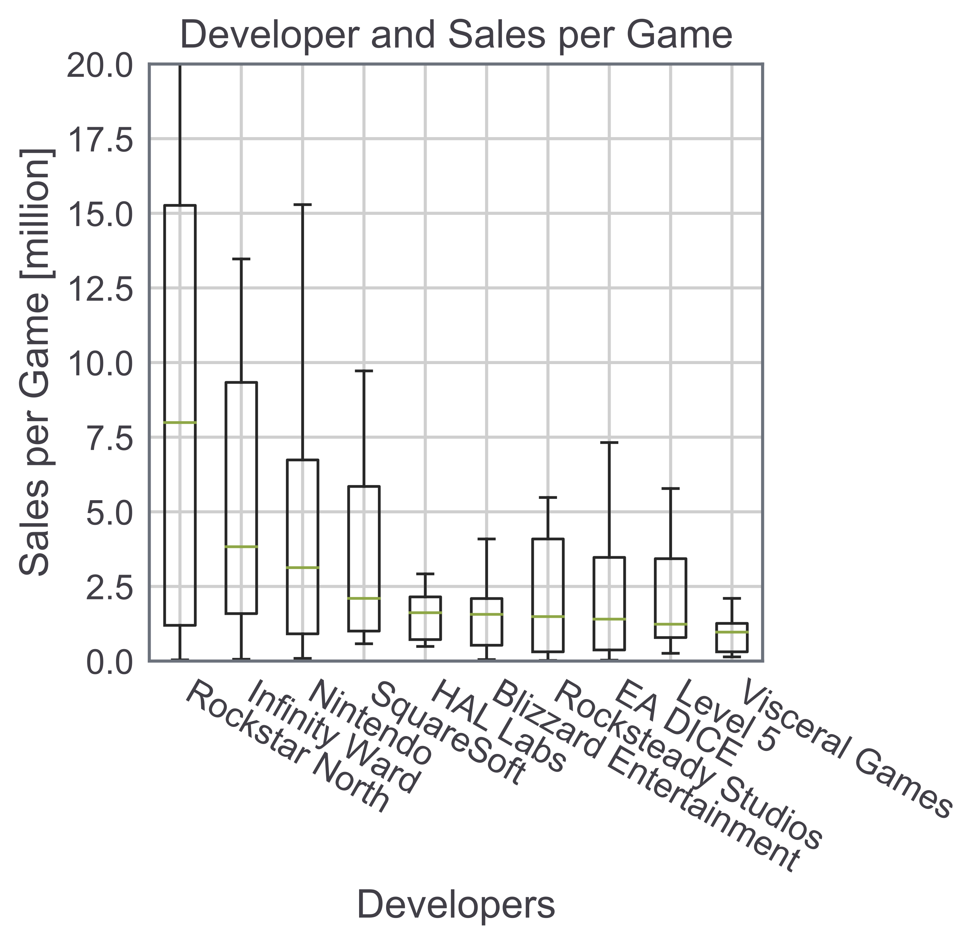
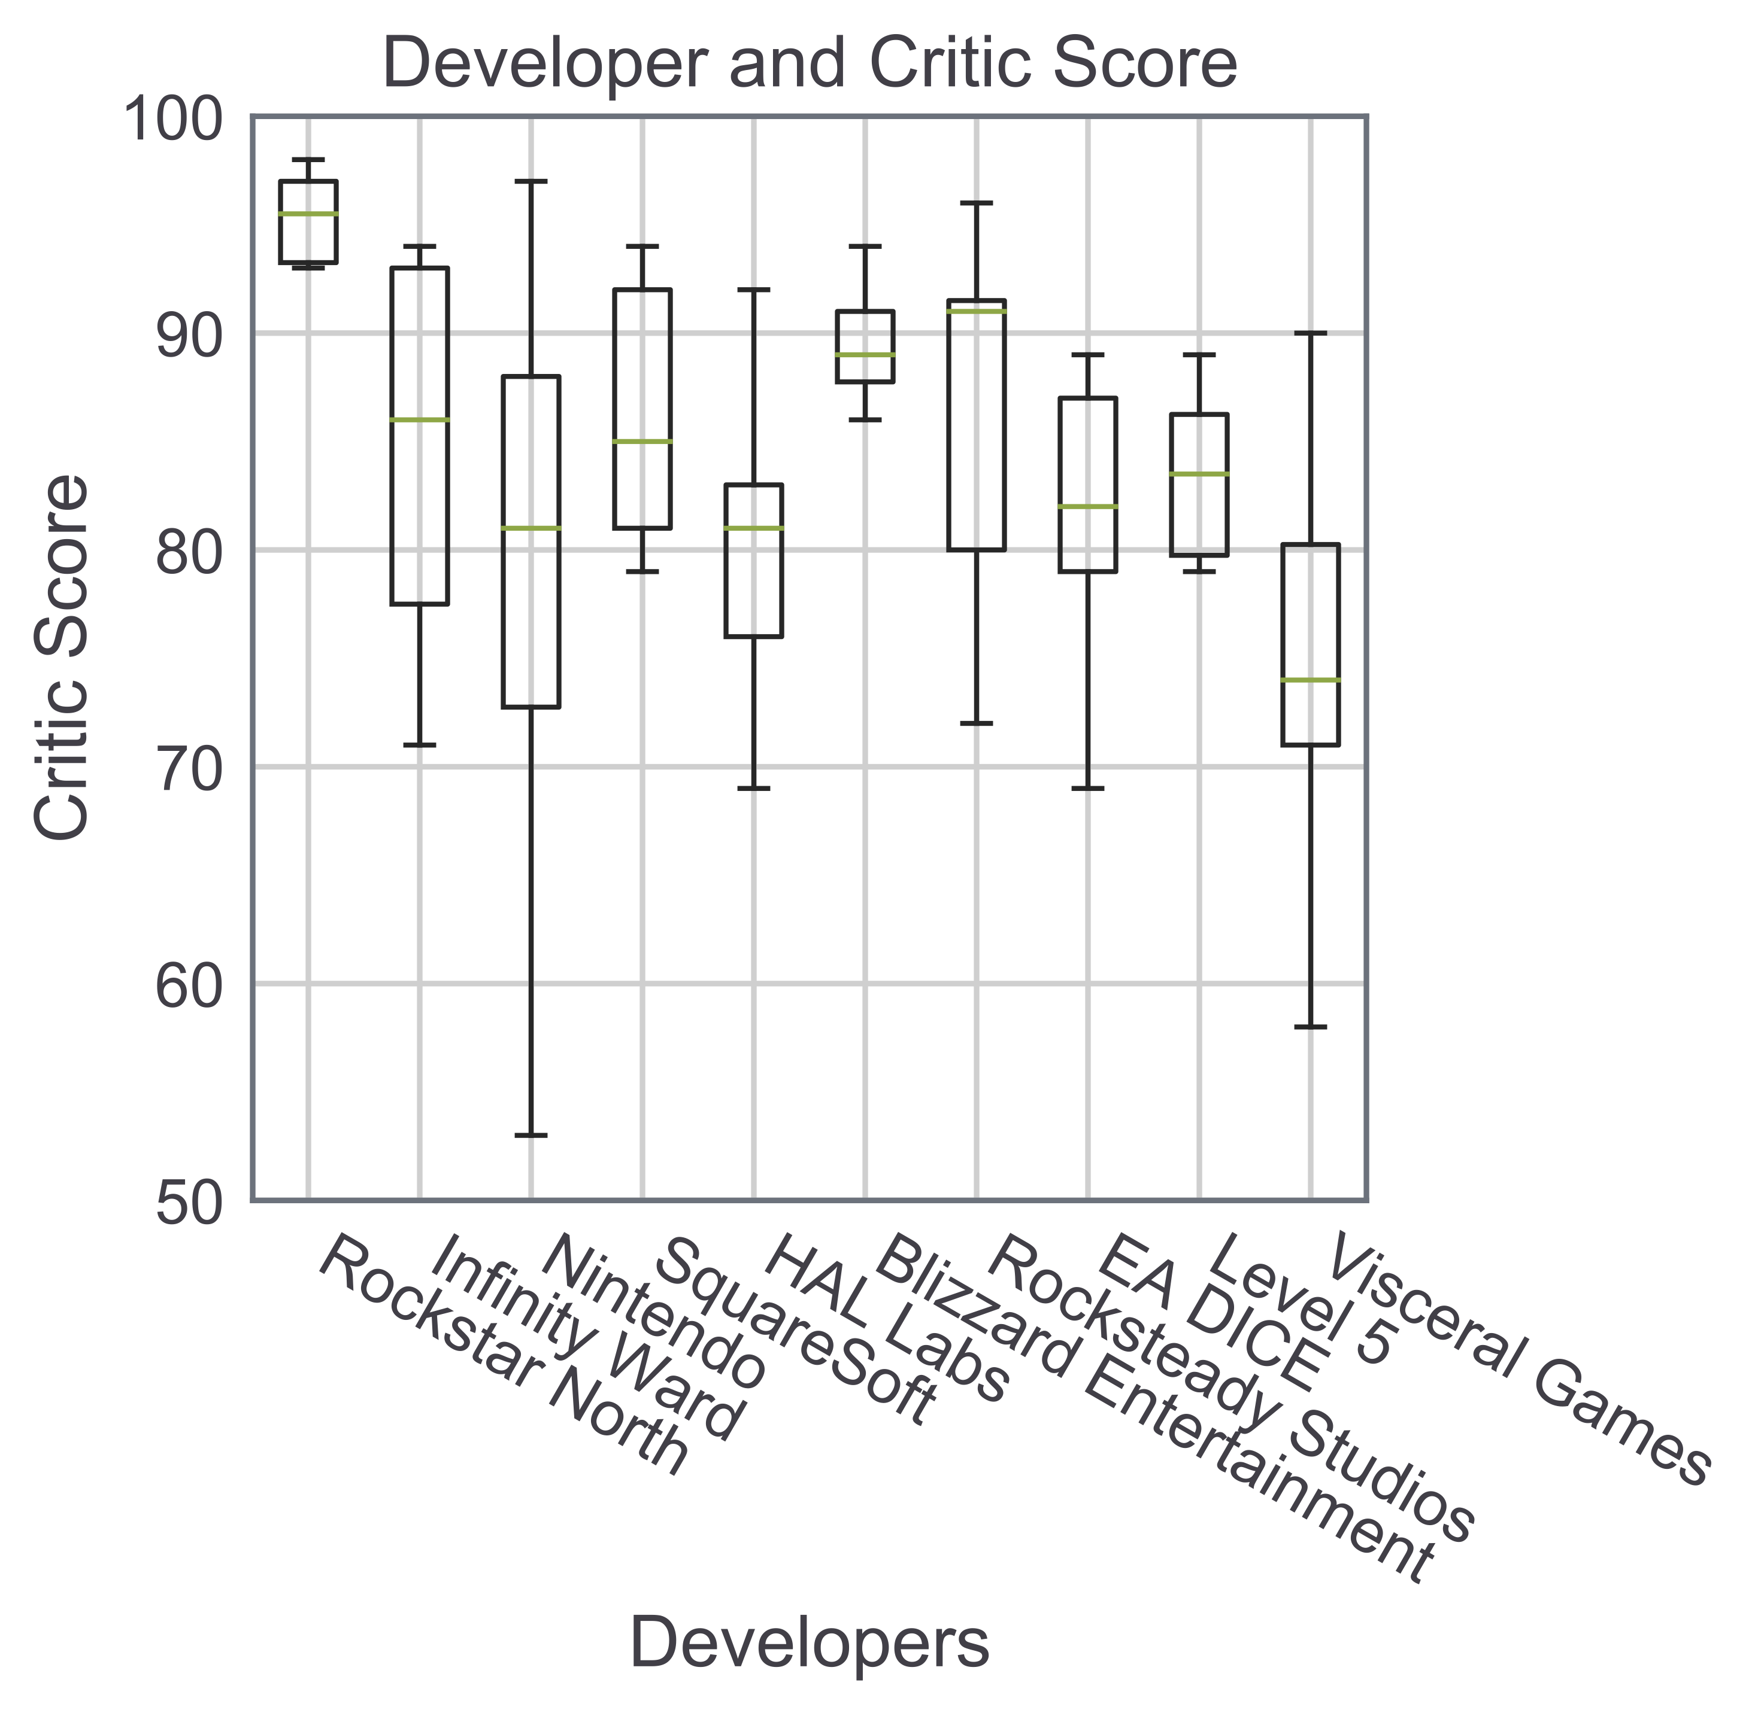

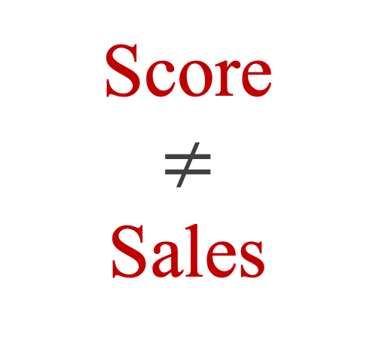
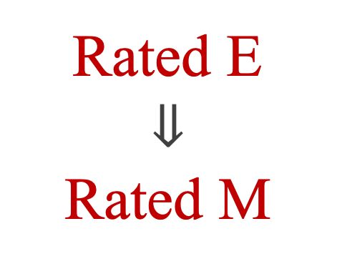
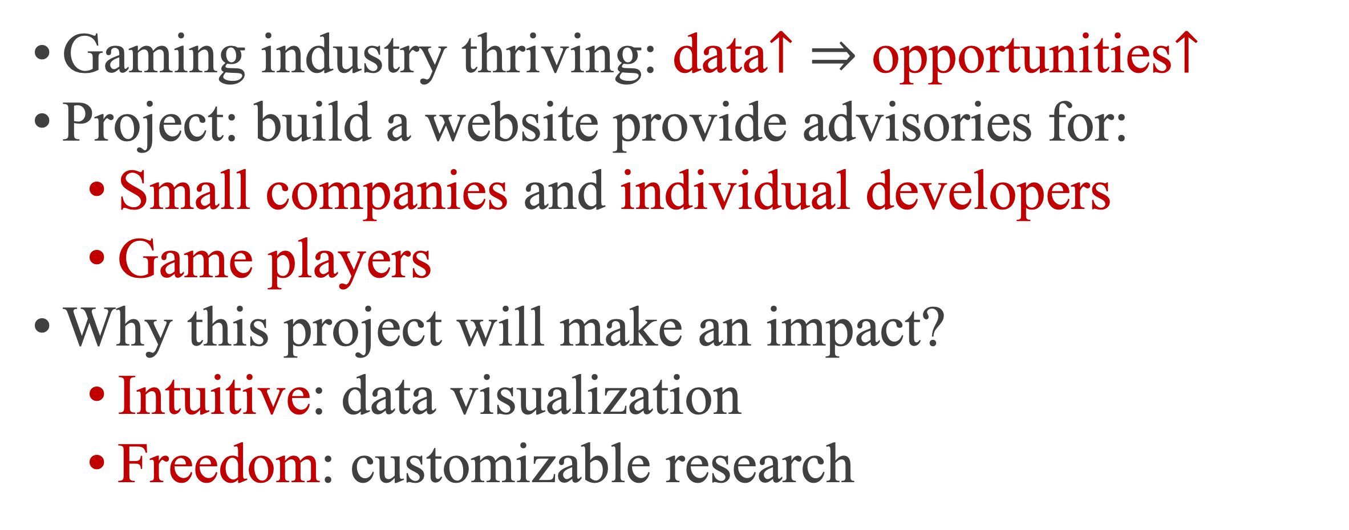
Studies on Video Game Market
-- Targeted for Game Companies and Game Players
Mingliang Zhou (Stony Brook Univ., TDI Finalist)
Project and Impact
Critic or User Score?
Gaming industry thriving: data$↑$ $⇒$ opportunities$↑$
Project: build a website provide advisories for:
Small companies and individual developers
Game players
Why this project will make an impact?
Intuitive: data visualization
Freedom: customizable research
Critic score
$$≠$$
User score
Easy to use & FREE!
Genre
Score
$$≠$$
Sales
Which Console?
Total sales: action | Sales per game: platform | Trending: shooting
Region
Title
Last console war: Nintendo won | This console war: Sony is winning
Content
Which Company?
Share: NA $>$ EU $>$ Japan $≈$ Others | NA $∝$ EU
Rating
Sales: Rockstar, Infinity Ward and Nintendo
Quality Consistency: Rockstar, Blizzard
Rated E
$$⇓$$
Rated M
Summary and Outlook
Transition
Many interesting patterns discovered:
For game company: genre | region | rating
For game player: score | console | company
Data Source: MetaCritic | Project Location: Github
About me: LinkedIn | Github | LeetCode
Next steps: more data | website | user customizable plot
Further thoughts: easily generalized to movies / songs

