Slide 1


Kalman Filter
Philipp Schön (5121059)
Constantin Thein (5121017)

Slide 2
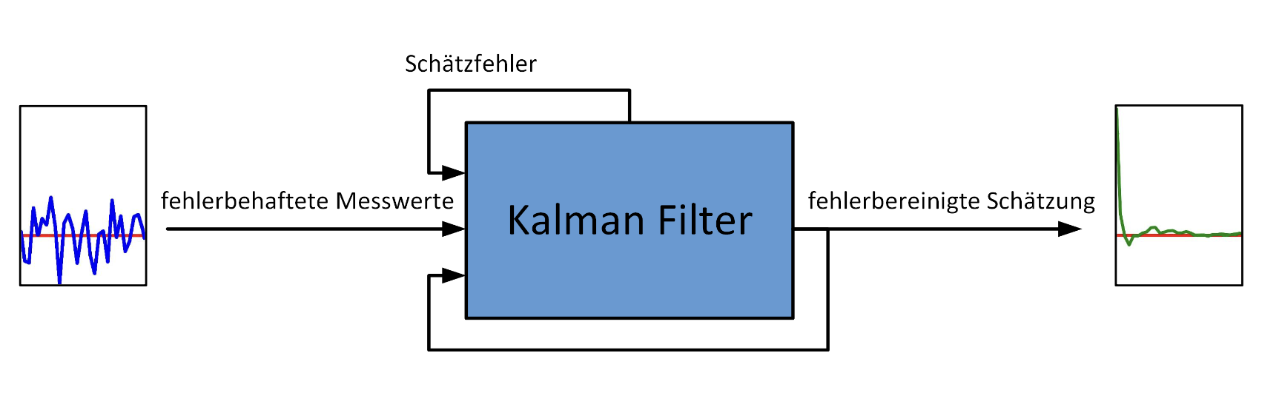
Kalman Filter
estimation error
inacurate measurements
error-corrected estimate

Slide 3
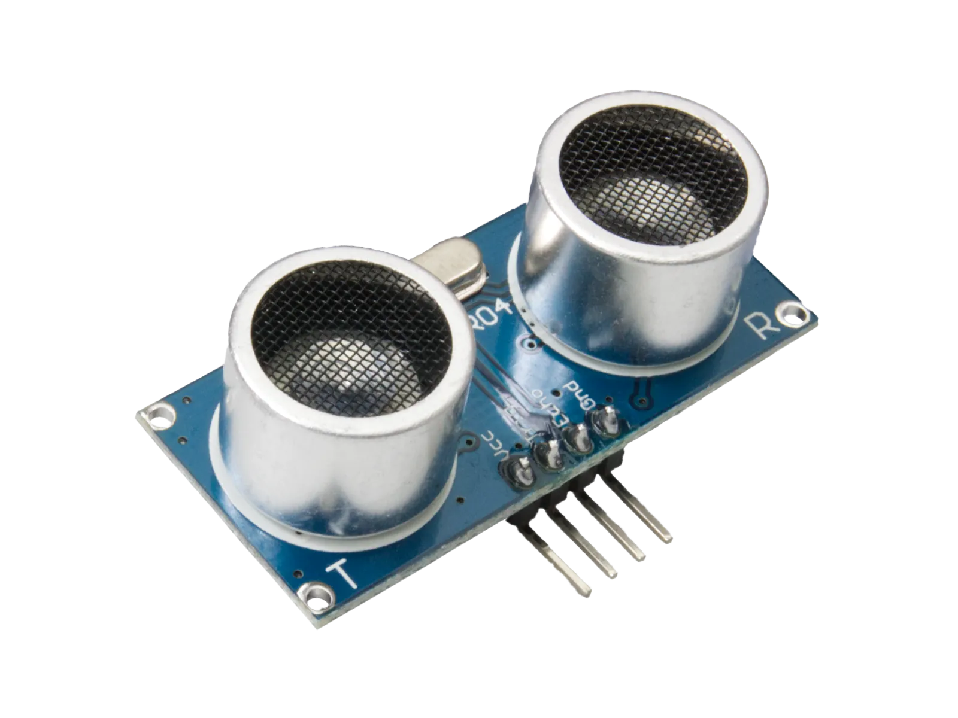
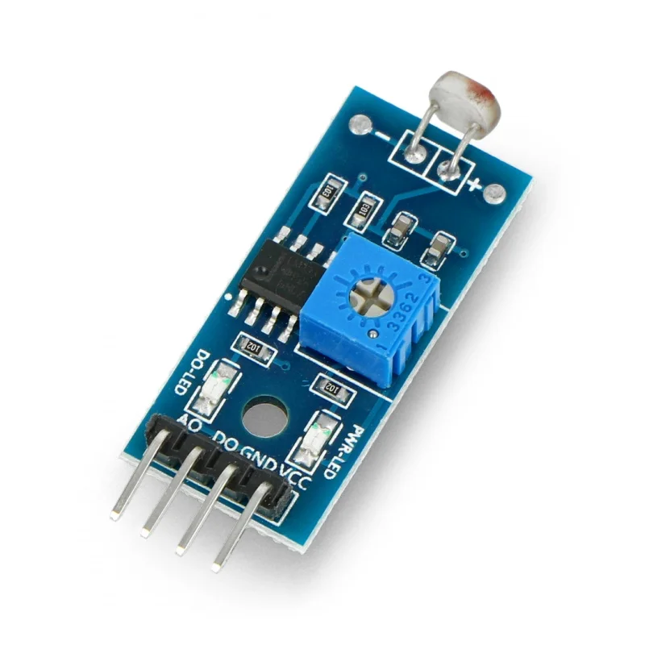
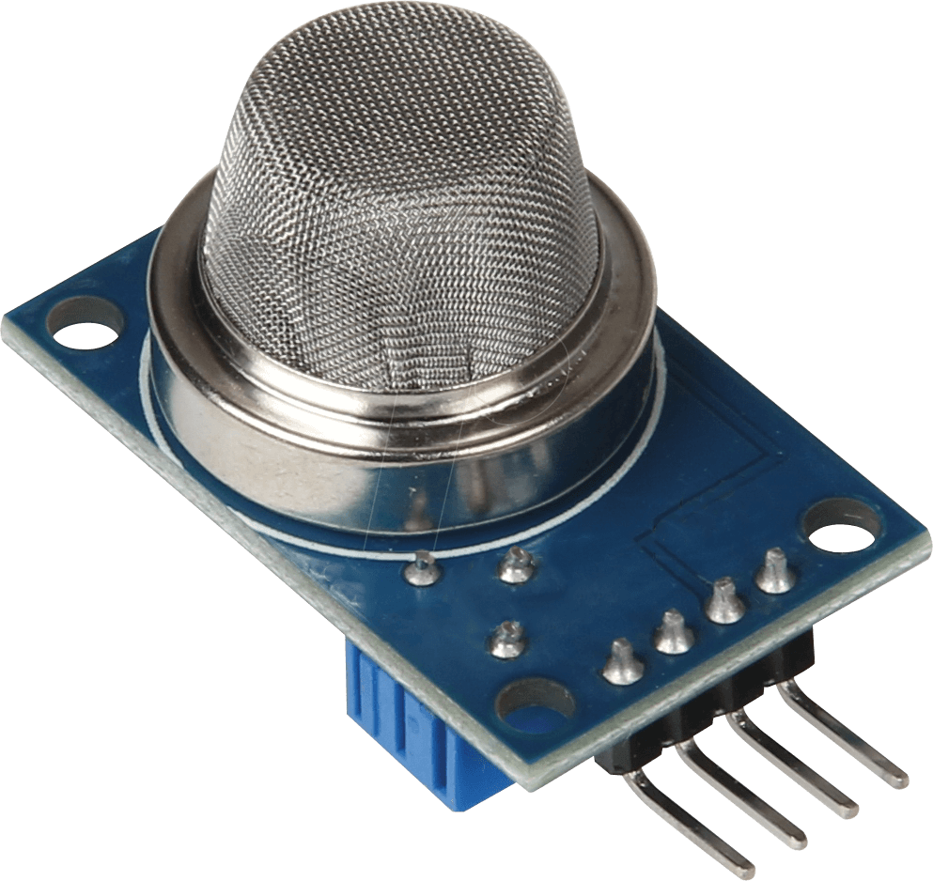
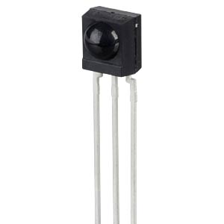
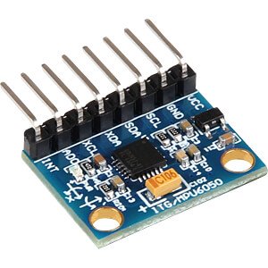
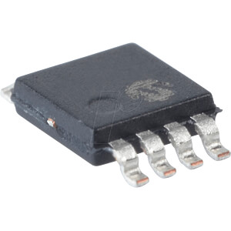
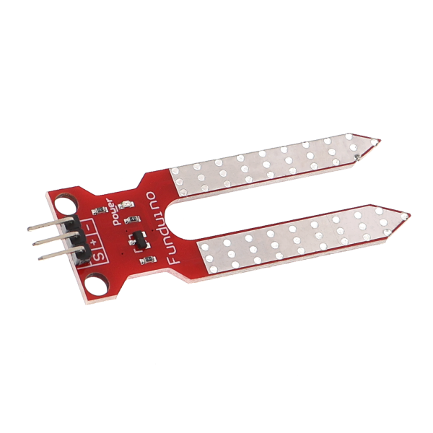
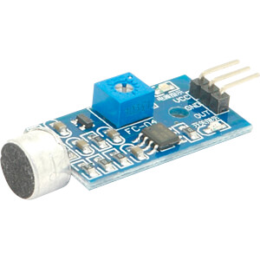
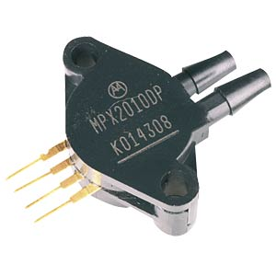
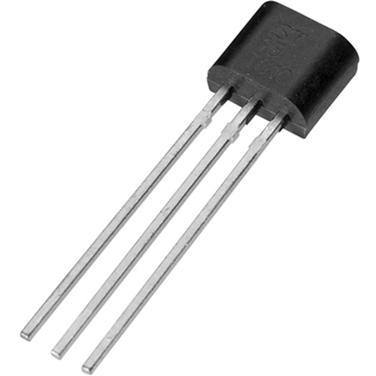
Sensors susceptible to failure
Light sensor (photoresistor)
Ultrasonic sensor
Infrared sensor
Temperature sensor (thermoelectric)
Magnetic field sensor
Gas and air quality sensor
Humidity sensor
Motion sensor (accelerometer)
Pressure sensor
Sound sensor

Slide 4
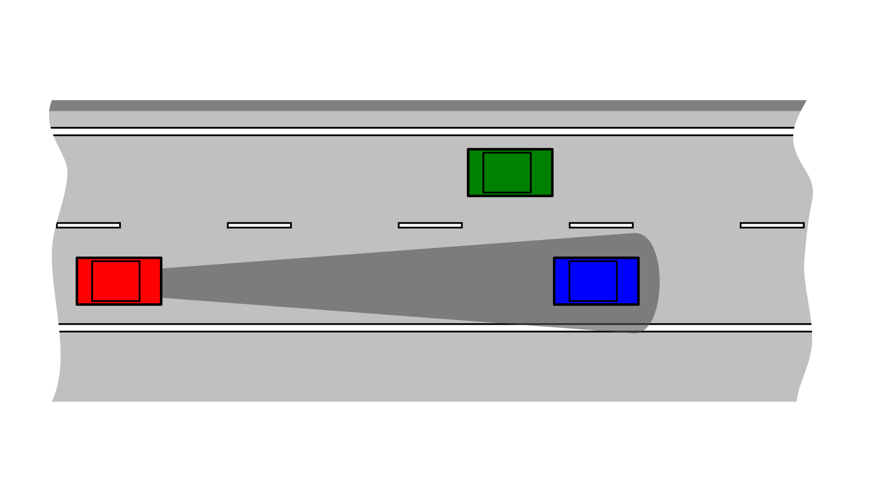
Table of contents
1. Explanation of the Kalman filter
1.2 Function
1.3 Use cases
2. Experiment
2.1 Structure
2.2 Process
2.3 Simulation
2.4 Result
3. Conclusion

