Slide 1



Crop and fertilizer Recommendation using ML
Name: Shreya Sharma
AICTE Id: STU67cfd6bb66cfe1741674171

Slide 2

Learning Objectives
Python : First we learned how python stores modules and use it for implementing machine learning models
Learned how Decision Tree algorithms classify data based on soil properties, climate conditions, and crop requirements.
Explored how DTC improves prediction accuracy for crop and fertilizer selection.
Gained insights into using Python libraries (Scikit-learn, Pandas, NumPy) for data processing and model training.
Discovered how Decision Tree Classifier predicts the best crop based on soil parameters.
GOAL

Slide 3
Tools and Technology used
Programming Language
Python – Core language for data processing, model development, and visualization.
Development Environment
Google Colab – Cloud-based interactive notebook for coding, training models, and visualization.
Machine Learning Libraries
Scikit-learn – Used for training and implementing Decision Tree Classifier (DTC) for crop and fertilizer recommendations.
Matplotlib – For creating data visualizations, including trends in crop selection and soil health analysis.
Seaborn – Enhancing data exploration with statistical visualizations for insightful decision-making.

Slide 4
Methodology
1. Data Collection
Gather soil data (pH, moisture, nutrients) and climate conditions.
Collect historical crop yield and fertilizer application records.
2. Data Preprocessing
Handle missing values and standardize data formats.
Perform feature selection to identify key variables for prediction.
Apply data visualization using Matplotlib & Seaborn for insights.
3. Model Building
Implement Decision Tree Classifier (DTC) using Scikit-learn.
Design separate models for crop recommendation and fertilizer recommendation.
Tune model parameters for improved accuracy.
4. Model Training
Split dataset into training (80%) and testing (20%) sets.
Train the DTC model on selected soil and climate features.
5. Model Evaluation
Assess accuracy using metrics like precision, recall.

Slide 5
Problem Statement:
Diverse Agricultural Land: Farmers have access to different types of soil across their lands, making crop selection challenging.
Multiple Crop Options: Various crops are available, but not all are suitable for a given soil type and climate conditions.
Fertilizer Optimization: Selecting the right fertilizer is essential for maintaining soil health and maximizing crop yield.
Data-Driven Farming: A machine learning-based recommendation system can help farmers make scientific, informed decisions to improve productivity and sustainability.

Slide 6
Solution: Leveraging Green Skills & AI for Precision Farming
To address the challenges in crop selection and fertilizer optimization, this system integrates Green Skills with AI, promoting sustainable, data-driven agriculture. Using Decision Tree algorithms, the model achieves:
98.49% accuracy in recommending the most suitable crop based on soil properties and environmental conditions.
100% accuracy in fertilizer recommendation, ensuring farmers apply the right nutrients for improved soil health and maximum yield.
By harnessing AI-powered precision farming, farmers can optimize their crop selection and fertilizer usage, leading to higher productivity, reduced waste, and long-term sustainability in agricultural business practices.
Link for the project

Slide 7
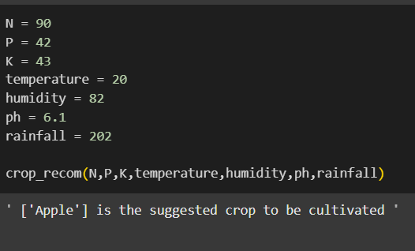
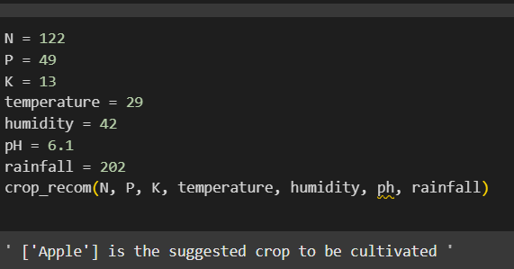
Screenshot of Output:
Test cases

Slide 8
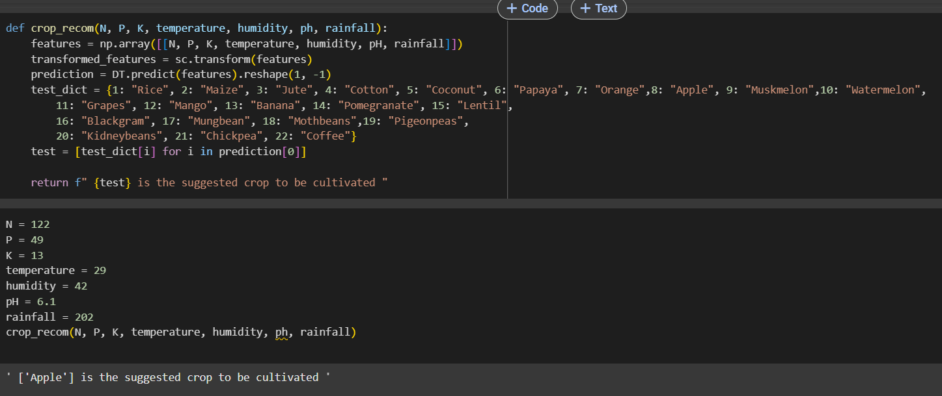
Screenshot of Output:
Test functions

Slide 9
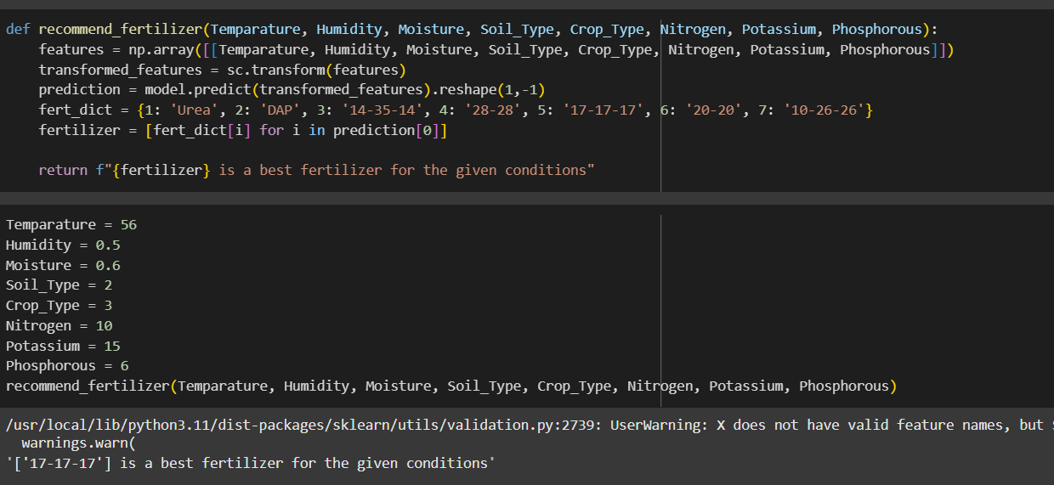
Screenshot of Output:
Test functions

Slide 10
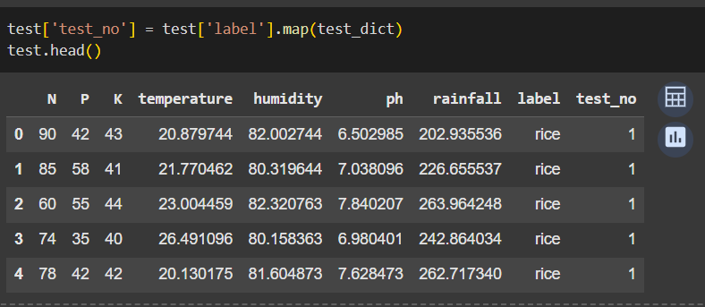
Screenshot of Output:
Test data

Slide 11
Conclusion:
Through data preprocessing, model training, and evaluation, this system enables farmers to make informed agricultural decisions, improving both productivity and sustainability.
This project highlights the importance of AI in precision agriculture, reducing reliance on guesswork and increasing efficiency in crop selection and soil management.
This project was successfully implemented using Decision Tree Classifier (DTC) to provide accurate crop and fertilizer recommendations.
FUTURE SCOPE:
• Implementation of Random Forest – Future iterations can incorporate Random Forest, an ensemble learning method that improves accuracy by reducing overfitting and providing more stable predictions.
• Deep Learning Integration – Advanced techniques like Neural Networks and CNNs (if spatial data is used) can refine predictions, especially when analyzing complex relationships between soil properties and crop yield.

