Slide 1



CROP RECOMMENDATION SYSTEM

Slide 2

Learning Objectives
Identify key issues faced by farmers regarding crop selection and fertilizer usage.
Recognize the impact of traditional farming practices on yield and sustainability.
Learn About AI-Based Precision Agriculture
Explore how AI and machine learning can enhance crop and fertilizer recommendations.
Understand the role of data analytics, predictive modelling, and soil analysis in decision-making.
Discover the Functionality of the Crop Recommendation System
Learn how your model analyses soil properties, weather patterns, and market trends to make precise recommendations.
Understand how fertilizer suggestions can optimize nutrient use and prevent soil depletion.
GOAL

Slide 3
Tools and Technology used
Machine Learning & AI Frameworks
Python:Primary language for developing AI models.
Data Processing & Analysis
Pandas & NumPy – For handling datasets, performing calculations, and processing soil or climate data.
Matplotlib / Seaborn – For visualizing crop yield trends and fertilizer impact.

Slide 4
Methodology
Data Collection & Preprocessing
Gather soil samples, climate data and crop yield records from reliable sources (e.g., agricultural databases, government reports).
Perform data cleaning and normalization to remove inconsistencies and prepare data for analysis.
Feature engineering: Extract relevant features like soil pH, moisture level, temperature, nutrient availability, etc.
Implement Machine Learning (ML) algorithms for crop selection
Training & Validation
Split the dataset into training and testing sets for model evaluation.
Apply hyperparameter tuning to improve accuracy.
Use performance metrics like accuracy, precision, recall, RMSE (Root Mean Square Error) to assess model effectiveness

Slide 5
Problem Statement: Transforming Agriculture with AI-Driven Recommendations
Unoptimized Crop Selection: Many farmers choose crops without considering soil properties, climate, or economic demand, often leading to low yield and financial loss.
Inefficient Fertilizer Use: Overuse or incorrect application of fertilizers depletes soil nutrients, reduces productivity, and contributes to environmental degradation.
Soil Health Decline: Years of poor soil management result in nutrient exhaustion, making sustainable farming more difficult.
Economic Instability: Poor agricultural practices increase costs, reduce profits, and make farmers more vulnerable to market fluctuations.
Climate Change & Sustainability Risks: Unpredictable weather demands adaptive strategies, yet farmers lack access to data-driven solutions.

Slide 6
Solution:
1. Building the AI-Driven Recommendation System
Data Collection & Preprocessing: Gather soil data, climate patterns, market trends, and fertilizer compositions to train your models effectively.
Algorithm Selection: Use classification and regression models for crop prediction and recommendation algorithms for fertilizer optimization.
Model Validation: Conduct real-world testing with farmers, analysing model accuracy and refining recommendations accordingly.
2. Partnering with Agricultural Institutions
Collaborate with Local Agricultural Boards: Work with government-backed agricultural bodies for validation and scalability.
Subsidy & Financial Assistance Integration: Recommend government schemes available for farmers adopting AI solutions

Slide 7
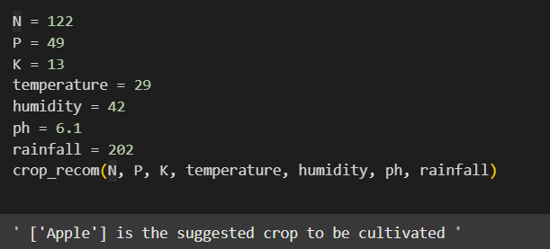
Screenshot of Output:

Slide 8
Conclusion:
The Crop Recommendation System represents a significant leap forward in agricultural decision-making. By leveraging artificial intelligence, machine learning, and IoT, the system enables farmers to make data-driven, scientifically backed choices, improving crop yield, soil health, and resource efficiency while ensuring long-term sustainability and profitability
This solution addresses critical agricultural challenges, including crop selection inefficiencies, soil degradation, and climate variability. Through predictive modeling, real-time soil analysis, and adaptive recommendations, farmers can maximize productivity while reducing environmental impact.
By integrating AI-powered solutions, farmers are empowered to transition from traditional methods to data-driven strategies, ensuring a smarter, more productive, and environmentally responsible future for agriculture.

Slide 9
THANK YOU
PREPARED BY : SHREYA SHARMA
EMAIL: csjma22001390170ece@csjmu.ac.in

