Slide 1
Feature map of user information（N, 21, 1）
Stack of N user’s information
···
···
Actor network
filters.shape = (1, 3)
strides = (1, 1)
Output:
feature map with shape=(N, 21, filters)

Slide 2
np.mean(Output, axis=2):
feature map with shape=(N, 21)
···
Apply pooling operation to the feature map:
1、AveragePooling(pool_size(1, 7), strides=(1, 7)) or MaxPooling(pool_size(1, 7), strides=(1, 7))
2、 AveragePooling(pool_size(1, 3), strides=(1, 3))
3、 MaxPooling(pool_size(1, 3), strides=(1, 3))
···
···
···
shape=(n, 7)
shape=(n, 7)
shape=(n, 3)

Slide 3
feature map with shape=(N, 17)
···
···
···
Apply sofmax operation to the feature map by tf.softmax(feature_map, axis=1), and the output is the user preference of each RGB.Then, concatenate the user information(shape=[N, 21]) and scores(shape=[N, 17]) as the input(shape=[N, 38]) of critic network.
Global Pooling
Full connected layer
···
Vector with shape(1, filters)
reward
···
···
···
Critic network
filters.shape = (1, 3)
strides = (1, 1)
mixed feature map with shape=(N, 38)

Slide 4



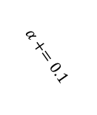





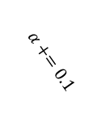





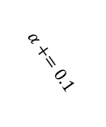


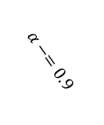
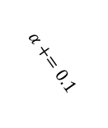





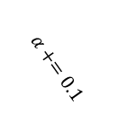
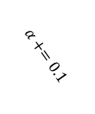
Delegated to Retransmission
UE1
17
UE2
$$⋮$$
$$⋮$$
$$⋮$$
$$⋮$$
$$⋮$$
$$⋮$$
$$⋮$$
$$⋮$$
$$⋮$$
$$⋮$$
$$⋮$$
$$⋮$$
$$⋮$$
$$⋮$$
$$⋮$$
$$⋮$$
$$⋮$$
$$⋮$$
$$⋮$$
$$⋮$$
UE3
RBG Index
3
UE4
2
1
Time (TTI)
1
2
3
4
5
6
7
8
9
10
11
12
13
14
15
16
17
18
19
20
HARQ
1
HARQ
2
HARQ
3
HARQ
4
HARQ
2
HARQ
5
HARQ
6
HARQ
7
HARQ
8
HARQ
1
HARQ
2
$$α+=0.1$$
$$α−=0.9$$
$$α+=0.1$$
$$α+=0.1$$
$$α+=0.1$$
$$α+=0.1$$
UE1
$$α+=0.1$$
Retransmission
A
N
A
A
A
A
A
OLLA

Slide 5
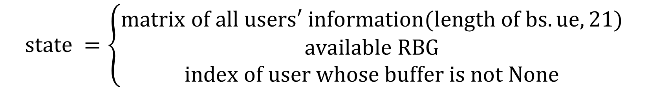
$$state =\left\{\begin{aligned}matrix of all users′ information(length of bs.ue, 21) \\ available RBG \\ index of user whose buffer is not None\end{aligned}\right.$$

Slide 6
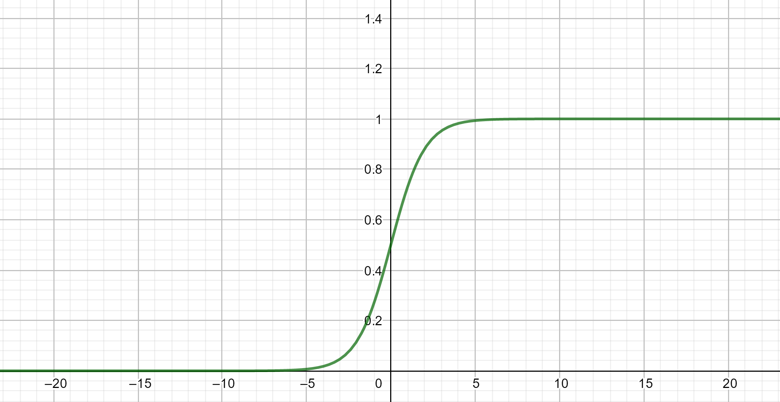
$$reward=λ_{1}sigmoid\left(effective tb size\right)+λ_{2}sigmoid(5\%−tile user rate)$$

Slide 7
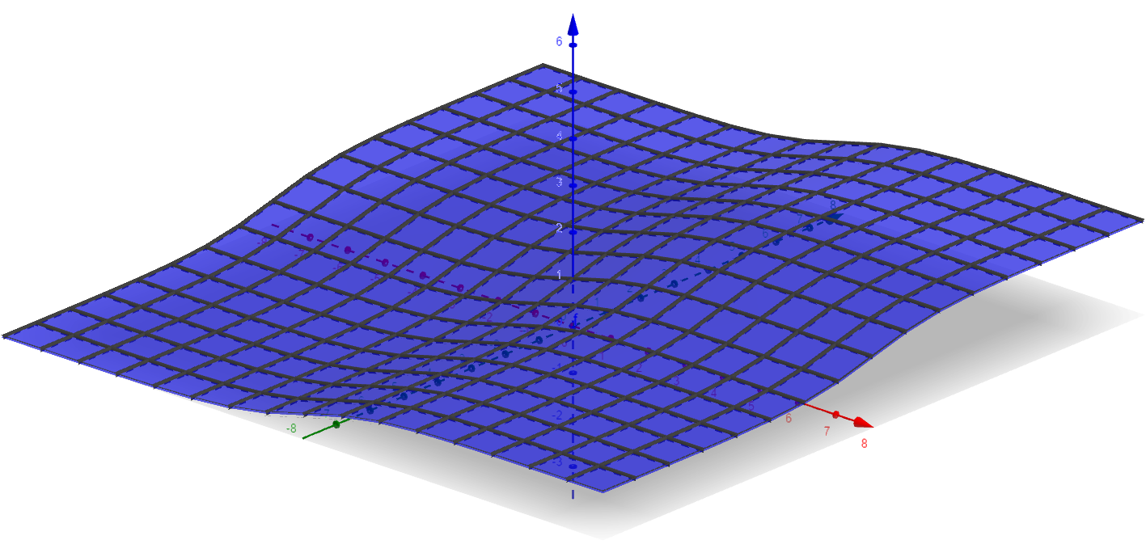

Slide 8
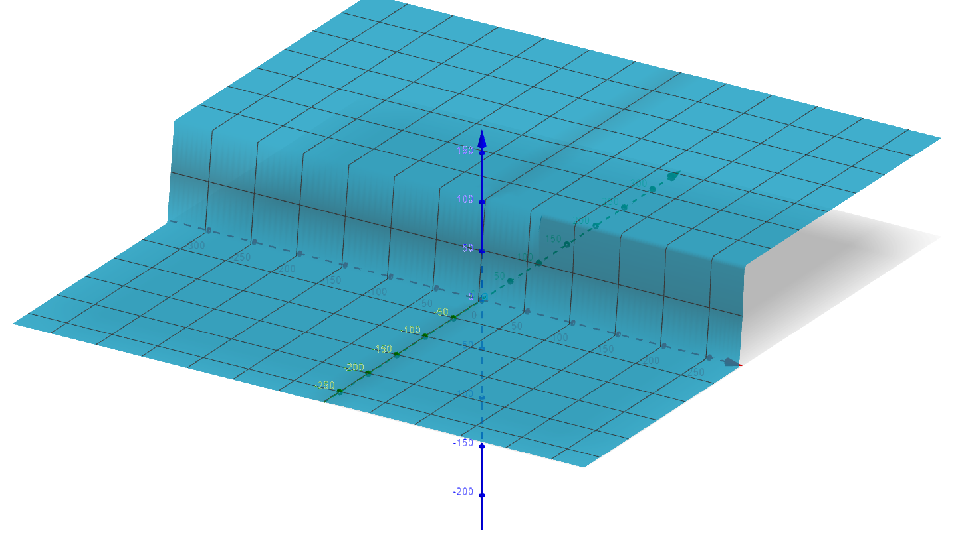

Slide 9
3x3 conv, 64
3x3 conv, 64
actor
Downsampling 1
critic
Downsampling 1
3x3 conv, 64
3x3 conv, 64
3x3 conv, 64
3x3 conv, 64
3x3 conv, 128
3x3 conv, 128
Downsampling 2
Downsampling 2
3x3 conv, 128
3x3 conv, 128
3x3 conv, 128
3x3 conv, 128
3x3 conv, 256
3x3 conv, 256
Downsampling 3
Downsampling 3
3x3 conv, 512
3x3 conv, 512
1x1 conv, RBG_NUM
Global Pooling
Softmax
FC

Slide 10
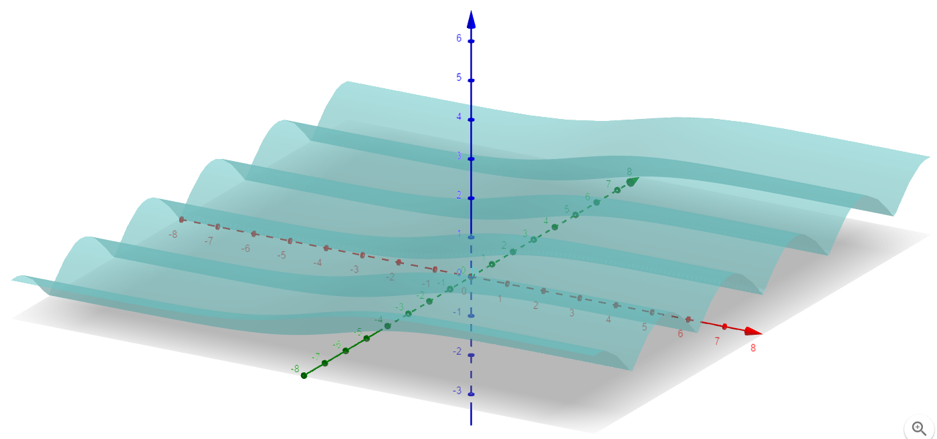

Slide 11
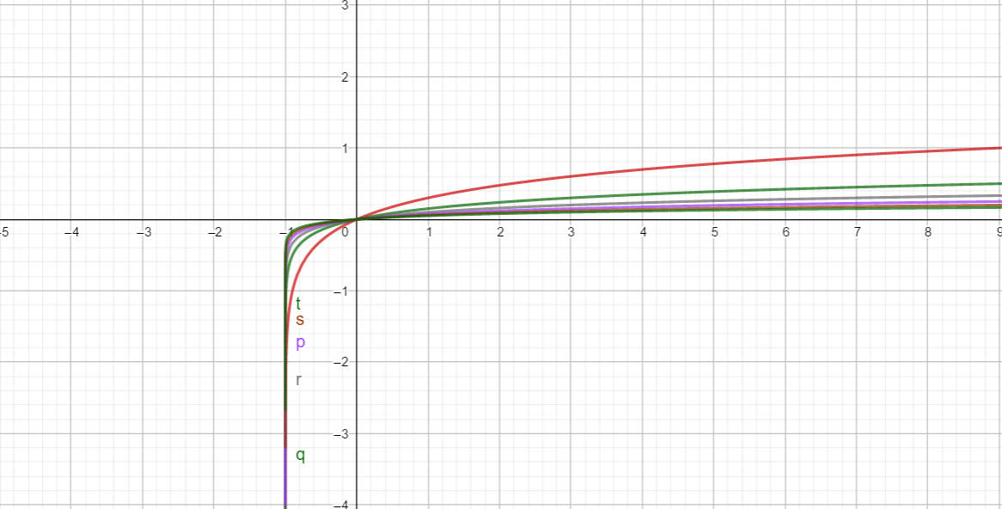

$$U=({user rate}_{1},{user rate}_{2},…,{user rate}_{n})$$
$$𝒯\left(x_{1},x_{2},…,x_{n}\right)=\frac{{(\sum_{i=1}^{n}{x_{i}})}^{2}}{n∙\sum_{i=1}^{n}{x_{i}^{2}}}=\frac{{\overline{X}}^{2}}{\overline{X^{2}}}$$
$$reward= \log_{λ_{avg}}{(effective tb size+1)}+{𝒯\left(U\right)}^{λ_{fairness}}$$

Slide 12
NEW FEATURE LIST:
1、rsrp dim=1
2、before scheduled buffer dim=1
3、avg_rate dim=1
4、rb_cqi dim=50
5、mean(rb_cqi) dim=1
6、std(rb_cqi) dim=1
7、olla_offset dim=1
8、itx_times dim=1

