Slide 1
Three-layer controller (one 2 ms tick)
Editable shapes; colours: green = learned descending layer, yellow = command gate, orange = steering muscle, blue = reflex PID, grey = classical
LIF hidden layer
8 neurons, 2 sub-steps
Features
25-D: 16 rectified IMU, bias, 8 command channels
Delay lines
11 taps, 0–20 ms
Command gate
learned pulse and set-points in charge while the command is on + 1 s tail; otherwise classical base law, set-points 0
Refractory 37 ms
≤ 1 learned onset per wingbeat
IMU + ToF
11-D reading, 500 Hz, noisy
Outputs
via 11 axonal delays: 2 spiking → pulse; 2 graded g_r, g_p
Steering-muscle layer
pulse → ω = 3807 rad/s for 3 ticks (6 ms); ≈ +690 rad/s after the lag → pitch torque, sign set by wingbeat phase
Task command
evade channel or dash/redirect channel; unit vector along φ
PLL
wingbeat phase from the pitch gyro
Classical base pulse law
phase-locked: k_θ = 8, k_q = 0.4; righting reflex (tilt > 25°) only outside the gate
Reflex layer (PID)
α, β ← PID(e), e = (g_r, g_p) − (roll, pitch); ω ← PID(z, v_z)
Actuators
α, β ±0.3 rad; ω 3115–3807 rad/s; 8.2 ms lag
Fixed interface: sensors, actuators, the 2 ms update and the limits are those of the original environment. A pulse gives pitch torque only; roll goes through g_r → PID → gimbal. Outside the gate every arm is tick-for-tick identical to the classical base law.

Slide 2
Training and evaluation pipeline (plan v11)
The classical opponent (1) is the imitation teacher, the ES normaliser, the selection reference and the paired comparator
1 Opponent
classical: 2-D set-point schedule per task and direction class (7); evade/redirect 24 configs × 8 tuning cases; dash 108 × 16
2 Imitation
BPTT with a surrogate gradient on the opponent's traces; 16 training + 4 validation cases per task; 40 epochs; 5 seeds → 5 starts
3 OpenAI-ES
2564-D, population 16 (8 antithetic pairs), σ 0.02, lr 0.01·0.85^g; 8 cases/task/gen = 24 episodes per candidate (all directions, turns, strata); crash-aware ranking; 16 generations; shared pre-command prefix
4 Selection
imitation start + 9 saved centres on 64 fixed validation cases per task; exclude any crash or tilt ≥ 70°; lowest objective → frozen controller
5 Blind test
fresh seed base, 64 cases per task, paired with the opponent; prereg. pass: ratio ≤ 0.95 and crashes ≤ opponent (≥ 3 of 5 seeds); paired Δ reported
6 Robustness
frozen controllers (v12–v13): torque hits 2/3/4.5 mN·m (timing, axis, double), turbulence ×1.25/×1.5, IMU noise ×5, sensor delay 3, mass +12.5 %; H1: paired Δ CI < 0 and crashes ≤ opponent, ≥ 3 of 5 seeds
Objective (stage 3): mean case score ÷ classical class mean + 0.3·[tilt_peak − 60°]₊. Ratio (stages 5–6): case score ÷ opponent class median on the blind cases; Δ = ratio − opponent's own ratio on identical cases (paired bootstrap 95 % CI). Machines: CloudPC-2 seeds 1–3, HomePC seeds 4–5 (bit-identical episodes); GoogleCloud exploratory seeds only.

Slide 3
Manoeuvre tasks (heading frame fixed at the command onset; 0° forward, 90° left)
Evade
0.10 m along φ ∈ {0, 90, 180, 270}°
window 1.5 s, t0 ~ U(2.2, 2.8) s
classes: pitch (0/180°), roll (90/270°)
score: t_reach (or 1.5 + 10·short) + 0.5·|cross| + 0.03·max|Δz| + crash
Redirect
along φ₁ ∈ {0, 90, 180, 270}°; at 0.08 m or 1.0 s the command switches to φ₂ = φ₁ ± 90°; then 0.10 m along φ₂
window 4 s, t0 = 2.4 s; class by φ₂
score: t_switch + (t_reach2 or (4 − t_switch) + 10·short) + 2·max(0, overrun − 0.05) + 0.03·max|Δz| + crash
Dash
0.15 m along φ ∈ {0, 45, …, 315}° and stop (|v_along| < 0.1 m/s for 0.3 s)
window 4 s, t0 = 2.4 s; classes pitch / roll / diagonal
score: (t_reach or 4 + 2·short) + (t_settle or 4) + 2·max(0, max_along − 0.25) + 0.5·|cross| + 0.03·max|Δz| + crash
Crash: true tilt > 80.2°, |z − z_start| > 1 m, z < 0.12 m, ground clearance ≤ 3 cm, or numerical failure; crash term 10 + 5·(unflown fraction of the window). Classical normalisers (ES; opponent class means on 24 cases): evade pitch 0.80 / roll 0.59, redirect 2.09 / 1.25, dash 5.79 / 1.53 / 4.96.

Slide 4
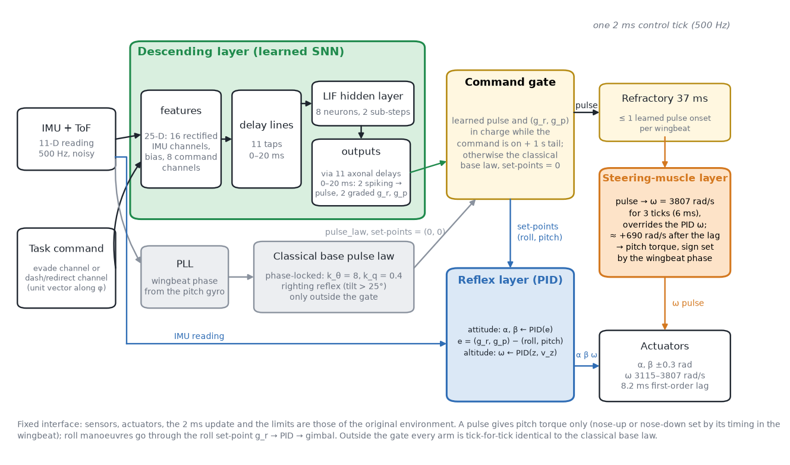
fig_m1_architecture

Slide 5
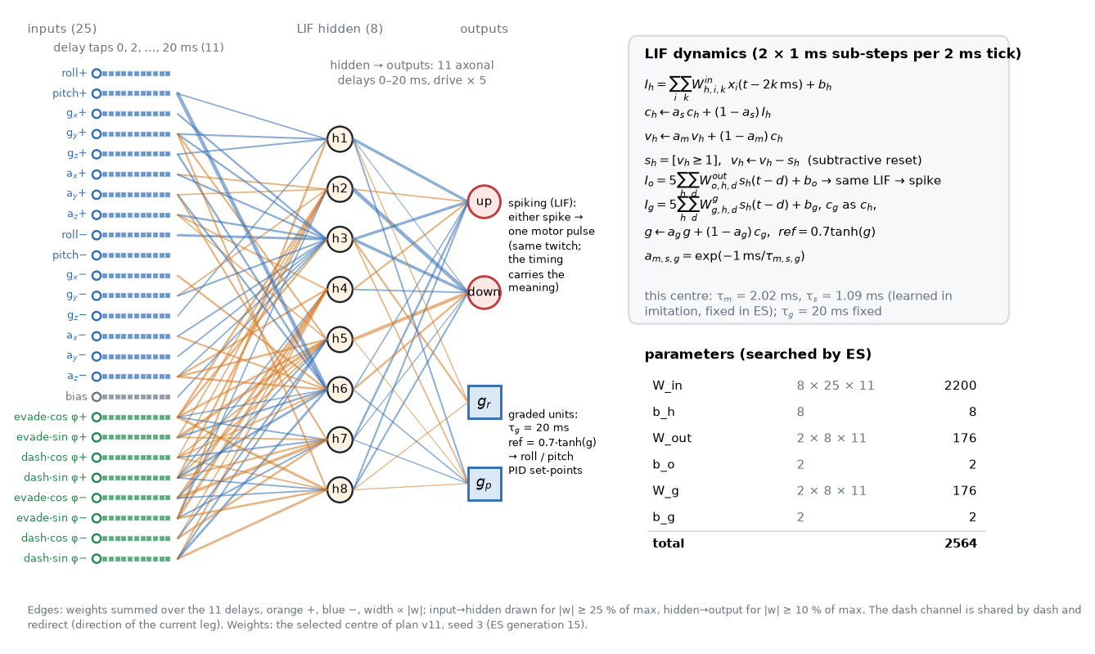
fig_m2_snn

Slide 6
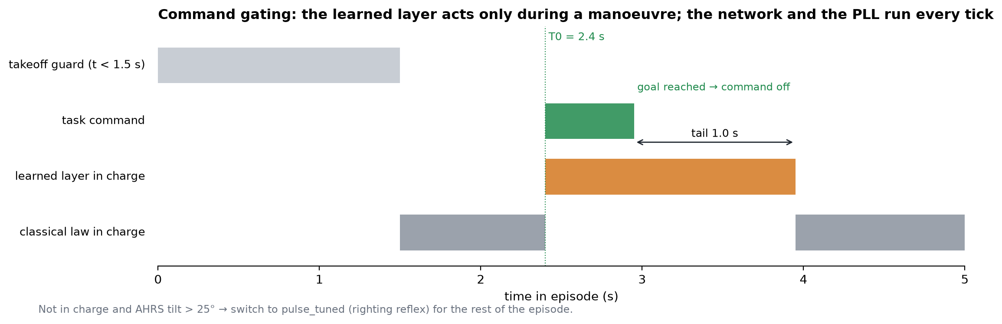
fig_m3_gating

Slide 7
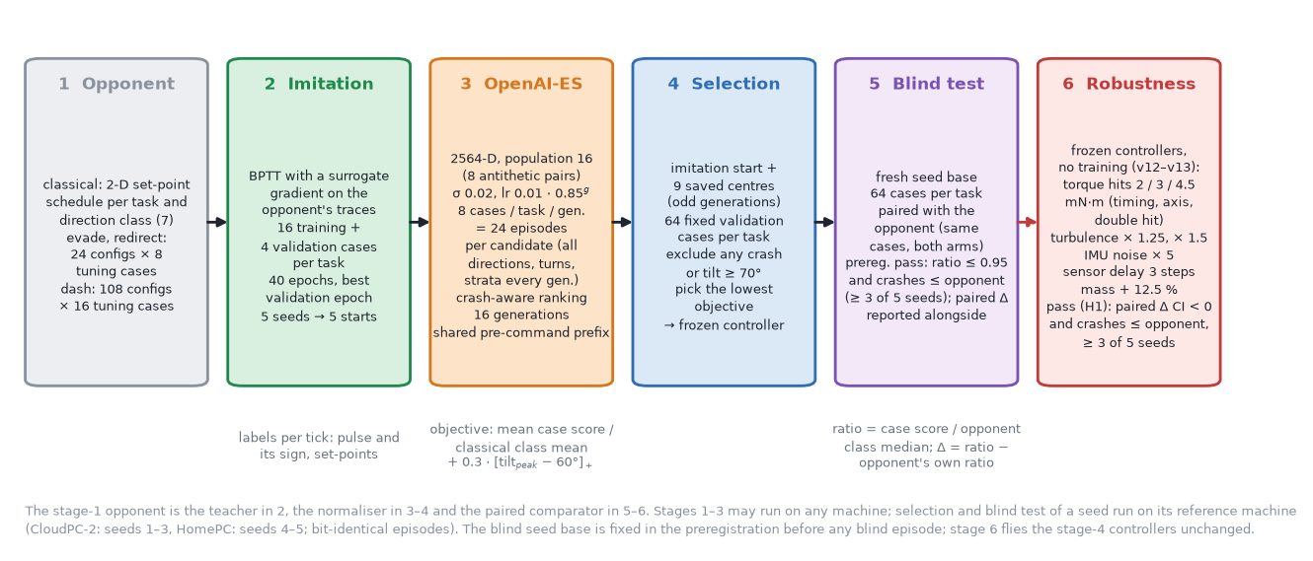
fig_m4_pipeline

Slide 8
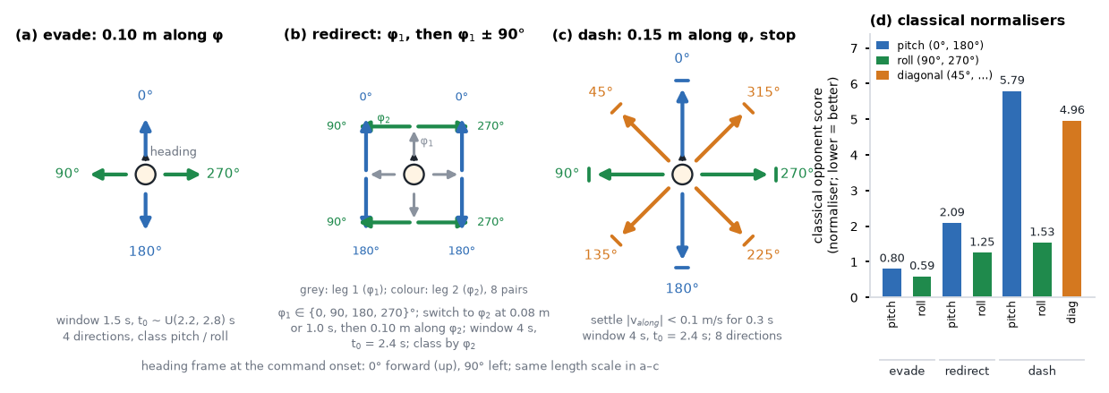
fig_m5_tasks

Slide 9
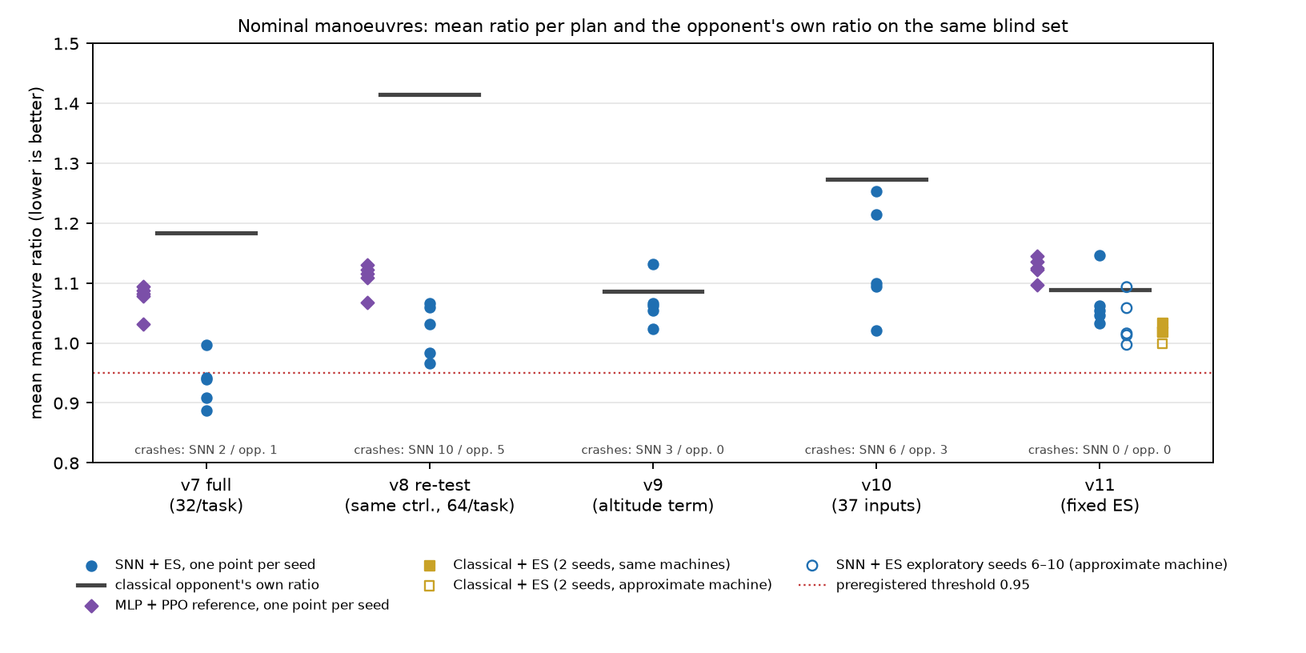
fig_r0_nominal

Slide 10
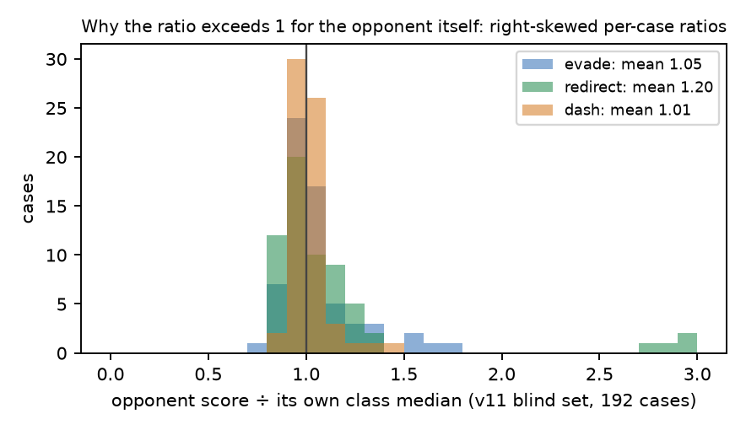
fig_r0b_skew

Slide 11
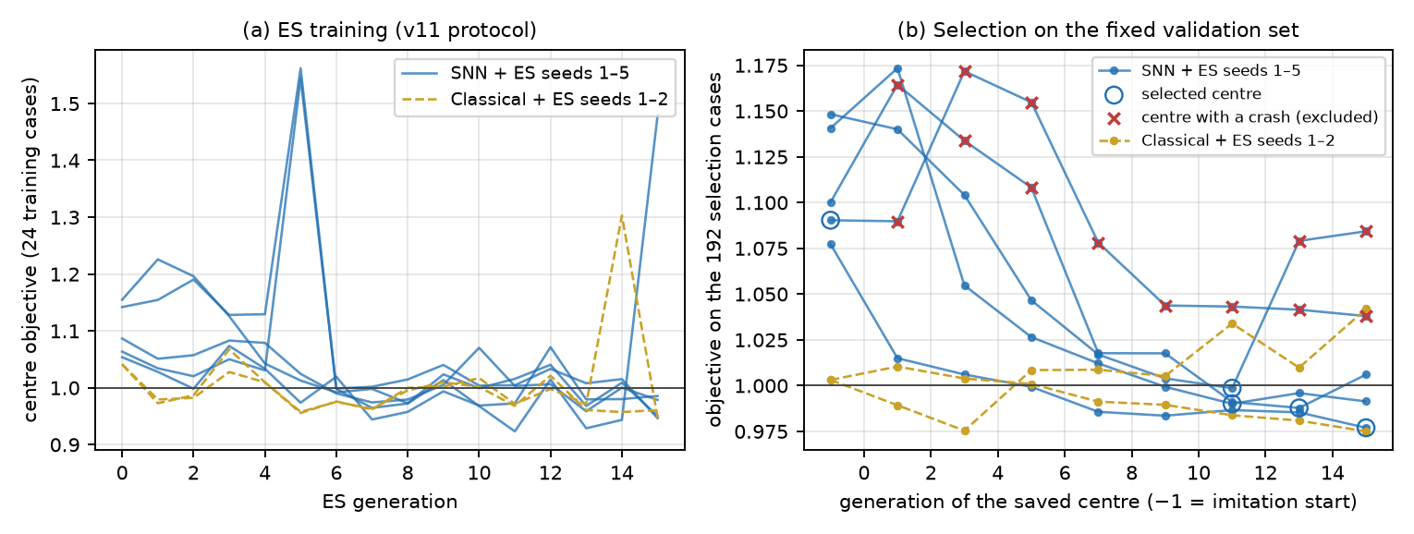
fig_r1_training

Slide 12
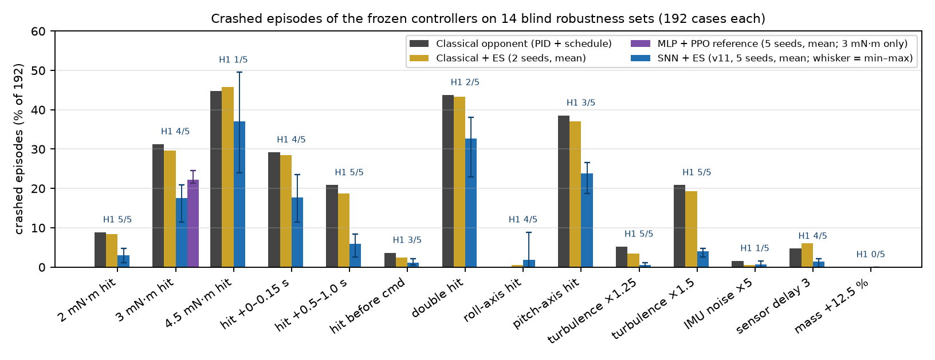
fig_r2_crashes

Slide 13
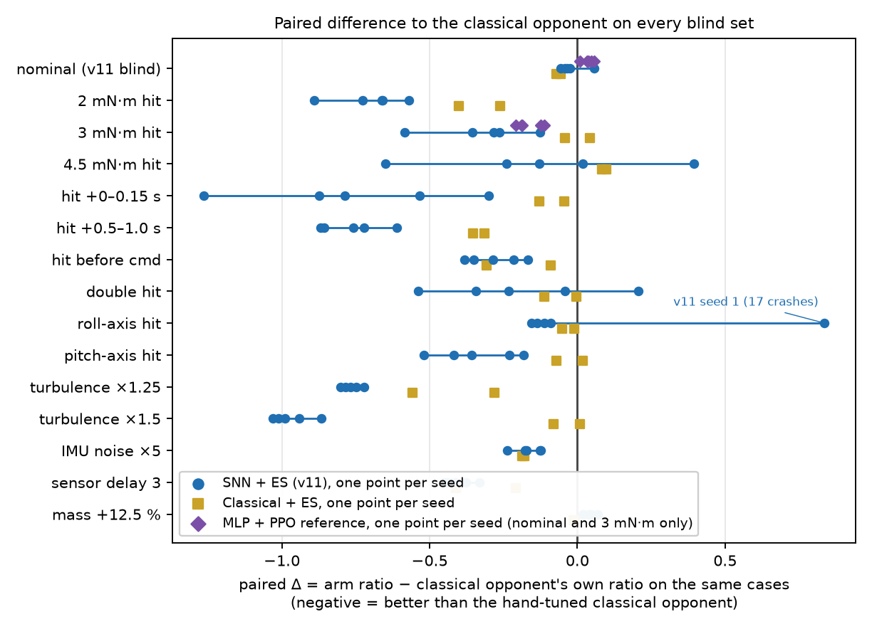
fig_r3_paired_delta

Slide 14
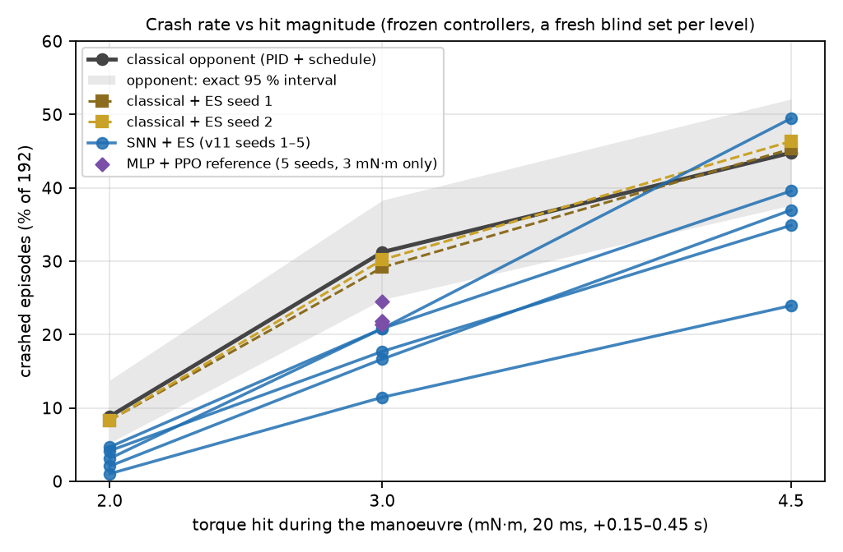
fig_r4_dose_response

Slide 15
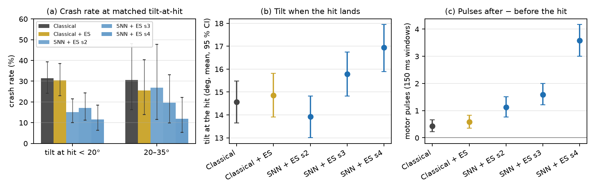
fig_r5_mechanism

Slide 16
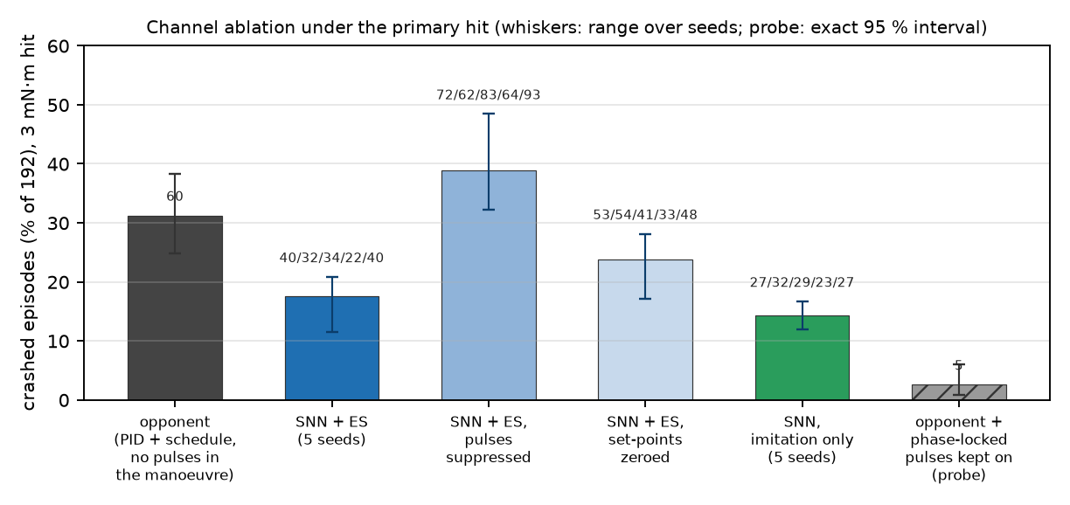
fig_r5b_ablation

Slide 17
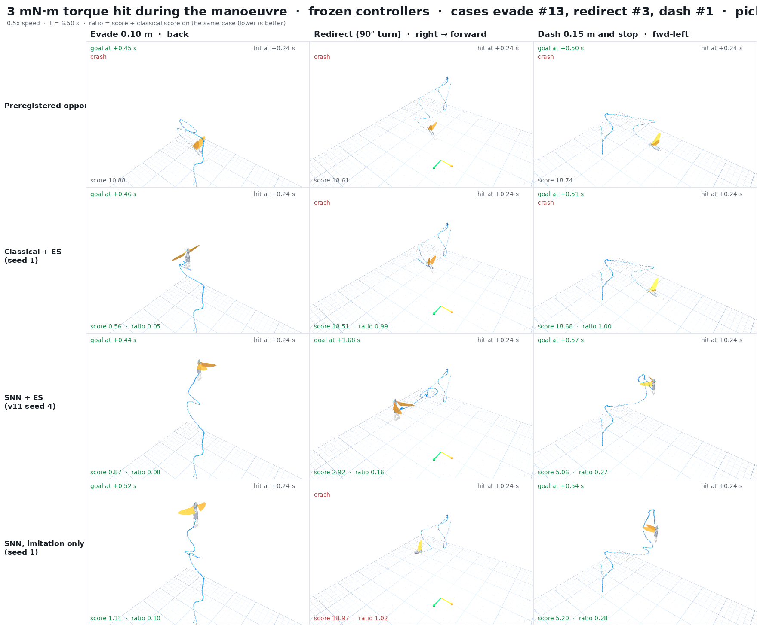
fig_r6_kick_frame

