Slide 1
Advertising Recommendation MiddleWare
Using OpenCV & Keras & Kafka

Slide 2
Quick Prev
Goal -> To Recommend Adv to Random Client
How ?
Get User’s Facial data
Predict User’s Age with Facial Data
By Using Age feature, Client Send Subscription to MiddleWare
And Published Adv will Matches in MiddleWare
Send to Subscriber Client

Slide 3
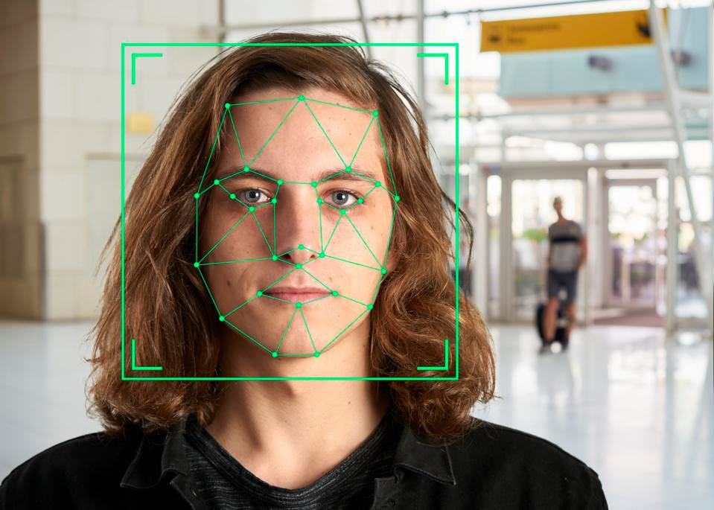
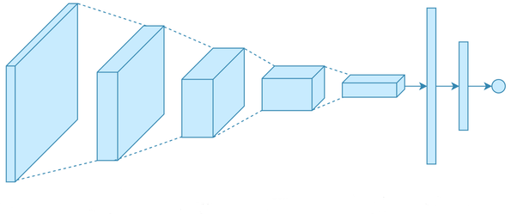

Subscription

Slide 4
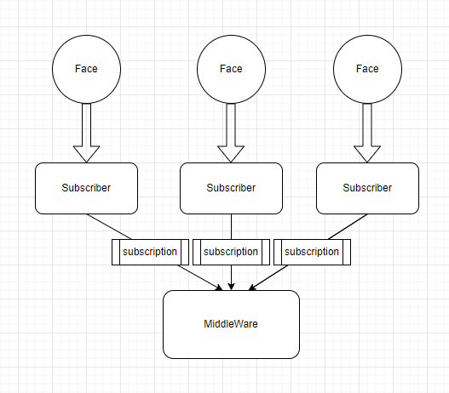

Slide 5
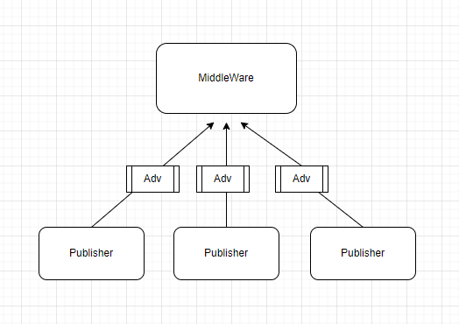

Slide 6
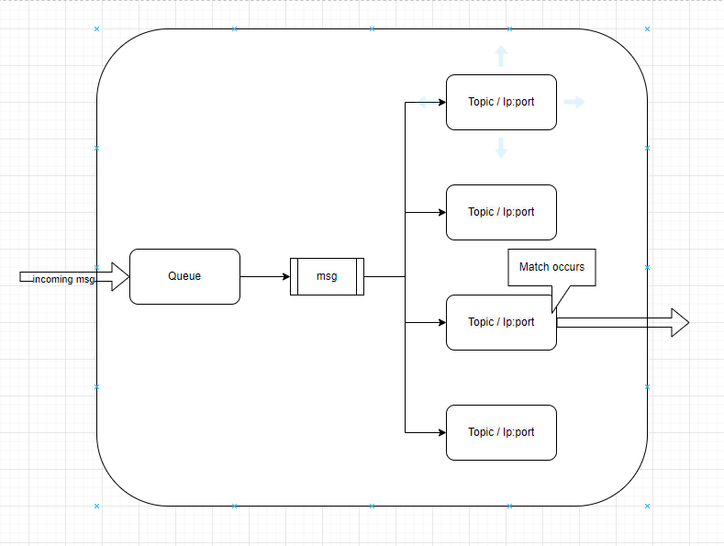
subscriber

Slide 7
Changed Schedule
WAS Designing has been Delayed
Need more Accuracy on Model, try to focus on it
So, WAS implement steps will behind schedule
주 설계요소 | 1 | 2 | 3 | 4 | 5 | 6 | 7 | 8 | 9 | 10 | 11 | 12 | 13 | 14 | 15 | 16
planning proposal | o | o | o
data survey | o | o | o
reusable tech research |  | o | o
ML model design |  |  |  | o | o | o | o
WAS production |  |  |  | o | o | o | o
model-applied middleware development |  |  |  |  |  |  | o | o | o
middleware development |  |  |  |  |  |  | o | o | o
Apache Kafka application |  |  |  |  |  |  | o | o | o
Service Applied Distribution |  |  |  |  |  |  |  |  | o | o | o
confirmation of practical use of massive data |  |  |  |  |  |  |  |  | o | o | o | o
Performance evaluation and correction of performance improvement points |  |  |  |  |  |  |  |  |  |  |  | o | o | o | o | o
Preparation of report and preparation for graduation exhibition |  |  |  |  |  |  |  |  |  |  |  |  |  | o | o | o

Slide 8
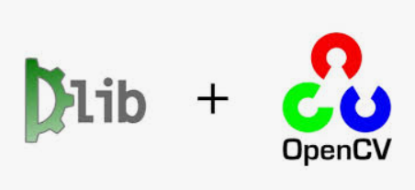
Face Recognition
We import 3 modules for face recognition.(cv2, cmake, dlib)
From dlib library, use get_frontal_face_detector for detect human’s face.
Use openCV.dnn for load model.
Load image’s pixel from function cv2.imread(image_path)
Save face’s imformations at x1,y1,x2,y2.
By using BlobFromImage, translate image into Blob shape like binary.

Slide 9
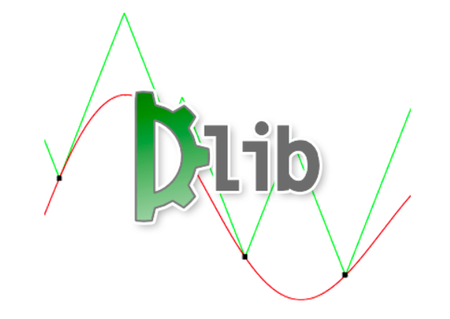
Import module (dlib)

Slide 10
Import module(dlib)
Dlib library use HOG(Histogram of Oriented Gradients) property for detect faces.
Dlib library can use HOG property or trained CNN model.
HOG can express the direction of change in image brightness, which can be identified as a change in pixel value, as a gradient, and find the shape of the object from this.
In addition to face search, it can be used for pedestrian detection.

Slide 11

Import module (CV2)

Slide 12
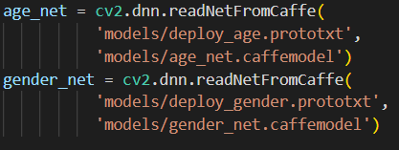
Import module(cv2)
To use OpenCV, we have to import module.
Import cv2 module for use input media files.
Use openCV.dnn for load model.

Slide 13
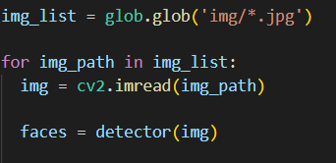
Import module(cv2)
Load all image files from img folder.
By using imread function load image files from img_path url.

Slide 14
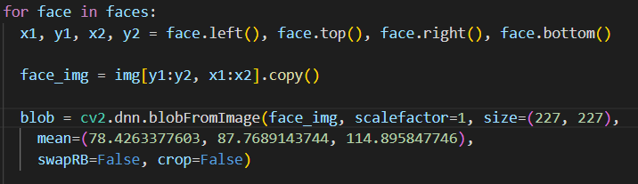
Import module(cv2)
Save face’s imformations at x1,y1,x2,y2.
By using BlobFromImage, translate image into Blob shape like binary.
Mean values are determined by model’s designer.

Slide 15
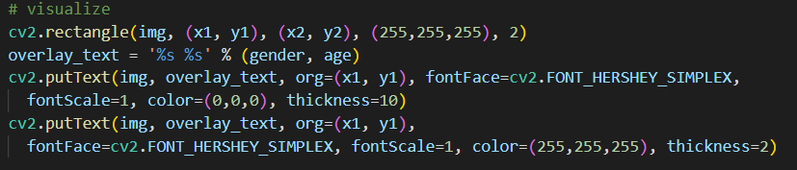
Import module(cv2)
By using rectangle function, draw rectangle at humans’ faces detected by dlib’s function.
By using PutText function, write imformations(Gender, age)

Slide 16
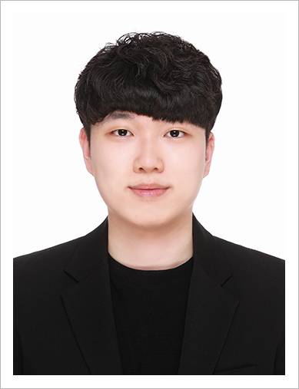
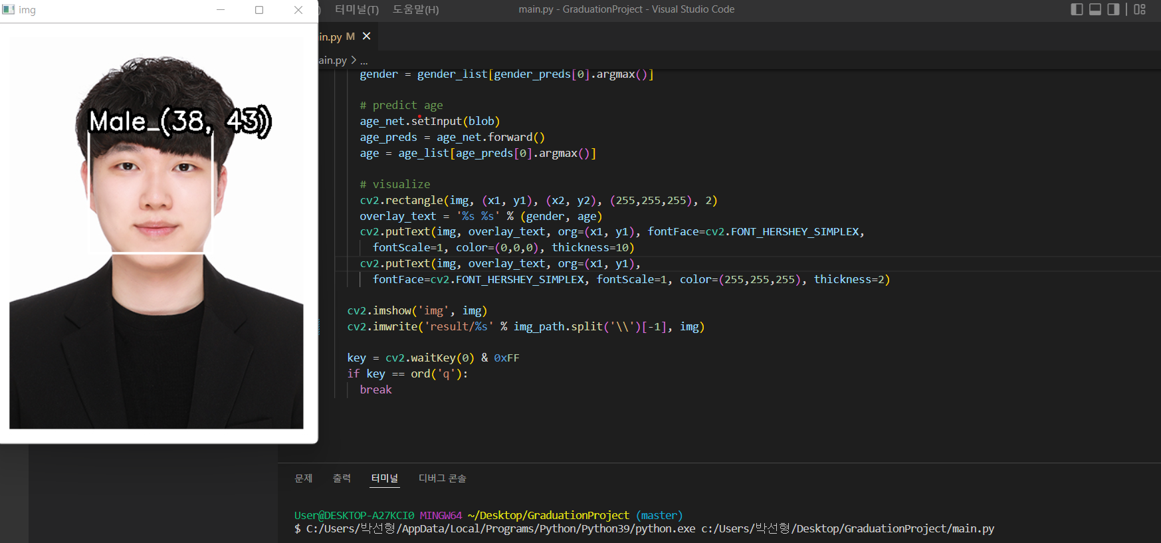
Execution
<<img/0.jpg>>
Python main.py

Slide 17
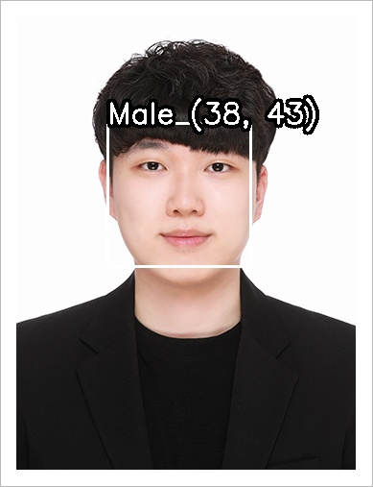
Execution
<<result/0.jpg>>
Need to design more precise model.

Slide 18
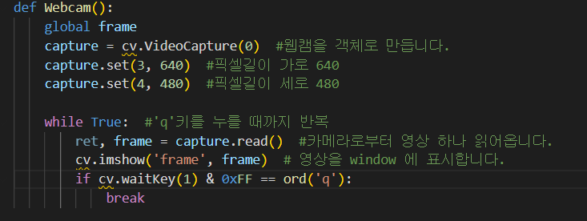
Webcam Function
Now we use saved picture.
By using Webcam function, we will save picture in realtime.
We will analyze the picture, and then save the statistics into database

Slide 19
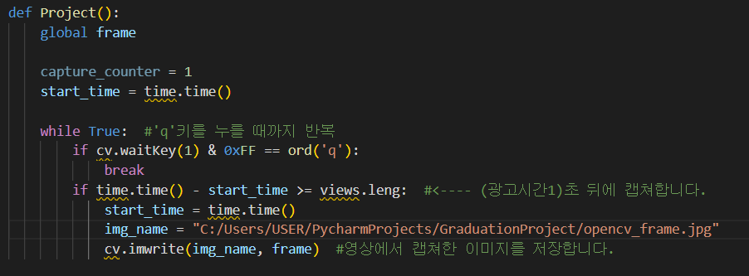
Pictured by Webcam and Save Function
By using Webcam function, we will save picture in realtime.
The picture saved in my folder.

Slide 20
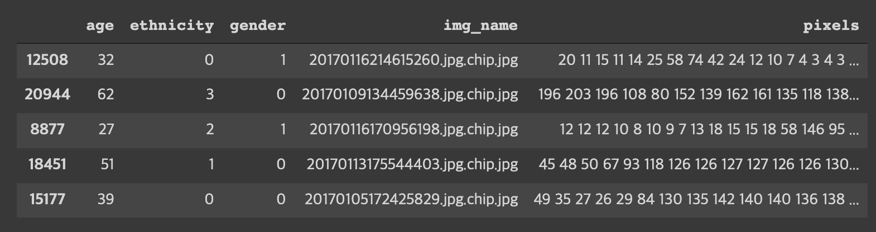
Data analysis
To Train ML Model, we need Train,Test Data
From Kaggle DataSet, (AGE, GENDER, AND ETHNICITY CSV)
Facial Image File and Features
About 23000 row in DATA SET
48 * 48 Image

Slide 21
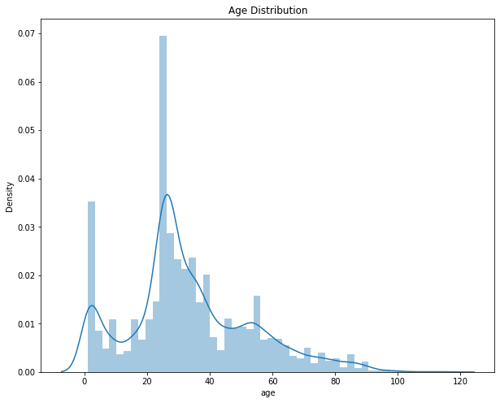
Data Analysis
we can distinguish from 5 to 116 years aged person.
the number of data is less than 500 and between 3 to 24 as well

Slide 22
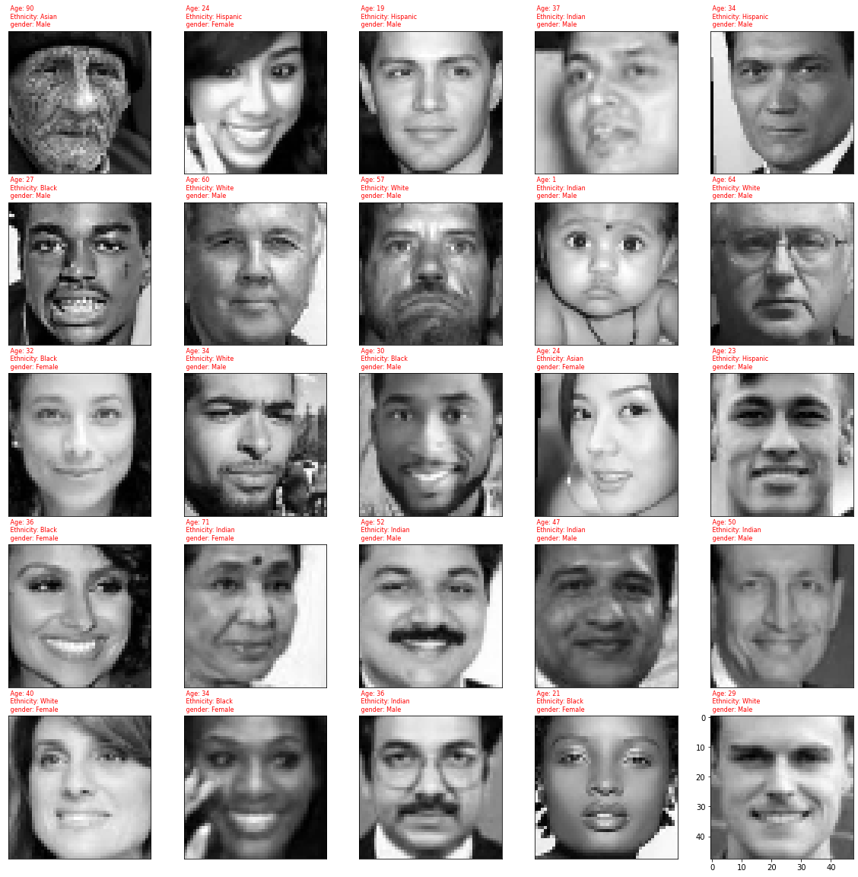
Data Analysis
We verify that the Data has Age, Gender, Ethnitiy Feature
And Visualized the Pixel to Image

Slide 23
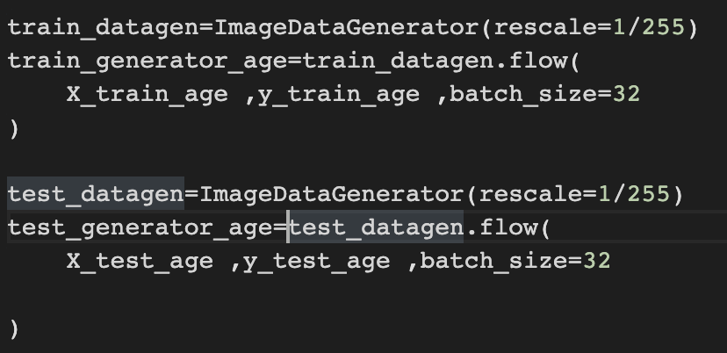
Test/Train set
We divide Data set -> Test/Train 70% of data set(about 7000) goes to Test set
Used Keras.ImageDataGenerator
Could Rescale the data, and Manage batchSize at Once

Slide 24
Use Callback func
callback을 설정하여 성능개선
earlystop=EarlyStopping(patience=6)
learning_rate_reduction=ReduceLROnPlateau
monitor='val_accuracy＇## val_accuracy를 관찰(변화가능)
patience= 3, ## 3회 에폭진행시 개선이 없을 때
verbose=1,
callbacks = [earlystop, learning_rate_reduction]

Slide 25
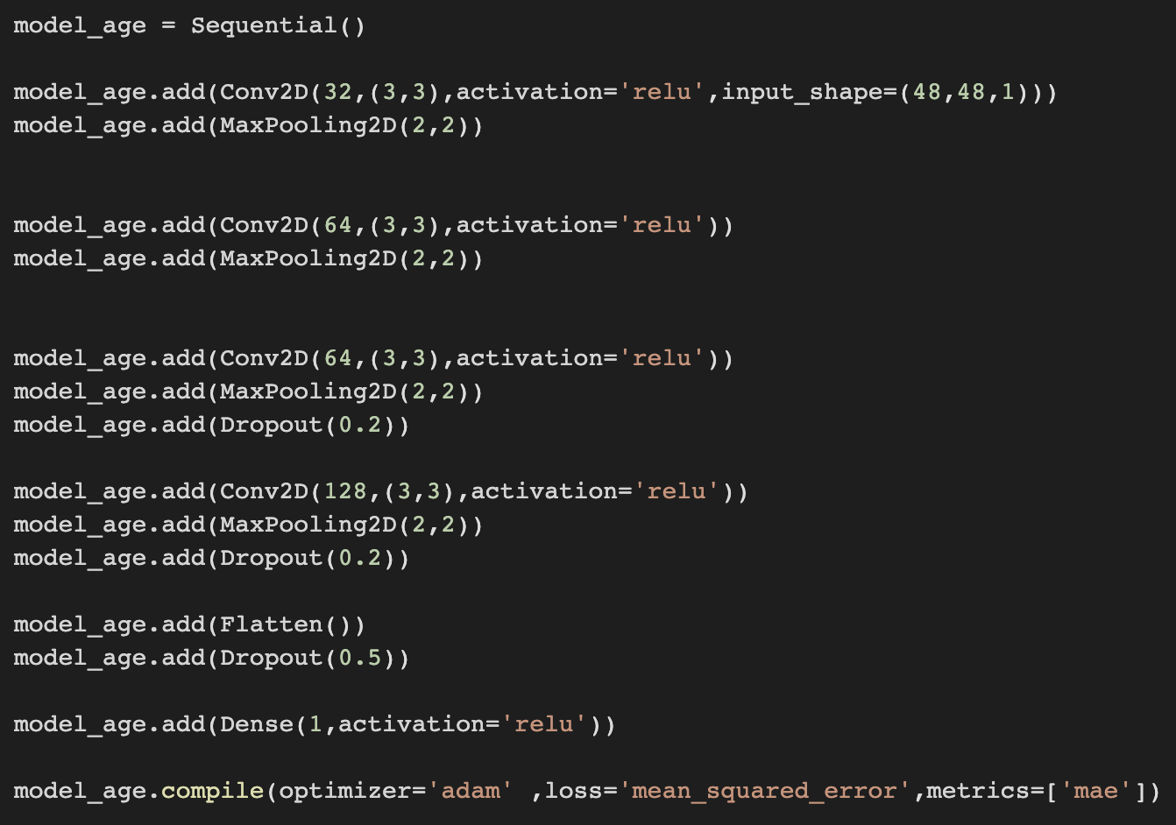
Model Design
Convolution Layer 32filters 3*3 size activation ”relu”
MaxPooling Layer
Dropout Layer

Slide 26
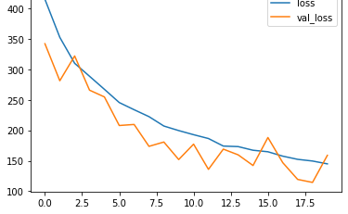
Model Loss
Epoch를 20으로 설정
Loss, val_loss값 둘다 감소 확인
Epoch이 17이 넘어가며 callback
OverFitting occurs

