Slide 1

JWST High Redshift Galaxies: Chemical Evolution of the Universe
Speaker: Mingyi Xu
Advisors: Dr. Anil K. Pradhan & Dr. Sultana N. Nahar
SURP 2025

Slide 2

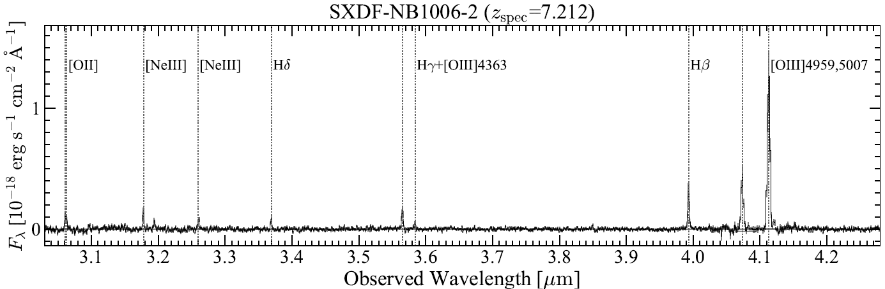

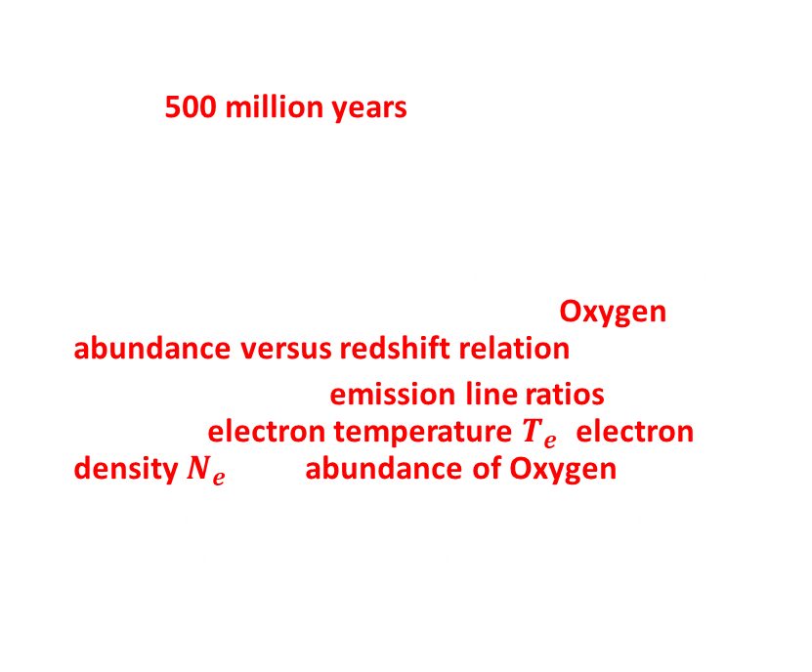


Introduction
JWST observations reveal that the first stars and galaxies formed much earlier than believed, within about 500 million years after Big Bang.
Spectra of metals (elements other than H and He) have been prominently observed from high-z galaxies.
Oxygen is a good tracer of chemical evolution for early universe. We aim to build an Oxygen abundance versus redshift relation.
Using the nebular emission line ratios, we can diagnose electron temperature $T_{e}$, electron density $N_{e}$, and abundance of Oxygen.
JWST enables researchers to measure line ratios from high-z galaxies, which were limited by earlier instruments.
JWST (James Webb Space Telescope)
Credit: NASA, ESA, CSA, Northrop Grumman
Spectra of a JWST high redshift galaxy
SXDF-NB1006-2
Credit: Harikane et al. 2025
$$N_{e}$$
$$T_{e}$$
$$T_{e}$$

Slide 3

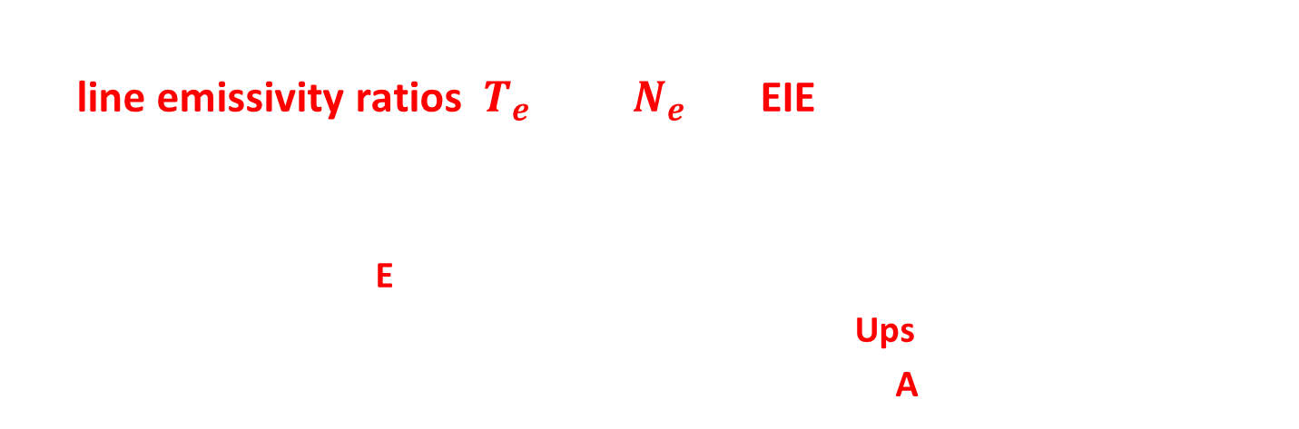
Method
SPECTRA code
SPECTRA code is a tool that could generate the relation between line emissivity ratios, $T_{e}$, and $N_{e}$ for EIE(electron impact excitation) in specific elements (OIII, OII, and SII in this research).
SPECTRA code take the following parameters:
  Level energies (E)
  Maxwellian averaged EIE collisional strenghth (Ups) (Storey et al. 2015)
  Einstein spontaneous radiative decay coefficient (A)
Inputs:
E: Ups(for 10⁴K): A:
OIII: ¹S₀ 3.94E-1
6.17E-1 1.78E0
¹D₂ 1.85E-1
1.26E0 1.96E-2
³P₂ 2.79E-3
Outputs:
$T_{e}$(K) $N_{e}({cm}^{−3})$ Ratio
10000 10 4076
10000 20 4076
10000 30 4076
10000 40 4076
……
SPECTRA
Emit 4364Å photon
Emit 5008Å photon

Slide 4
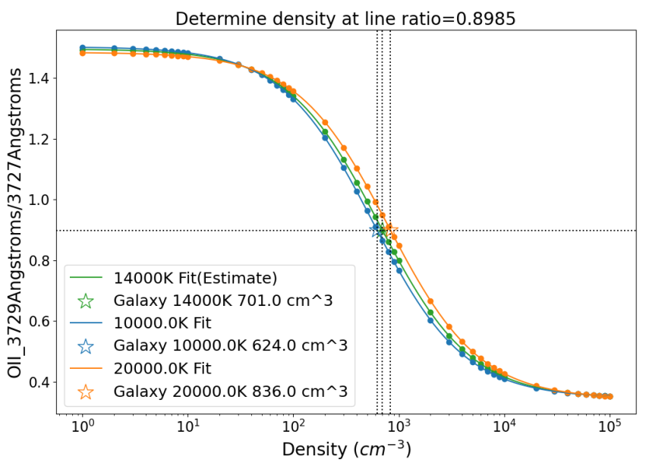
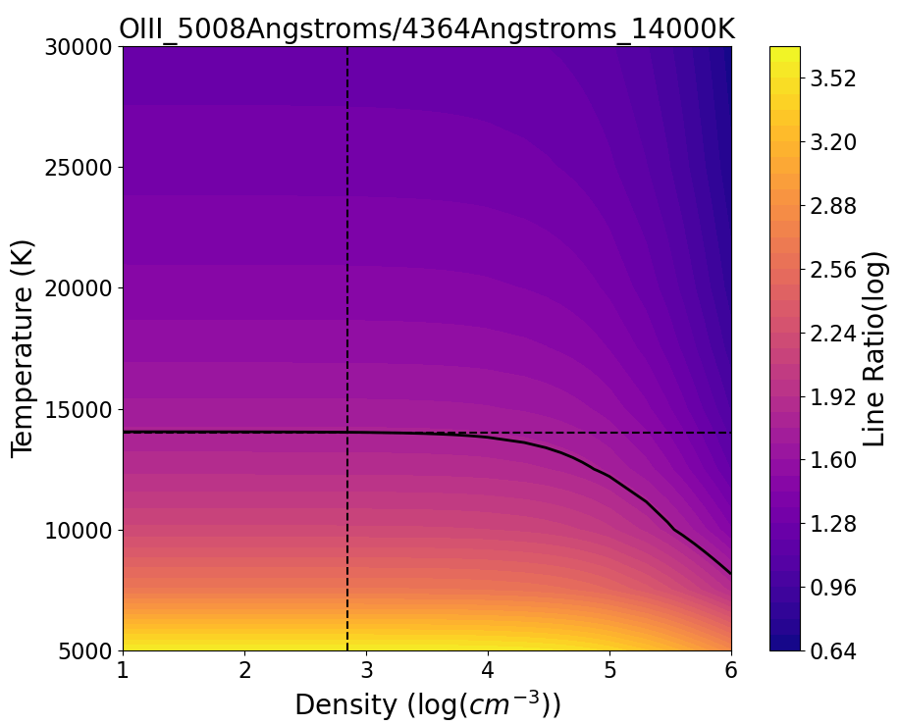
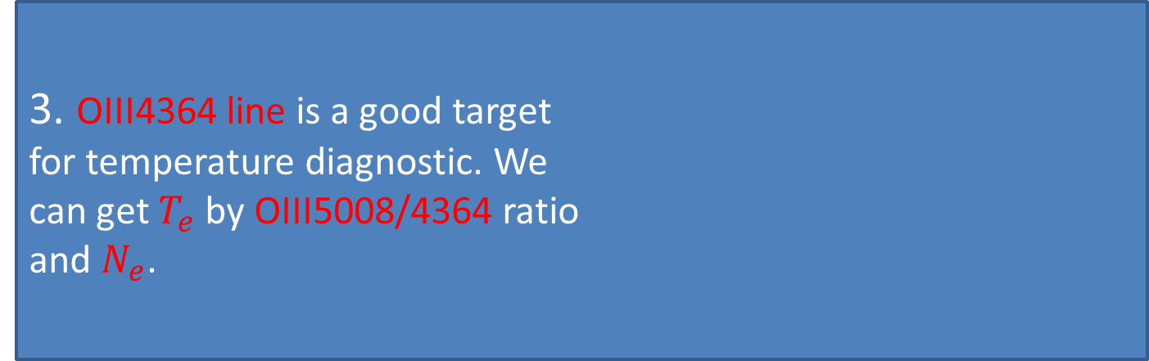
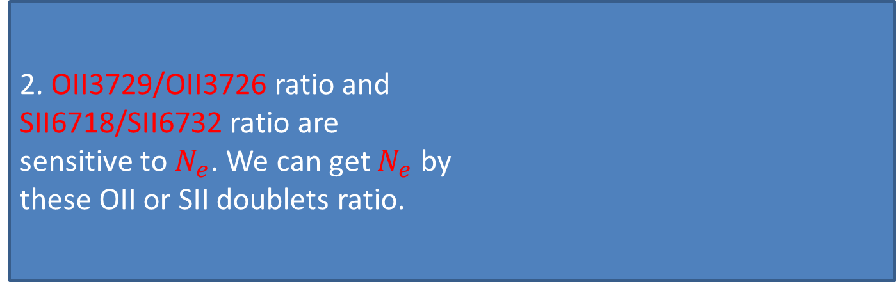
Method
Extract line ratios from literatures.
Our example: SXDF-NB1006-2 at z=7.212(Line ratios from Harikane et. al 2025)
2. OII3729/OII3726 ratio and SII6718/SII6732 ratio are sensitive to $N_{e}$. We can get $N_{e}$ by these OII or SII doublets ratio.
3. OIII4364 line is a good target for temperature diagnostic. We can get $T_{e}$ by OIII5008/4364 ratio and $N_{e}$.

Slide 5

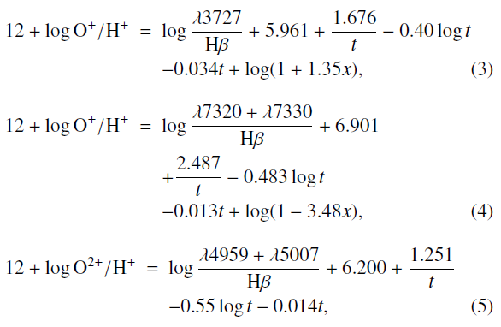

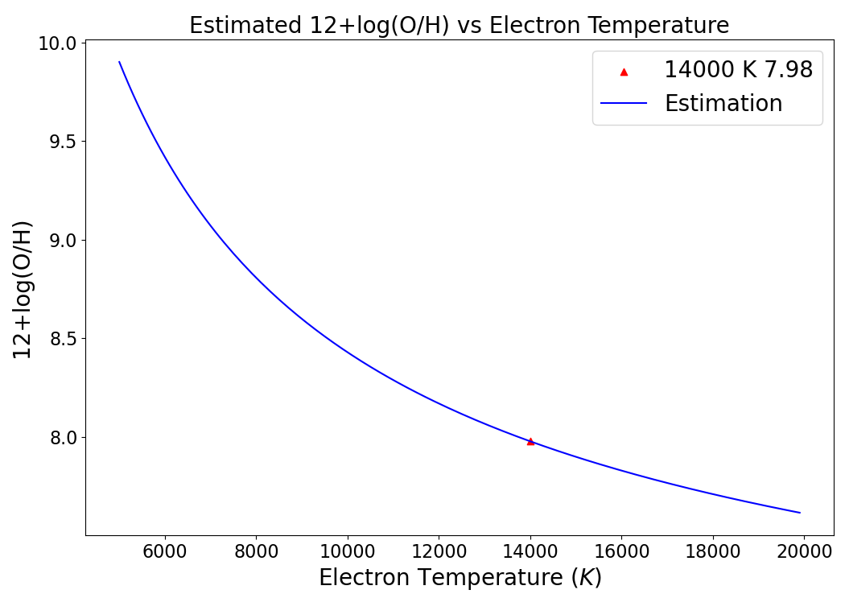


Method
4. By the empirical formula from Izotov et. al 2006,
Using OII3727 doublet flux or OII7320,7330 doublet flux and $T_{e}$, $N_{e}$ we can get OII abundance.
Using OIII4959,5007 doublet flux and $T_{e}$ we can get OIII abundance.
These two ionized states are dominant, we can just add them up to get total Oxygen abundance 12+log(O/H).
For SXDF-NB1006-2 at z=7.212, with $T_{e}$ = 14000K, we get an oxygen abundance 12+log(O/H) = 7.98 (Normalized by taking Hydrogen abundance as 12 in log scale).
This is close to literature (13900K and 7.99).
Solar value is 12+log(O/H) = 8.70.
This means, at ~720 Myr after the Big Bang(12.7 Gyr ago), Oxygen in SXDF-NB1006-2 is just 19% of current universe.

Slide 6
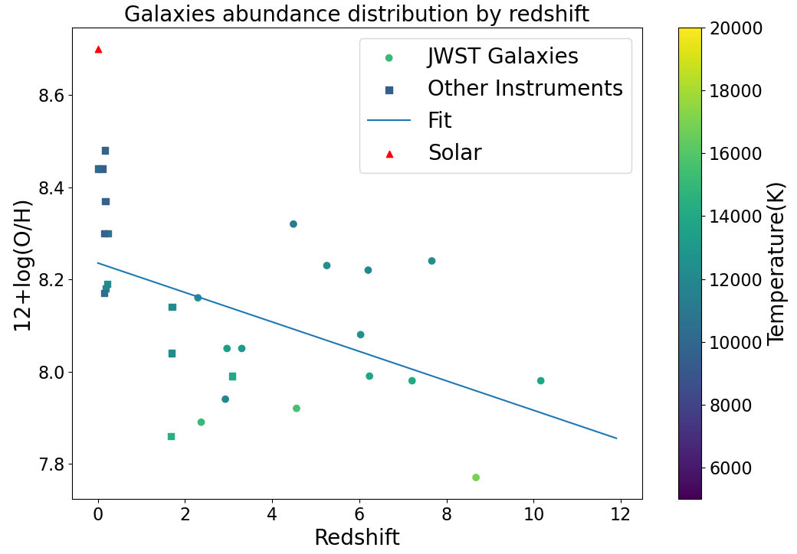
Result – Oxygen Abundance vs Redshift
If we just adopt a linear fitting, an downward trend of oxygen abundance with increasing redshift is prominent.
Some outliers might be dominant by AGN.

Slide 7
Conclusion
Oxygen abundance evolves from a much lower value in the early universe to solar value as the universe ages.
Future Works:
  Confirm on the line ratio extracted from papers.
  Analyze on more galaxies.
  A more precise curve-fitting.

Slide 8
