Slide 1
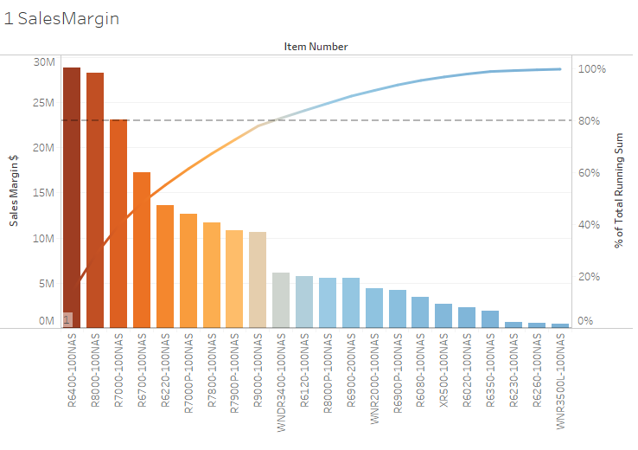
Routers Sales Margin

Slide 2
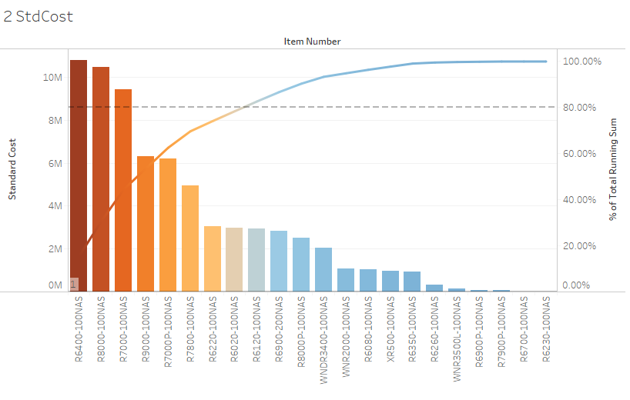
Routers Standard Cost

Slide 3
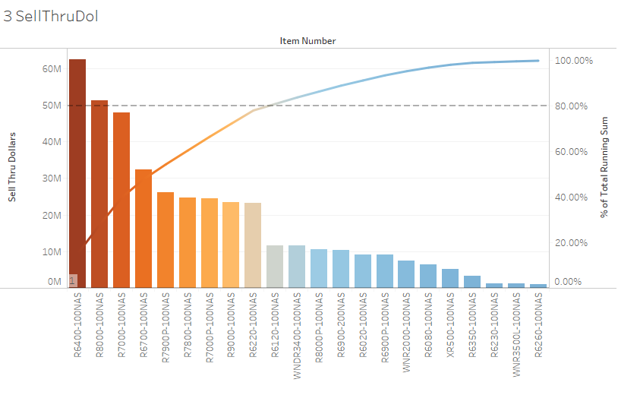
Routers Sell Thru Dollars

Slide 4
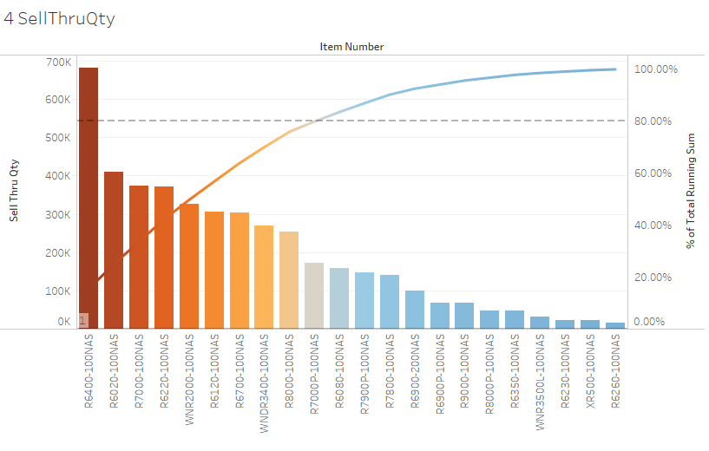
Routers Sell Thru Qty

