Slide 1
19XRF EXT ETO Selection rule
SRDC
2022/6/15

Slide 2
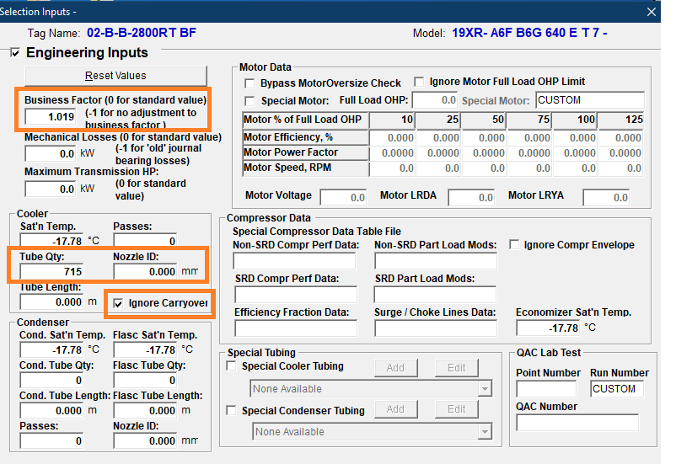
Engineer Inputs
Business Factor
Rule: Business factor increase 2%.
E.g. 0.9726*(1+2%)=0.992052
Cooler Tube Qty
Rule: Refer XRF-EXT EDR Section D
Nozzle ID
Rule: Refer XRF-EXT EDR Section D
Ignore Carryover
Others refer ECAT Engineering Selection Specification (XR)
Due to the difference in the calculation of the heat exchange of the large exchanger, it is not recommended to use the C5 tube for 45C heat pump working condition in XRF EXT project;

Slide 3
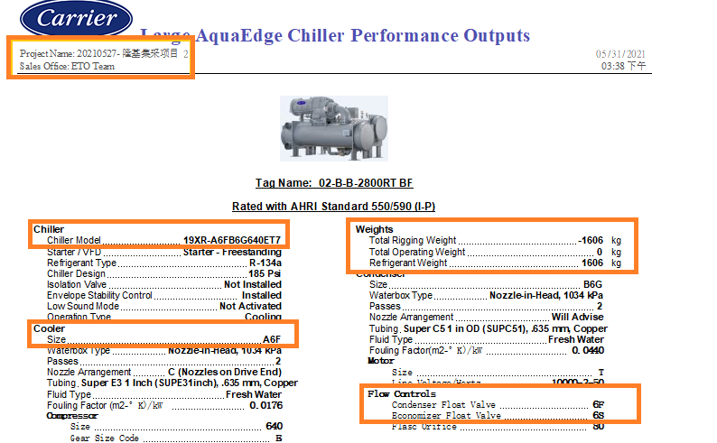
Chiller Performance Output
Sale Office: ETO Team
Chiller Model: Code change
Cooler Size: change with new code
Flow Control
Fix orifice change to Condenser Float 6F
Ref. Weight :
Refer XRF- EXT EDR section C

Slide 4
S & V report
对于XRF+FrameAA 项目如果出CTD噪声数据，考虑到孔板更换为浮球阀的影响，建议在现有19XRF ECAT对应选型计算噪音数据后，当噪音数据大于90分贝时，噪音在原有基础上+2分贝。

Slide 5
Comp
对于同一选型有双工况需求，需要压缩机设计团队评审。
由于高侧孔板换成了浮球，EDR喘振线可能会激进，满负荷点surge check需在冷凝器出水温度+2C （lift+2C）低于喘振线范围。
压缩机Diameter 4和Gear L（低扬程应用）由于测试数据有限， ETO选型需要压缩机设计团队评审。
压缩机Gear Y （高扬程齿轮）由于测试数据有限， ETO选型需要压缩机设计团队评审。
压缩机Shroud 1和Shroud 2（1200-1350Ton）由于测试数据有限， ETO选型需要压缩机设计团队评审。
Gear L/R/V/Y 的变频应用仅供工程部门研究所用，不建议对外提供性能选型报告。
恒水温负荷小于20%的ETO选型，需要压缩机设计团队评审。

