Slide 1
19XR6 with FrB cooler ETO Selection rule
SRDC May 2021

Slide 2
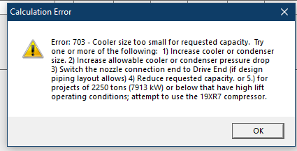
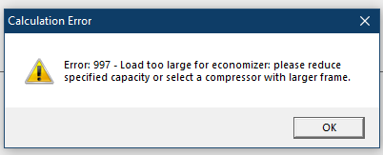
Background
Data center low lift application, 19XR6 extend to more than 2800RT with current Fr A cooler + Fr B Condenser is limited with cooler size and economizer size.
Capacity | 2800RT
Compressor | XR6
Cooler | Fr B
Condenser | Fr B
Economizer | 7S(XR7)
Condenser Float Vave | 7F(XR7)

Slide 3
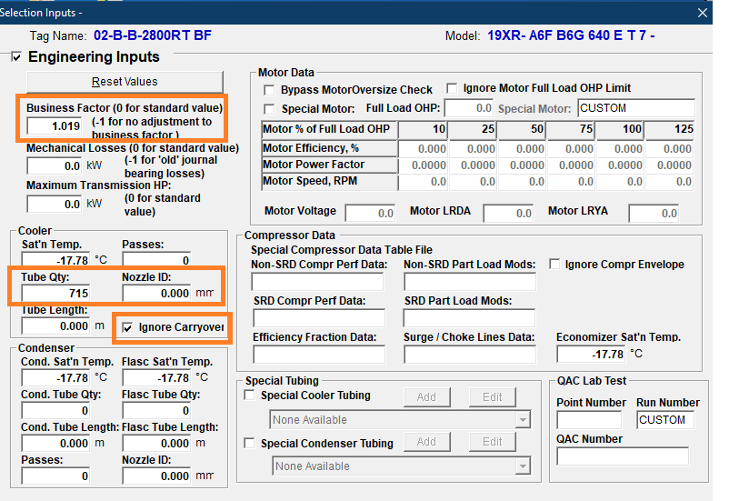
Engineer Inputs
Business Factor
Rule: Business factor increase with AHRI full load tolerance
E.g. 0.9726*(1+4.8%)=1.019
Cooler Tube Qty
Rule: Refer Frame B cooler data of EDR Section D
E.g. B6F cooler tube=715
Nozzle ID
Rule: Refer Frame B cooler data of EDR Section D
E.g. B6F cooler 2 pass NIH =456 mm
Ignore Carryover
Rule: click up if load too larger for economizer, check with 19XR6 with FrB cooler soft
Others refer ECAT Engineering Selection Specification (XR)

Slide 4
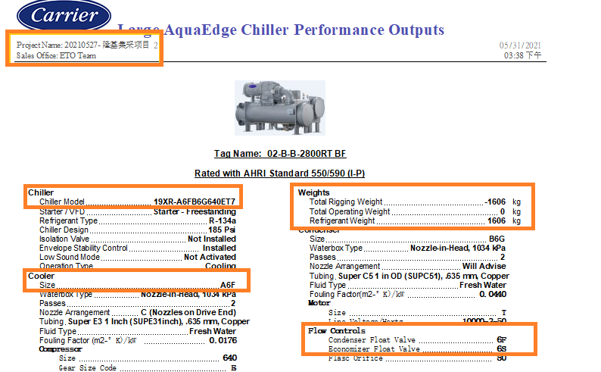
Chiller Performance Output
Sale Office: ETO Team
Chiller Model: Cooler Code change
Cooler Size: change with Fr B
Flow Control
Condenser Float Valve 6F change to 7F(XR7)
Economizer Float Valve 6S change to 7S for XR7 Economizer
7F&7S application on XR6 with E-cat patch
Weight : Refer section C
Refrigerant Gap between cooler and economizer
Dry weight gap between cooler and economizer
Water weight gap between cooler

Slide 5
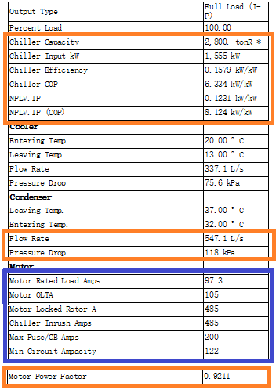
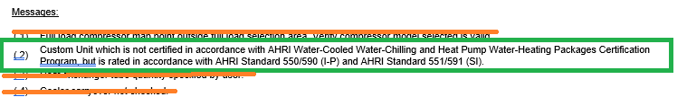
Chiller Performance Output
Chiller capacity increase with Fr B cooler
Input power increase with BF increase
Flow rate and pressure drop increase with BF increase
Motor Amps increase with AHRI full load tolerance by hand ( assumed PF keep)
Messages
Keep item 2#, others delete

