Slide 2
Agenda for Today
Group Apps Presentation
Publishing your App
01
02
Show your app!
Making it available to everybody
Data for your Project
Your Project
03
03
Educational Datasets
What is coming

Slide 3

Group App
Presentation
01

Slide 4

Publishing
Your App
02

Slide 5
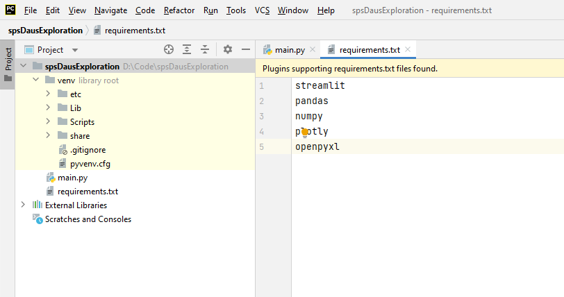
Requirements.txt

Slide 6
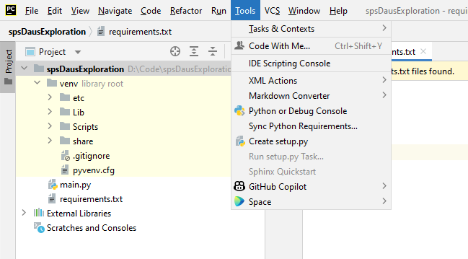
Requirements.txt

Slide 7
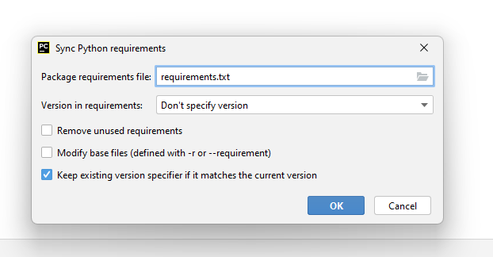
Requirements.txt

Slide 8
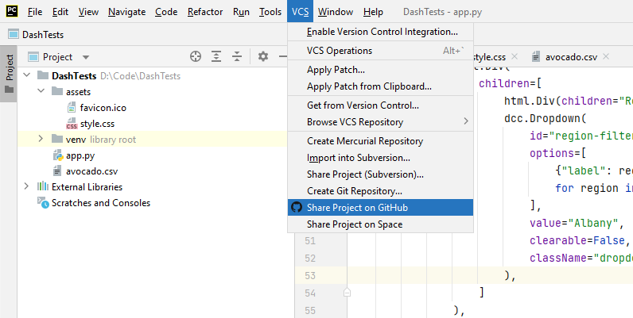
Add your App to Github

Slide 9
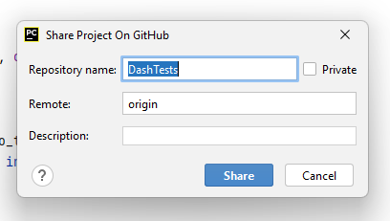
Add your App to Github

Slide 10
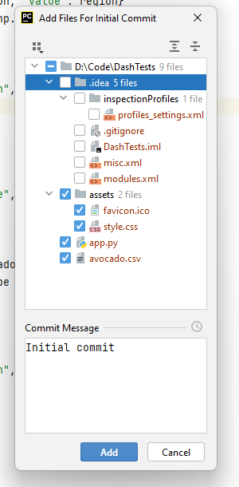
Add your App to Github

Slide 11
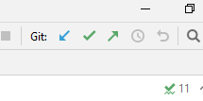
Add your App to Github
Commit + Push

Slide 12
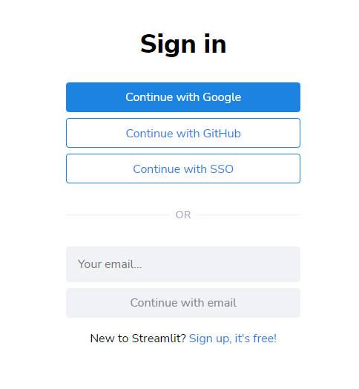
Sign in Streamlit Cloud
https://share.streamlit.io/

Slide 13
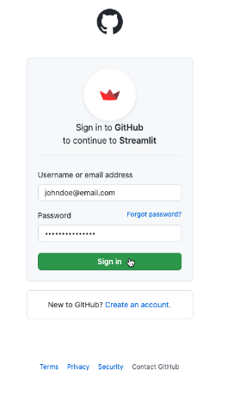
Sign in Streamlit Cloud
https://share.streamlit.io/

Slide 14
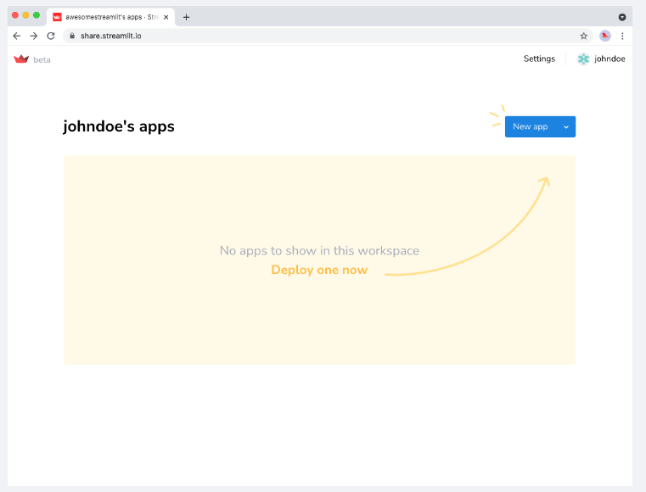
Create an App
https://share.streamlit.io/

Slide 15
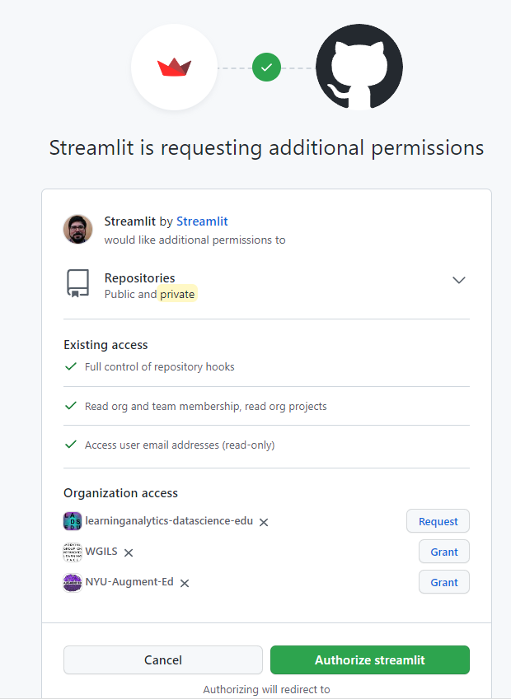
Create an App
https://share.streamlit.io/

Slide 16
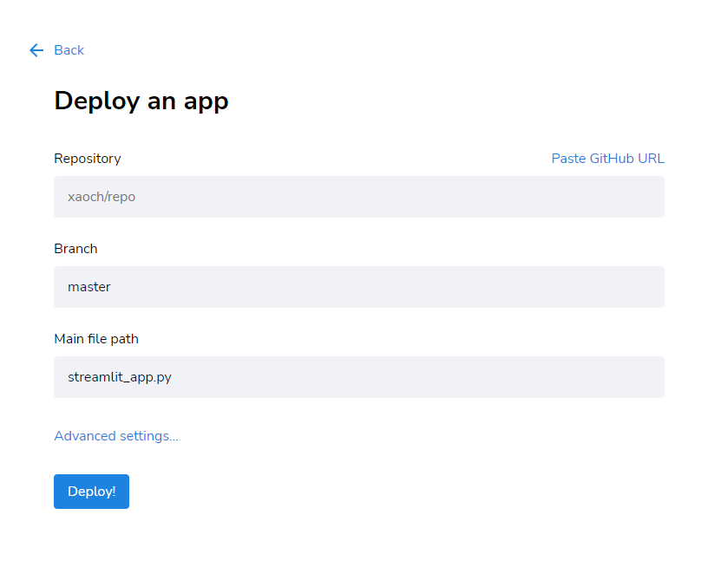
Create an App
https://share.streamlit.io/

Slide 17
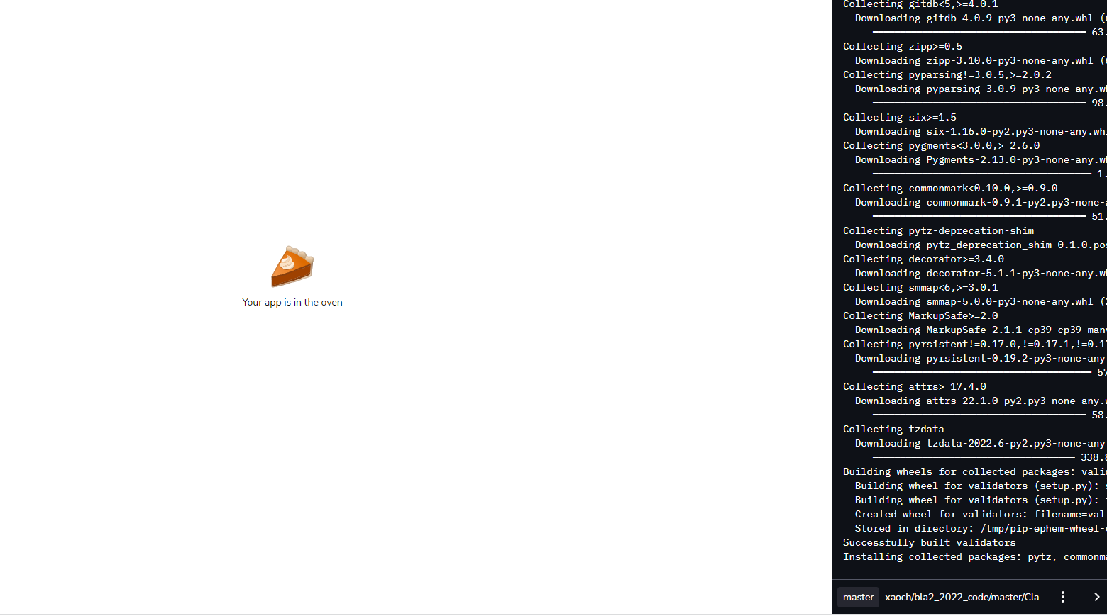
Create an App
https://share.streamlit.io/

Slide 18
Data
Sources
03

Slide 19
Data Sources
Open University Learning Analytics dataset
LIX Dataset
Students’ activities in several courses at an online University (LARGE)
Data captured from an Educational Game (MEDIUM)
EPM Data Set
LARC Mock Dataset
Clicks made by students in an online system (SMALL)
Academic Records from University of Michigan (simulated) (SMALL)

Slide 20
Data Sources
New York City School Directory
PISA Scores
Large standardized test for students around the Globe (SMALL)
Information about all public schools in NYC (LARGE)
New York City Historical School Demographics
Dropout Data
Academic Records from University of Michigan (simulated) (LARGE)
Race/Ethnicity populations at NYC public schools (MEDIUM)

Slide 21
Data Sources
Teacher Assistant Evaluation
User Knowledge Model
Information about study time and knowledge (SMALL)
Survey data about TA performance (SMALL)
Flip Classroom Performance
Student Life
Tracking of Students activities (LARGE)
Grades for Students in Flip and Traditional Physics classes (SMALL)

Slide 22
Your
Project
04

Slide 23
Session 12
Project Objective and Data
What will be the objective of your application
Decisions to Support
Stakeholders / Users
What part of the data you will you use
General overview of the data
Interface Mockup

Slide 24
Session 13
Data Analysis and Visualizations
Data loaded into application
Cleaned
Wrangled
Main visualizations ready
Static is ok

Slide 25
Session 14
Final Prototype
Controls and Filters
Users can manipulate visualization
Explanations and Polish
App Published

Slide 26
Thanks!
Do you have any questions?
xavier.ochoa@nyu.edu
Slack Channel

