Slide 1
New York City Historical School Demographics
Annual school accounts of NYC public school student populations served by grade, special programs, ethnicity, gender and Title I funded programs

Slide 2
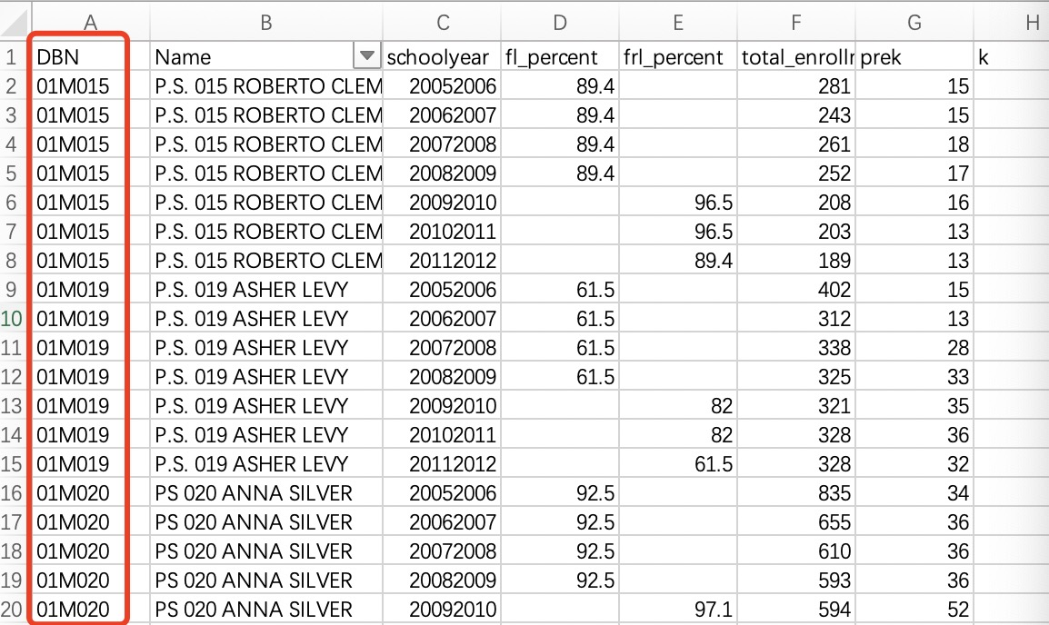
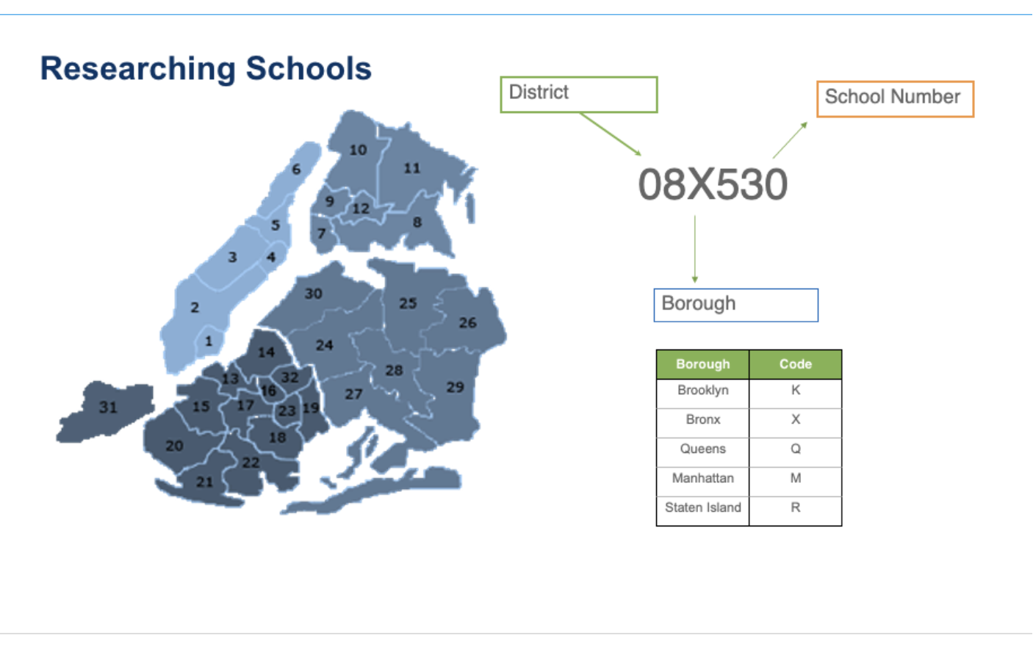
By considering the regional dimension, assess the performance of each public schools
Notes:
Local educational institutions or the education departments of the government
They can gain insights into the student demographics of schools in each district. These insights enable them to provide targeted support or development recommendations to various districts or specific schools in the future.

Slide 3
Question1: In different years, what is the percentage of subsidized students in various public schools across different districts?
Choose the school year
percentage
Data：DBN、schoolyear、fl_percent、frl_percent
Choose the district
80%
70%
60%
50%
45%
s1
s2
s3
s4
s5
school
Notes:
Arrange the value of percentage in ascending order
If the percentage of subsidized students is high, it may indicate that these schools have a higher number of poverty students. Therefore, these schools could be considered for increased financial support aimed at assisting poverty students.

Slide 4
Question2: In different years, how is the racial distribution among students in public schools across various districs?
Choose the school year
Data：DBN、schoolyear、asian_num、black_num、hispanic_num、white_num
Black10%
Choose the district
Hispanic 25%
Asian 25%
White 40%
Notes:
After reviewing the racial distribution of students in public schools across various districts, governments can offer enrollment suggestions to schools in areas where racial diversity is uneven. This guidance encourages these schools to enroll a more diverse student population in the following year, promoting the establishment of a diverse and inclusive learning atmosphere

Slide 5
Question3: In different years, which district has the highest percentage of special education students?
Choose the school year
Data：DBN、schoolyear、sped_percent
percentage
70%
76%
66%
50%
20%
d1
d2
d3
d4
d5
district

