Slide 1
Network slicing with programmable switches
Supervisor: Jun.-Prof. Dr.-Ing. Giang T. Nguyen
Mingyu Ma
04.01.2023

Slide 2
Task Description Of Diploma Thesis
Network slicing with programmable switches:
Survey state-of-the-art (SoTA) algorithms for QoS-aware congestion control
Sketch novel concepts and design novel algorithm to support different traffic priorities
Survey and select an environment for the evaluation methodology
Implement the proposed scheme and one of the SoTA algorithms
Perform performance evaluation for both the developed algorithm and SoTA
Write up a report describing the completed work

Slide 3
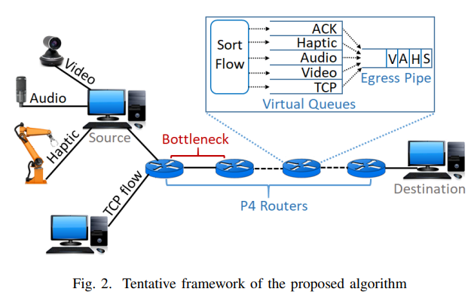
The novel concepts and design
[√] Example: Deal with the normal TCP flow.
[√] Example: Now the virtual queue with “Exponentially Weighted Moving-Average”(EWMA) estimated future queue length for packet drop;
[ ] but the estimate process is done in ns3(p4-queue-disc.cc:275), not in switch. In switch(p4) just do some basic functions for the random drop. And we need to use p4 to direct the switch for the whole action to be completed, not in ns3.
Priority implementation:
[√] New demo with full topology.
[ ] ns3 have to generate data streams with different priority: video, audio, haptic … etc.
[ ] p4 controls the switch to queue the different flows in the virtual queue according to their priority.

Slide 4
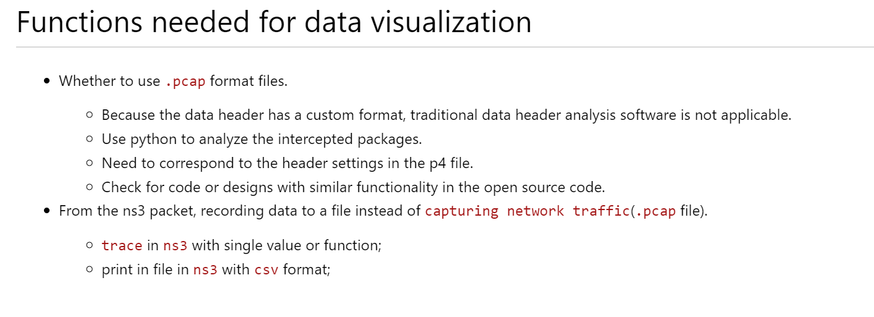
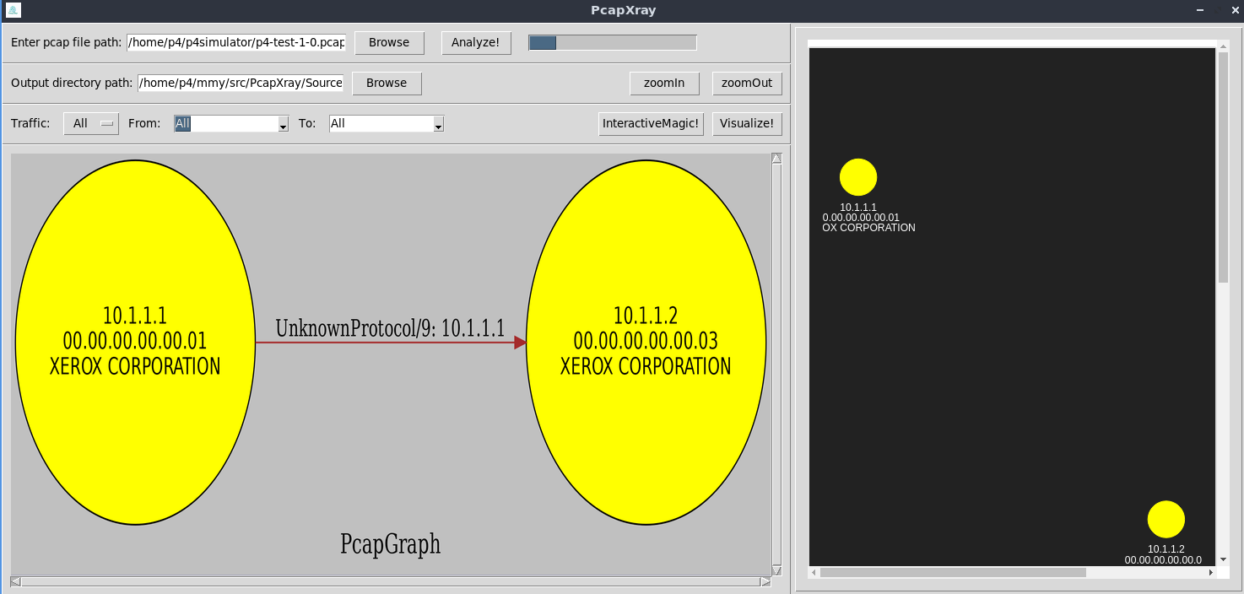

Slide 5
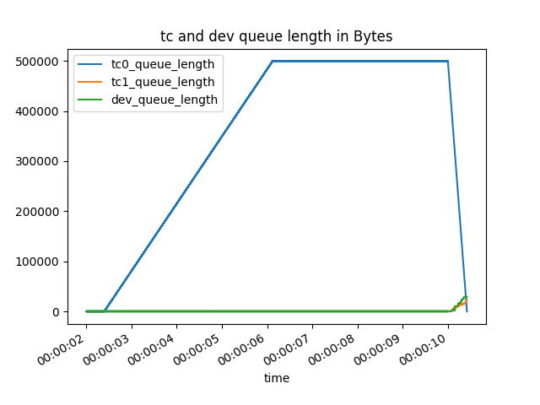
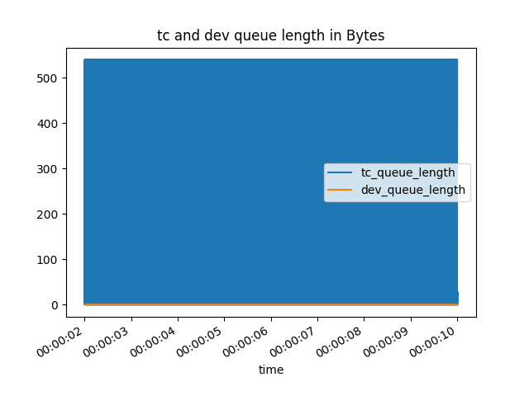
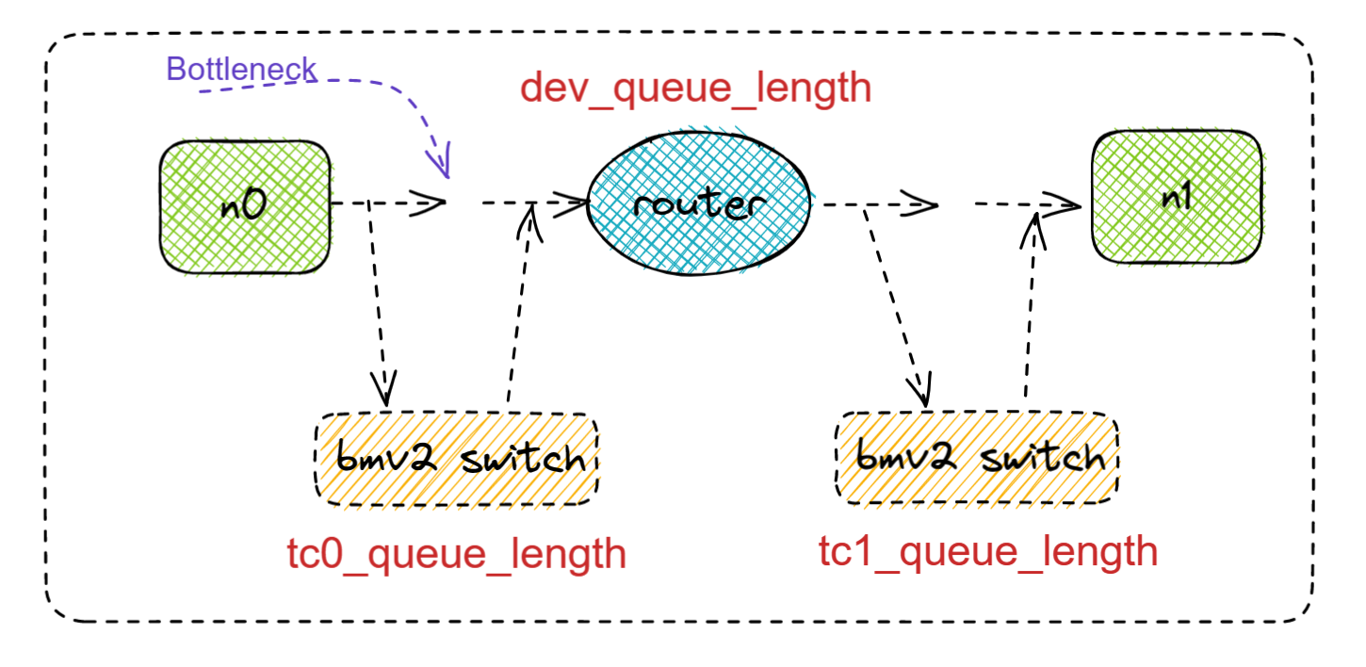
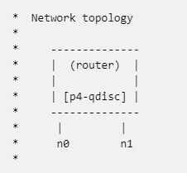
Example
The program reduces network congestion by randomly dropping packets on the switch.
The switch is controlled by the p4 program, which implements the probability of packet loss by relative queue length. The `UDP` flow will goes from n0 to n1.
With congestion
Without congestion
Here in figure 1, the “dev_queue_length” does not goes up when there is a lang queue in “tc_0_queue_length” p4 switch. But Why?
It may be a bit tricky: in that we calculate the length of the virtual queue based on the length of the real queue that the switch can hold.

Slide 6
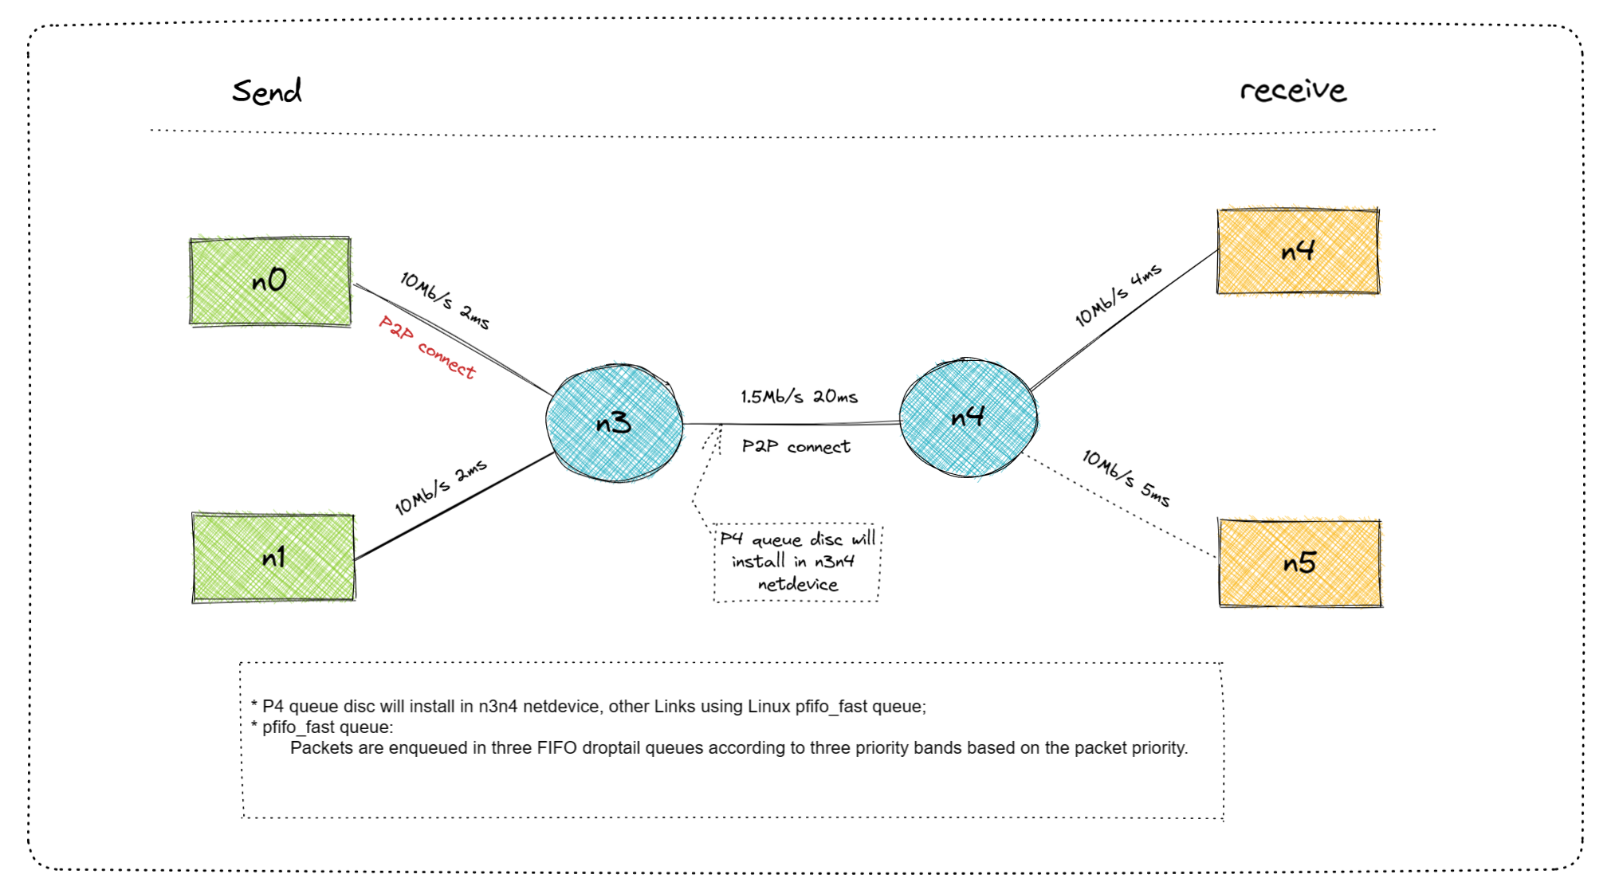
Overall Look for Demo
"Track more data in the package and try to visualize it."

Slide 7
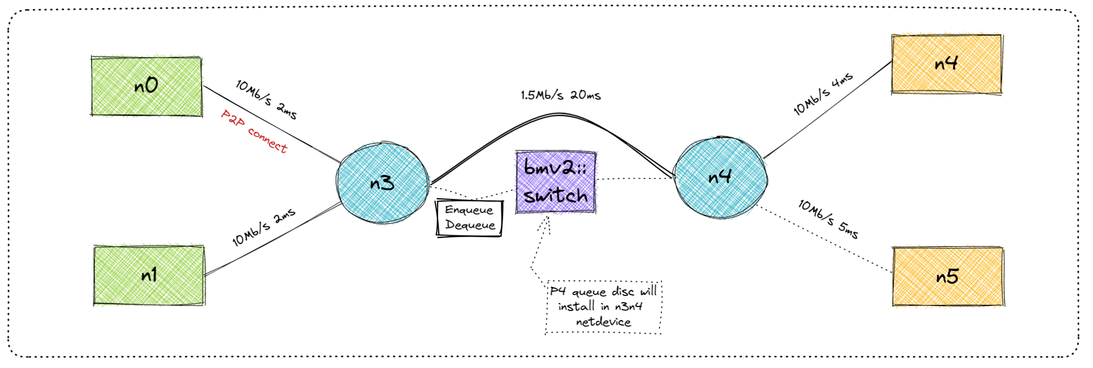
Overall Look for Demo

