Slide 1

Welcome to a new world
ChatWithMe
Interactive Guide Assistant
Engineer:Min & Ming
UI/UX:Yiyin
PM:Anqi(Andrew)

Slide 2
Now everyone wants to program with AI But 80% of people give up in the first minute when they see platforms like Codex full of English, API interfaces, and strange parameters.
。

Slide 3
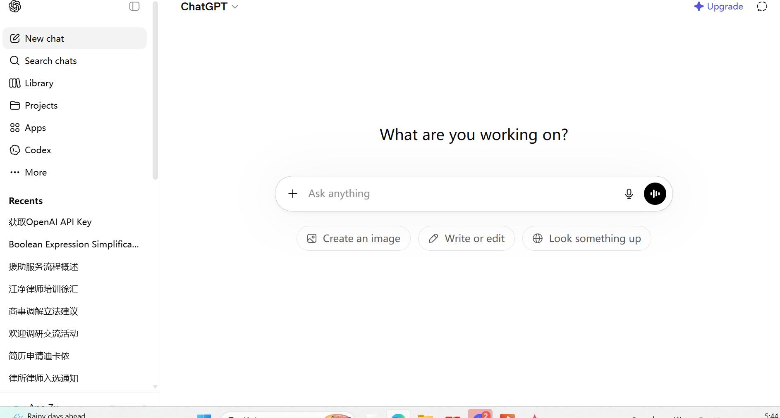
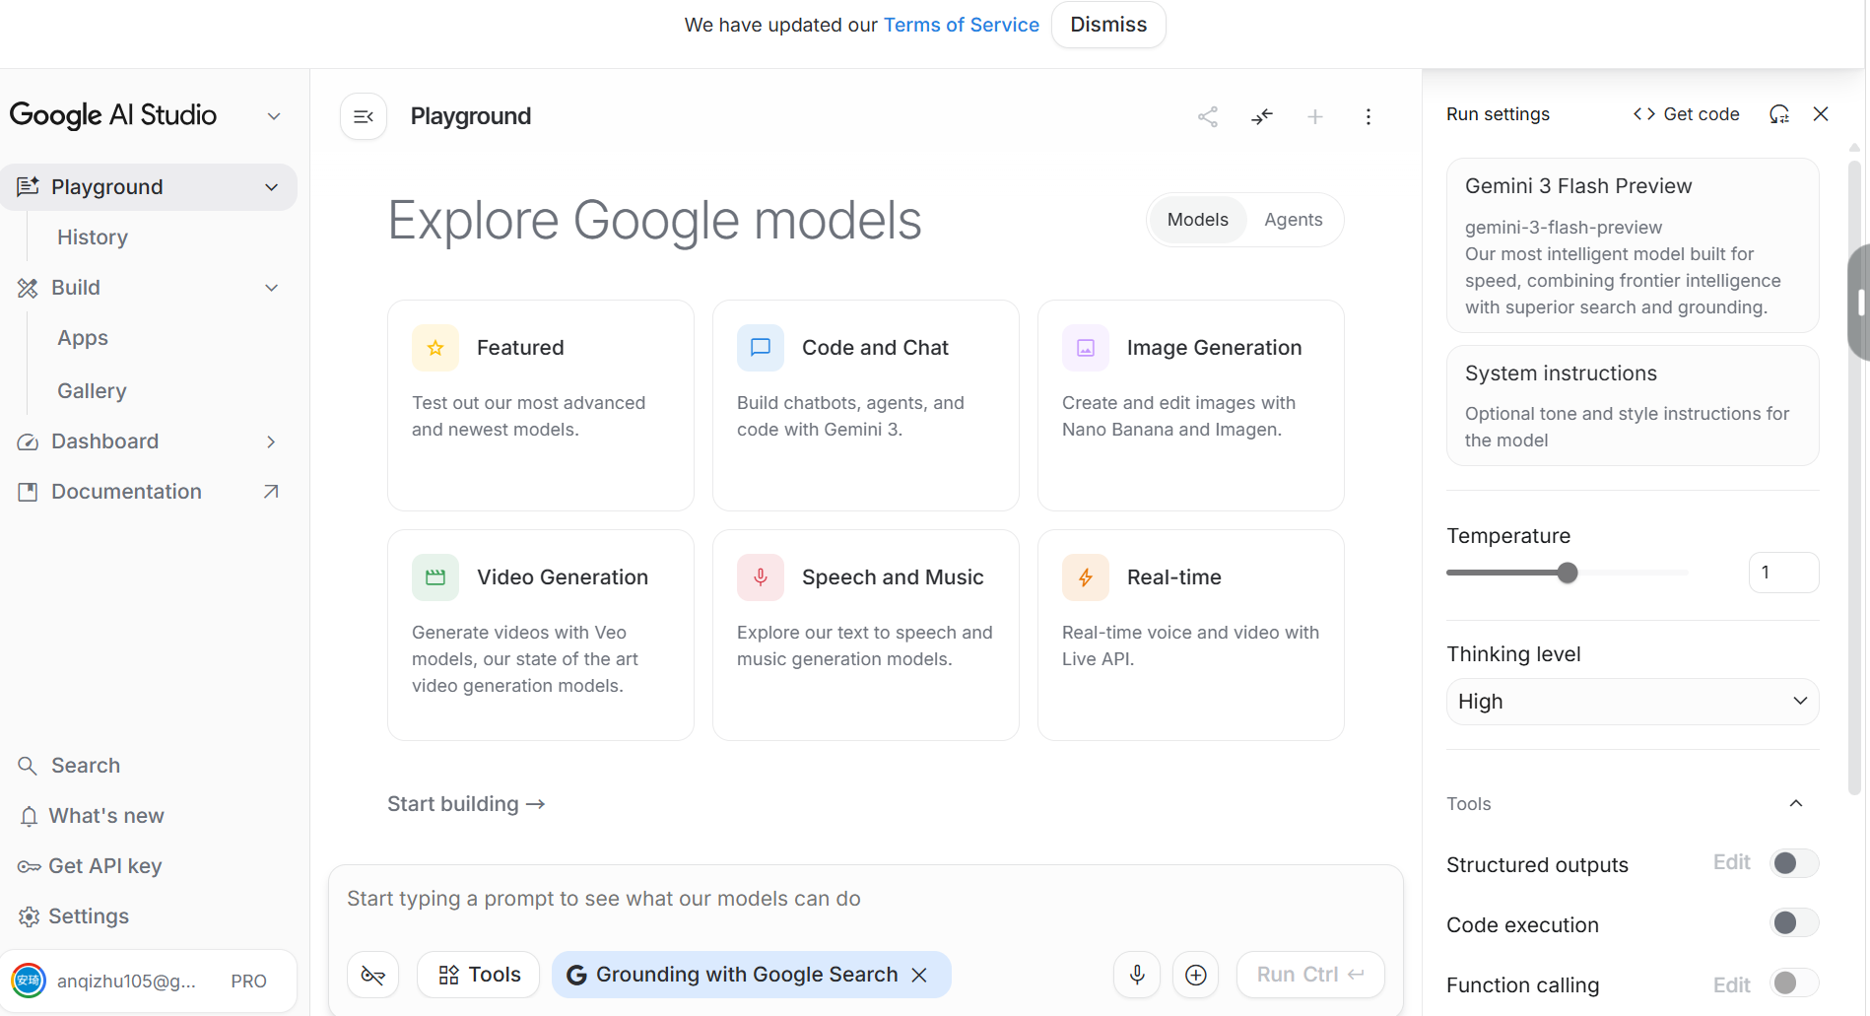
LIKE:

Slide 4
Every member of our team hopes that in the AI era, everyone can keep up with the pace of the times.
So we created this simple, easy-to-use instructional AI plugin.
ChatWithMe

Slide 5
Values of ‘ChatWithMe’
Among annual subscribers of AI applications, up to 79% churn within a year. Comparative contrast: the annual retention rate of AI applications is only 21.1%, while traditional non-AI applications are 30.7%. The gap is even worse in monthly retention, with AI applications at only 6.1%, compared to 9.5% for traditional non-AI applications.
The Onboarding Cliff
Core hit: Efficiency apps have a 32.86% retention rate on day 1, but it plummets to 9.63% by day 30. This means that within the first month, retention drops by 71% --- Data come from ‘Reddit’
The Cost of Confusion
Core hit: Up to 72% of users turn to competitors after experiencing only one negative interaction. When users find the operation process confusing or frustrating, they are very likely to give up immediately. --- Data come from ‘Qualtrics’

Slide 6
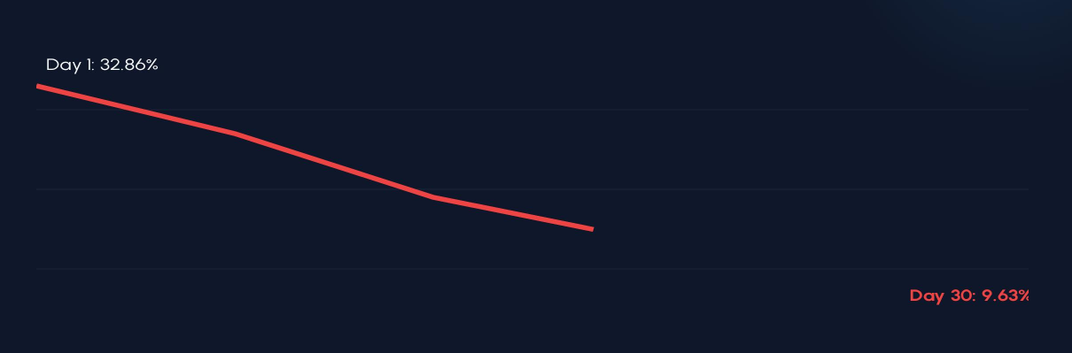
Cliff-like drop during the newbie phase - 71% attrition rate-from Deepseek
Over 70% of users choose to give up in the first minute when faced with a complex interface. This is a huge loss for SaoS Company.

Slide 7
Why do they leave? Complexity kills curiosity
"Don't make me think"
For complete AI novices with no technical background, the following elements are 'deterrents':
• Screens full of English terms and parameters
• Missing locations to fill in API interfaces
• Complex URL configurations and environment variables
When the cognitive load exceeds the critical threshold, users will not hesitate to close the webpage.

Slide 8
SO！

Slide 9
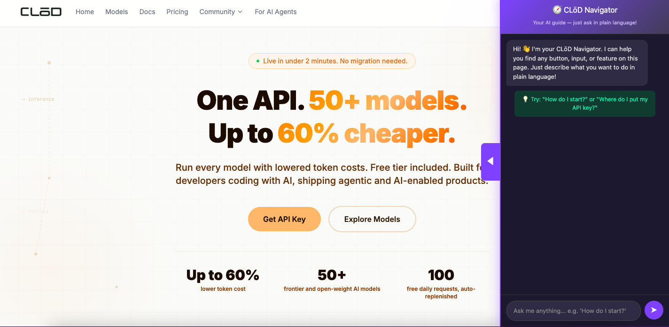
Minimalist
sidebar UI
Refuse long lectures
Keep only one dialog in the sidebar, support plain everyday language "input";
Where should I click to start?
Where do I put the API Key?
I want to test it, but I can't understand these

Slide 10
Minimalist
sidebar UI
Refuse long lectures
Keep only one dialog in the sidebar, support plain everyday language "input";
Where should I click to start?
Where do I put the API Key?
I want to test it, but I can't understand these

Slide 11

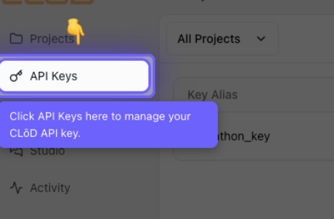
Soul Function:
Spotlight Interaction for Precision Strikes" Confusion
When the user issues a command, the webpage instantly darkens and a semi-transparent overlay is applied. The system behaves like a spotlight:
• Instant Focus: The spotlight shines on the target button.
• Dynamic Prompt: A bouncing arrow guides the click.
• Zero Mental Burden: The user only needs to follow the light.

Slide 12



Logical Guidance:
Order Assurance
Strictly follow the operational logic. If you need to click the menu before saving, the guide pointer will never skip steps.
Real-Time Observation
The plugin observes the user's actual clicks. Only when the first step is successful will the spotlight on the second step be activated.
Error Tolerance
If the user makes a wrong choice, the system will gently pull them back, replacing cold error messages with sincere retention prompts.

Slide 13
Business Value: Saving SaaS Profits
Reduce Churn
Recover 15%-25% of potential lost users for SaaS companies by addressing the 'first minute barrier.'
Accelerate Activation
Shorten Time-to-Value, allowing beginners to quickly enter the core experience area.
B2B Purchase Potential
Not just a plugin, but a set of visual guidance middleware that can be embedded in any complex web application.'

Slide 14
Question Section
Thanks
HachClub & CozyLab

