Slide 1
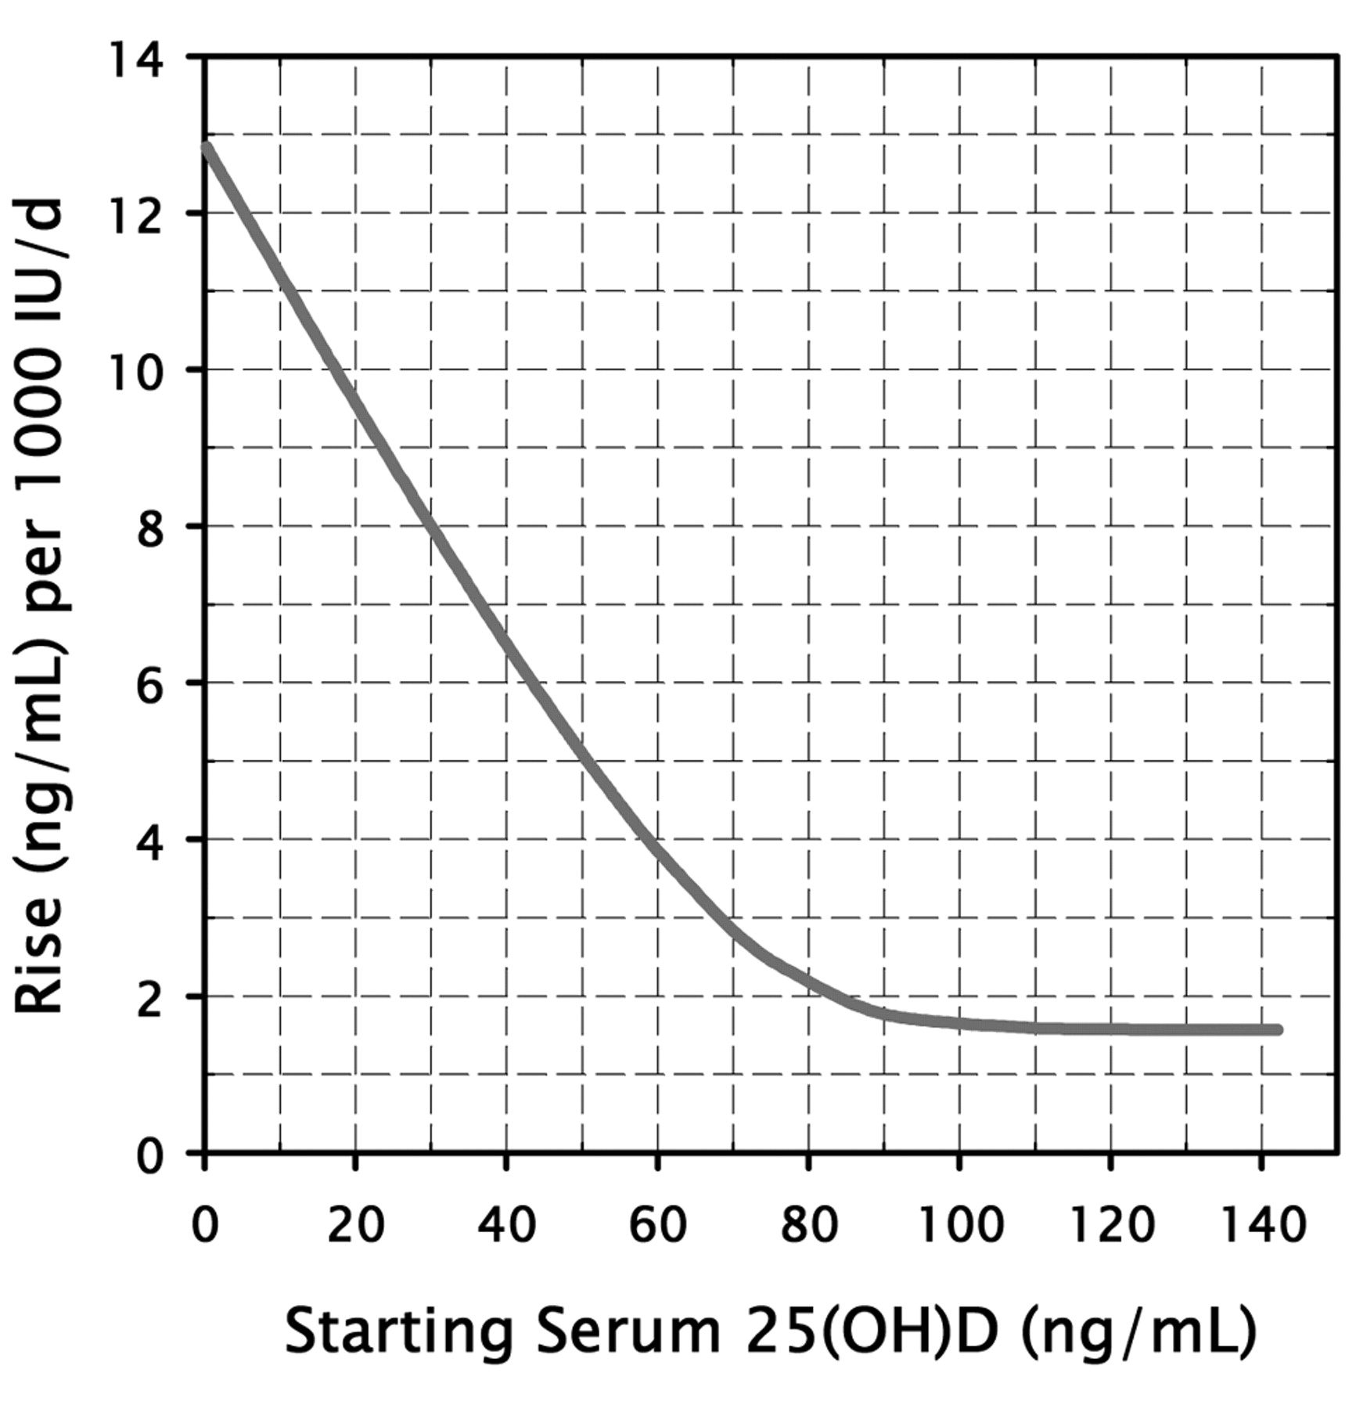

Plot of the expected rise in serum 25(OH)D for every 1,000 IU vitamin D3 supplemented daily, as a function of basal 25(OH)D value.
CEDRIC F. GARLAND et al. Anticancer Res 2011;31:607-611
Copyright© 2011 International Institute of Anticancer Research (Dr. John G. Delinassios), All rights reserved
Notes:
Plot of the expected rise in serum 25(OH)D for every 1,000 IU vitamin D3 supplemented daily, as a function of basal 25(OH)D value. (Copyright Robert P. Heaney, 2011. Used with permission.)‏

