Slide 1

DATA DEFINITION AND DATA TYPES

Slide 2
Table of Contents
Data Types
Database Modeling
Basic SQL Queries and Table Customization
Deleting Data and Structures

Slide 3
Data Types in SQL Server

Slide 4
Data Types in SQL Server
Numeric
  bit (1-bit), integer (32-bit), bigint (64-bit)
  float, real, numeric(scale, precision)
  money – for money (precise) operations
Strings
  char(size) – fixed size string
  varchar(size) – variable size string
  nvarchar(size) – Unicode variable size string
  text / ntext – text data block (unlimited size)

Slide 5
Data Types in SQL Server (1)
Binary data
  binary(size) – fixed length sequence of bits
  varbinary(size) – a sequence of bits, 1-8000 bytes or max (2GB)
Date and time
  date – date in range 0001-01-01 through 9999-12-31
  datetime – date and time with precision of 1/300 sec
  smalldatetime – date and time (1-minute precision)

Slide 6
Database Modeling
Data Definition using Management Studio

Slide 7
Working with Object Explorer
Object Explorer is the main tool to use when working with the database and its objects
Enables us:
  To create a new database
  To create objects in the database (tables, stored procedures, relationships and others)
  To change the properties of objects
  To enter records into the tables

Slide 8
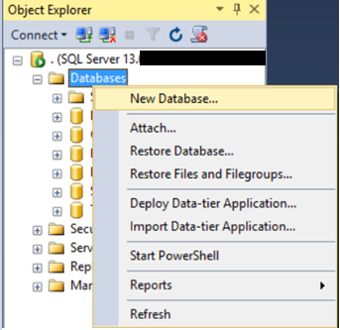
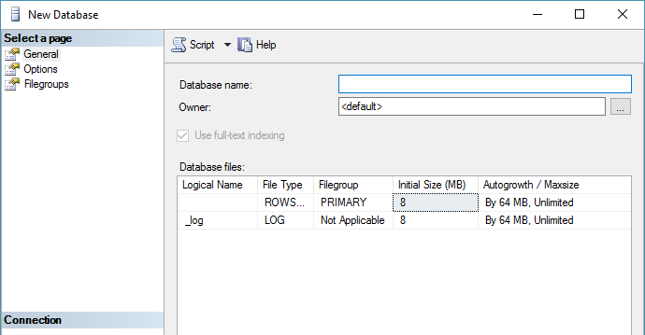
Creating a New Database
Select New Database from the context menu under "Databases"
You may need to Refresh [F5] to see the results

Slide 9
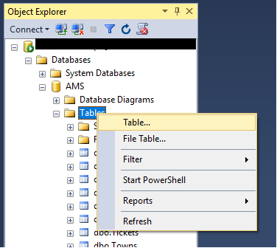
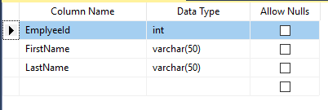
Creating Tables
From the context menu under "Tables" inside the desired database
Table name can be set from its Properties [F4] or when it is saved

Slide 10
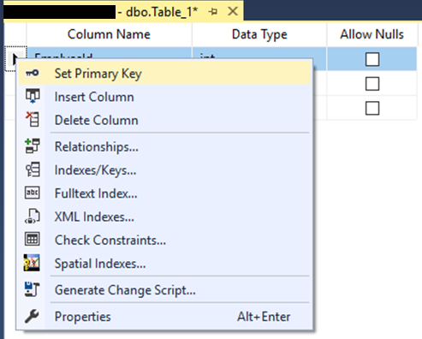
Creating Tables (1)
A Primary Key is used to uniquely identify and index records
Click Set Primary Key from the context menu of the desired row

Slide 11
Creating Tables (2)
Identity means that the values in a certain column are auto incremented for every newly inserted record
  These values cannot be assigned manually
  Identity Seed – the starting number from which the values in the column begin to increase.
  Identity Increment – by how much each consecutive value is increased

Slide 12
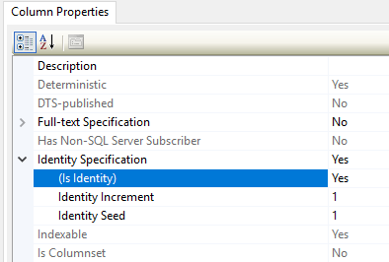
Creating Tables (3)
Setting an identity through the "Column Properties" window

Slide 13
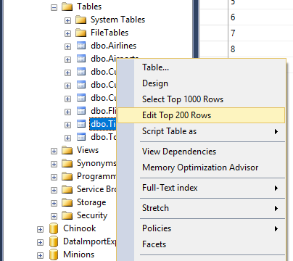
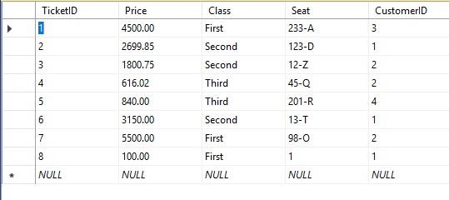
Storing and Retrieving Data
We can add, modify and read records with Management Studio
To insert or edit a record, click Edit from the context menu
Enter data at the end
to add a new row

Slide 14
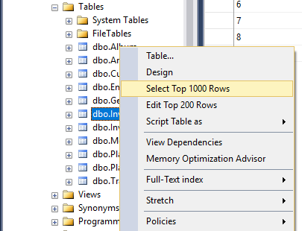
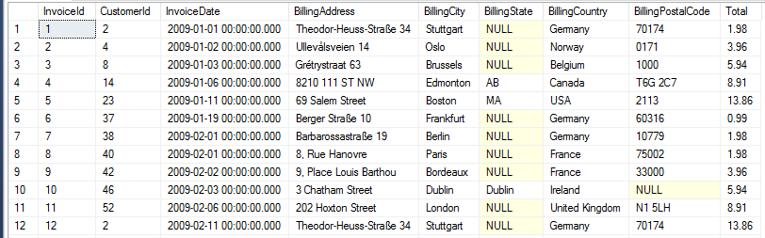
Storing and Retrieving Data (1)
To retrieve records, click Select from the context menu
The received information can be customized with SQL queries

Slide 15
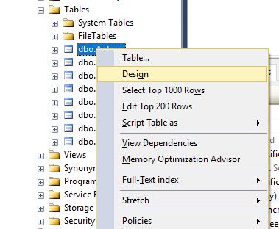
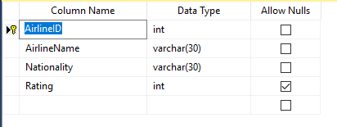
Altering Tables
You can change the properties of a table after it's creation
Select Design from the table's context menu
Changes cannot conflict with existing rules!

Slide 16
Basic SQL Queries
Data Definition using T-SQL

Slide 17
SQL Queries
We can communicate with the database engine using SQL
Queries provide greater control and flexibility
To create a database using SQL:
SQL keywords are traditionally capitalized
Database name
CREATE DATABASE Employees

Slide 18
Table Creation in SQL
Table name
CREATE TABLE People
(
Id int NOT NULL,
Email varchar(50) NOT NULL,
FirstName varchar(50),
LastName varchar(50)
)
Custom properties
Column name
Data type

Slide 19
Retrieve Records in SQL
Table name
To get all information from a table
You can limit the columns and number of records
SELECT * FROM Employees
Number of records
List of columns
SELECT TOP (5) FirstName, LastName
FROM Employees

Slide 20
Table Customization
Adding Rules, Constraints and Relationship

Slide 21
Custom Column Properties
Primary Key
Identity (auto-increment)
Unique constraint – no repeating values in entire table
Id int NOT NULL PRIMARY KEY
Id int IDENTITY PRIMARY KEY
Email varchar(50) UNIQUE

Slide 22
Custom Column Properties (1)
Default value – if not specified (otherwise set to NULL)
Value constraint
Balance decimal(10,2) DEFAULT 0
Kelvin float(10,2) CHECK (Kelvin > 0)

Slide 23
Altering Tables
Changing Table Properties After Creation

Slide 24
Altering Tables Using SQL
A table can be changed using the keywords ALTER TABLE
Add new column
ALTER TABLE Employees
Table name
ALTER TABLE Employees
ADD Salary money
Column name
Data type

Slide 25
Altering Tables Using SQL (1)
Delete existing column
Modify data type of existing column
Column name
ALTER TABLE People
DROP COLUMN FullName
ALTER TABLE People
ALTER COLUMN Email varchar(100)
Column name
New data type

Slide 26
Altering Tables Using SQL (2)
Add primary key to existing column
Add unique constraint
Constraint name
ALTER TABLE People
ADD CONSTRAINT PK_Id
PRIMARY KEY (Id)
Column name
(more than one for composite key)
Constraint name
ALTER TABLE People
ADD CONSTRAINT uq_Email
UNIQUE (Email)
Columns name(s)

Slide 27
Altering Tables Using SQL (3)
Set default value
Add check constraint
ALTER TABLE People
ADD DEFAULT 0
FOR Balance
Default value
Column name
Constraint name
ALTER TABLE InstrumentReadings
ADD CONSTRAINT PositiveValue
CHECK (Kelvin > 0)
Condition

Slide 28
Deleting Data and Structures

Slide 29
Deleting from Database
Deleting structures is called dropping
  You can drop keys, constraints, tables and entire databases
Deleting all data in a table is called truncating
Both of these actions cannot be undone – use with caution!

Slide 30
Dropping and Truncating
To delete all the entries in a table
To drop a table – delete data and structure
To drop entire database
TRUNCATE TABLE Employees
Table name
DROP TABLE Employees
Table name
Database name
DROP DATABASE AMS

Slide 31
Dropping and Truncating (1)
To remove a constraining rule from a column
  This includes primary keys, value constraints and unique fields
To remove default value (if not specified, revert to NULL)
Table name
ALTER TABLE Employess
DROP CONSTRAINT pk_Id
Constraint name
Table name
ALTER TABLE Employess
ALTER COLUMN Clients
DROP DEFAULT
Columns name

Slide 32
Summary
Table columns have a fixed type
Setting up the database is the last step of the design process
We can use Management Studio to create and customize tables
SQL provides greater control
CREATE TABLE People
(
Id int NOT NULL,
Email varchar(50) NOT NULL,
FirstName varchar(50),
LastName varchar(50)
)

