Slide 1

ADAPTIVE PRISON BREAK
A playable stealth game loop with real Codex-driven adaptation.
Built as a browser game using Phaser, TypeScript, Vite, Express, SQLite, and local Codex CLI integration.
75
4
SQLite
automated tests passing
browser-verified gameplay screens
persistent round memory
Adaptive Prison Break / Ronny / 01

Slide 2
PRODUCT GOAL
The prototype proves a complete stealth loop, not just a visual mockup.
Player objective
System objective
Core gameplay loop
Move through patrols, collect the security key, and reach the locked exit before suspicion becomes capture.
Capture player events, summarize behavior, and generate a validated adaptation for the next run.
The player sneaks through patrol routes, collects the key, uses hiding spots, and races for the locked exit.
Gameplay focus: every run produces readable stealth moments, visible guard pressure, and a clear next-round security response.
Adaptive Prison Break / Ronny / 02

Slide 3
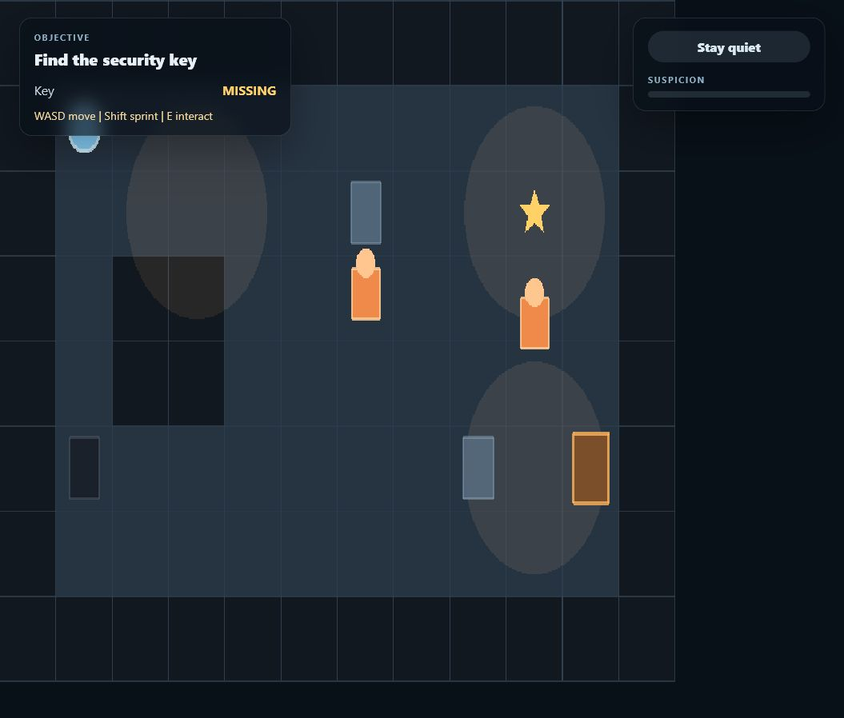
LIVE GAMEPLAY
The player loop is visible, interactive, and readable in-browser.
Readable stealth state
HUD tracks objective, key status, prompts, and suspicion without blocking the playfield.
Tuned movement
Guard and player speeds were adjusted through tests and browser feedback to avoid frantic gameplay.
Event capture
Movement, sprint, noise, hiding, detection, escape, and capture events feed the service.
Adaptive Prison Break / Ronny / 03

Slide 4
ADAPTIVE LOOP
Every completed run becomes training signal for the next round.
Run events
SQLite
Analytics
Codex CLI
Next config
Client submits detailed timeline
Runs, reports, adaptations persist
Recent behavior is weighted
Chooses one eligible response
Guards adapt next round
The validator prevents unsafe or unsupported Codex decisions, and a capped fallback records that the system has already learned the available response.
Adaptive Prison Break / Ronny / 04

Slide 5
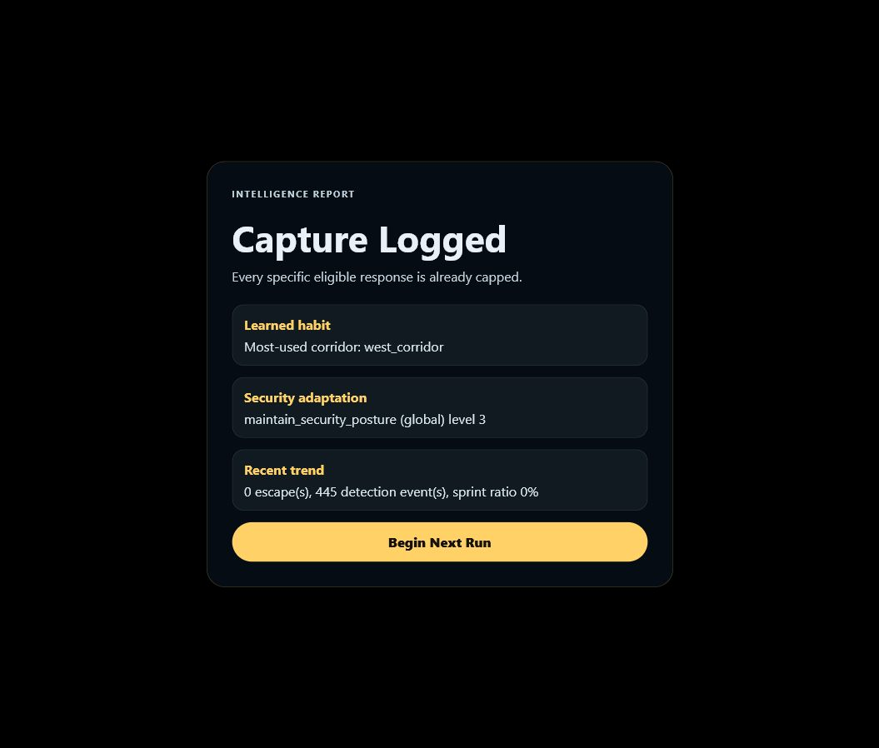
LEARNING EVIDENCE
The intelligence report shows the system carrying memory across rounds.
Behavior summary
Reports expose detected habits such as most-used corridor, detections, escapes, and sprint ratio.
Validated adaptation
Codex output is checked against allowlisted actions, target rules, prerequisites, and caps.
Round-to-round memory
The next run starts with the persisted adaptation config, so later runs build on earlier runs.
Adaptive Prison Break / Ronny / 05

Slide 6
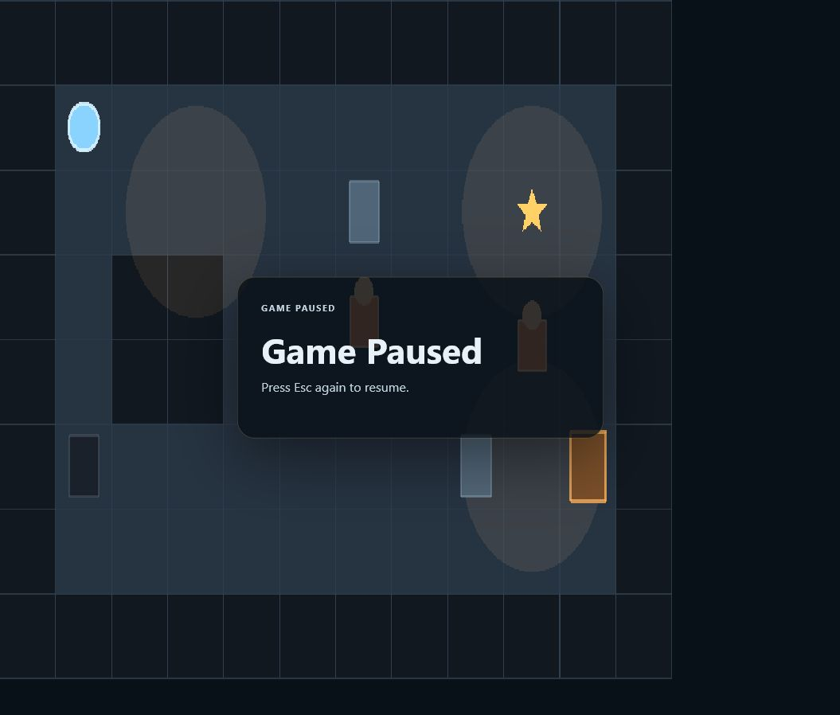
GAME FEEL POLISH
Pause, pacing, and error handling make the prototype presentable.
Esc pause overlay
The run freezes and shows a clear Game Paused popup; pressing Esc again resumes exactly where the player left off.
Service resilience
HTML fallthrough and malformed service responses now show readable retryable errors instead of raw JSON parser crashes.
Browser-tested UX
Screenshots and smoke tests verify the actual local app, not just isolated units.
Adaptive Prison Break / Ronny / 06

Slide 7
ENGINEERING TAKEAWAY
The project demonstrates product instincts plus end-to-end implementation discipline.
Frontend gameplay
Backend learning
Quality loop
Phaser scene orchestration, fixed-step simulation, HUD overlays, camera/render separation, and keyboard input.
Express API, SQLite persistence, analytics summary, Codex CLI execution, schema validation, and idempotency.
Unit/contract/service tests, browser smoke tests, production build checks, and iterative tuning from observed gameplay.
Gameplay close: the prototype turns each escape or capture into a more reactive prison wing, keeping the next run familiar but more strategically pressured.
Adaptive Prison Break / Ronny / 07

