Slide 1
ITI – Intake 39 – Embedded Systems Track
Digital Hearing Aid
Graduation Project
Team Members:-
Hanna Nabil.
Bishoy Medhat.
Under the supervision of:-
1) Eng.\ Ahmed Al-Ashmawy.
2) Eng.\ Yousef Nofel.

Slide 2
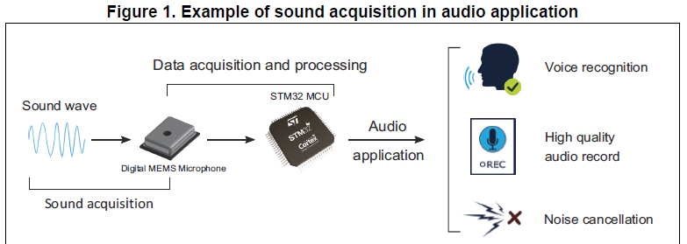
Project Description

Slide 3
Early Prototype

Slide 4
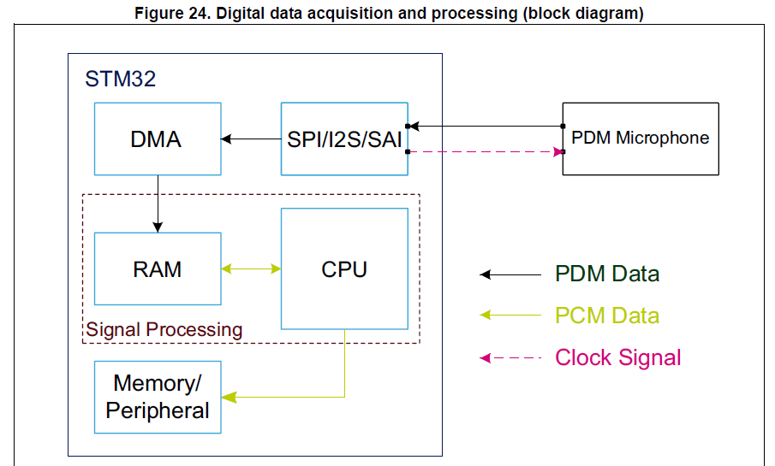
Block Diagram

Slide 5
Block Diagram
STM32
Audio Codec
MEMS Microphone
PDM Data
I2S Peripheral
I2S Peripheral
DMA
Clock Signal
Headphones
DAC
CPU
RAM
PCM Data
DSP Filters
Audio Bluetooth
I2S Peripheral
PCM Data
Bluetooth Earphone
DMA
I2S Peripheral
A2DP Peripheral

Slide 6
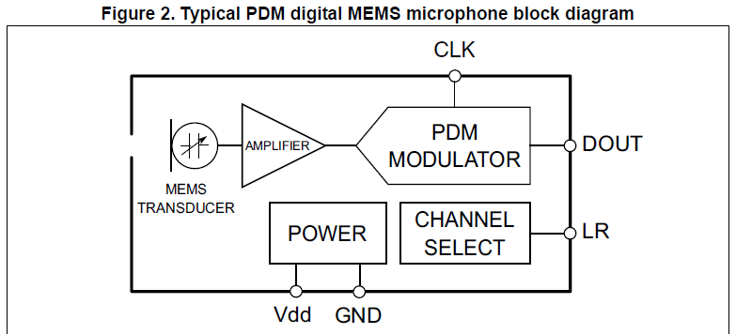
MEMS Microphones

Slide 7
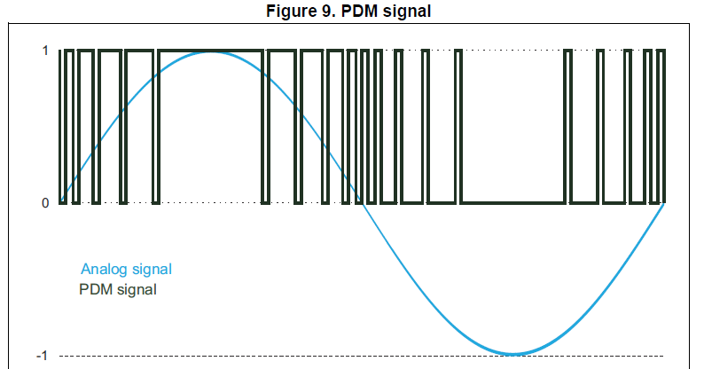
PDM Signal

Slide 8
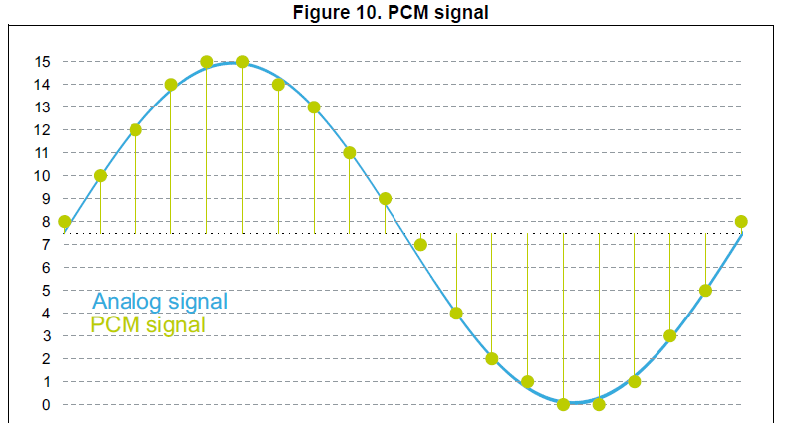
PCM Signal

Slide 9
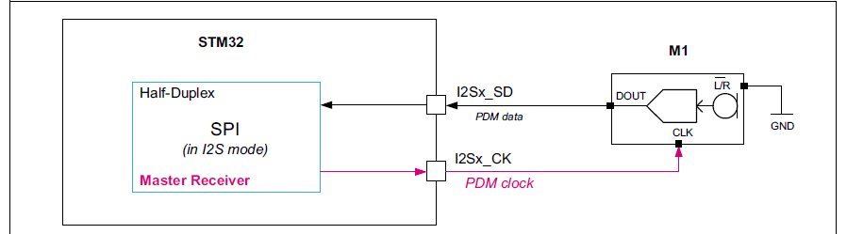
I2S Protocol

Slide 10
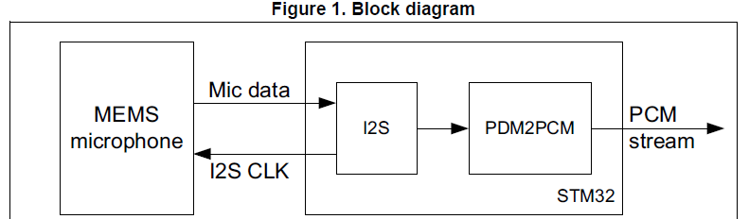
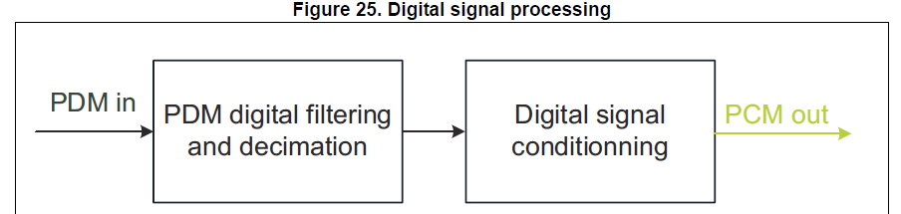
PDM2PCM Conversion

Slide 11
Audio codec (CS43L22)

Slide 12
Audio Bluetooth module (WT32I-A-AI6)

Slide 13
Hardware Components

Slide 14
PCB Designs

Slide 15
Our Next Step

