Slide 1
ITI – Intake 39 – Embedded Systems Track
Digital Hearing Aid
Graduation Project
Team Members:-
Hanna Nabil.
Bishoy Medhat.
Under the supervision of:-
1) Eng.\ Ahmed Al-Ashmawy.
2) Eng.\ Yousef Nofel.

Slide 2
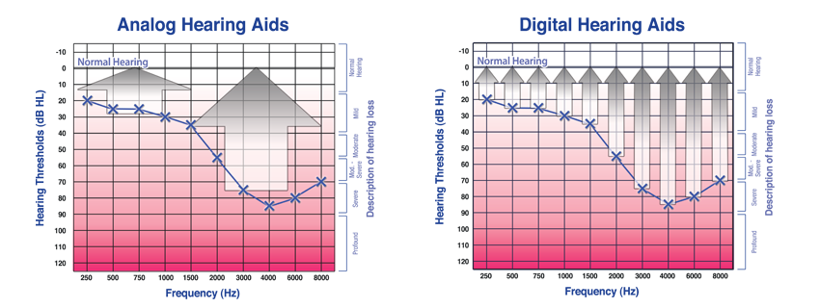
Why digital hearing aid?
- Analog vs digital

Slide 3
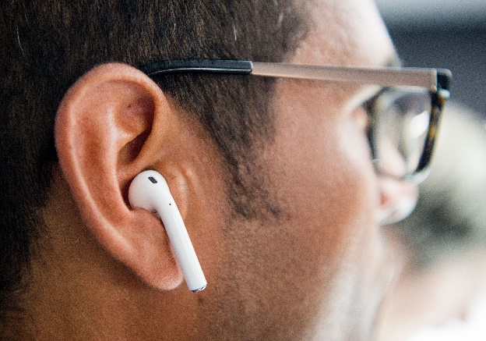
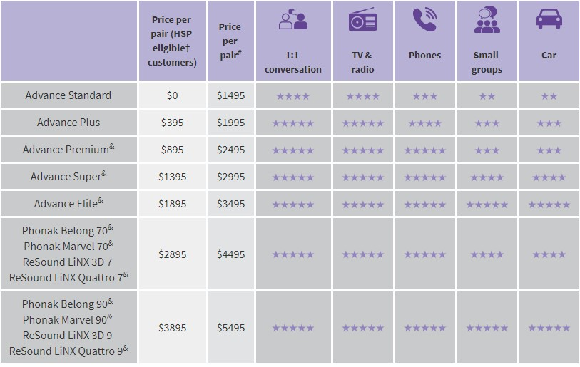
Product Idea
Appearance
Cost
Mobile App

Slide 4
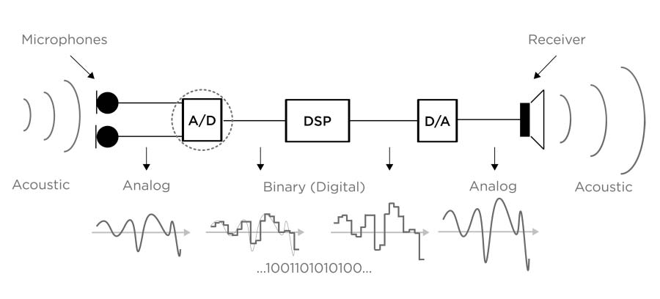
Early Prototype

Slide 5
Block Diagram
STM32
Audio Codec
MEMS Microphone
PDM Data
I2S Peripheral
I2S Peripheral
PDM Data
DMA
Clock Signal
Option 1
CPU
RAM
DAC
Headphones
PDM Data
Wired
PCM Data
PDM Filter
Audio Bluetooth
PCM Data
Mobile App
DSP Filters
Band , Gain
I2S Peripheral
PCM Data
Bluetooth Earphone
DMA
I2S Peripheral
Option 2
A2DP Peripheral
Wireless

Slide 6
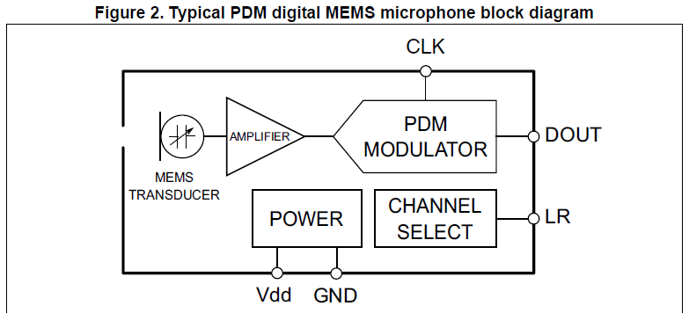
MEMS Microphones
- The digital MEMS microphone is a sensor that convert acoustic pressure waves into a digital signal.

Slide 7
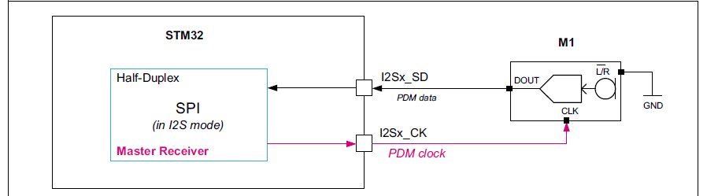
I2S Protocol
- The I2S protocol is widely used to transfer audio data from a microcontroller/DSP (Digital Signal Processor) to an audio codec.
- In order to play melodies or to capture sound from a microphone.

Slide 8
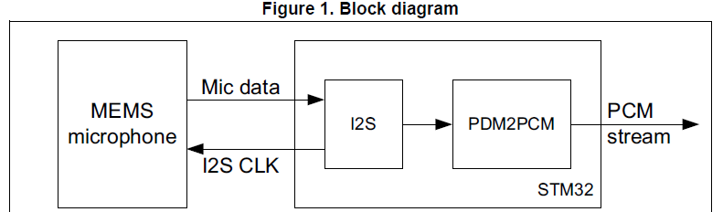
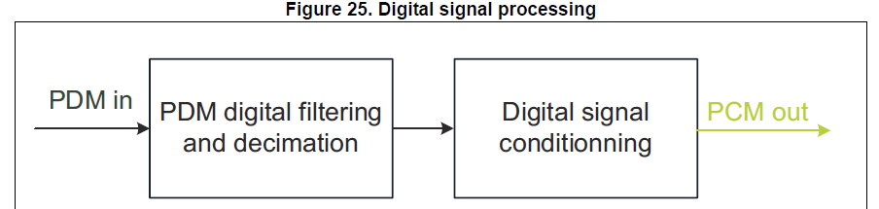
PDM2PCM Conversion

Slide 9
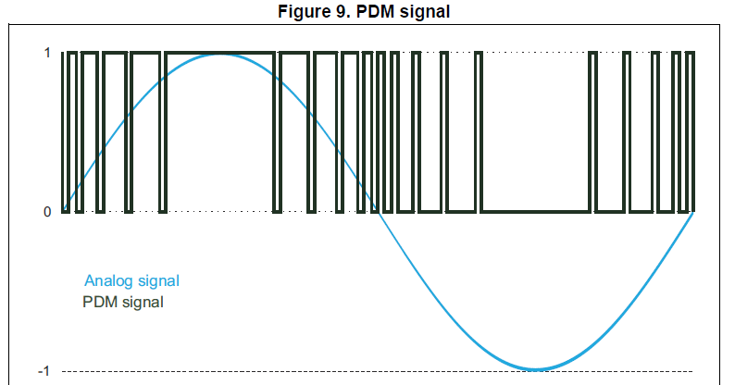
PDM Signal
- A large cluster of 1s correspond to a high (positive) amplitude value.
- A large cluster of 0s correspond to a low (negative) amplitude value.
- Alternating 1s and 0s correspond to a zero amplitude value.

Slide 10
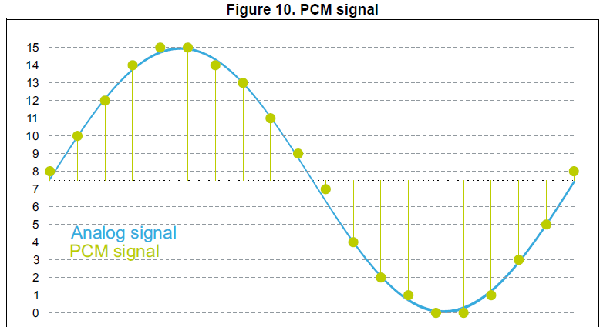
PCM Signal
- Specific amplitude values are encoded into pulses.
- The sampling rate is the number of samples of a signal that are taken per second to represent it digitally.
- The bit depth determines the number of bits of information in each sample.

Slide 11
Block Diagram
STM32
Audio Codec
MEMS Microphone
PDM Data
I2S Peripheral
I2S Peripheral
PDM Data
DMA
Clock Signal
Option 1
CPU
RAM
DAC
Headphones
PDM Data
Wired
PCM Data
PDM Filter
Audio Bluetooth
PCM Data
Mobile App
DSP Filters
Band , Gain
I2S Peripheral
PCM Data
Bluetooth Earphone
DMA
I2S Peripheral
A2DP Peripheral
Option 2
Wireless

Slide 12
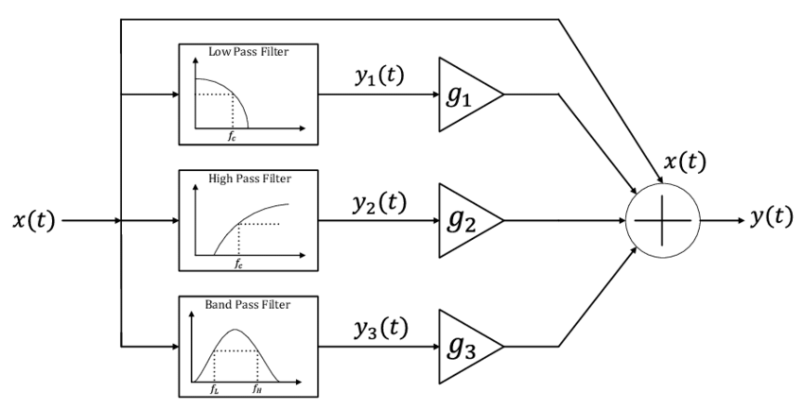
DSP

Slide 13
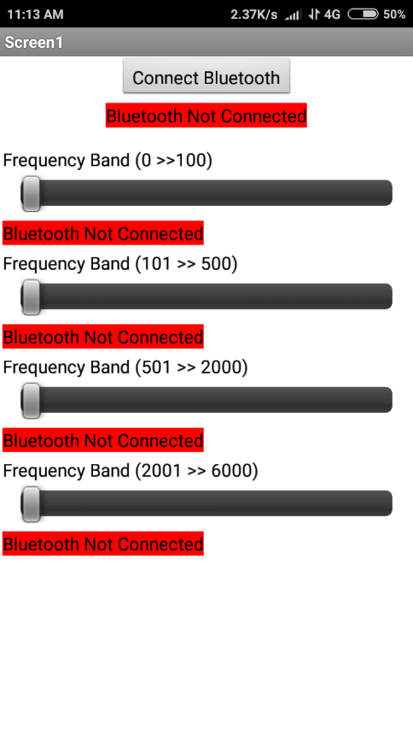
Mobile App to Control DSP

Slide 14
Hardware Components
Stm32F446RC : (DAC – I2S - FPU)
MEMS MIC : MP34DT06
Audio codec (CS43L22)
Audio Bluetooth module (WT32I-A-AI6)

Slide 15
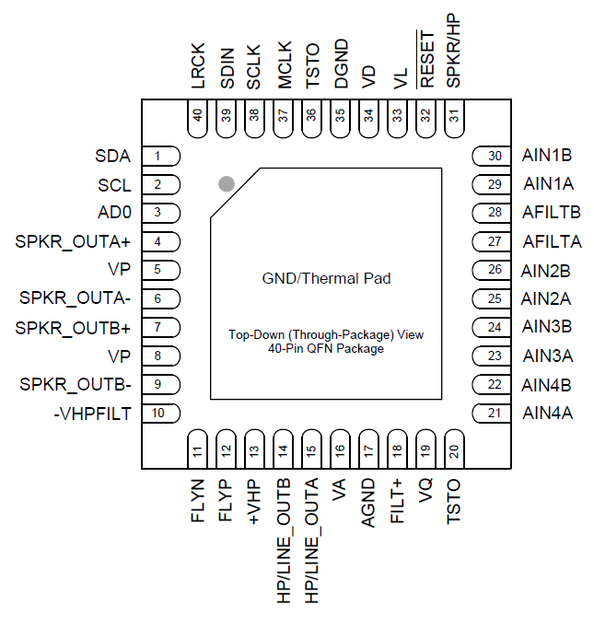
Audio codec (CS43L22)
- The control port operates using an I²C interface.
- The audio port operates using an I²S interface.
- The CS43L22 is a highly integrated, low power, 24-bit audio DAC comprised of a Digital Signal Processing Engine, headphone amplifiers.

Slide 16
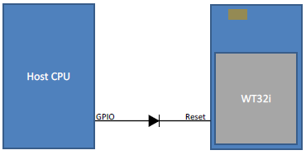
Audio Bluetooth module (WT32I-A-AI6)
I2S Peripheral
PCM Data
I2S Peripheral
A2DP Peripheral

Slide 17
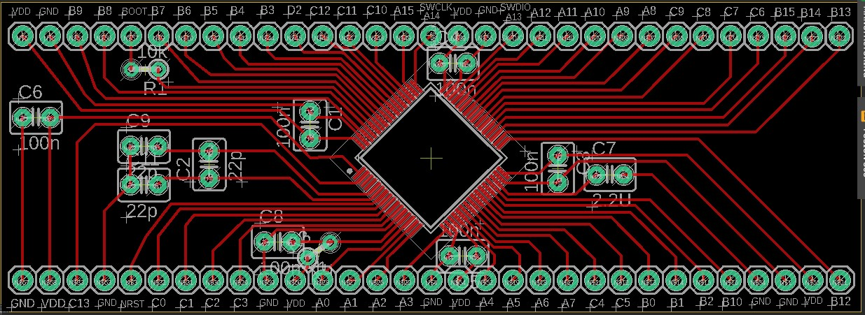
PCB Designs
- STM32F446RC (Version 1):-

Slide 18
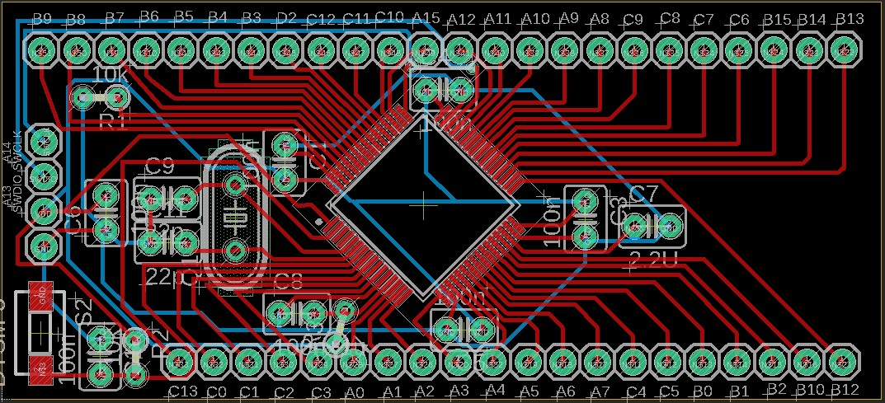
PCB Designs
- STM32F446RC (Version 2):-

Slide 19
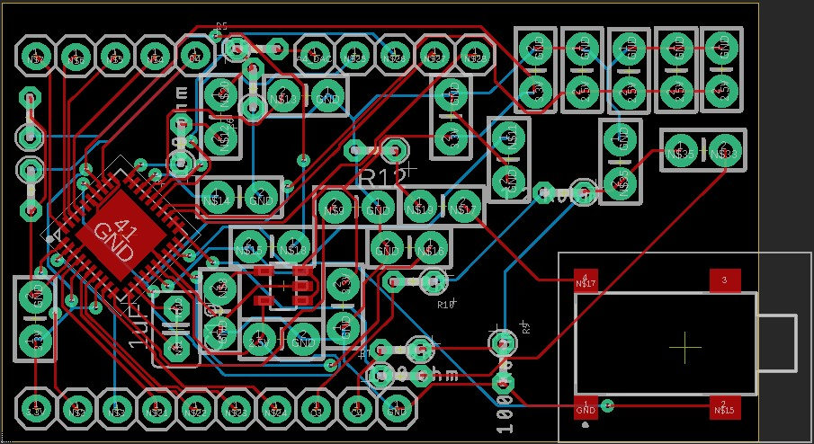
PCB Designs
- CS43L22-CNZ with Analog Pins:-

Slide 20
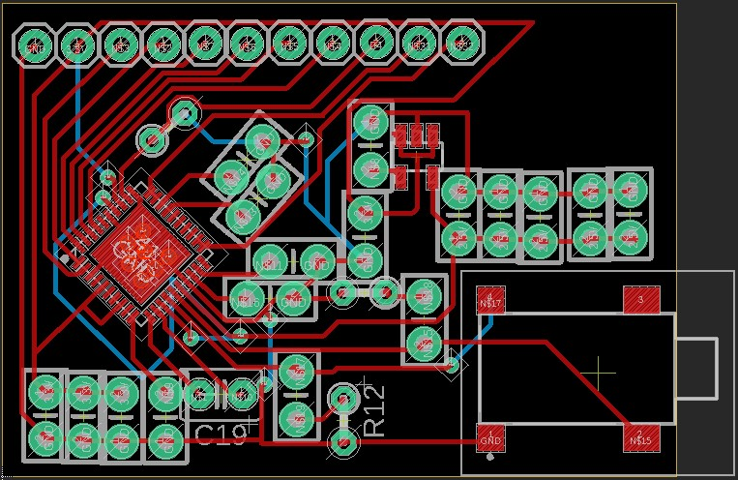
PCB Designs
- CS43L22-CNZ without Analog Pins:-

Slide 21
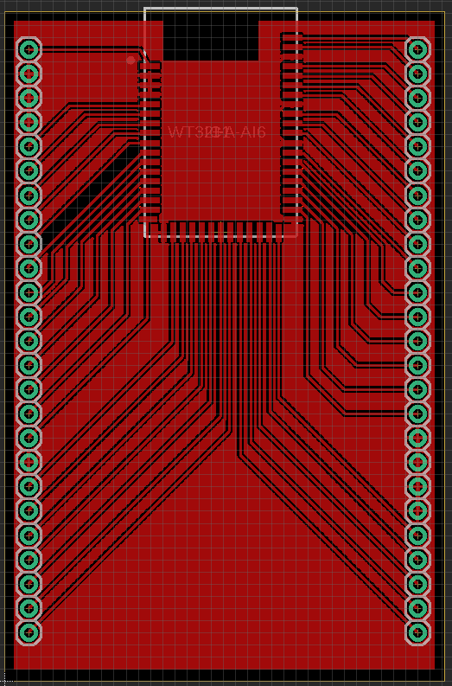
PCB Designs
- Audio Bluetooth Module (WT32I-A-AI6):-

Slide 22
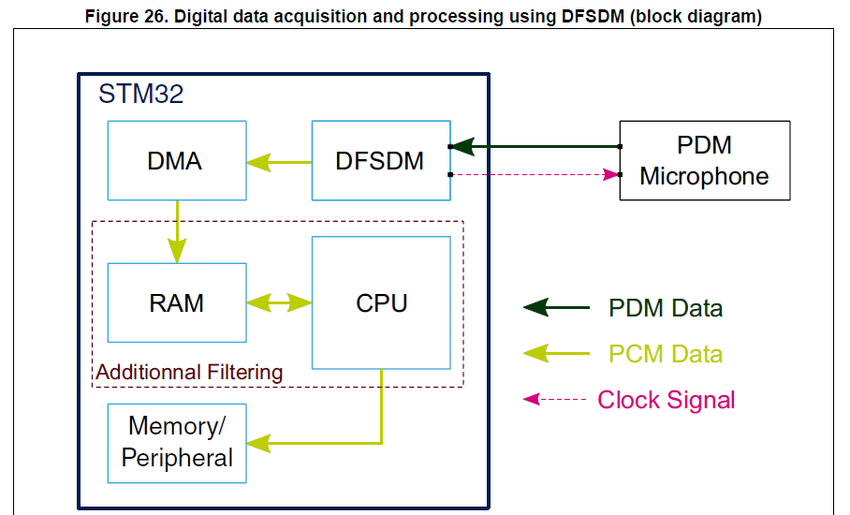
Our Next Step
Use Digital filter for Sigma-Delta modulators instead of Software PDM to PCM Conversion.

Slide 23
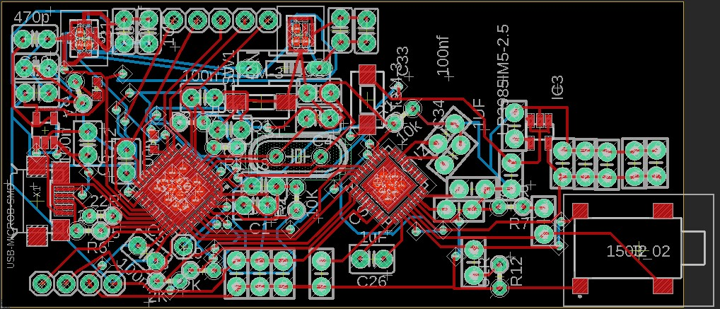
PCB Designs
- STM32F413CG (Version 1) with Audio Codec:-

