Slide 1
ITI – Intake 39 – Embedded Systems Track
Digital Hearing Aid
Graduation Project
Team Members:-
Hanna Nabil.
Bishoy Medhat.
Under the supervision of:-
1) Eng.\ Ahmed Al-Ashmawy.
2) Eng.\ Yousef Nofel.

Slide 2
Why digital hearing aid?
- Analog vs digital

Slide 3
Product Idea
Appearance
Cost

Slide 4
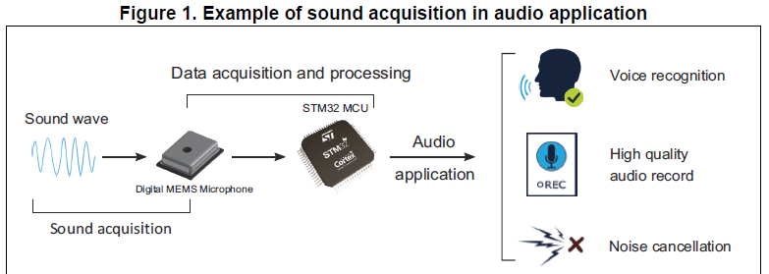
Project Description

Slide 5
Early Prototype

Slide 6
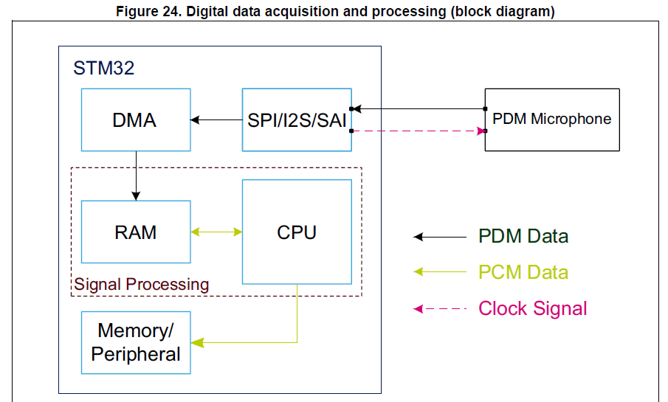
Block Diagram

Slide 7
Block Diagram
STM32
Audio Codec
Option 1
MEMS Microphone
PDM Data
I2S Peripheral
I2S Peripheral
DMA
PDM Data
Clock Signal
Headphones
DAC
Wired
CPU
RAM
PCM Data
PCM Data
DSP Filters
Audio Bluetooth
I2S Peripheral
PCM Data
Bluetooth Earphone
DMA
I2S Peripheral
Option 2
A2DP Peripheral
Wireless

Slide 8
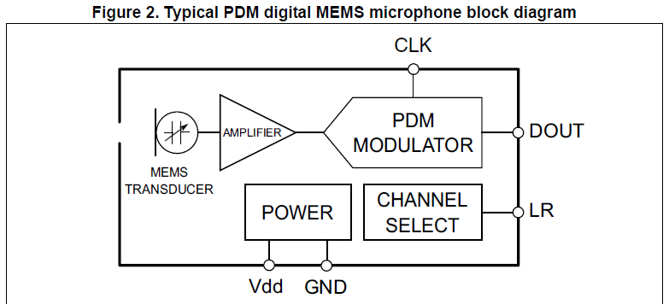
MEMS Microphones
- The digital MEMS microphone is a sensor that convert acoustic pressure waves into a digital signal.

Slide 9
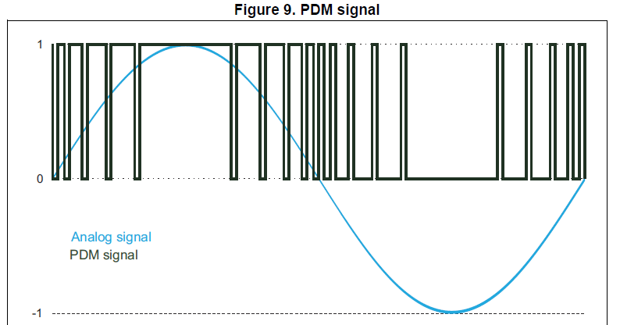
PDM Signal
- A large cluster of 1s correspond to a high (positive) amplitude value.
- A large cluster of 0s correspond to a low (negative) amplitude value.
- Alternating 1s and 0s correspond to a zero amplitude value.

Slide 10
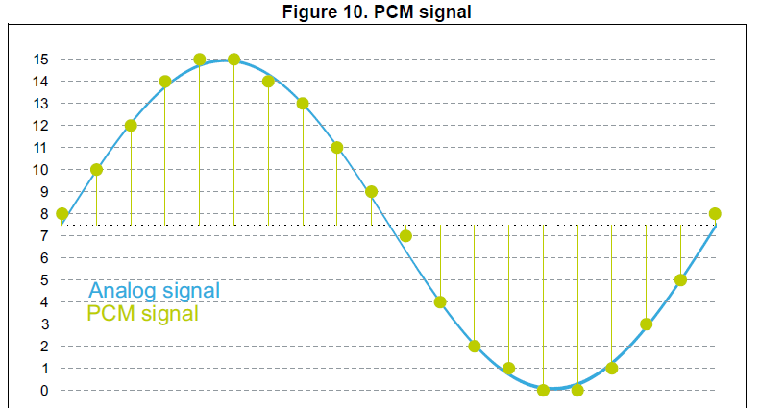
PCM Signal
- Specific amplitude values are encoded into pulses.
- The sampling rate is the number of samples of a signal that are taken per second to represent it digitally.
- The bit depth determines the number of bits of information in each sample.

Slide 11
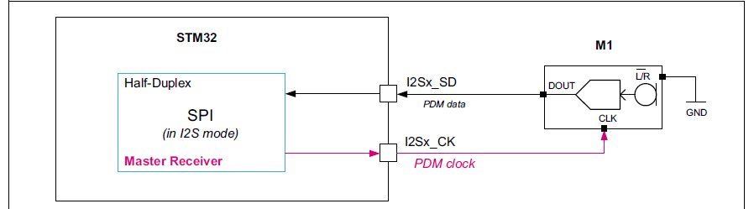
I2S Protocol
- The I2S protocol is widely used to transfer audio data from a microcontroller/DSP (Digital Signal Processor) to an audio codec.
- In order to play melodies or to capture sound from a microphone.

Slide 12
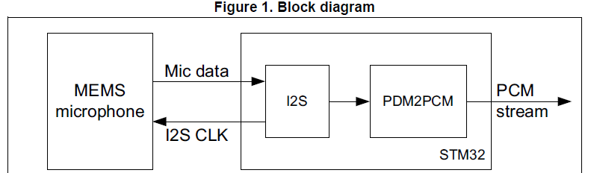
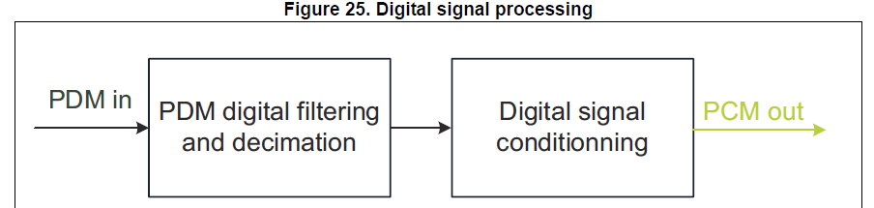
PDM2PCM Conversion

Slide 13
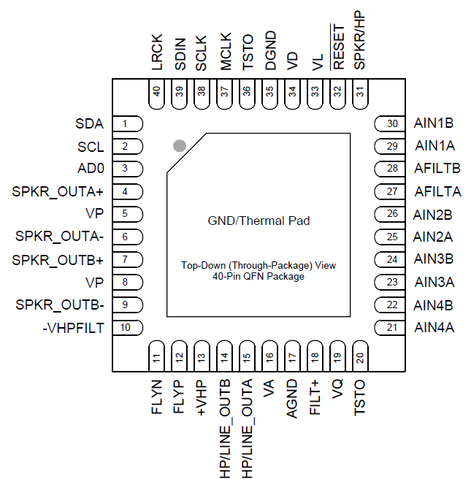
Audio codec (CS43L22)
- The control port operates using an I²C interface.
- The audio port operates using an I²S interface.
- The CS43L22 is a highly integrated, low power, 24-bit audio DAC comprised of a Digital Signal Processing Engine, headphone amplifiers, a digital PWM modulator and two full-bridge power back-ends.

Slide 14
Audio Bluetooth module (WT32I-A-AI6)

Slide 15
Hardware Components

Slide 16
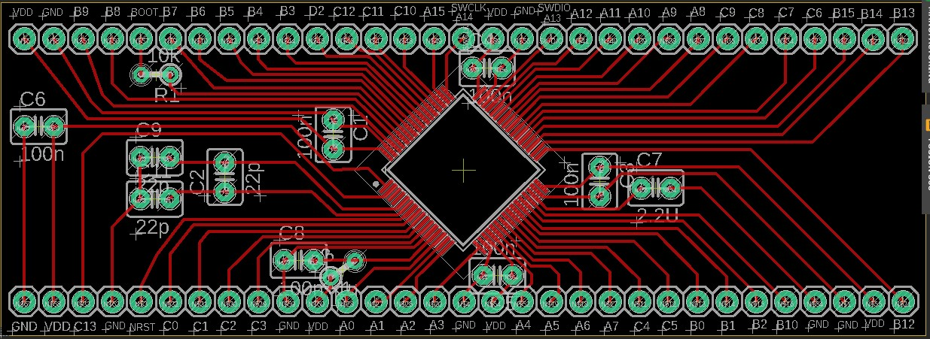
PCB Designs
- STM32F446RC (Version 1):-

Slide 17
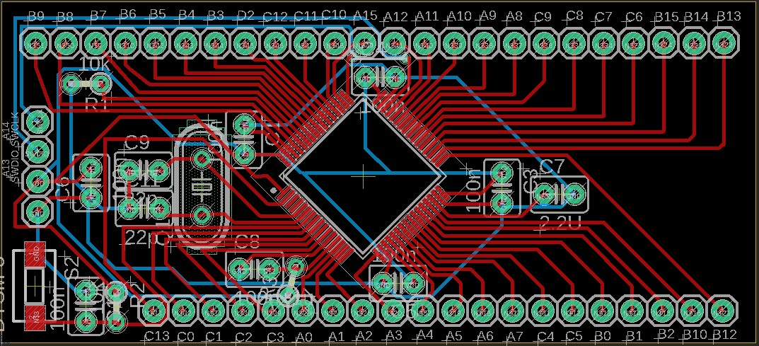
PCB Designs
- STM32F446RC (Version 2):-

Slide 18
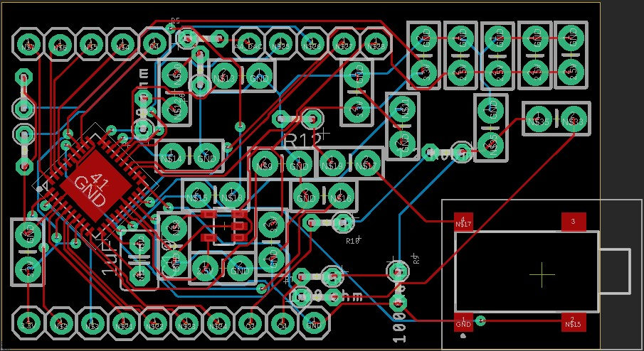
PCB Designs
- CS43L22-CNZ with Analog Pins:-

Slide 19
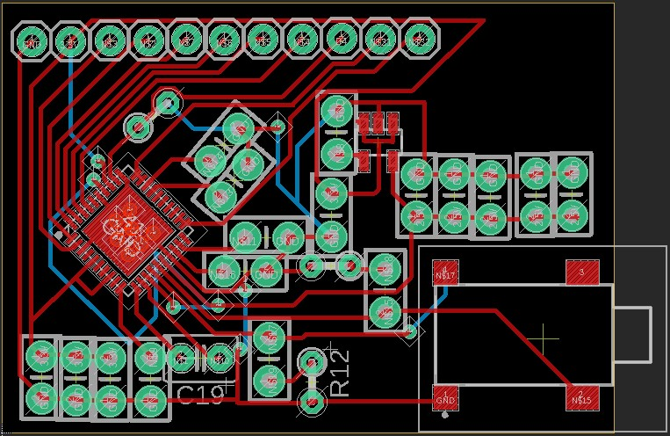
PCB Designs
- CS43L22-CNZ without Analog Pins:-

Slide 20
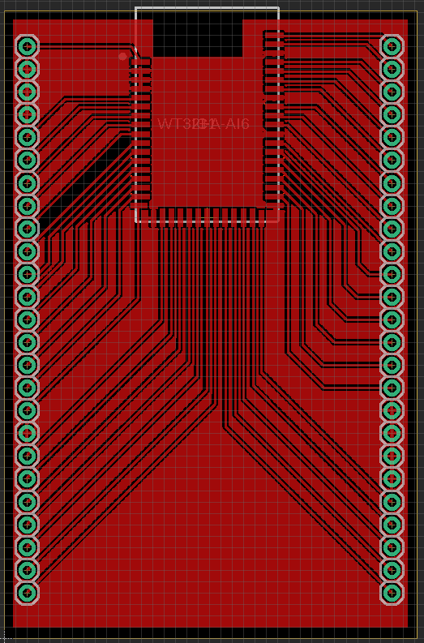
PCB Designs
- Audio Bluetooth Module (WT32I-A-AI6):-

Slide 21
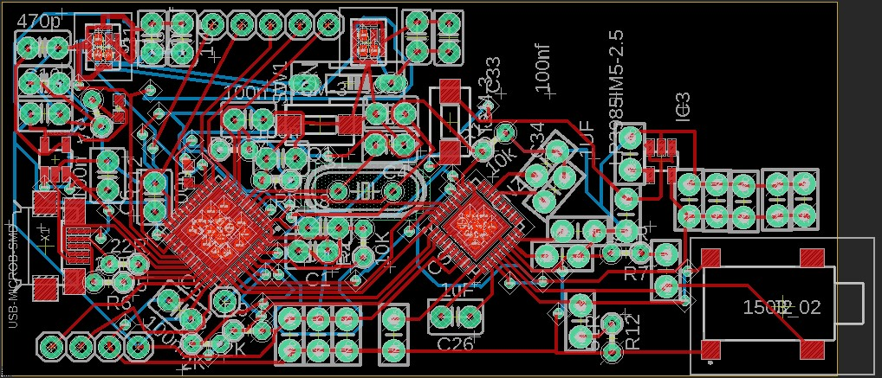
PCB Designs
- STM32F413CG (Version 1) with Audio Codec:-

Slide 22
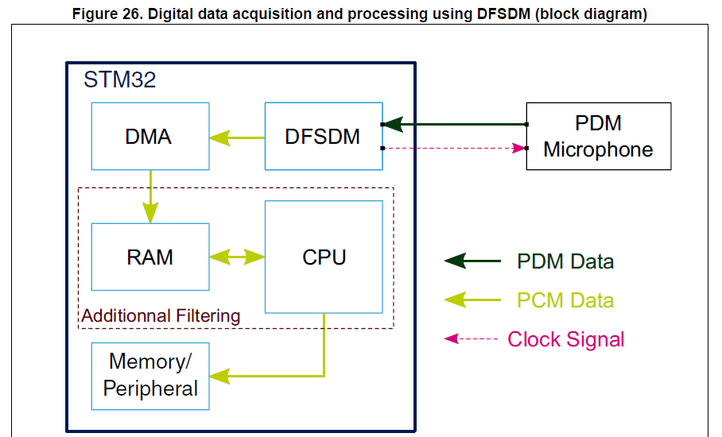
Our Next Step

